Slide 1
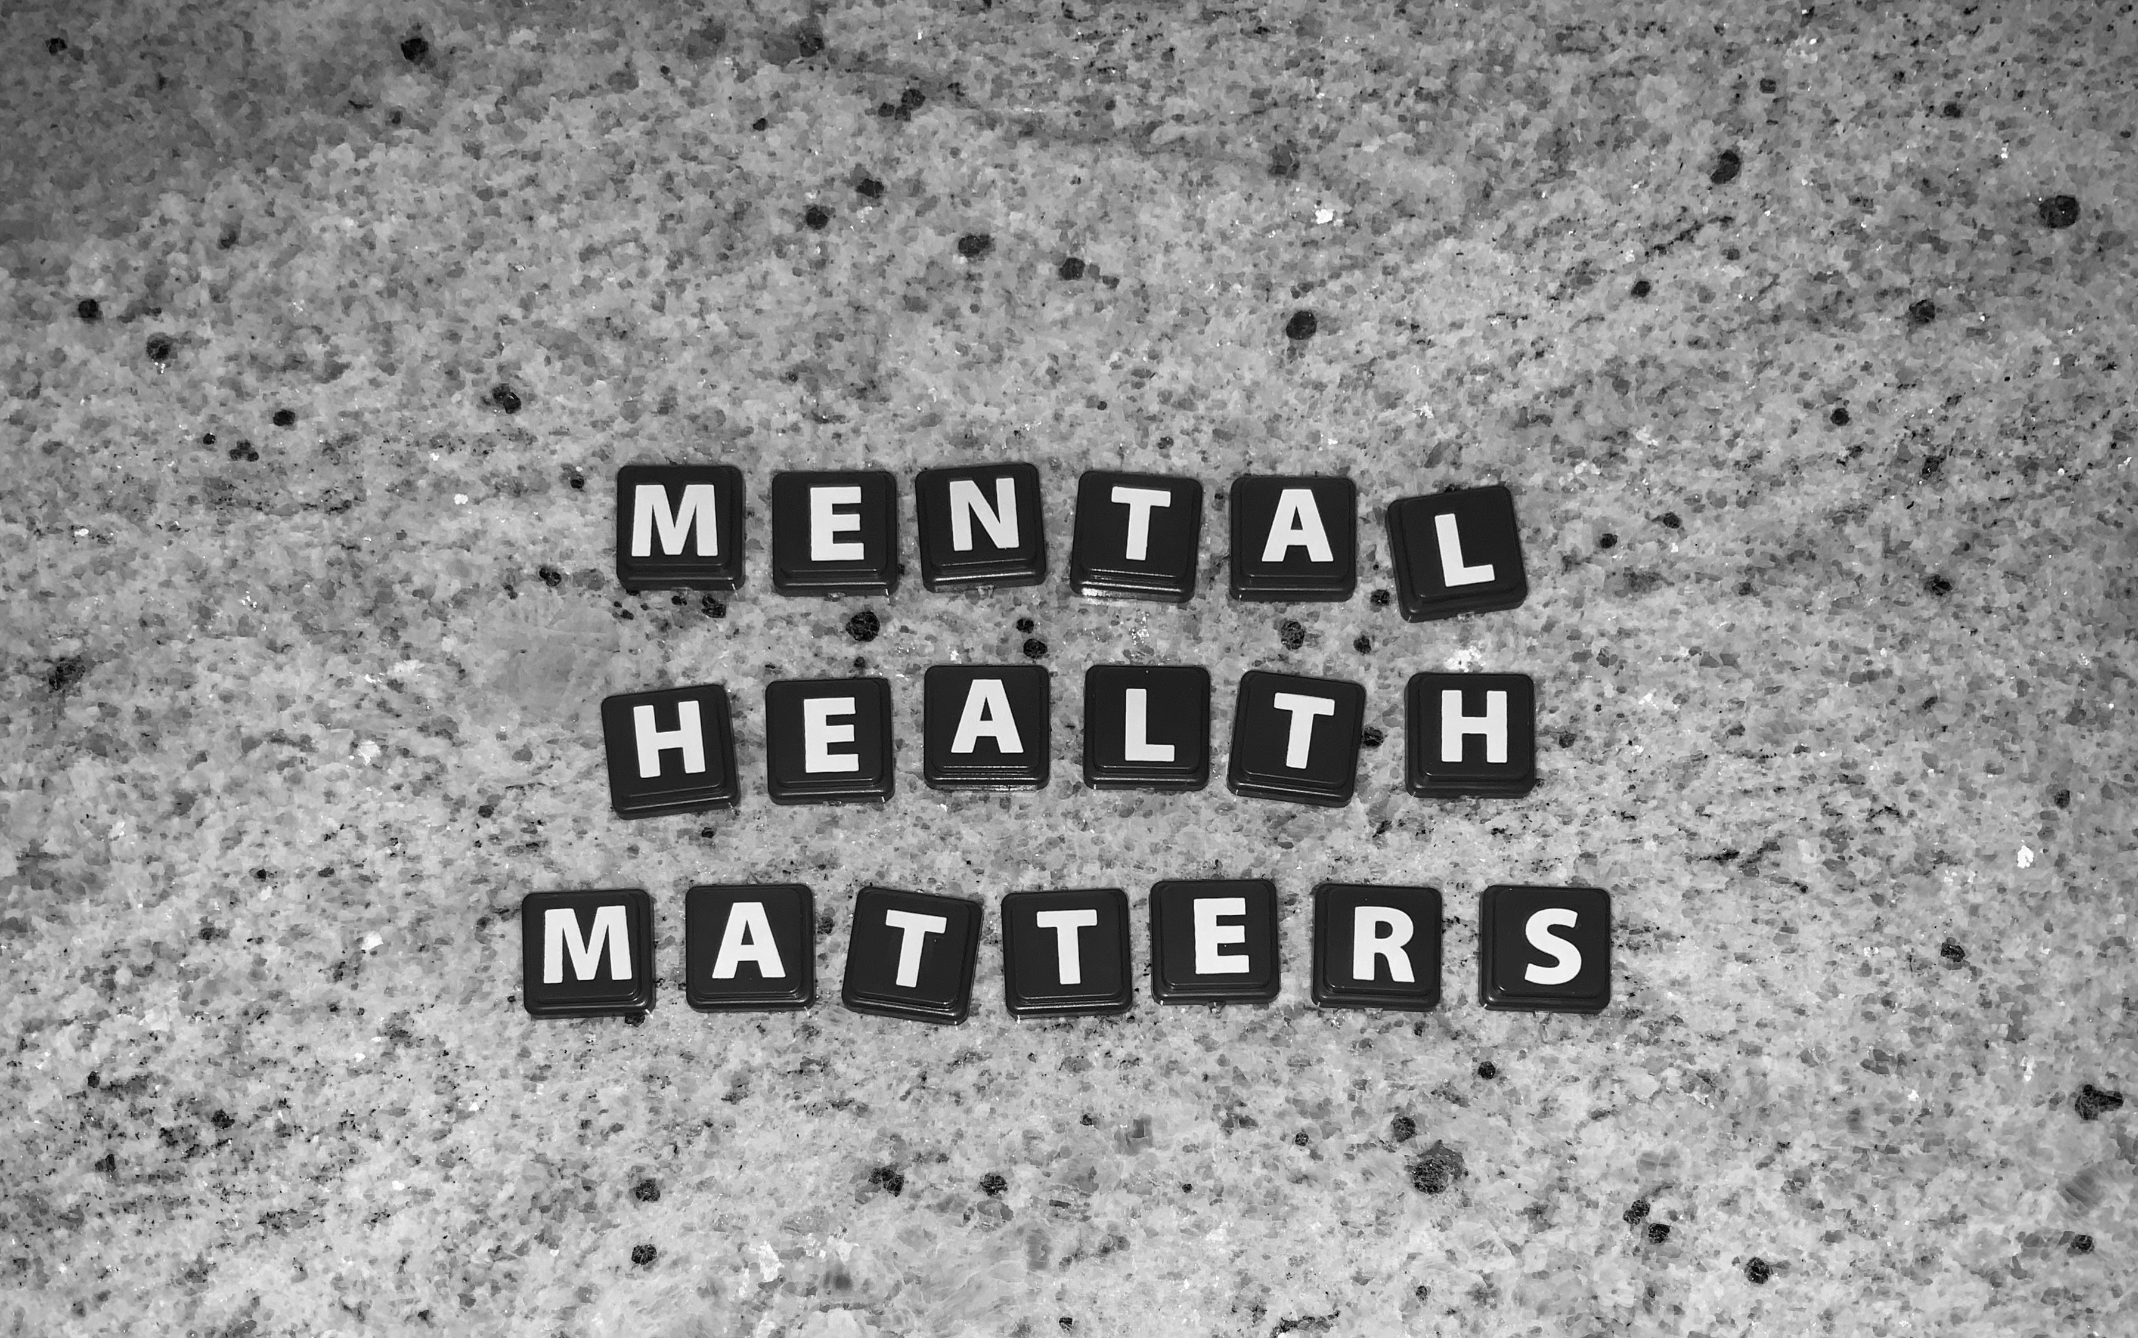
DATA STORY FOR JB MUSIC – All charts are interactive and dynamic

Slide 2
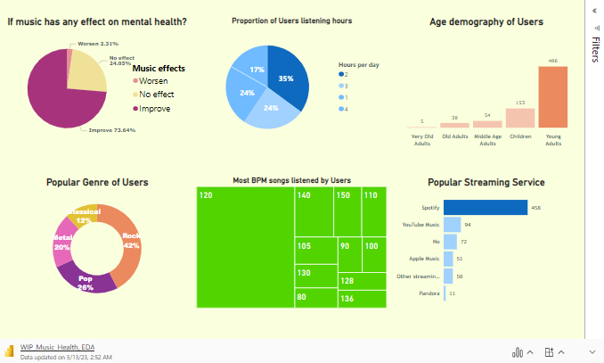
Up to 73% people reported improved mental health after listening to music. Moreover; 59% of users listen up to 2 or 3 hours per day. Dataset is imbalanced in favor of young adults (18-25 years of age). Spotify is popular streaming service and Rock and Pop are the top 2 popular genre.

Slide 3
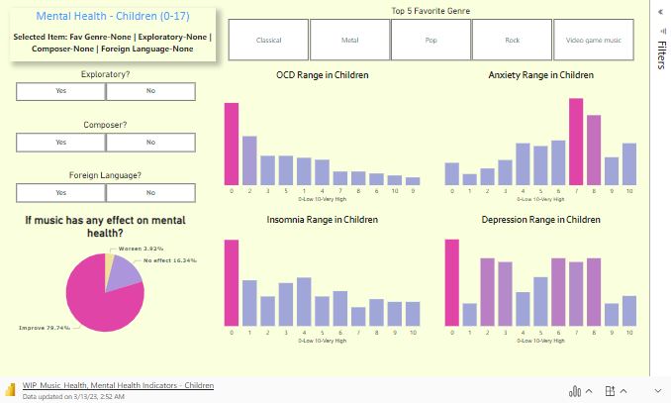
Children; Top 5 genre are classical, metal, pop, rock, video-game music. Surprisingly, majority of children have strong correlation between improved mood and Anxiety. Children who are composers or listen to Pop had a higher chance for improved mood. Children who listened to metal more likely to have insomnia and depression.

Slide 4
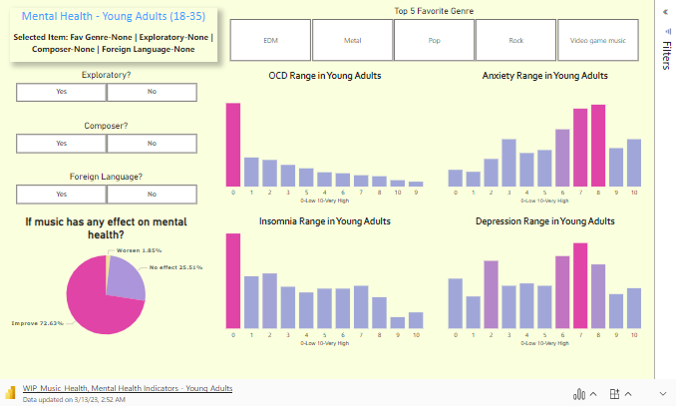
Young Adults reported higher anxiety and depression. Most streamed band among young adults is Rock and has a stronger correlation with Anxiety and Depression and worsens mental health. EDM genre seems to improve mental health among Young Adults. Composers tend to strongly correlate with higher insomnia among Young Adults.

Slide 5
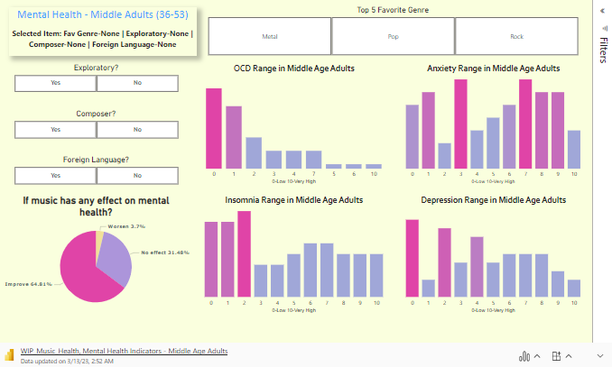
Among Middle Adults Top 3 genres are Metal, Pop, Rock. Due to limited data; Rock and Metal seems to increase Anxiety, Depression, and Insomnia. Pop genre improves the mood the most. Users who prefer exploring and listening to foreign music seems to increase Anxiety and Depression in Middle Adults.

Slide 6
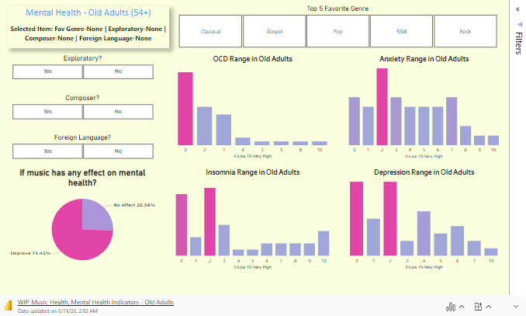
Very limited data available for old adults.

Slide 7
Suggestions and improvements for JB
Based on observations; JB should suggest more Pop songs to children(0-17 age) to improve mental health.
JB should suggest more EDM songs to decrease Anxiety and depression among Young Adults (18-35 age).
JB should suggest more Pop songs to middle-aged adults.
In General, JB should also suggest all user's foreign music as it has strong correlation with decreased depression, insomnia and anxiety.

