Slide 1
OAUTH-2
OPEN AUTHORIZATION- AN AUTHORIZATION FRAMEWORK

Slide 2
OAUTH-2
OAUTH-2 is referred to as an authorization framework whose primary purpose is to allow a third party website/App access to a resource.

Slide 3
Why oauth?

Slide 4
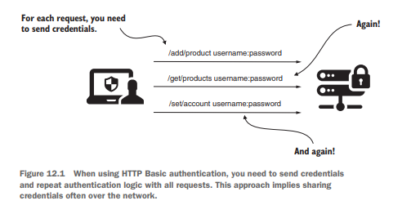
EXAMPLE-1

Slide 5
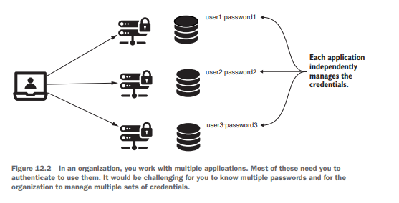
EXAMPLE-2

Slide 6
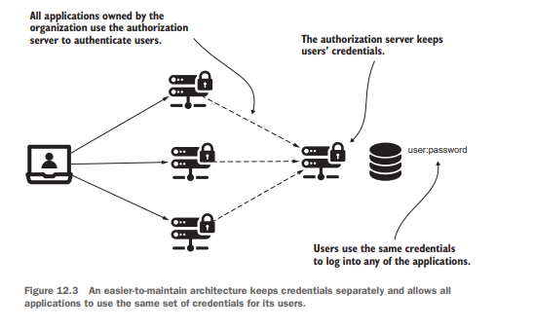
EXAMPLE-3

Slide 7
COMPONENTS OF OAUTH-2
Resource Server
User/Resource Owner
Client
Authorization Server

Slide 8
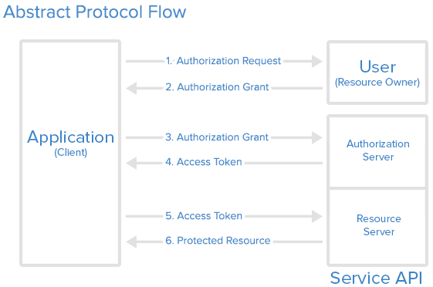
BASIC OAUTH-2 ARCHITECTURE

Slide 9
SCOPE
Scope is a mechanism in OAuth 2.0 to limit an application's access to a resource server.
Example:
Read, Write, Name, Email, /user/list etc.
Notes:
Resource Server a token er access limitation korte scope use kora hoi. Token diye koto tuku acees korte parbe tar define kora hoi

Slide 10
GRANT TYPES
The way of getting access token from authorization server.
Type:
○ Authorization code
○ Password
○ Refresh token
○ Client credential

Slide 11
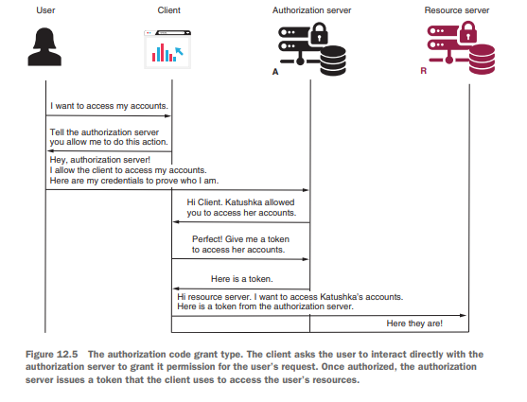
GRANT TYPE- AUTHORIZATION CODE

Slide 12
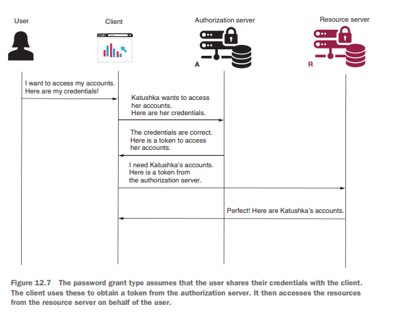
GRANT TYPE- PASSWORD

Slide 13
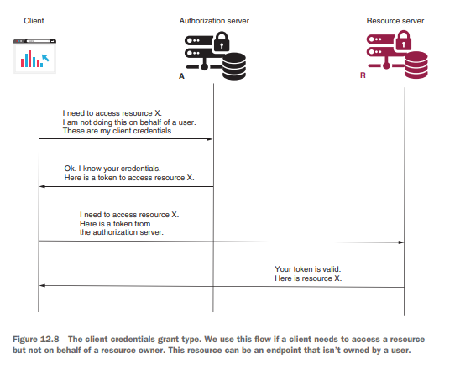
GRANT TYPE- CLIENT CREDENTIAL

Slide 14
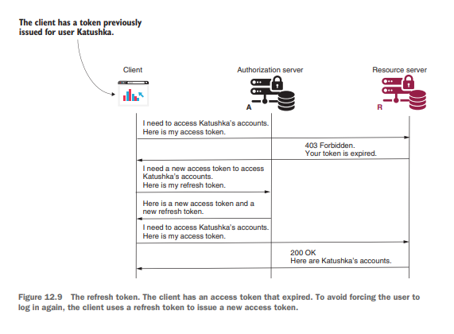
GRANT TYPE- REFRESH TOKEN

Slide 15
WHEN WE USE WHICH TYPE!!!!!!!
Password – When Authorization & resource server developed by same vendor. Not preferable when authorization server developed by another vendor.
Client Credential – Third party application wants to access some resource.
Refresh Token - When we don’t want to logout user.
Authorization Code – Various 3rd party application access resource server. Mostly used types and recommended this authorization types.

Slide 16

PROS AND CONS
Pros
Capability to authorize a user.
OAuth 2.0 is a very flexible protocol that relies on SSL (Secure Sockets Layer) to save user access token.
This protocols ensure data safety.
It has ability to share data for users without having to release personal
information.
It is easier to implement if you know properly

Slide 17
PROS AND CONS
Cons
There is no common format, as a result, each service requires its own implementation.
When a token is stolen, an attacker gains access to the secure data for a while.
Hard to implement if you don’t know well about oauth2 architecture.

Slide 18
THANK YOU

