Slide 1
REAL-TIME SYSTEMS SEMINAR
Priority Exchange
Bandwidth-preserving aperiodic service in fixed- and dynamic-priority real-time systems
Md Jubair Salehin Razin
Hochschule Hamm-Lippstadt · Dept. of Electronic Engineering

Slide 2


THE CHALLENGE
Two workloads share one processor
Periodic tasks
Aperiodic events
Hard deadlines.
Soft deadlines.
Control loops, signal-processing pipelines, actuation.
Arrival pattern known in advance; temporal correctness is verified offline by worst-case schedulability analysis.
Operator commands, alarms, sporadic sensor interrupts.
Arrival times unknown; a late response is not catastrophic, but average and worst-case latency should be as small as possible.
The goal: serve aperiodic load as responsively as possible — without ever jeopardising the periodic guarantee.

Slide 3


WHY NOT THE SIMPLE OPTIONS
The two baselines disappoint
Background scheduling
Polling server
Aperiodic requests run only when no periodic task is ready.
A periodic task with a reserved capacity serves whatever requests are pending at its period.
✓ Never affects the periodic guarantee.
✗ Response is slow and, under load, effectively unbounded.
✓ Bounded, predictable response.
✗ If nothing is pending at the polling instant, the budget is discarded — wasted exactly when it may soon be needed.
Bandwidth-preserving servers fix the second flaw — they keep the reserved budget available until the load actually arrives.

Slide 4


THE KEY IDEA
Preserve the budget — by trading it, not holding it
PE and the Deferrable Server (DS) solve the same problem in opposite ways.
Deferrable Server
Priority Exchange
Holds its capacity at its high priority until a request uses it.
Simple; overhead is independent of the task count — but parking capacity at high priority weakens the utilization bound.
Exchanges the budget for the execution time of the highest-priority pending periodic task.
That task advances; an equal amount of budget is parked at its lower level, degrading step by step and staying reclaimable.
Because PE never executes above its budget, it behaves like a periodic task
→ it inherits the full rate-monotonic schedulability bound — strictly better than the Deferrable Server.

Slide 5
MECHANISM
Three rules govern the server
1
Replenish
At the start of each server period, the capacity is reset to its full value Cs.
Serve, or exchange
2
At every scheduling instant the highest-priority entity runs. If an aperiodic request is pending and the budget sits on top, serve it. Otherwise, exchange the budget with the highest-priority active periodic task — the task runs, and an equal budget is parked at its level.
3
Degrade only at idle
If no aperiodic request and no periodic job can use the budget, it is gradually discarded — but solely when the processor would otherwise sit idle.

Slide 6
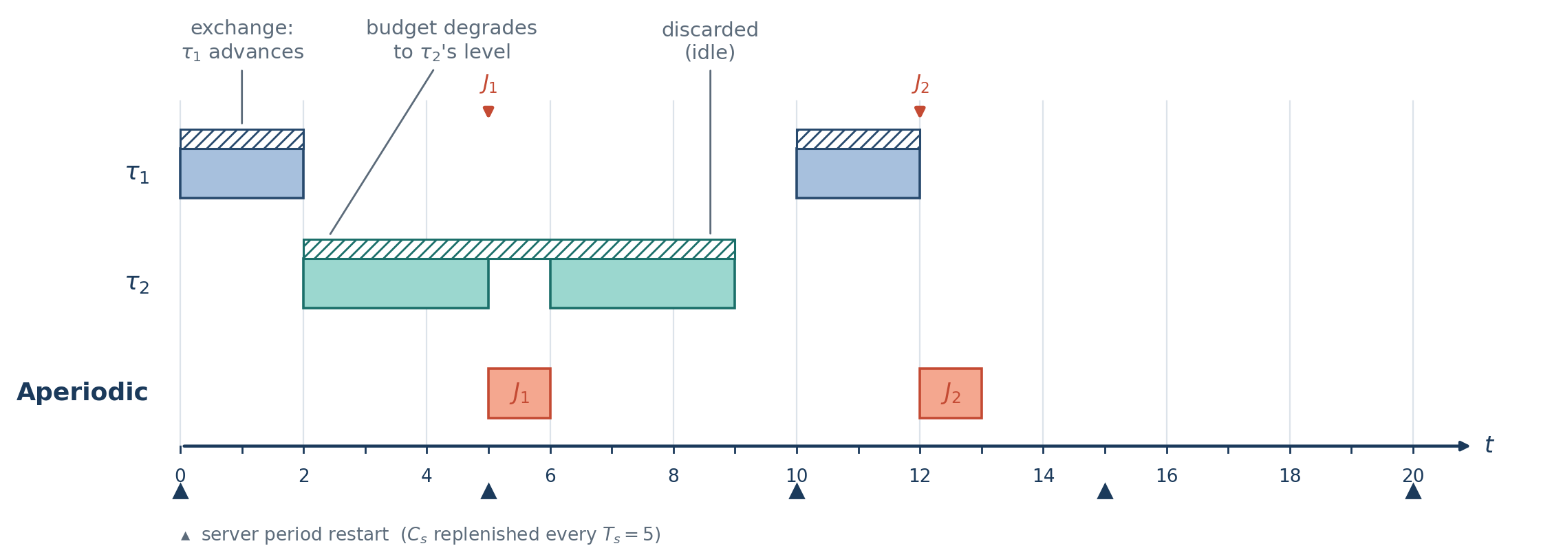
WORKED EXAMPLE
Following the budget through one hyperperiod
Cs = 1, Ts = 5 · τ1 = (2, 10), τ2 = (6, 20) · generated and checked by a unit-time simulator
t = 0 budget exchanged with τ1
t = 5 J1 served at once, top priority
t = 9 budget discarded — at idle
t = 12 J2 served from reclaimed budget
Key property: reserved time is lost only at a genuine idle instant (t = 9) — never merely because a request happened to be absent.

Slide 7
SCHEDULABILITY · FIXED PRIORITY
PE earns the full periodic bound
In the worst case a PE server behaves exactly like a periodic task: every unit it spends at high priority is either aperiodic work paid from its budget, or periodic work merely advanced.
So it inherits the rate-monotonic utilization bound — the same as the Polling Server, and
strictly better than the Deferrable Server.
LEAST UPPER BOUND
U_{lub} = U_{s} + n ( K^{1/n} − 1 )
with K = 2 / ( U_{s} + 1 )
GUARANTEE (schedulable under RM)
U_{p} ≤ n [ ( 2 / (U_{s}+1) )^{1/n} − 1 ]
As Us → 0 the bound reduces to Liu & Layland's n(2^{1/n}−1).
Large n: a non-trivial fraction of the processor can still be reserved for aperiodic service.

Slide 8

DYNAMIC PRIORITY · EDF
The same idea, carried into EDF
Under earliest-deadline-first the budget is tagged with a deadline and exchanged the same way.
Dynamic Priority Exchange
Improved Priority Exchange
Spuri & Buttazzo. The server trades runtime with lower-priority periodic tasks; freed capacity is re-tagged with the matching deadline.
Pre-computes the EDL idle times offline, so the server can always run at the highest priority. Near-optimal response.
Exact bound Up + Us ≤ 1. Supports resource reclaiming.
Bound Up ≤ 1 — the entire residual bandwidth goes to aperiodic load.
EDF lifts PE from a good fixed-priority bound to the exact and near-optimal dynamic-priority bounds.

Slide 9
THE DESIGN SPACE
PE among the aperiodic servers
Algorithm | Priority | Periodic bound | Aperiodic response | Implementation overhead | Budget preserved?
Background | any | Up ≤ Ulub (none reserved) | very poor | negligible | —
Polling Server | RM | periodic-task bound | moderate | low | no
Deferrable Server | RM | weaker than periodic | good | low | yes (high prio.)
Priority Exchange | RM | periodic-task bound | good | grows with n | yes (degrades)
Sporadic Server | RM | periodic-task bound | good | low / moderate | yes (high prio.)
Dynamic Prio. Exch. | EDF | Up + Us ≤ 1 | very good | moderate | yes
Total Bandwidth | EDF | Up + Us ≤ 1 | very good | low | yes
Improved Prio. Exch. | EDF | Up ≤ 1 | near-optimal | high (offline EDL) | yes
PE recovers the full periodic bound while preserving budget

Slide 10

HEAD-TO-HEAD
Priority Exchange vs. Deferrable Server
Deferrable Server
Priority Exchange
Simpler to implement.
Overhead is independent of the task count.
Slightly better aperiodic responsiveness.
But a weaker periodic bound: Us(DS) < Us(PE) is the largest guaranteed server.
Full rate-monotonic bound.
More bandwidth can be reserved before the periodic set becomes unschedulable.
But higher cost: tracks budget at every level and exchanges at each scheduling decision → overhead grows with n.
Opposite corners of the same responsiveness – schedulability – overhead trade-off.

Slide 11

CRITICAL EVALUATION
Strengths
Preserves bandwidth
Budget is discarded only at genuine idle instants never because a request was absent.
Full rate-monotonic bound
Strictly better than the Deferrable Server, so more bandwidth can be reserved for aperiodic service.
Immediate service
Sitting atop the priority order, a fresh budget serves an arriving request at once.
Graceful degradation
Unused budget lowers its priority step by step instead of being dropped outright — reclaimable for as long as possible.
Generalises to EDF
The exchange idea yields the exact Dynamic and near-optimal Improved Priority Exchange servers.

Slide 12

CRITICAL EVALUATION
Limitations & risks
Implementation complexity
Per-level budget counters and an exchange at every scheduling decision; runtime overhead and O(n) state scale with the number of periodic tasks.
No runtime-slack reclaim
Budget freed when periodic jobs finish early is recovered only at idle — slack-stealing and dual-priority scheduling do better.
Soft deadlines only
PE addresses soft aperiodic requests; it gives no built-in guarantee for firm or hard aperiodic deadlines.
Superseded in practice
The Sporadic Server (fixed priority) and Total Bandwidth Server (dynamic) match the bound with lower, task-count-independent overhead.

Slide 13
CONCLUSION
A counter-intuitive principle
High-priority budget is preserved — not by holding it, but by trading it for the runtime of lower-priority work.
1
Reserved time is lost only at genuine idle — giving PE the full rate-monotonic schedulability of an ordinary periodic task.
2
The same idea carries into EDF — yielding the exact Dynamic and the near-optimal Improved Priority Exchange servers.
3
4
Its lasting importance is conceptual — it defines the responsiveness–schedulability–overhead trade-off and is the ancestor of the optimal dynamic-priority servers.

Slide 14

REFERENCES & METHOD
Key sources
Lehoczky, Sha & Strosnider (1987) — Origin of the Priority Exchange and Deferrable Server. RTSS.
AI usage protocol
Buttazzo (2011) — Hard Real-Time Computing Systems, 3rd ed. Primary reference.
AI tools (Anthropic Claude) assisted with drafting, source synthesis, the schedule simulator, and LaTeX / figure generation.
Every formula was verified against Buttazzo, each citation checked against the published record, and the schedule traced by hand.
Spuri & Buttazzo (1994, 1996) — Dynamic and Improved Priority Exchange under EDF.
Sprunt, Sha & Lehoczky (1989) — The Sporadic Server. Real-Time Systems.
Davis & Wellings (1995) — Dual-priority scheduling; critique of offline reclaiming.
Liu & Layland (1973) — The rate-monotonic utilization bound. JACM.

