Slide 1
Deferrable Server for Aperiodic Task Handling in Fixed-Priority Real-Time Systems
Presenter: MD Rafiul Islam
Student ID: 1232714

Slide 2
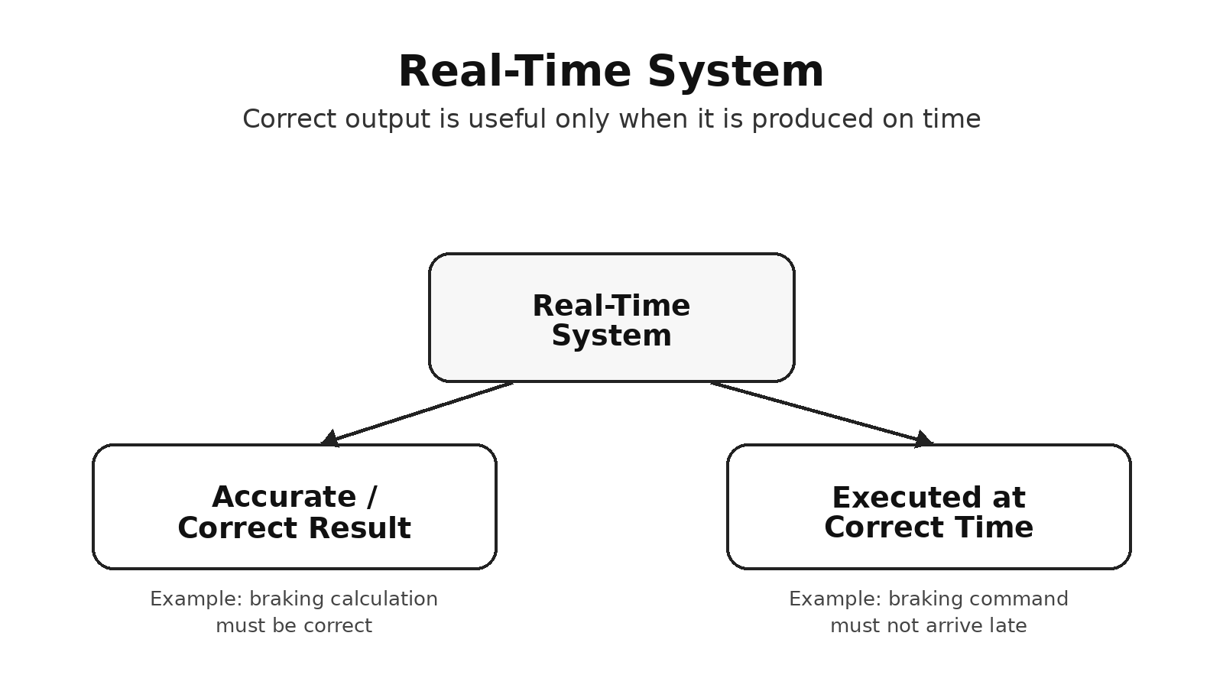
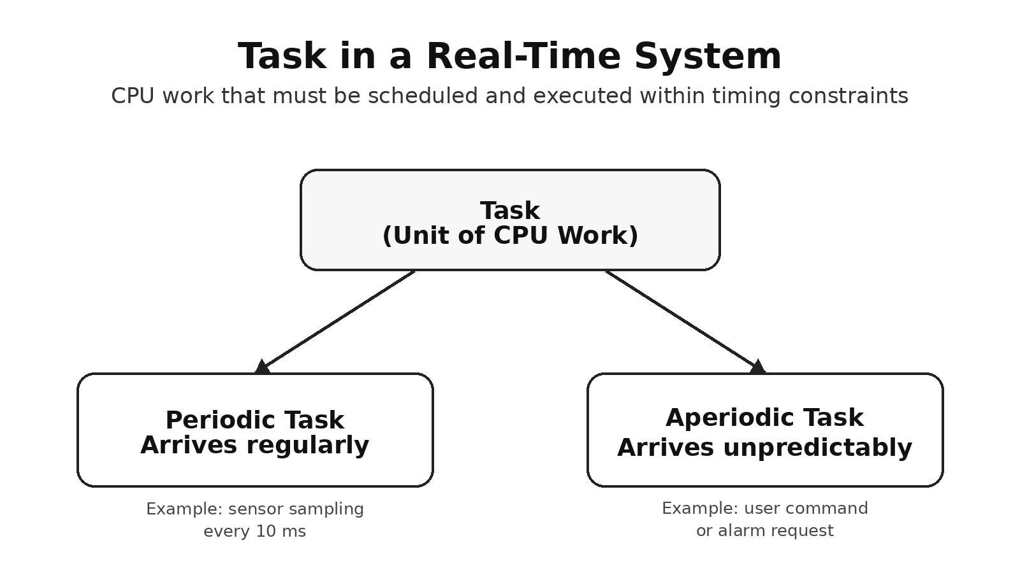
What Is a Real-Time System?
Type of computer system where:
The output must be correct.
The output must be produced at the correct time.
Source: Author-created diagram based on Buttazzo [1].
Task: A task is a unit of CPU work that must be scheduled and executed within timing constraints.
Source: Author-created diagram based on Buttazzo [1].

Slide 3
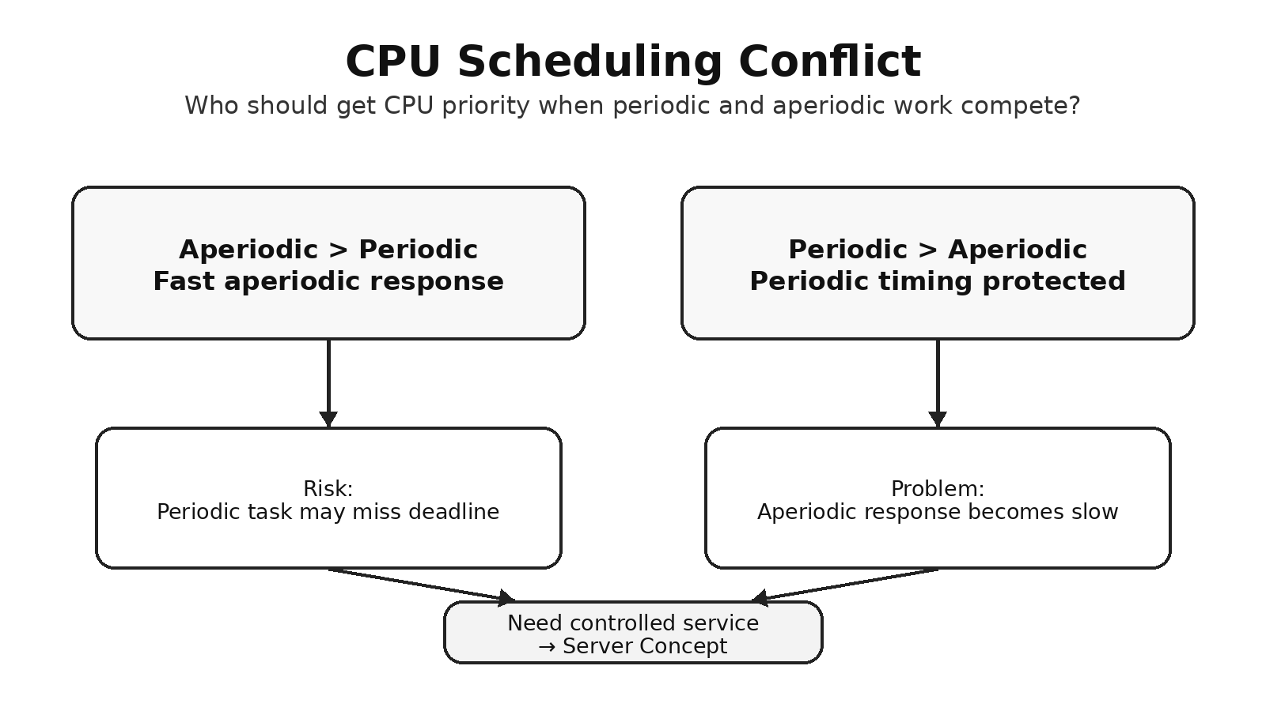
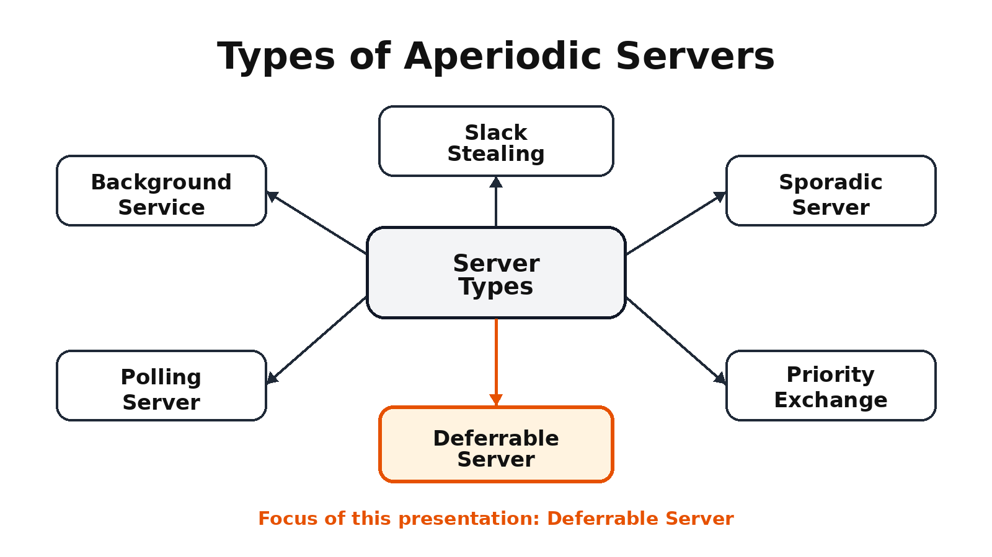
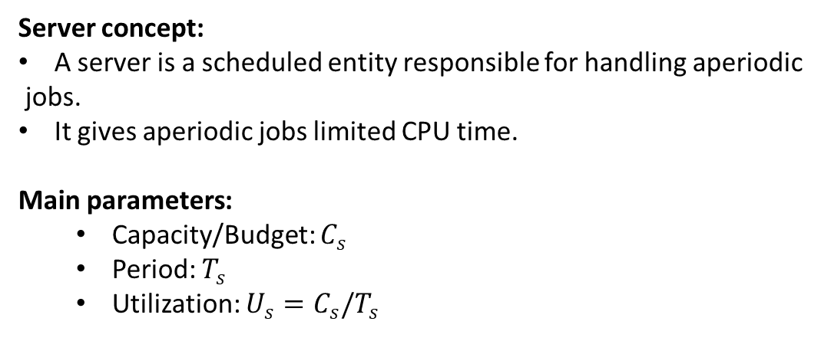
Origin of Server Concept
CPU scheduling problem:
Server concept:
A server is a scheduled entity responsible for handling aperiodic
jobs.
It gives aperiodic jobs limited CPU time.
Main parameters:
Capacity/Budget: $C_{s}$
Period: $T_{s}$
Utilization: $U_{s}=C_{s}/T_{s}$
Source: Author-created diagram based on Buttazzo [1].
Types of servers:
Polling Server
Deferrable Server
Priority Exchange
Sporadic Server
Slack Stealing
Source: Author-created diagram based on Buttazzo [1].

Slide 4
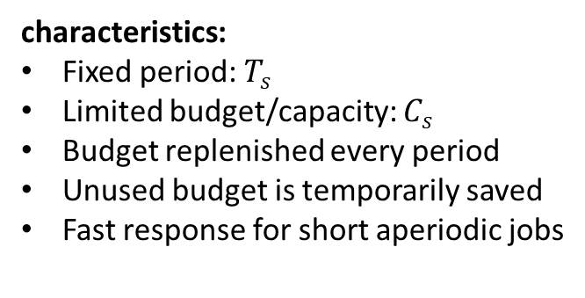
Deferrable Server
Deferrable Server
A fixed-priority server for handling aperiodic jobs.
Reserves CPU budget for aperiodic jobs.
Preserves unused budget until the end of the server period.
characteristics:
Fixed period: $T_{s}$
Limited budget/capacity: $C_{s}$
Budget replenished every period
Unused budget is temporarily saved
Fast response for short aperiodic jobs

Slide 5
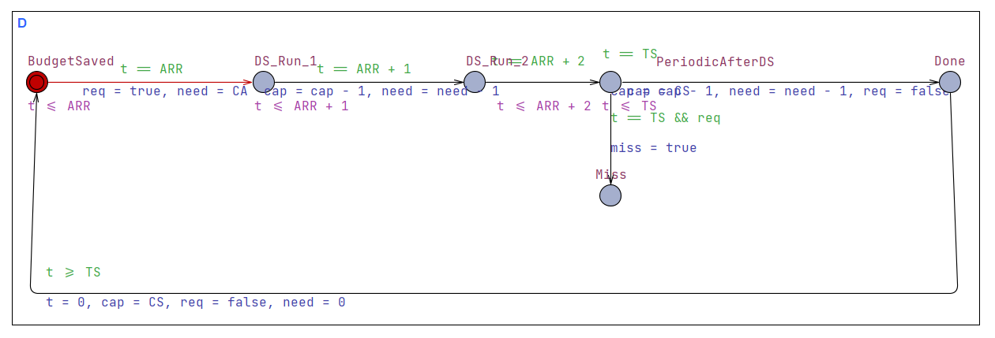
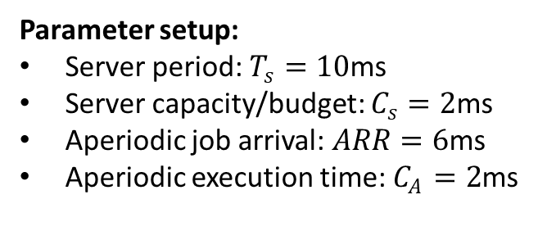
UPPAAL Model Task Overview
Parameter setup:
Server period: $T_{s}=10$ms
Server capacity/budget: $C_{s}=2$ms
Aperiodic job arrival: $ARR=6$ms
Aperiodic execution time: $C_{A}=2$ms
UPPAAL task overview:
Model starts in BudgetSaved with full budget.
From 0–6 ms, no aperiodic job arrives, so DS preserves budget.
At 6 ms, the aperiodic job arrives.
DS executes the job in DS Run 1 and DS Run 2.
At 10 ms, the server period finishes successfully in Done.
Source: Author’s UPPAAL model/screenshot, 2026.

Slide 6
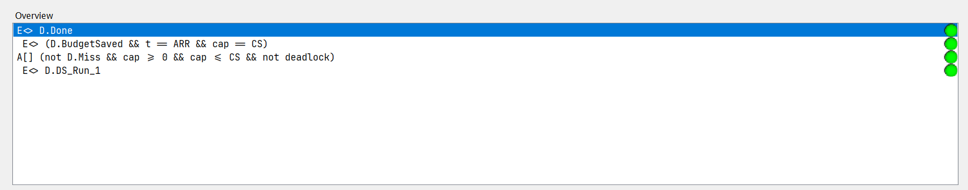
UPPAAL Verifier Results
All queries are green, so the selected properties are satisfied.
E<> D.Done means the model can successfully reach the final Done state.
E<> D.DS_Run_1 means the Deferrable Server starts executing the aperiodic job.
E<> (D.BudgetSaved && t == ARR && cap == CS) confirms that the budget is still full when the job arrives.
A[] (...) safety query confirms no Miss state, valid budget range, and no deadlock.
Source: Author’s UPPAAL model/screenshot, 2026.

Slide 7
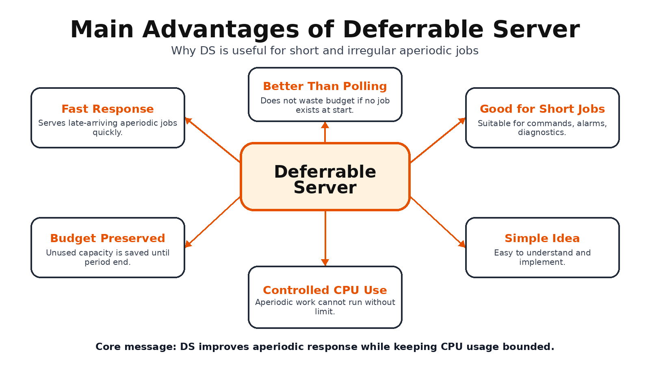
Advantages of Deferrable Server
Source: AI-assisted diagram generated with ChatGPT, edited by author, 2026.

Slide 8
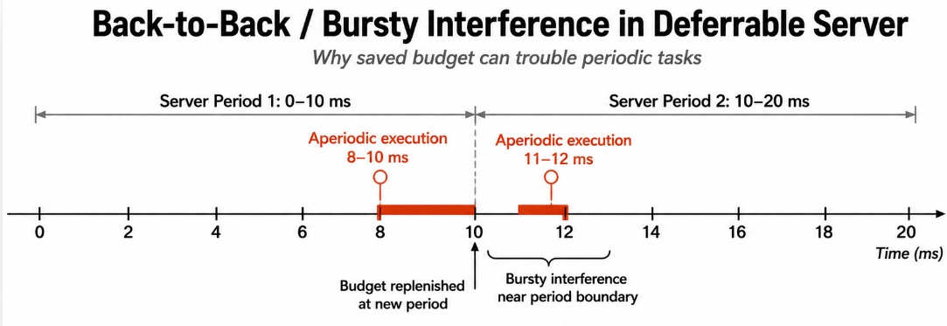
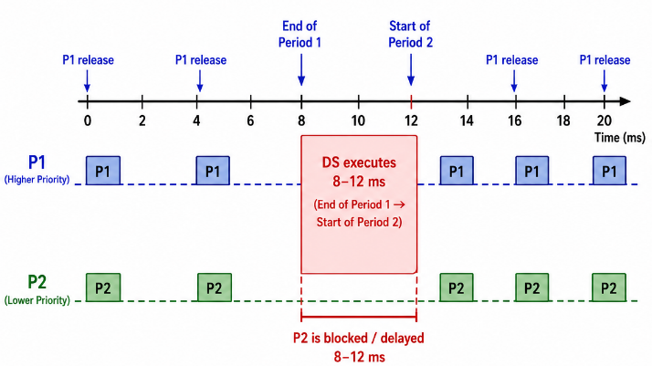
Limitations of Deferrable Server
Back-to-back execution problem.
Source: AI-assisted diagram generated with ChatGPT, edited by author, 2026.
Higher interference on periodic tasks.
Not good for long aperiodic jobs.
Budget can still be exhausted.
Source: AI-assisted diagram generated with ChatGPT, edited by author, 2026.

Slide 9
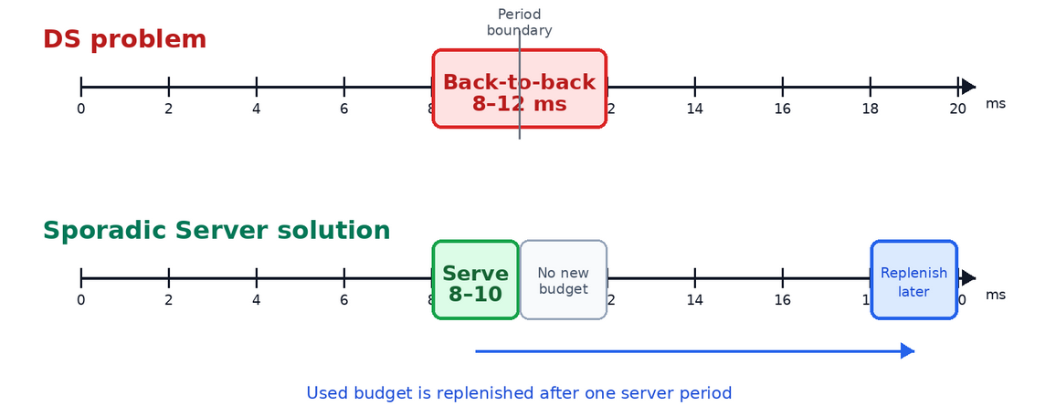
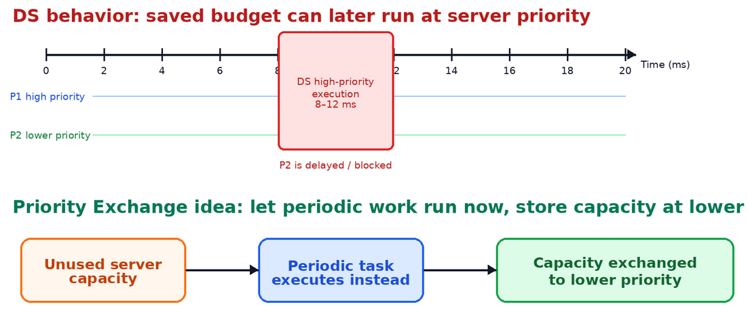
Probable Solutions Initiated from DS Limitations
Back-to-back execution problem → Sporadic Server
Source: AI-assisted diagram generated with ChatGPT, edited by author, 2026.
Higher interference on periodic tasks → Priority Exchange Server
Source: AI-assisted diagram generated with ChatGPT, edited by author, 2026.

Slide 10
References
[1] G. C. Buttazzo, Hard Real-Time Computing Systems: Predictable Scheduling Algorithms and Applications, 3rd ed., Springer, 2011.
[2] C. L. Liu and J. W. Layland, “Scheduling Algorithms for Multiprogramming in a Hard-Real-Time Environment,” Journal of the ACM, vol. 20, no. 1, pp. 46–61, 1973.
[3] J. P. Lehoczky, L. Sha, and J. K. Strosnider, “Enhanced Aperiodic Responsiveness in Hard Real-Time Environments,” IEEE Real-Time Systems Symposium, 1987.
[4] B. Sprunt, L. Sha, and J. P. Lehoczky, “Aperiodic Task Scheduling for Hard-Real-Time Systems,” Real-Time Systems, vol. 1, no. 1, pp. 27–60, 1989.
[5] G. Behrmann, A. David, and K. G. Larsen, “A Tutorial on UPPAAL,” Formal Methods for the Design of Real-Time Systems, Springer, 2004.
[6] UPPAAL screenshots and verifier results: Author’s own UPPAAL model, 2026.
[7] Presentation diagrams: AI-assisted diagrams generated with ChatGPT and edited by the author, 2026.

Slide 11
Thank you

