Slide 1
REAL-TIME SYSTEMS
Priority Exchange
Mechanism · Schedulability
Md Jubair Salehin Razin 1230281
Hochschule Hamm-Lippstadt

Slide 2
THE SETTING
One CPU, Two Kinds of Work
Hard periodic tasks
Soft aperiodic events
Arrival times unknown beforehand
No hard deadline but want the shortest response
Operator commands, alarms, mode changes
Deadlines verified offline by a worst-case test
Relative deadline = period; a miss is catastrophic
Control loops, signal processing, actuation

Slide 3


THE BASELINES
Two Naive Answers — Each Flawed
Background scheduling
Polling server
Aperiodic work runs only when no periodic task is ready.
A periodic task with reserved capacity dedicated to aperiodic service.
Never disturbs the periodic guarantee
Responsive when a request is waiting
Response time unbounded under high load
Capacity discarded if none pending at the poll instant

Slide 4
THE CORE IDEA - Priority Exchange
Don't hold the budget — trade it.
No aperiodic request: run the highest-priority ready periodic task.
Exchange: periodic work runs earlier; equal PE budget is parked at that task’s priority.
Later use: an aperiodic request can use the parked budget.
Budget is discarded only when the CPU is idle.
Move unused budget down the priority order do not waste it.

Slide 5
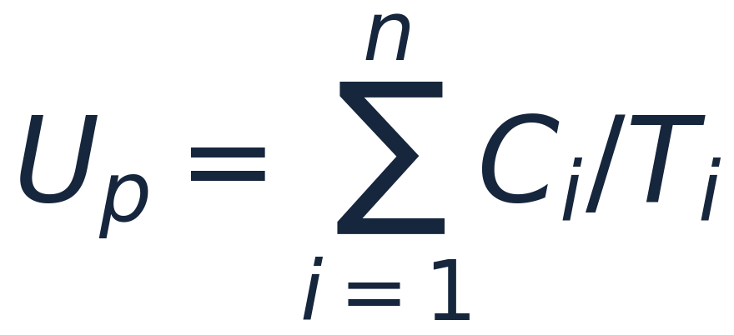

FOUNDATIONS
System Model
Single processor; periodic set Γ = {τ₁ … τₙ}, each task (Cᵢ, Tᵢ) with Dᵢ = Tᵢ.
Fully preemptive
Priorities assigned by Rate Monotonic
PE server has the highest priority
Aperiodic jobs arrive unpredictably
Goal: minimise aperiodic response time
PERIODIC UTILISATION
[2]
SERVER UTILISATION
[2]
Server described by capacity Cₛ and period Tₛ.

Slide 6
HOW IT WORKS
The Exchange Mechanism
At each server period: Replenish budget (C_s)
CASE 1: Aperiodic request pending
Serve the request
Consume available PE budget
CASE 2: Nothing pending
Run the highest-priority ready periodic task
Park equal budget at that task’s priority
Budget is discarded only when the CPU would otherwise be idle.

Slide 7
WORKED EXAMPLE
Setup
CONFIGURATION
PE server Cₛ = 1, Tₛ = 5 → Uₛ = 0.2
Task τ₁ C₁ = 2, T₁ = 10
Task τ₂ C₂ = 6, T₂ = 20
Arrivals J₁ @ t=5, J₂ @ t=12 (1 unit each)
Up = 0.5 · Us = 0.2
The question. Can PE serve both jobs quickly while τ₁ and τ₂ still meet every deadline?

Slide 8
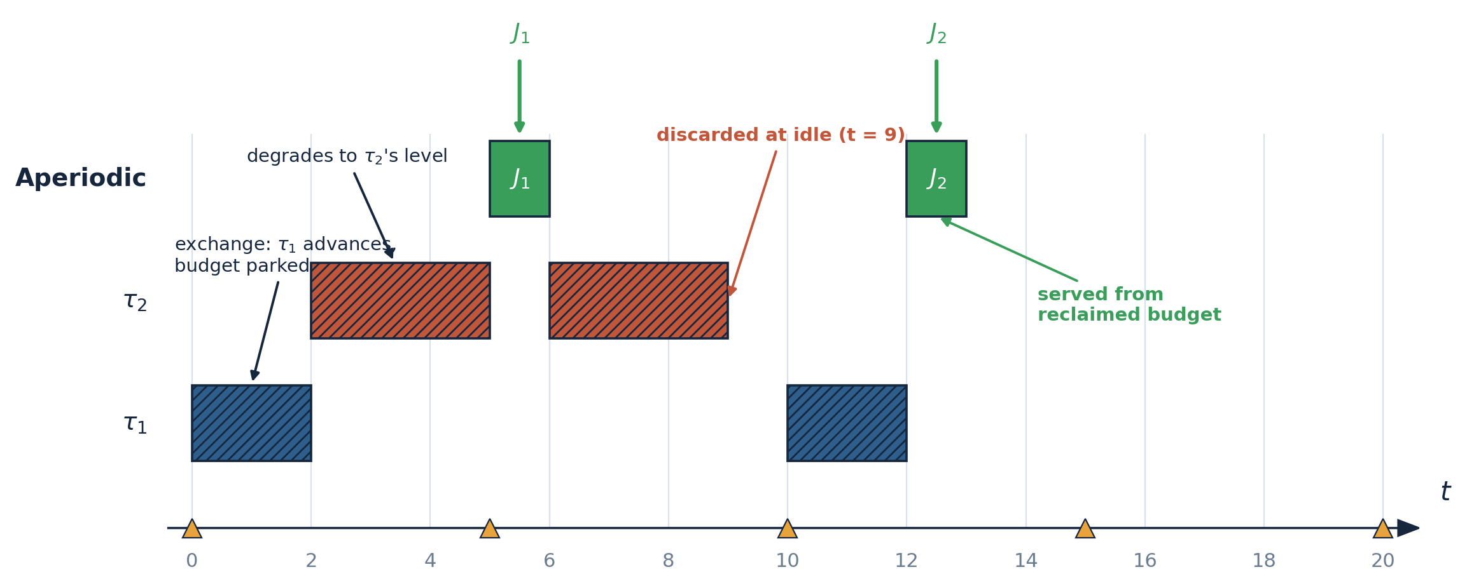
WORKED EXAMPLE
The Schedule
[ Rendered from LaTeX/TikZ source with the help of Opus 4.8 Max ]
J₁ → instant top-priority service
J₂ → reclaimed parked budget
Budget lost only at idle (t = 9, 15)

Slide 9
IMPLEMENTATION
A discrete, unit-time, fixed-priority simulator configured to the exact worked example (Cs=1, Ts=5, τ1=(2,10), τ2=(6,20), J@5, J@12). Full C++ source (raw code) on GitHub [1].
What the simulator enforces
Core decision (each tick, choose what runs in [t, t+1) )
if(t % Ts == 0) cap[0] += Cs; // replenish
if (aperiodic_pending) { // CASE 1
serve(job, top_budget_lvl); // consume
} else if (periodic_ready) { // CASE 2
exchange(budget_lvl, task);
park(budget, task.level); // degrade
} else { // idle
discard(top_budget_lvl);
}
1 Replenish - server gains Cₛ budget every Tₛ.
2 Serve - aperiodic pending → consume highest-priority budget.
3 Exchange - else advance the top ready periodic task.
4 Park - drop the equal budget to that task’s priority.
5 Discard - only when the CPU would otherwise idle.

Slide 10
Simulated Trace - Tick by Tick
Every scheduling decision the simulator made over [0, 20). Serve and Discard instants are highlighted.
t
Runs
PE decision
Budget after
0
τ₁
EXCHANGE → run τ₁, park @τ₁
[τ₁:1]
1
τ₁
run τ₁ normally
[τ₁:1]
2
τ₂
EXCHANGE → run τ₂, park @τ₂
[τ₂:1]
3–4
τ₂
run τ₂ normally
[τ₂:1]
5
J₁
SERVE J₁ (fresh top budget)
[τ₂:1]
6–8
τ₂
run τ₂ normally
[τ₂:1]
9
—
DISCARD @ idle (lose parked)
[ empty ]
10
τ₁
EXCHANGE → run τ₁, park @τ₁
[τ₁:1]
11
τ₁
run τ₁ normally
[τ₁:1]
12
J₂
SERVE J₂ (reclaimed budget)
[ empty ]
13–14
—
idle
[ empty ]
15
—
DISCARD @ idle
[ empty ]
16–19
—
idle
[ empty ]
[Reformatted from the raw terminal output with Claude Opus 4.7]

Slide 11

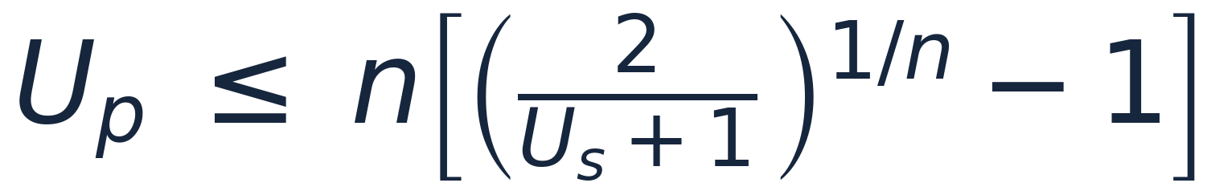
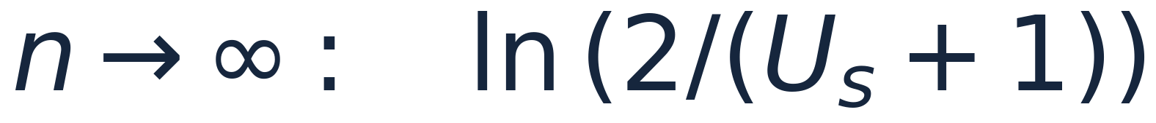
GUARANTEE
Why It Works + Schedulability Bound
TWO LIMITING CASES
All hard periodic tasks can meet their deadlines
Us → 0 (server vanishes)
[2]
n → ∞ (large task set)
RM guarantee
[2]
[2]
Applied to this example
Worst case it behaves like an ordinary periodic task.
Up = 0.5 < 0.582 → guaranteed (matches zero misses).

Slide 12
RESULTS
Theory Confirmed by the Simulator
APERIODIC RESPONSE
DEADLINE MISSES
BUDGET DISCARDED
J₁=1
τ₁=0
t=9
J₂=1
τ₂=0
t=15
Both served immediately.
Every periodic deadline met.
Only at idle — no early waste.
Up = 0.5 < 0.582 (RM bound for n = 2) → the simulator shows zero misses

Slide 13
Where PE Sits Among the Servers
Algorithm
Priority
Periodic bound
Aperiodic response
Background
any
none reserved
very poor
Polling Server
RM
periodic-task
moderate
Deferrable Server
RM
weaker than PE
good
Priority Exchange
RM
periodic-task
good
Sporadic Server
RM
periodic-task
good
Dynamic Prio. Exch.
EDF
Up + Us ≤ 1
very good
Improved Prio. Exch.
EDF
Up ≤ 1
near-optimal
EDL
EDF
Up ≤ 1
optimal
Claude generated table; data from [2]

Slide 14
LIMITATIONS
1. High bookkeeping overhead
2. Overhead grows with task count 3. Aperiodic response is not always immediate 4. No hard guarantee for aperiodic jobs 5. Based on restrictive assumptions
6. Less attractive in modern implementations
[2]

Slide 15
CONCLUSION
Preserve budget by trading it, not holding it.
Strong guarantee
Same schedulability bound as a periodic task
Better guarantee than Deferrable Server
No early waste
Budget moves to lower priorities
Discarded only when the CPU is idle
Extends to EDF
Leads to DPE and IPE
Supports very good aperiodic response
[2]

Slide 16
Thank you

Slide 17
References
[1] [1] All source code, the executable, and the LaTeX/TikZ schedule figure (slide 8) are available in GitHub repository, 2026.
[2] G. C. Buttazzo, Hard Real-Time Computing Systems: Predictable Scheduling Algorithms and Applications, 3rd ed. New York: Springer, 2011.
AI usage
Claude (Opus 4.7 and Opus 4.8 Max) and ChatGPT (GPT-5.5 Thinking) were used during preparation, and all results were checked by the author against [2].

