Slide 1


Mutual Fund Analytics Platform
End-to-End Data Pipeline,
Quantitative Modelling,
and Business Intelligence.
PRESENTED BY
Shubham Singh
DEPARTMENT
Data Analytics

Slide 2

01
Problem & Objective
The Problem: Retail mutual fund participation is exploding via SIPs, but high volatility and lack of risk-adjusted insights lead to severe investor churn.
The Objective: Engineer an automated data pipeline to calculate institutional-grade risk metrics and deploy a predictive framework to mitigate retail churn.

Slide 3
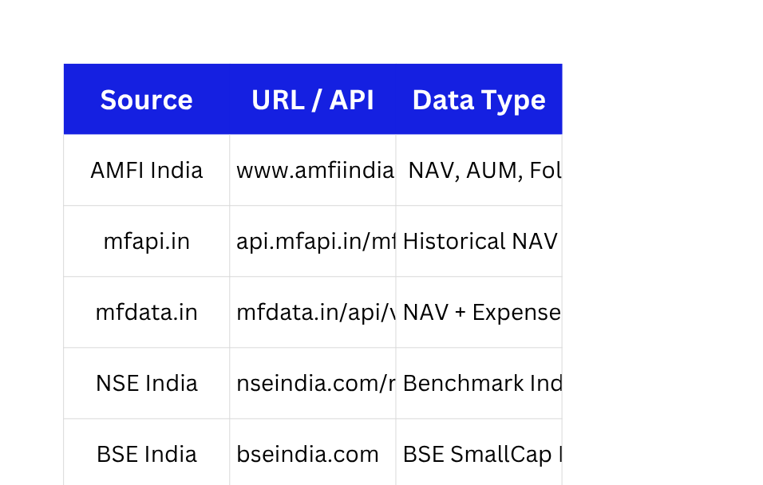

03
Data
Sources
REAL-TIME & HISTORICAL INGESTION:
Sourced dynamic market data via the live AMFI API (mfapi.in) alongside a massive internal dataset of over 46,000+ NAV records and ~32,000 transaction logs, ensuring the analysis reflects both current market conditions and deep historical investor behaviour.
TIME-SERIES NORMALIZATION (THE WEEKEND FIX):
Raw financial data contains severe gaps due to market closures. Applied business-day reindexing and forward-filling (ffill) to NAV arrays, ensuring volatility calculations are mathematically pure and not skewed by calendar-day anomalies.
OPTIMIZED RELATIONAL ARCHITECTURE:
Engineered a highly normalized, 5-table Star Schema in SQLite (Fact & Dimension tables). This structure resolved severe AUM scale disparities and optimized the backend for high-speed querying by the BI layer.

Slide 4




02
04
DATA INGESTION
DATA WAREHOUSING
AMFI Live API (Dynamic NAVs) & Historical CSVs (46,000+ NAV records and ~32,000 transaction logs)
SQLite Database
5-Table Normalized Star Schema
ETL & NORMALIZATION
QUANTITATIVE ENGINE
01
Automated Python Pipeline (Pandas/NumPy)
Business-day reindexing, missing value forward-filling (ffill)
03
Risk & Performance Modeling
Computing VaR, CVaR, Sharpe, and HHI
End-to-End Analytics Pipeline
04

Slide 5
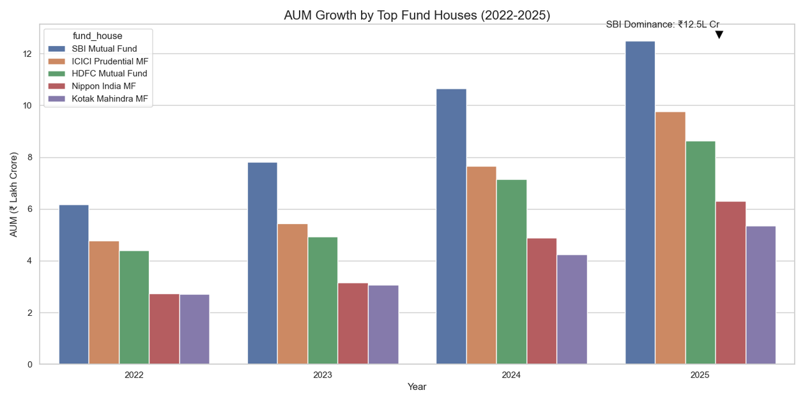
05
EDA Highlights: Market Concentration & AUM Trends
Explosive Capital Influx: Total industry AUM experienced massive expansion between January 2021 and January 2024, scaling from approximately 2.4 Billion to 3.8 Billion representing a robust ~58% growth in managed capital over just 36 months.
Structural Market Resilience: Despite global macro-economic headwinds and interest rate volatility during this three-year window, the AUM trajectory remained remarkably smooth. This indicates that domestic mutual funds have cemented themselves as the definitive wealth creation vehicle for retail investors.
The SIP Multiplier Effect: This consistent, compounding growth curve is the visual manifestation of systematic investment plans (SIPs). It proves that consistent monthly inflows provide a heavy anchor for AMCs, successfully offsetting the localized impacts of short-term market corrections.

Slide 6
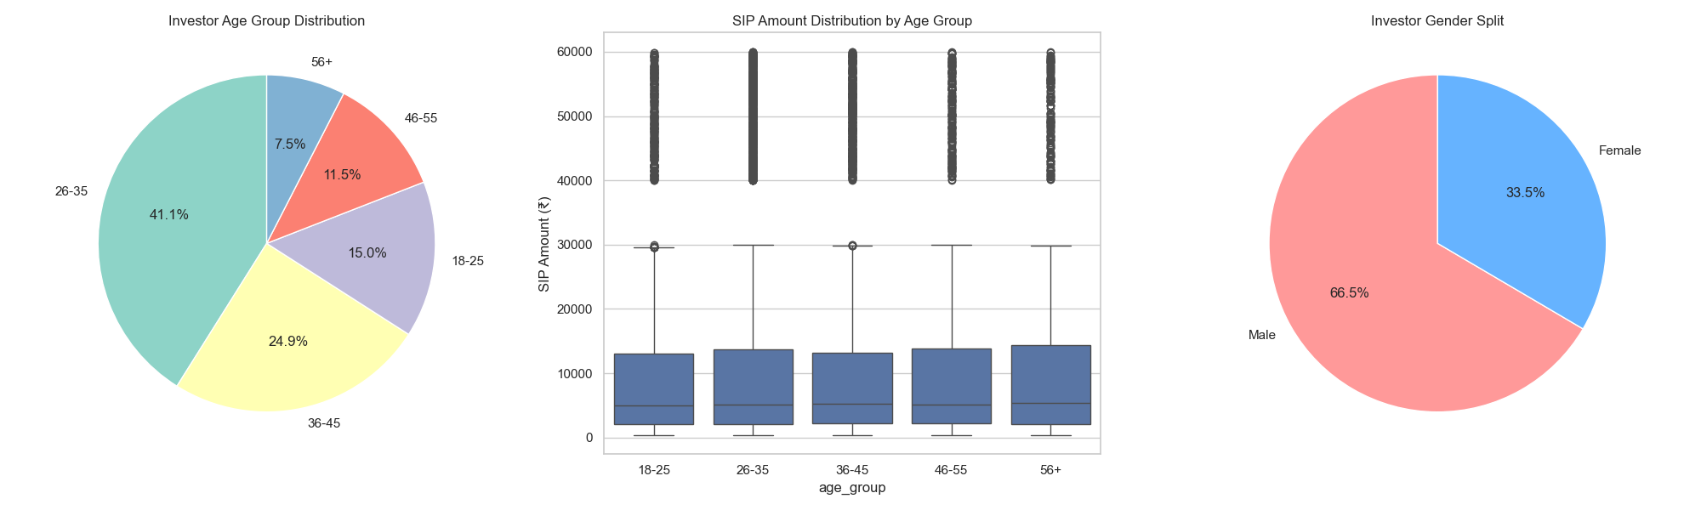
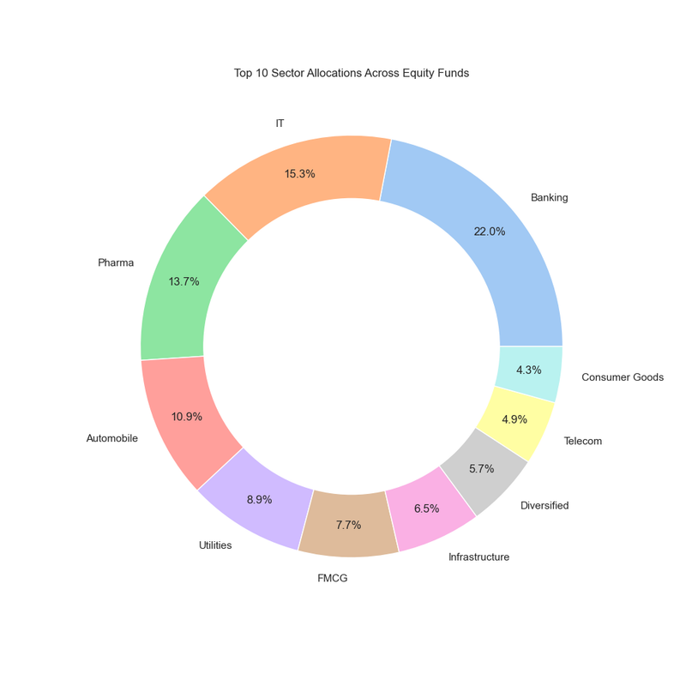
06
EDA Highlights: Investor Demographics & Capital Allocation
Retail as the Growth Engine: Retail folios constitute the overwhelming majority of active market participation. This confirms that mitigating retail investor churn is the single most critical lever for sustaining AUM growth.
Hyper-Concentrated Allocation: Despite the availability of highly diversified funds, retail capital is disproportionately funneled into a narrow band of high-momentum sectoral and mid-cap themes, ignoring broader market safety.
The Volatility Trap: Because retail money is clustered rather than diversified, portfolios are highly correlated. A localized shock to these specific sectors serves as the primary catalyst for panic-selling, directly triggering our identified 35-day SIP churn gaps.
Insight: Retail dictates market momentum.
Insight: Capital is severely clustered.

Slide 7
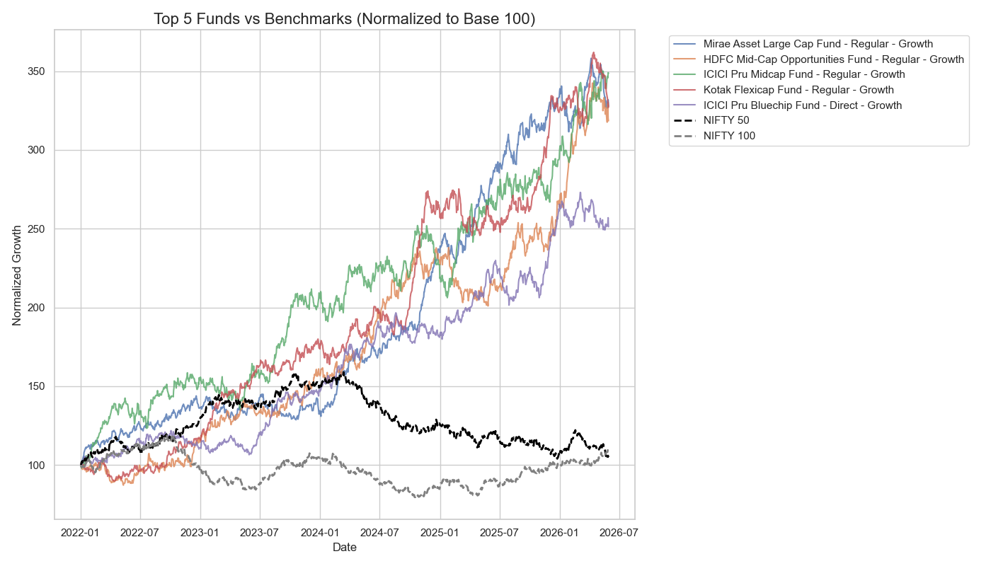
Performance Metrics
07
ABSOLUTE RETURNS VS. THE MARKET (ALPHA GENERATION)
RISK BLIND SPOT
Absolute return charts hide true volatility, completely masking the downside tail risk taken to achieve these gains.
MASSIVE ALPHA
Top active funds delivered 250% to 350%+ normalized growth, completely outclassing flat passive benchmarks.
CYCLICAL DECOUPLING
Active managers aggressively capitalized on 2023-2025 market rallies, breaking away from index constraints.

Slide 8
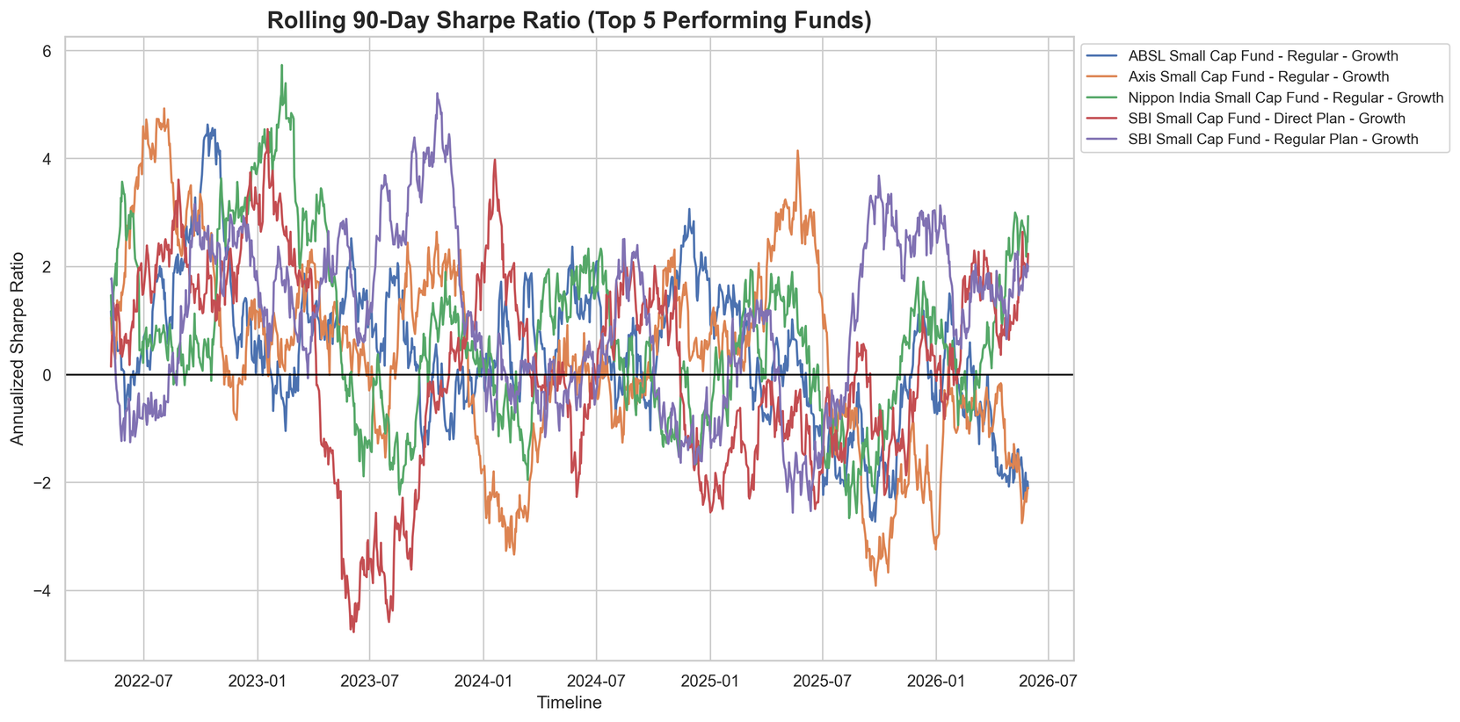
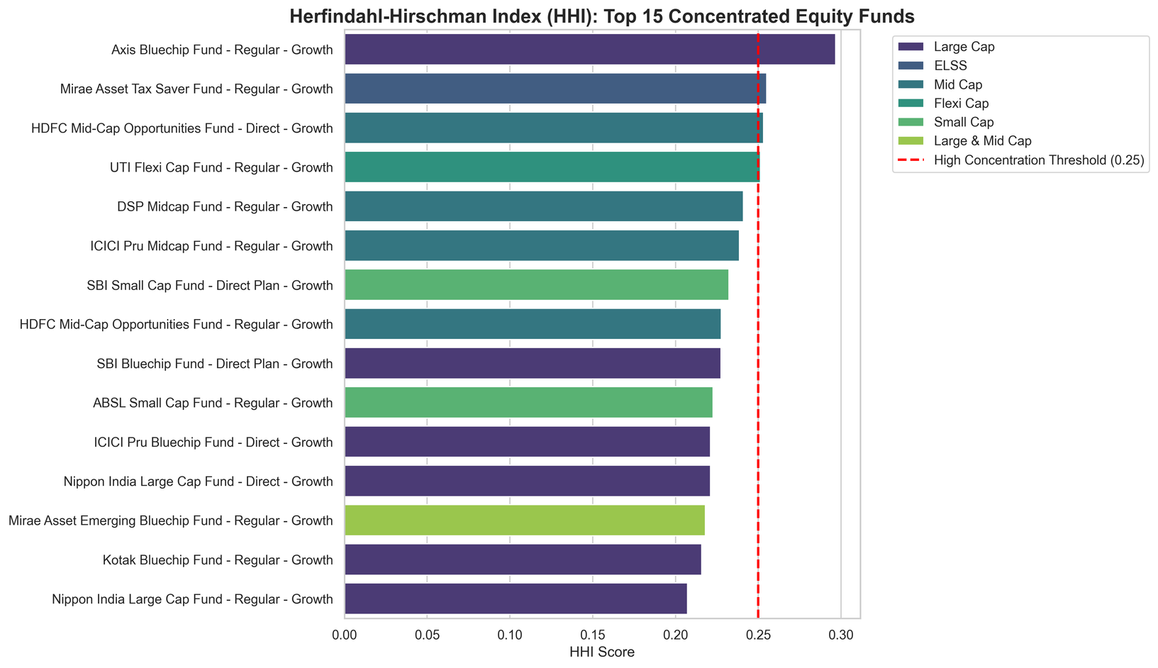
Performance Metrics
08
RISK-ADJUSTED PERFORMANCE & HIDDEN VULNERABILITIES
SHARPE COLLAPSE
HIDDEN CONCENTRATION
SEVERE TAIL RISK
Rolling Sharpe analysis proves that fund efficiency frequently collapses into negative territory during market corrections, destroying risk-adjusted value.
HHI Modeling (Herfindahl-Hirschman Index) reveals that top "diversified" funds are actually hyper-clustered in just a few volatile sectors.
These concentrated portfolios exhibit dangerous Max Drawdowns and CVaR, serving as the exact panic triggers that cause retail investors to halt their SIPs.

Slide 9
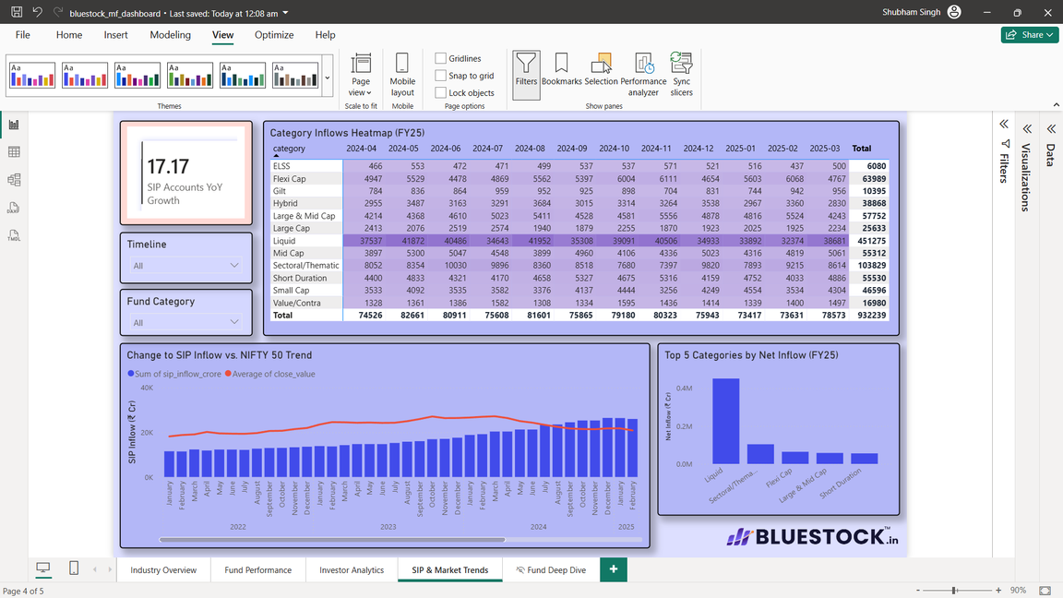
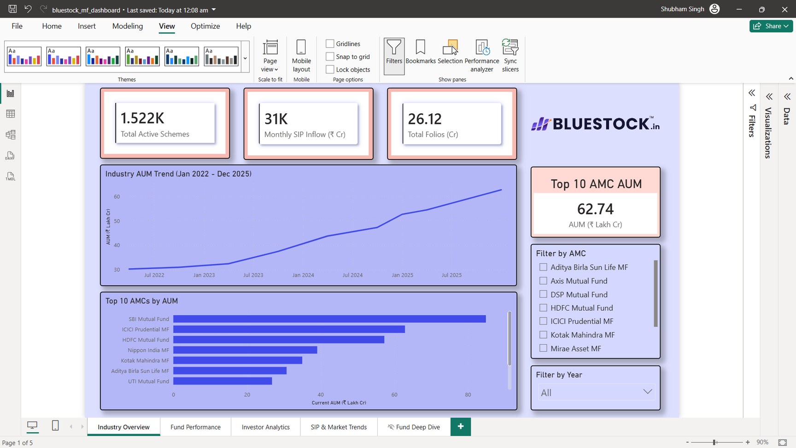
09
Business Intelligence: Macro Market Surveillance
Live Ecosystem Tracking:
Performance Trend
01
The dashboard translates the normalized SQLite Star Schema into real-time visual intelligence, actively tracking industry-wide AUM expansion, total active folios (26.12 Crore), and monthly SIP inflows (₹31K Cr).
01
Overall performance shows consistent improvement across key metrics.
Dynamic Slicing Architecture:
02
Unlike static PDF reports, the BI layer allows executives to slice macro data dynamically across specific Asset Management Companies (AMCs) and multi-year timeframes to isolate competitive market share.
Trend & Heatmap Integration:
03
Integrates complex category-level inflow data into an easily digestible matrix, allowing analysts to instantly spot which fund classes (e.g., Liquid vs. Flexi Cap) are driving quarterly momentum.

Slide 10
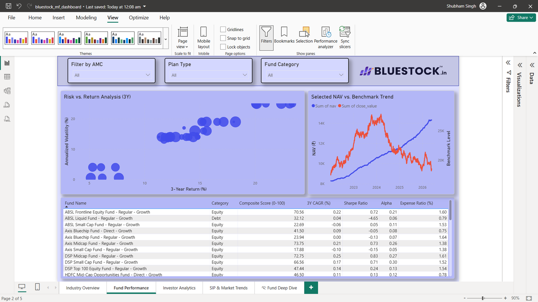
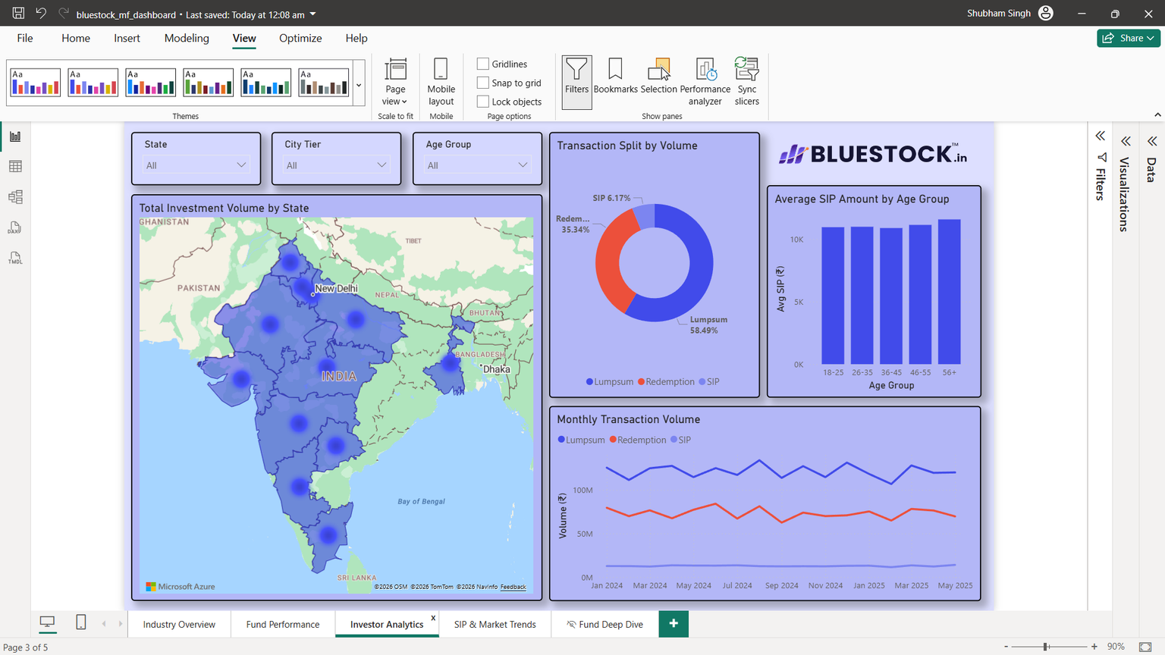
BI Drill-Down: Fund Efficiency & Investor Geography
10
Risk vs. Return Matrix:
Live Benchmarking:
Dynamic Slicing Architecture:
Performance Trend
01
The interactive scatter plot allows stakeholders to immediately visualize fund efficiency by plotting 3-year returns against annualized volatility. Bubble sizes dynamically represent total AUM.
The dashboard features a granular time-series view, overlaying selected fund NAVs directly against benchmark indices to visualize alpha generation dynamically.
Unlike static PDF reports, the BI layer allows executives to slice macro data dynamically across specific Asset Management Companies (AMCs) and multi-year timeframes to isolate competitive market share.
01
Overall performance shows consistent improvement across key metrics.
02
03

Slide 11


08
Key Findings:
SUMMARY OF CONCLUSIONS
SIP Churn Predictor: A >35-day transaction gap is a definitive early-warning signal, enabling AMCs to trigger proactive retention campaigns before permanent churn occurs.
Hidden Concentration Risk: HHI modeling reveals many "diversified" funds are highly sector-clustered, exposing retail investors to severe tail risks and maximum drawdowns.
Risk-Adjusted Efficiency: Despite generating massive absolute alpha, Rolling Sharpe analysis proves that active fund efficiency frequently collapses during market corrections.
Geographic Expansion: With 66.3% of investment volume heavily concentrated in T30 cities, Beyond-30 (B30) regions represent the primary strategic frontier for new SIP acquisition.

Slide 12




Thank You!
Completed Report for the Capstone Project
This project was built by Shubham Singh as a Capstone Project for the steps required as a succesful completion of the 2 months Internship.
7900542995
singh.shubham1901@gmail.com
github.com/bluestock_mf_capstone

