Slide 1

Face search : find your face effortlessly
Submitted by: Anurag Singh(21bcom1367)
Yash Prajapati(21bcon638)
Prachi Agarwal(21bcon532)
KirtiVardhan Singh (21bcon126)

Slide 2
The Challenge of Photo Management
In an era dominated by digital imagery, the sheer volume of photos captured and stored presents a significant challenge: locating specific images within vast archives. The exponential growth of digital photography, fueled by the proliferation of smartphones and digital cameras, has led to an unprecedented accumulation of personal and professional images. Yet, alongside this wealth of visual content comes the daunting task of effectively managing and retrieving these photos. For many individuals, the frustration of scrolling endlessly through albums or directories in search of a particular photograph is all too familiar. Manual sorting and tagging can be time-consuming and impractical, particularly as photo collections expand over time. Moreover, traditional keywordbased search methods may prove inadequate when attempting to locate images based on the individuals depicted within them.

Slide 3
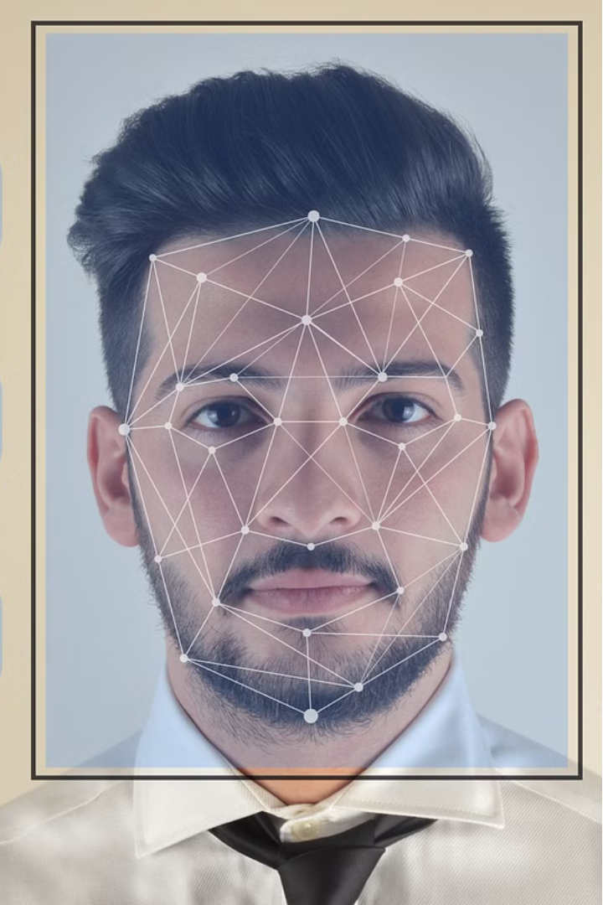
Introduction to Face Search using AI
Face search technology powered by artificial intelligence (AI) is revolutionizing the way we identify and locate individuals. This advanced system utilizes sophisticated algorithms to detect, extract, and match facial features with remarkable accuracy, enabling seamless and efficient person identification across a vast database of images or video footage.

Slide 4
Overview of Face Recognition Technology
Facial Detection
Feature Extraction
Facial Matching
The first step in face search is detecting and extracting facial features from an input image or video frame. AI-powered algorithms can precisely locate and isolate individual faces, even in crowded or complex scenes.
Once a face is detected, the system analyzes and extracts unique facial characteristics, such as the shape of the eyes, nose, lips, and other distinguishing features, creating a numerical representation or "facial template".
The facial template is then compared against a database of stored facial profiles to find the closest match, allowing the system to identify the individual with high accuracy.

Slide 5
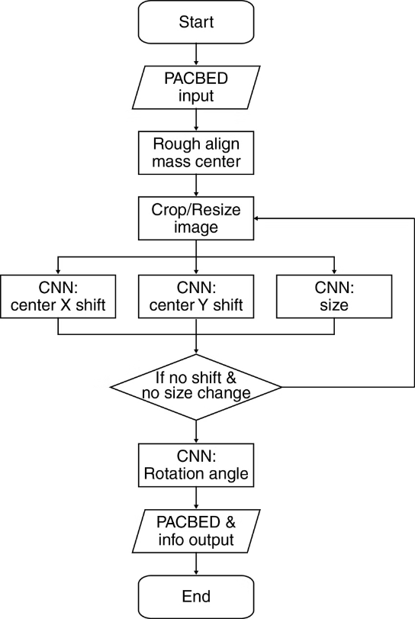
Methods for Searching Images
Develop a user-friendly image organizing tool that establishes seamless integration with Google Drive, simplifying the process of managing image collections.

Slide 6
Utilize advanced image analysis techniques, such as Convolutional Neural Networks (CNN), to enhance the tool's ability to understand and interpret image content accurately.
Implement intelligent sorting algorithms capable of automatically categorizing images based on their content similarity.
Design an intuitive user interface that ensures ease of interaction and navigation, catering to users with varying levels of technical expertise.
Conduct extensive testing with real users to evaluate the effectiveness and usability of the tool, gathering valuable feedback for iterative improvements. Ensure the scalability and reliability of the tool to accommodate large-scale image datasets while maintaining optimal performance.

Slide 7
GENERATING ROOM
If you choose "Generate Room Code," you can start by putting your pictures into the app. Then, the app looks at those pictures using a special technology called face recognition. It's like a smart tool that looks at faces and remembers them.
After looking at your pictures, the app gives them a special code. This code is like a secret password that keeps your pictures safe and organized. It helps the app know which pictures belong together. Once your pictures have been given a special code, you can generate a room.
If you want to find your own face in those pictures, there's a button called "Find Your Face." This helps you search for pictures with your face in them.

Slide 8
Building Face Recognition Using
Django:
A powerful Python web framework, to build the backend and handle server-side logic for the face recognition application.
Bootstrap :
A popular CSS framework, to create a responsive and visually appealing user interface that seamlessly integrates with the face recognition functionality.
SQLite:
A lightweight and embedded database management system, to store and manage the facial feature data, user profiles, and other relevant information required for the face recognition system.

Slide 9

Data Collection and Database Management
1
Comprehensive Data Collection
2
Secure Database Storage
3
Continuous Database Updating
Gathering a large and diverse dataset of facial images is crucial for building an effective face search system. This data can be sourced from various channels.
The facial data is securely stored in a centralized database, with robust measures in place to ensure the privacy and integrity of the information.
The database must be regularly updated to incorporate new facial data, ensuring the system remains comprehensive and up-to-date.

Slide 10

Face Detection and Extraction
1
Image Acquisition
The face search process begins by capturing or inputting an image or video frame containing one or more faces.
2
Facial Detection
AI-powered algorithms analyze the input image, quickly identifying and isolating any faces present within the scene.
3
Facial Extraction
The detected faces are then extracted from the original image, creating individual facial profiles that can be processed and matched against the database.

Slide 11
Facial Feature Extraction and Matching
Facial Feature Extraction
Facial Matching
Confidence Scores
The facial template is compared against the database of stored facial profiles to find the closest match. Advanced AI algorithms can accurately identify individuals with high precision, even in large-scale databases.
The system provides a confidence score indicating the likelihood of a successful match, allowing users to assess the reliability of the identification results.
The extracted facial profiles are analyzed to identify unique and distinguishing characteristics, such as the shape and positioning of the eyes, nose, and mouth. These features are then converted into a numerical representation or "facial template".

Slide 12




Integrating Face Search into Applications
Security
Marketing
Healthcare
Law Enforcement
Face search technology can enhance security and surveillance systems, enabling real-time identification of individuals of interest.
Retailers can leverage face search to analyze customer behavior and preferences, optimizing their marketing strategies.
Face search can assist in patient identification and medical record management, improving healthcare efficiency and patient safety.
Law enforcement agencies can utilize face search to aid in criminal investigations and identification of suspects.

Slide 13
Challenges and Limitations of Face Search
Privacy Concerns
Bias and Accuracy
The widespread use of face search technology raises important privacy issues, as individuals may feel their personal information is being compromised.
Facial recognition algorithms can sometimes exhibit bias and inaccuracies, particularly when dealing with diverse populations or challenging environmental conditions.
Technological Limitations
Ethical Considerations
Face search systems may struggle with low-quality images, occlusions, or dramatic changes in facial appearance, limiting their effectiveness in certain scenarios.
The use of face search technology must be carefully balanced with ethical concerns, such as the potential for abuse or misuse of personal information.

Slide 14
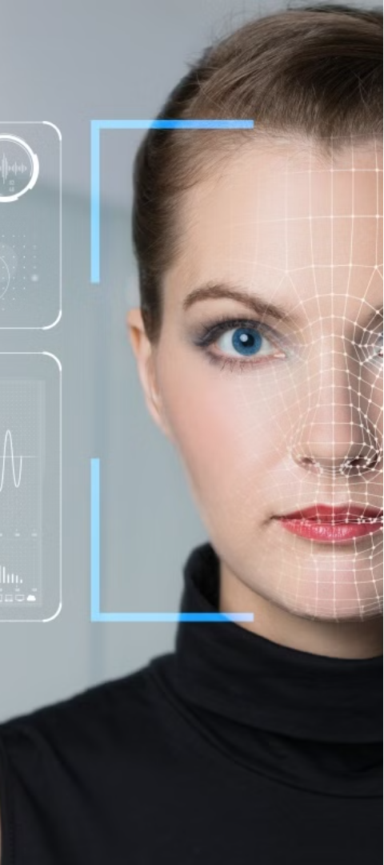



Conclusion and Future Directions
Continuous Innovation
As AI and computer vision technologies continue to advance, face search capabilities are expected to become increasingly accurate, efficient, and widely adopted.
Ethical Frameworks
Policymakers and industry leaders must work together to develop robust ethical frameworks that ensure the responsible and transparent use of face search technology.
Multimodal Biometrics
The integration of face search with other biometric modalities, such as fingerprint or iris recognition, can enhance the overall reliability and security of identification systems.

