Slide 1
A guide of Machine learning for a 5G future
Presented by
Md Rasel (IT-17049)
Razu Ahamed(IT-17047)
Presented to
Nazrul Islam
Assistant Professor
Dept. of ICT, MBSTU

Slide 2
Contents
Conclusion
Introduction
Artificial Intelligence (AI) and Machine Learning (ML)
Applications of AI
Applications of ML
5G networks security
Potential of machine learning to support 5G requirements
Types of learning and its application
Open research challenges and future directions
Thursday, October 29, 2020

Slide 3
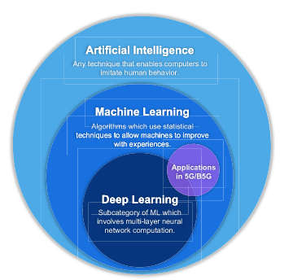
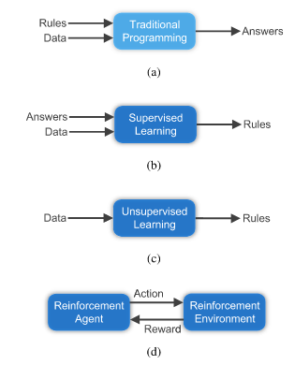
Introduction
Machine Learning (ML) is everywhere, from medical diagnosis based on image recognition to navigation for self-driving cars.
Preliminary interest and discussions about the feasibility of evolving 5G standards
ML is great for complex problems where existing solutions require a lot of hand-tuning, or for problems which there is no solution at all using a traditional approach.
Figure: Relation between AI, ML, DL

Slide 4
Artificial Intelligence (AI) and Machine Learning (ML)
The concept of using AI and ML in security and privacy is not new but their feasibility and performance superiority gained attention with the evolution of deep learning (DL) algorithms.
The 5G networks are expected to support much higher-level heterogeneity (in terms of connected devices and networks) as compared to its predecessors.
AI and ML can provide solutions by classifying fragile security links in-between, for instance, identity, authentication, and assurance.
AI and ML can help in developing security mechanisms by creating trust models, device security and data assurance to provide systematic security for the whole 5G-IoT network.

Slide 5
Applications of AI
Improve Workplace Communication
Human Resource Management
Intelligent Cybersecurity
Logistics and Supply Chain

Slide 6
Applications of ML
Social Media Services
Email Spam and Malware Filtering
Online Customer Support
Search Engine Result Refining

Slide 7
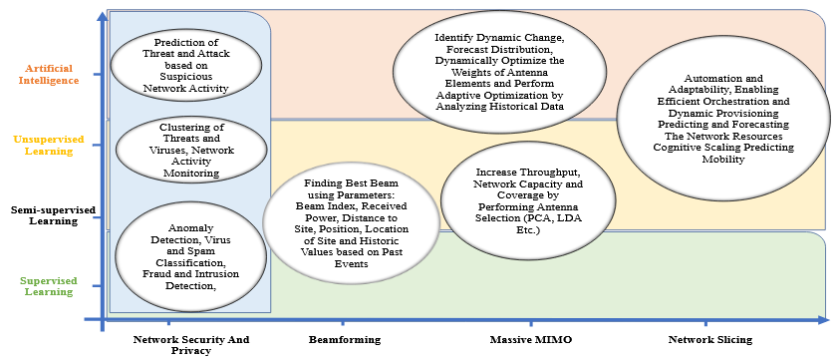
5G networks security
Contrary to this, manual or traditional need based upgrades to network security are no more feasible, therefore, security automation should be an integral part of the overall network.
Figure: Applications of AI and ML in 5G network

Slide 8
Potential of ML to support 5G requirements
Peak Data Rate
User Experienced Data Rate
Area Traffic Capacity
Spectrum Efficiency

Slide 9
Peak Data Rate
Peak data rate is planned to increase and support high-demand data-driven use cases.
An increase of the peak data rate in 5G should be viewed as an evolution that builds on all spectrum assets.
Massive or large Multiple-Input Multiple-Output (MIMO)is an essential contribution in the promise to provide an increased spectral efficiency in 5G.
Future system swill have to develop flexibility in order to operate across aide range of regulatory models and sharing arrangements.

Slide 10
User Experienced Data Rate
Emerging technologies such as wireless network virtualization (WNV) will become one of the main trends in 5G systems and empower a better quality of experience (QoE)for end users.
WNV relies on software-defined net-working (SDN), and network function virtualization (NFV)to fulfill different network standards.
Network resource allocator systems have been designed based on SDN and NFV to enable autonomous network management.

Slide 11
Area Traffic Capacity
To handle this area traffic capacity demand, cell densification has been proposed with pleasant results under 5G scenarios.
Additional tiers of small cells provide a tremendous increase in the spectrum reuse factor, which allows the allocation of more bandwidth per UE.
The major drawback of cell densification is that the traffic that can be served by an SBS is limited by the capacity of the backhaul link.

Slide 12
Spectrum Efficiency
The minimum requirements for peak spectral efficiencies in IMT-2020 are 30 bit/s/Hz for downlink, and 15 bit/s/Hz for uplink.
The peak spectral efficiency denotes the maximum data rate under ideal conditions normalized by channel band-width (in bit/s/Hz).
To meet this requirement, access to flexible techniques that maximize the spectrum efficiency are needed as well.

Slide 13
Types of learning and its application
Supervised learning in 5g mobile and wireless communications technology
Unsupervised learning in 5g mobile and wireless communications technology
Reinforcement learning in 5g mobile and wireless communications technology

Slide 14
Open research challenges and future directions
The aim of fully automated cyber defense system might be a long-term goal, but meanwhile, the cost of integrating AI and ML for existing and future systems also need rigorous analysis.
For instance, in finding anomalies in a network, first, we need to define normal.
Network activity is seldom normal, and therefore, a fully supervised or semi-supervised network would be one possible way to deal with in this situation.

Slide 15
Conclusion
This presentation presents AI-assisted technologies, scenarios and application for security of 5G and beyond wireless networks.
Fully automated security framework is built-upon smart AI technologies.
AI can significantly improve the security for distributed ad-hoc setup of network infrastructure providing different network functions.

Slide 16
Thank You

