Slide 1


Stock Price Prediction: Classical vs Modern Approaches
Student: Moga Răzvan-Andrei
Faculty of Mathematics and Computer Science,
Babes-Bolyai University Cluj-Napoca

Slide 2
Table of contents
01
02
03
04
05
06
Introduction
Related Works
Data Collection
Data Preprocessing
System Design
Model Architecture
07
08
09
Fine-Tuning and Hyperparameter Tuning
Comparison
of Models
Accuracy Metrics and Results
10
Conclusion

Slide 3
01
Introduction

Slide 4
Objective
Importance of Stock Market
This research compares classical machine learning models with large language models (LLMs) for stock trend forecasting by incorporating sentiment analysis from financial news and Google Trends data. The primary objective is to evaluate how traditional ML approaches and LLMs perform when combining financial metrics with sentiment analysis and Google Trends data.
The stock market is crucial for the global economy, reflecting economic health and investor sentiment. Predicting stock trends is vital for informed investment strategies and decision-making.
Chosen Models & Stock Tickers
1 LSTM, 4 LLMs, 2 Prompts, 4 Stock Ticker for a total of 36 results to analyze.
Chose cost effective models of big companies for ease of use and in order to test for bias.

Slide 5
02
Related Works

Slide 6
Traditional Methods
Sentiment Analysis
Stock price forecasting traditionally involves methods like technical and fundamental analysis. These methods are now enhanced by machine learning techniques that process large datasets and identify complex patterns.
Sentiment analysis converts textual data into structured data to predict stock movements by analysing investor attitudes. Studies have shown that investor sentiment impacts stock prices, making it a valuable component for prediction models.
Modern Approaches
Google Trends
Classical machine learning approaches, including neural networks like LSTMs, have traditionally been employed for their ability to extract features from extensive data and manage time-series patterns. However, the emergence of large language models (LLMs) presents new opportunities for stock price prediction. Recent studies have shown the effectiveness of integrating sentiment analysis with both classical machine learning and modern LLM approaches, each offering distinct advantages for prediction accuracy.
Google Trends data captures public interest in specific keywords, offering insights into social and economic trends. Studies have linked search volumes with stock returns and trading volumes, highlighting the importance of Google Trends data in predicting market movements.

Slide 7
03
Data Collection

Slide 8
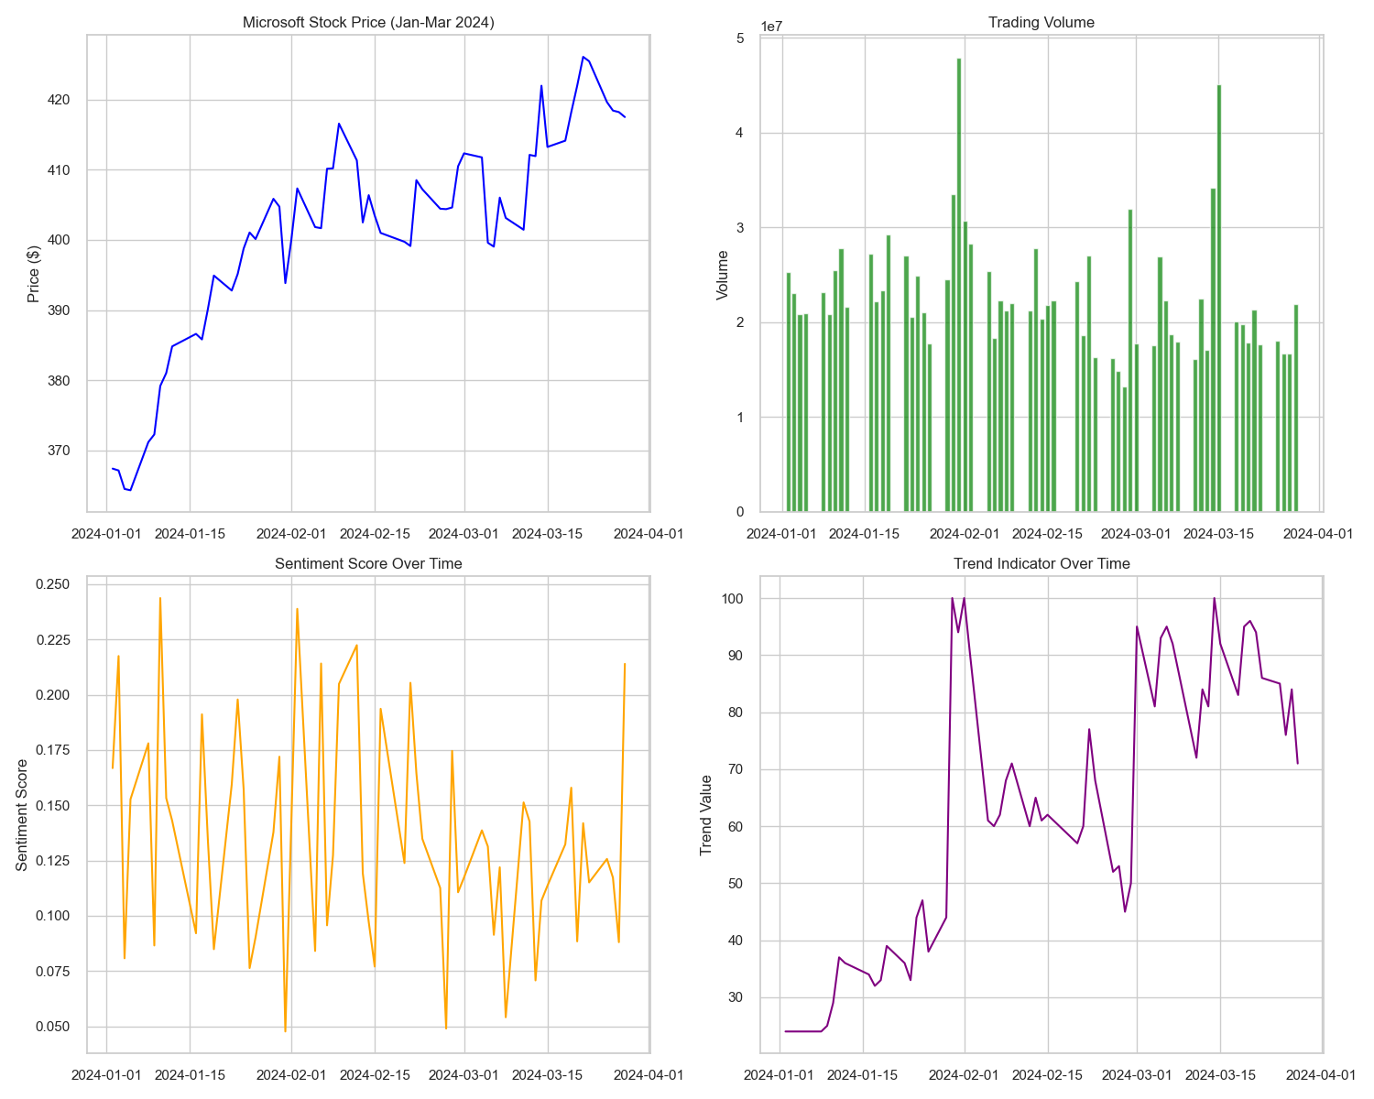
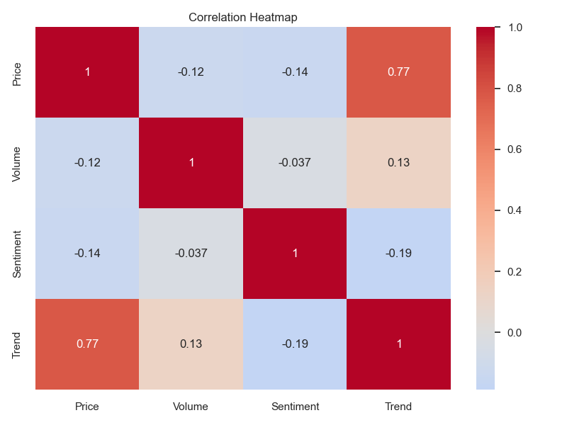
Period:
Data was collected from
January 1, 2024, to March 31, 2024, including historical stock prices, news headlines, and Google Trends data. The choice of this period was motivated by the availability of comprehensive data across all sources.
Sources:
Historical stock prices: Obtained using the Yahoo Finance API, which provides reliable and extensive financial data.
News headlines: Collected using the FinnHub API, which aggregates news from various financial sources.
Google Trends data: Collected using the pytrends library, providing access to search volume data for specific keywords.

Slide 9
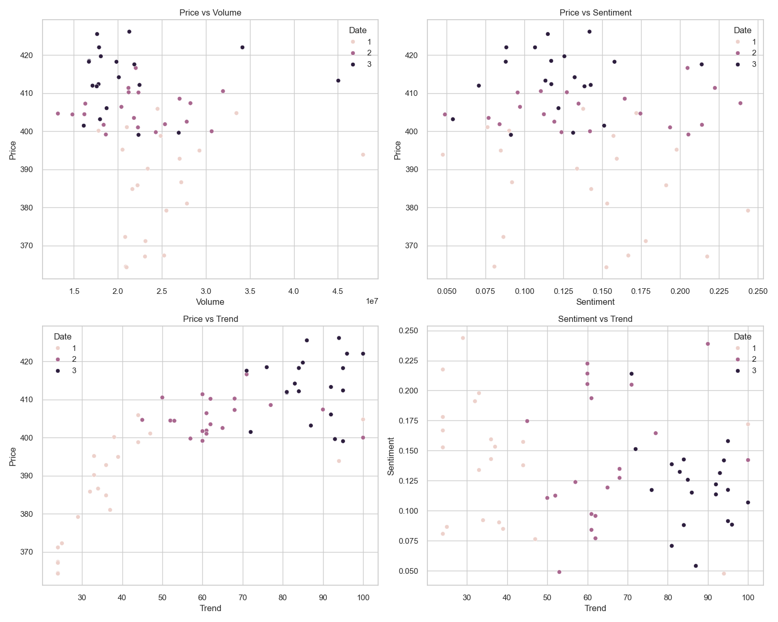
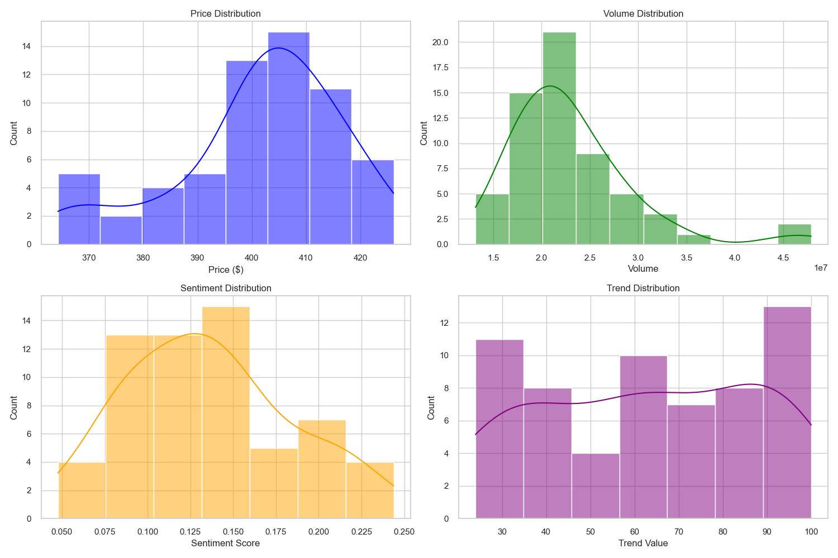
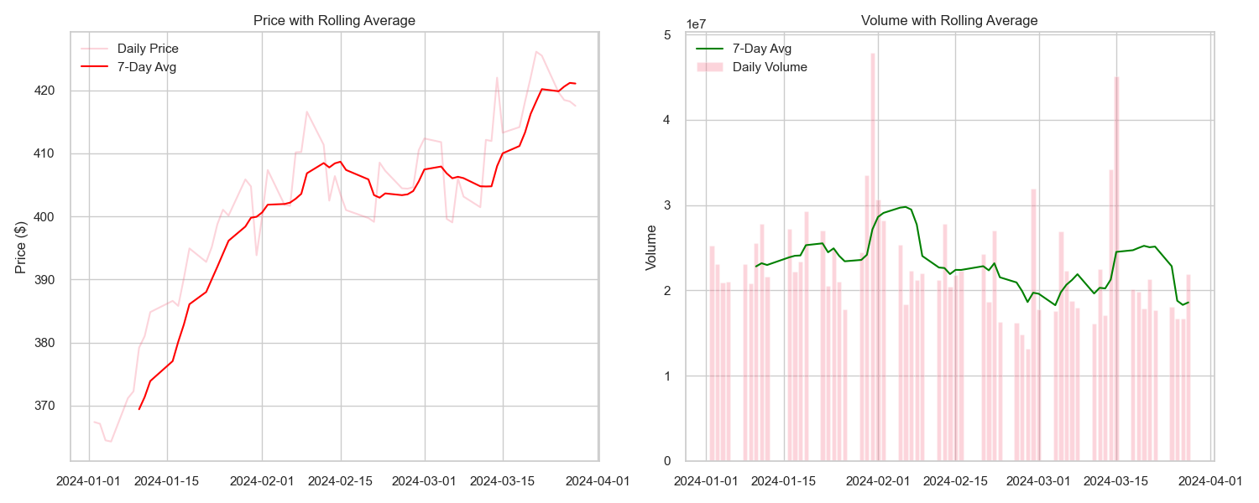

Slide 10
04
Data Preprocessing

Slide 11
Cleaning
Sentiment Analysis
This step involved handling missing values, outliers, and irrelevant data. Missing values in closing prices or trading volumes were addressed by removing the affected records.
Sentiment analysis on the collected news headlines was performed using the VADER sentiment analysis tool. Compound sentiment scores were calculated for each headline and then averaged daily to produce a daily sentiment score for the target stock.
Normalization
Integration
The MinMaxScaler from the sklearn.preprocessing module was used to normalize the financial data, scaling each feature to a specified range of [0, 1]. This process ensures that all features contribute equally to the model’s learning process.
Cleaned and normalized data from all sources were merged into a single dataset. The financial data, sentiment scores, and Google Trends data were aligned based on their timestamps, ensuring that the model received a comprehensive set of features for each day in the dataset.

Slide 12
06
System Design

Slide 13
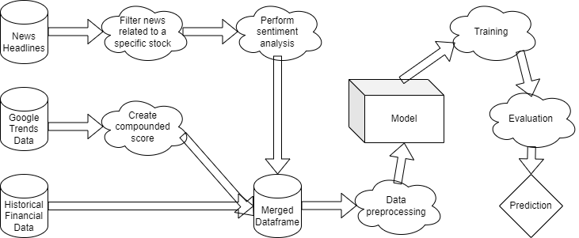
Components
This module trains the predictive models using the preprocessed data. It includes mechanisms for hyperparameter tuning and model validation to ensure optimal performance.
Model Training Module
These modules are responsible for fetching historical stock prices, news headlines, and Google Trends data. The data is collected using APIs from Yahoo Finance, FinnHub, and pytrends.
Data Collection Modules
This module assesses the model’s performance using metrics such as Mean Absolute Error (MAE), Root Mean Squared Error (RMSE), Symmetric Mean Absolute Percentage Error (sMAPE), the Coefficient of Determination (R²) and the Directional Accuracy (DA).
Evaluation Module
This module handles cleaning, normalization, and feature extraction from the collected data. It ensures that the data is in a suitable format for input into the predictive models.
Data Preprocessing Module
The predictive models are a Long Short-Term Memory (LSTM) neural network, Phi-4, Llama-4 Maverick, Gemini 2.5 and Deepseek R1.
Prediction Model

Slide 14
07
Model Architecture

Slide 15
LSTM Model:
Input Layer
Accepts sequences of stock-related features, including the closing price, trading volume, sentiment scores derived from news headlines, and Google Trends data.
Dense Layer
The final layer is a dense layer with a single unit, which outputs the predicted closing price.
Compilation
The model is compiled using the Adam optimizer and MSE as the loss function.
LSTM Layers
The core of the model consists of four LSTM layers, each containing 50 units, with dropout layers added after each LSTM layer to prevent overfitting.
Training
The model is trained on historical stock data using 80% of the dataset for training and 20% for testing.
LLM Models:
Microsoft: Phi 4 – 14B parameters
DeepSeek: R1 0528 – 671B parameters
Meta: Llama 4 Maverick – 400B parameters
Google: Gemini 2.5 Flash Preview 05-20 – 128B parameters
Prompts:
Used two separate prompts, one very simple and one more detailed.

Slide 16
08
Fine-Tuning and Hyperparameter Tuning

Slide 17
Hyperparameters Considered
Number of LSTM Units: Tested values of 25, 50, and 100 to determine the optimal number of units.
Dropout Rate: Experimented with rates of 0.1, 0.2, and 0.3 to prevent overfitting.
Batch Size:
Evaluated sizes of 16, 32, and 64 to balance training speed and model convergence.
Number of Epochs: Trained for 10, 20, and 50 epochs to find the optimal stopping point.
Techniques Used
Model Checkpointing:
The ModelCheckpoint callback saves the model with the lowest validation loss during training.
K-Fold Cross-Validation: 5-fold cross-validation was employed within the training set to ensure robust evaluation. The purpose of splitting the data then k-fold cross-validation was to simulate a 60-20-20 split.
Early Stopping:
The EarlyStopping callback was used to halt training if the validation loss did not improve for 10 consecutive epochs.

Slide 18
09
Comparison of Models

Slide 19
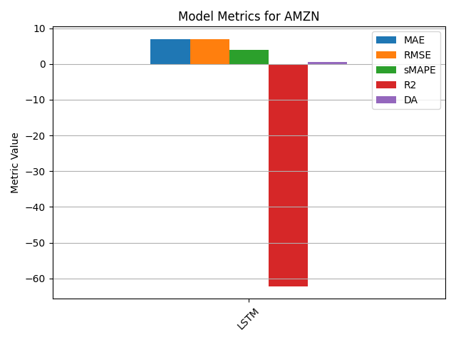
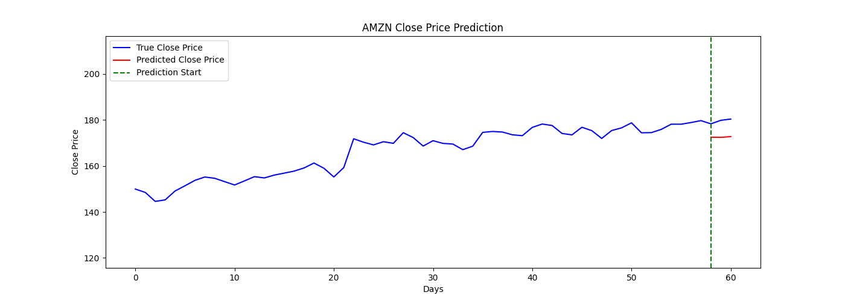
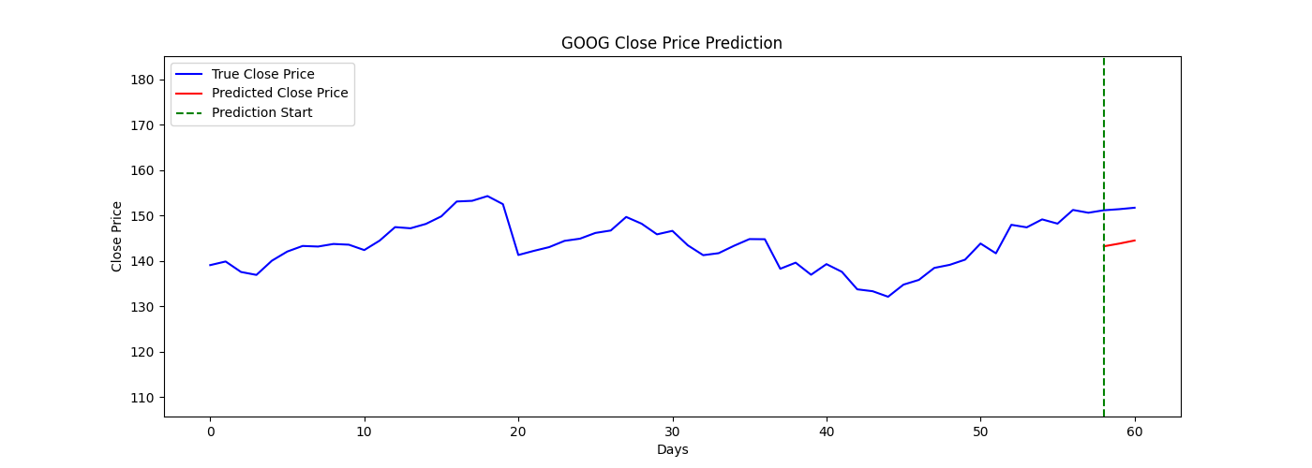
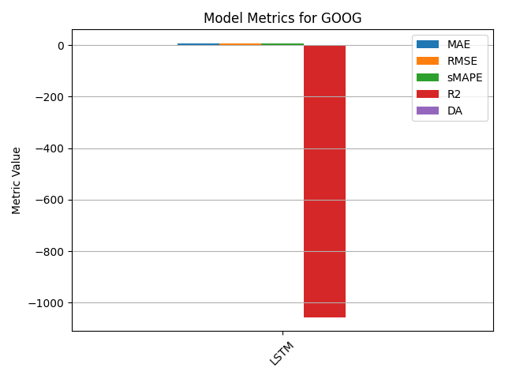
LSTM:

Slide 20
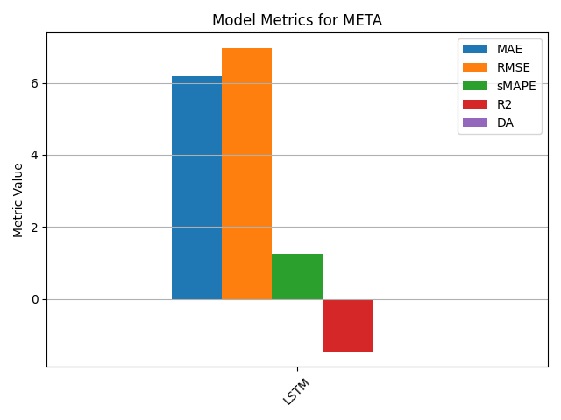
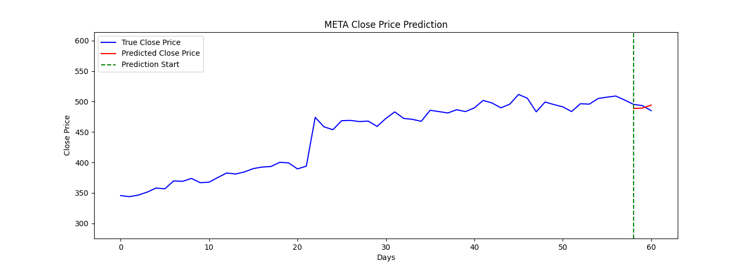
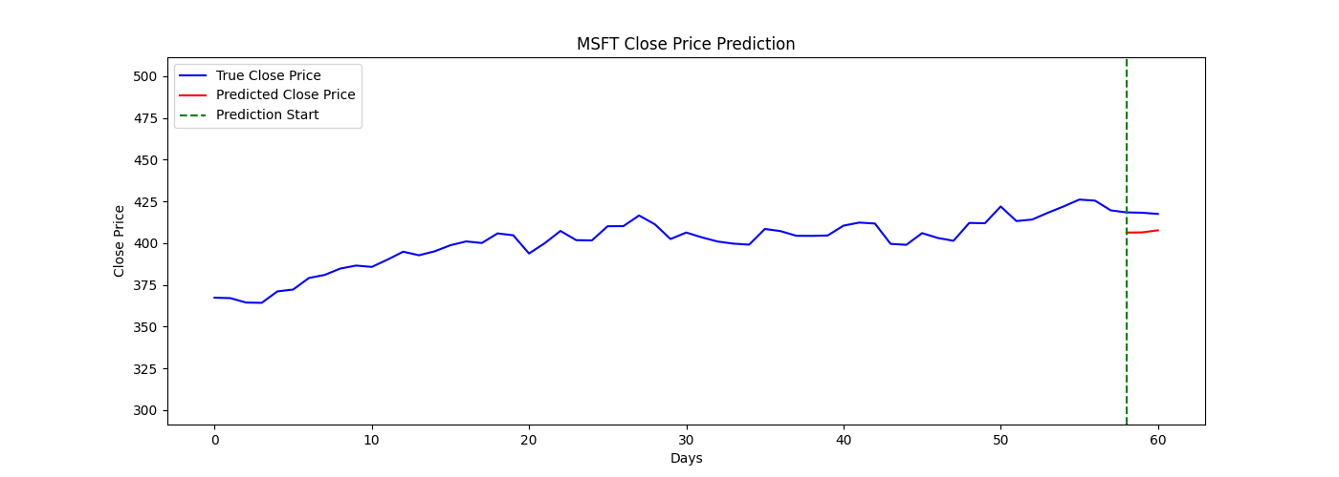
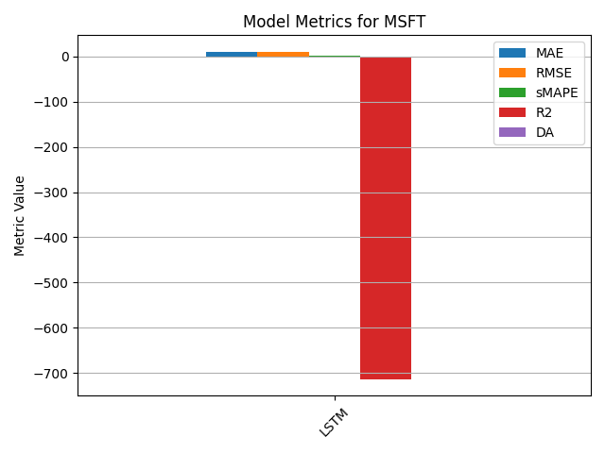

Slide 21
LLMs basic prompt:
You are given a dataset containing the last 10 days of information about a company stock. The dataset contains the Date, Price, Volume, News Healines and Trend, all from a given day. Predict the price of the next 3 days. Only output the price.
Phi-4, the smallest model, did not listen to the formatting instruction, it responded with an entire analysis.

Slide 22
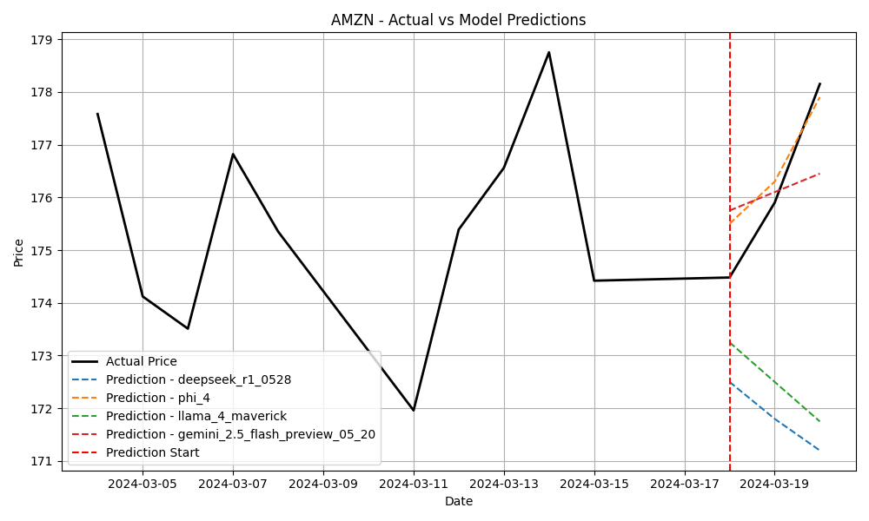
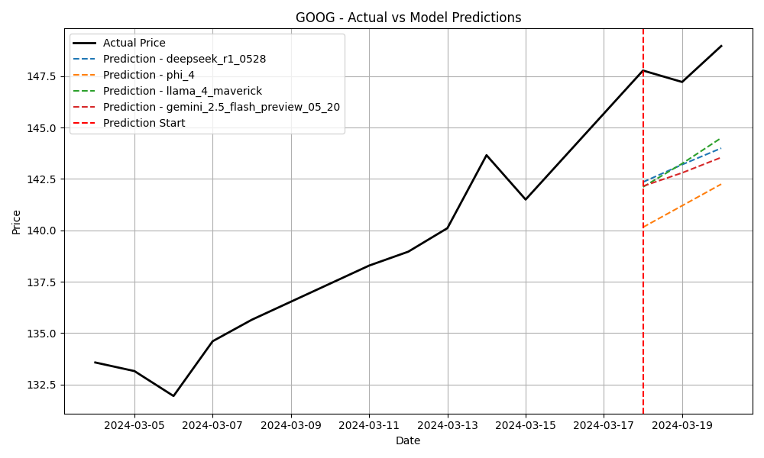
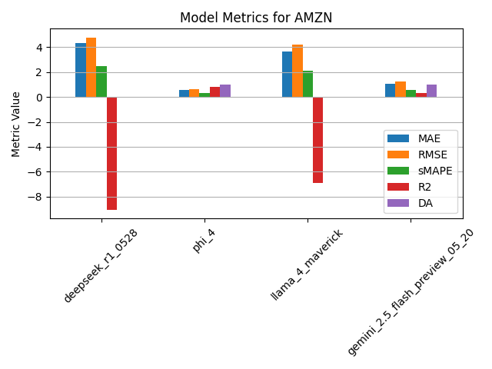
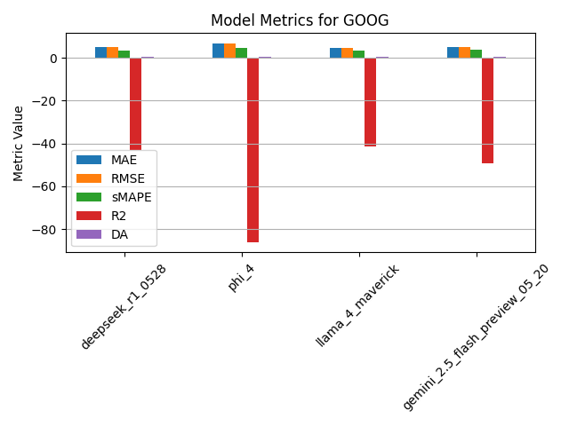

Slide 23
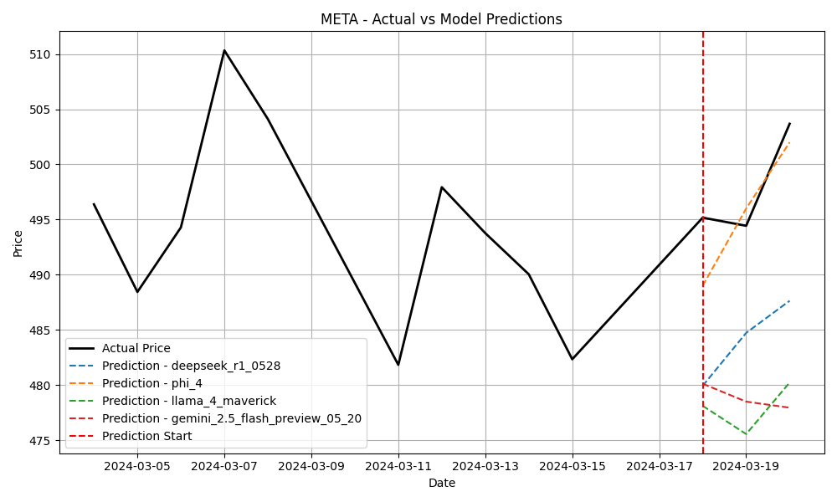
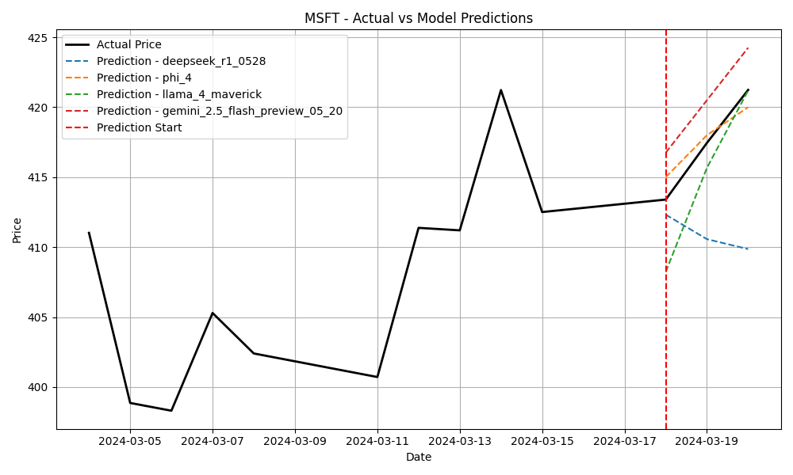
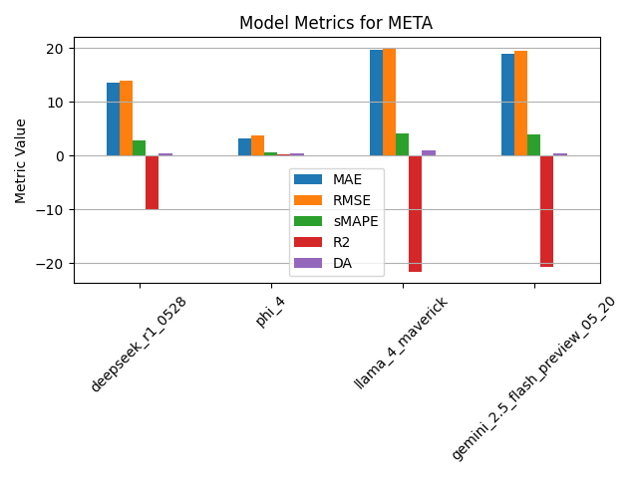
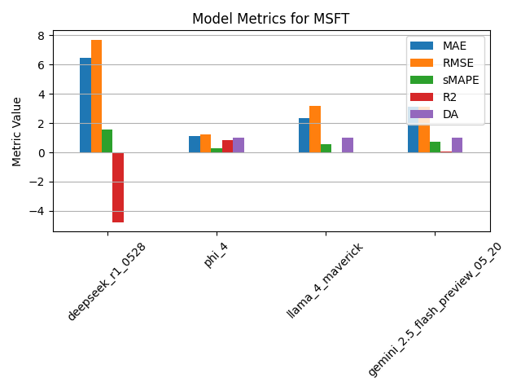

Slide 24
LLMs complex prompt:
<role>
You are an expert financial analyst with 15+ years of experience in quantitative analysis, technical analysis, and market sentiment evaluation.
</role>
<task>
Your task is to predict stock prices for the next 3 trading days based on comprehensive historical data analysis.
</task>
<context>
You will receive 10 days of historical stock data with the following structure:
- Date: Trading date
- Headline: Key news headline for that date
- Price: Stock price in USD
- Volume: Trading volume
- Trend: Google Trends score (0-100)
</context>
<analysis_framework>
1. **Technical Analysis**: Examine price patterns, volume trends, and momentum indicators
2. **Sentiment Analysis**: Evaluate news headlines for market sentiment impact
3. **Trend Analysis**: Assess Google Trends data for public interest correlation
4. **Pattern Recognition**: Identify recurring patterns in the 10-day historical window
</analysis_framework>
<instructions>
- Calculate price momentum and volatility from the historical data
- Identify any correlation between news sentiment and price movements
- Assess volume patterns for institutional vs retail activity indicators
- Evaluate Google Trends correlation with price action
- Consider any emerging patterns or breakout/breakdown signals
- Account for weekend gaps and trading day adjustments
</instructions>
<output_requirements>
You MUST respond with ONLY the 3 predicted prices in USD. NO explanations, NO reasoning, NO additional text whatsoever.
Format your response as exactly 3 numbers with dollar signs, separated by commas:
$XX.XX, $XX.XX, $XX.XX
IMPORTANT: Do not include any other text, analysis, or commentary. Only the 3 prices.
</output_requirements>
<dataset>
{df}
</dataset>

Slide 25
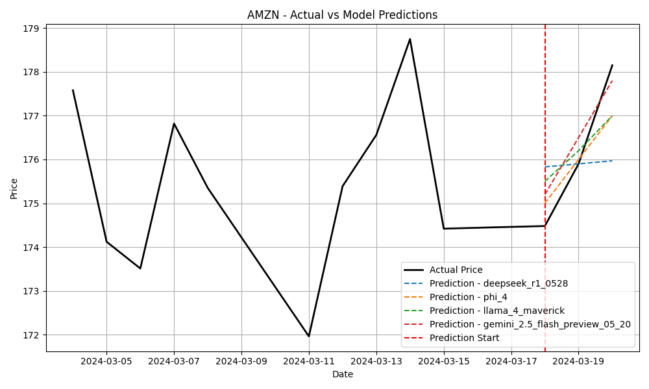
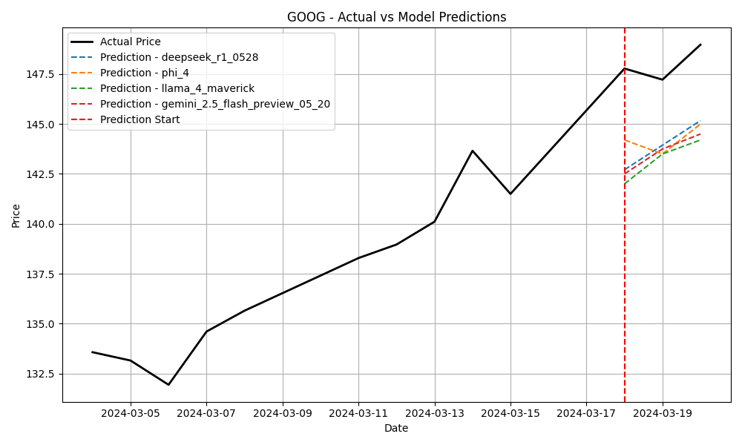
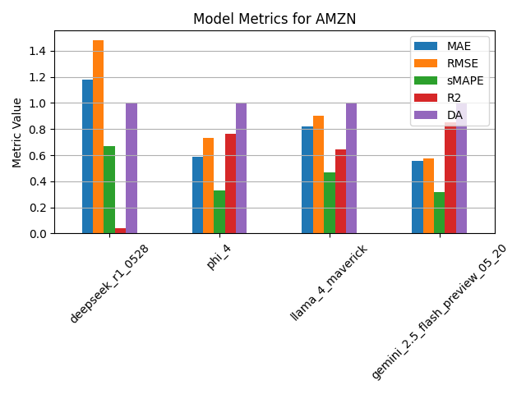
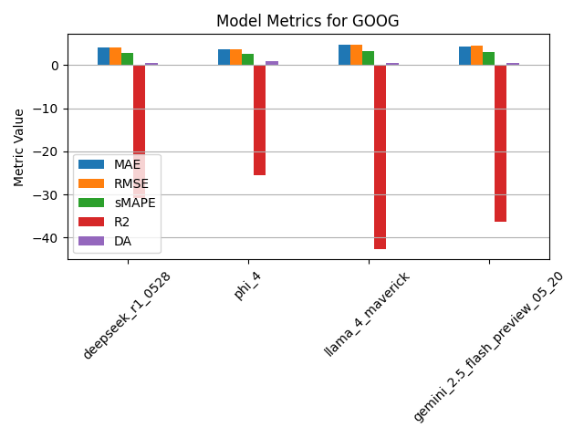

Slide 26
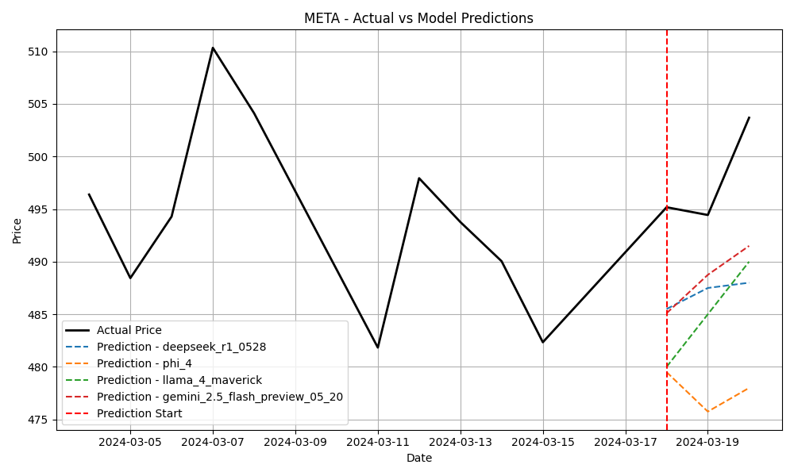
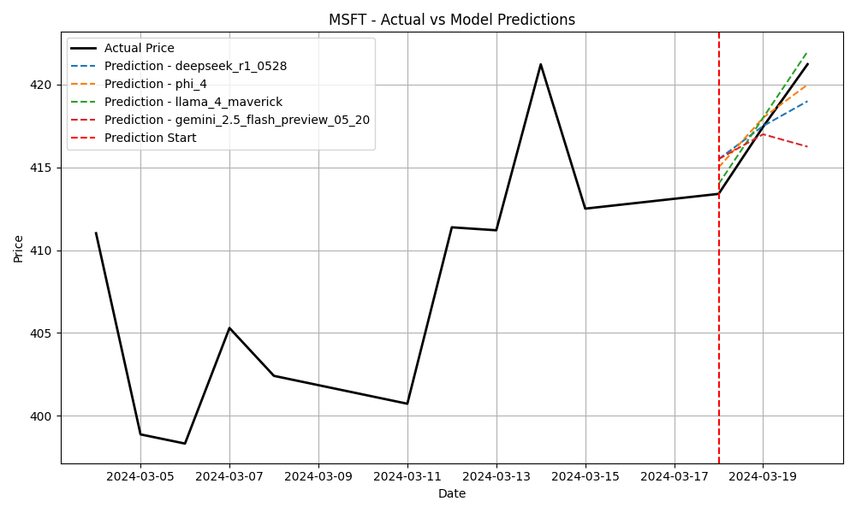
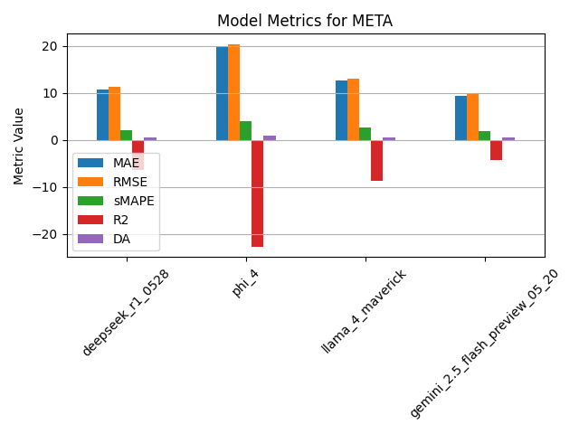
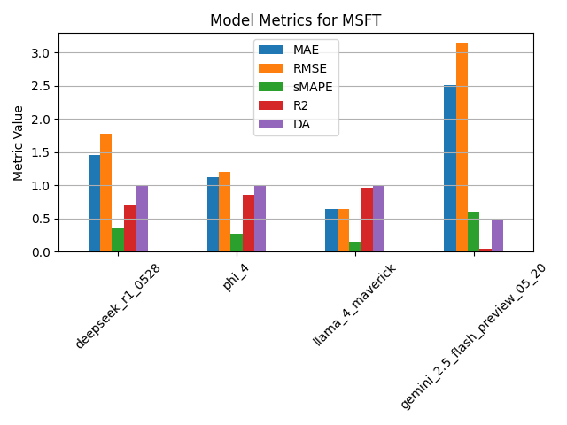

Slide 27
10
Accuracy Metrics and Results

Slide 28
Best Results
Best performing model
Best performing dataset
AMZN
Meta: Llama-4 Maverick
Best:
Model: gemini_2.5_flash_preview_05_20
MAE: 0.5567
RMSE: 0.5776
sMAPE: 0.32%
R2 Score: 0.8539
Directional Accuracy (DA): 1.0000
Best:
Ticker: MSFT
MAE: 0.6385
RMSE: 0.6451
sMAPE: 0.15%
R2 Score: 0.9594
Directional Accuracy (DA): 1.0000
Worst:
Model: deepseek_r1_0528
MAE: 1.1767
RMSE: 1.4804
sMAPE: 0.67%
R2 Score: 0.0401
Directional Accuracy (DA): 1.0000
Worst:
Ticker: GOOG
MAE: 4.7590
RMSE: 4.8326
sMAPE: 3.27%
R2 Score: -42.7385
Directional Accuracy (DA): 0.5000

Slide 29
12
Conclusion

Slide 30
Summary of Findings
The LLMs given with a complex prompt provided the best results, even though they were given less data than the LSTM due to input context restraints
The integration of sentiment analysis and Google Trends data proved valuable in enhancing prediction accuracy, especially when given to LLMs that are trained to process human speech.
The LLMs showed no bias towards their parent company and had better results with the more complex prompt.
Future Work
Incorporate Additional Data Sources
Develop Real-Time Prediction Systems
Integrate more diverse data sources, such as social media sentiment, economic indicators, and geopolitical events, to further improve the model’s accuracy.
Implement real-time prediction systems that continuously update predictions based on incoming data.

Slide 31

Thank you for your patience and attention!
I am happy to answer any questions you have!
/razvan-andrei-moga

