Slide 1
What is the price of
internet-scale database?

Slide 2
Owls Transactions
are not what they seem.

Slide 3
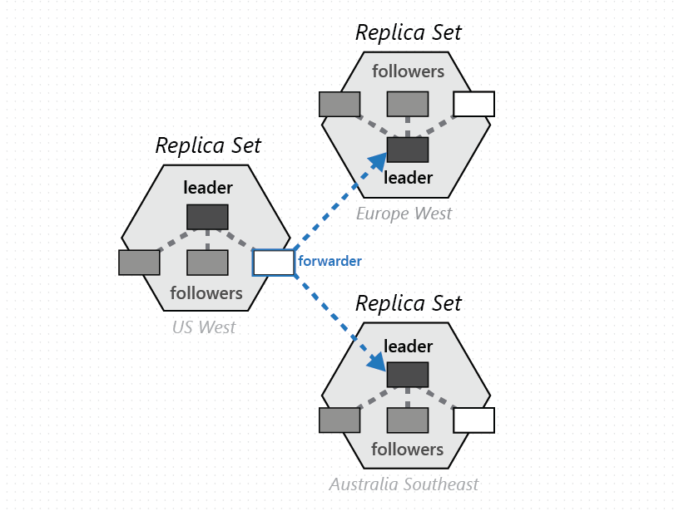
https://docs.microsoft.com/en-us/azure/cosmos-db/global-dist-under-the-hood

Slide 4
Single-partition, non-interactive
transactions

Slide 5
Configurable consisteny model
with optimistic concurrency control

Slide 6
Document level Time-To-Live

Slide 7
Data model denormalization

Slide 8
Single Partition Transactions
No Interactive Transactions – “no locking”
TTL on documents
Different consistency models
Optimistic concurrency on a single entity
Access-based data modelling

