Slide 1
How the automanual tests work?

Slide 2
Can we generate and run
all tests possible?

Slide 3
Model is a SIMPLIFICATION
made for particular PURPOSE

Slide 4
Modeling is deciding on
what to keep and what to remove

Slide 5
Temporal logic of actions aka. TLA+
Sa
Formal system to express models
Built to model distributed and concurrent systems
Concurrency (atomicity)
Partial failures
Enables checking for safety and liveness
Safety aka. nothing bad happens
Liveness aka. something good eventually happens
Can be transpiled from PlusCal (C or Pascal like language)
A1
A3
A2
Sd
Sb
Sc

Slide 6
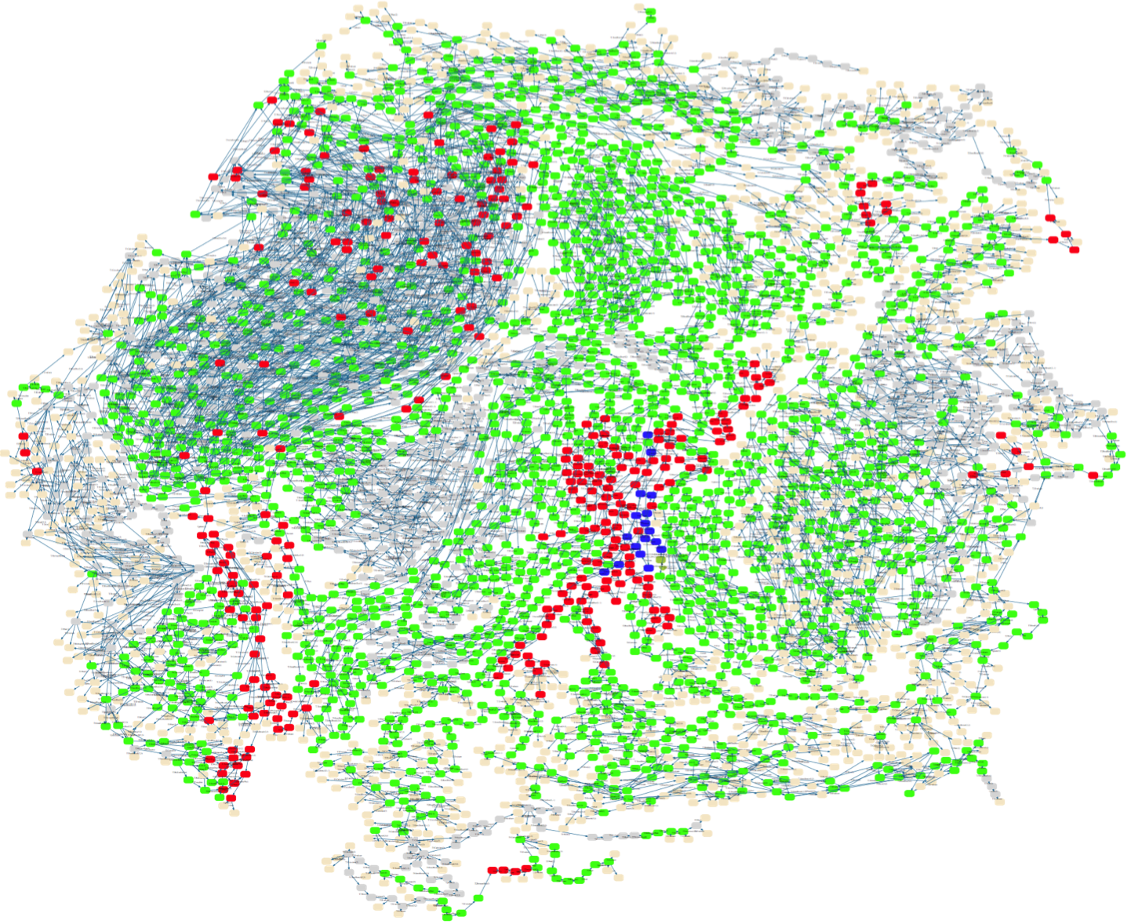

Slide 7
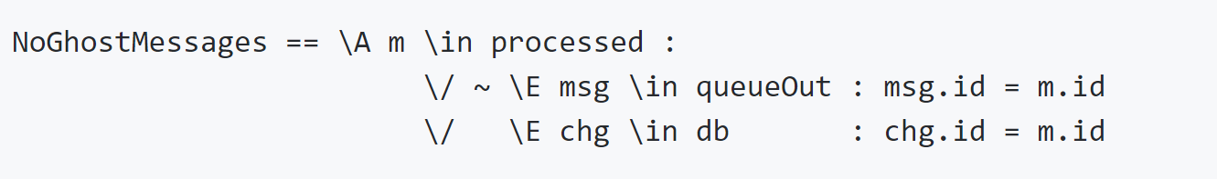
Invariants = always hold

Slide 8
Take a model,
generate all behaviors,
check invariants.

