Slide 1
Replacing DRuntime Hooks with Templates
3rd August 2022
Teodor-Ştefan Duțu
teodor.dutu@gmail.com
Răzvan Nițu
Edi Stăniloiu

Slide 2
Why?
My dissertation project: Pay-as-you-go Libraries for Embedded Systems
DRuntime is huge for embedded systems: ~16MB
Gut feeling: using template hooks will reduce size
Functions with which the compiler replaces some high-level expressions
Research: Do templates reduce DRuntime size?
Compiler
Executable file
D code
IR Generator
Linking
_d_arrayctor:
…
_d_arrayappendT:
…
_Dmain:
…
call _d_arrayctor
…
S[3] a = b
_d_arratyctor(a, b)
_d_arrayctor:
…
_d_arrayappendT:
…
libdruntime.a
Notes:
betterC pus pe slide 4, dupa slide 3 ca un “de ce nu -betterC”

Slide 3
betterC?
Too restrictive
No GC
No classes
No dynamic arrays
No associative arrays
Notes:
betterC pus pe slide 4, dupa slide 3 ca un “de ce nu -betterC”

Slide 4
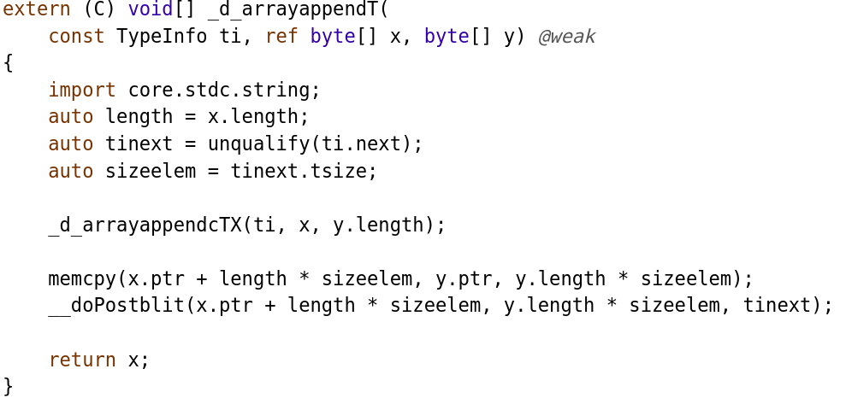
Current Approach - Disadvantages

Slide 5
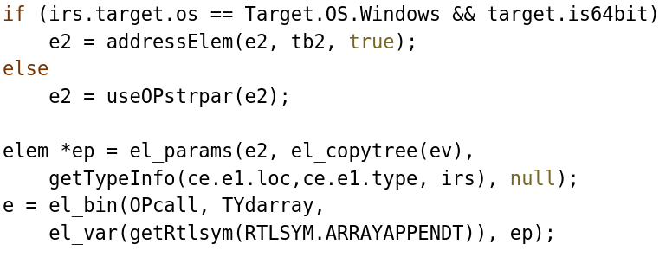
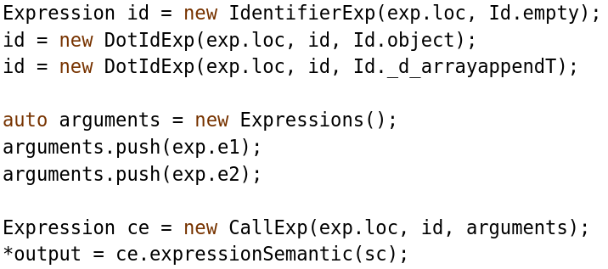
Current Approach - Disadvantages
Back-end Lowering
Front-end Lowering

Slide 6
Goals
Applications only embed the hooks that they use
Each hook becomes a template instance
Type check the arguments
Do not use TypeInfo
Leverage type information at compile-time
Increase performance
Improve maintainability
Move lowering logic from IR phase to semantic phase
Limit the Increase of Compilation Times

Slide 7
Fallen Comrades
Lucia Cojocaru - UPB 2017:
__cmp: b[] < a[] lowered to __cmp(b[], a[])
__equals: arr1 == arr2 lowered to __equals(arr1[], arr2[])
__switch: switch (cond) { “a”: … “b”: … } lowered to
__switch (cond) {0: … 1: …}
Dan Printzell - GSOC 2019:
_d_arraysetlengthT: arr.length = n lowered to _d_arraysetlengthT(arr, n)
Unfinished: _d_array{,set}ctor, _d_arrayappend{cTX,T}, _d_arraycatnTX
Difficulties:
Depends on compiler internals
Lowering should be transparent. Call a function as if it isn’t called.

Slide 8
Hooks - Proposed Approach
Compiler
Executable file
D code
Semantic Analysis
_d_arrayctor:
…
_Dmain:
…
call _d_arrayctor
…
Linking
S[3] a = b
_d_arratyctor(a, b)
Tarr _d_arrayctor(Tarr : T[], T)(...) {...}
Tarr _d_arrayappendT(Tarr : T[], T)(...) {...}

Slide 9
War Stories
38 Hooks in Total
Earlier: 4 Template Hooks
Us: 9 Template Hooks
_d_allocclass
_d_delstruct
_d_arrayappendcTX
_d_dynamic_cast
_d_arrayappendT
_d_interface_cast
_d_arrayassign
_d_isbaseof
_d_arrayassign_l
_d_isbaseof2
_d_arrayassign_r
_d_newarrayiT
_d_arraycatnTX
_d_newarraymiTX
_d_arraycatT
_d_newarraymTX
_d_arrayliteralTX
_d_newarrayOpT
_d_arraysetassign
_d_newarrayT
_d_arraysetcapacity
_d_newarrayU
_d_arraysetctor
_d_newclass
_d_arraysetlengthiT
_d_newitemiT
_d_arraysetlengthT
_d_newitemT
_d_arrayshrinkfit
_d_newitemU
_d_assocarrayliteralTX
_d_newThrowable
_d_delarray_t
__cmp
__equals
__switch
__arraysetlengthT
_d_arrayctor
_d_arraysetctor
_d_arrayassign
_d_arrayassign_l
_d_arrayassign_r
_d_delstruct
_d_newThrowable
_d_arrayappendT
_d_arrayappendcTX

Slide 10
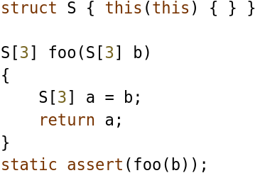
What to Interpret?
High-level expression:
S[3] a = b
Semantic Analysis:
_d_arrayctor(a, b)
CTFE:
S[3] a = b
IR Generator:
_d_arrayctor(a, b)

Slide 11
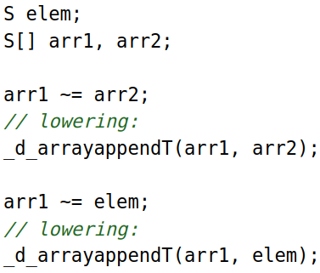
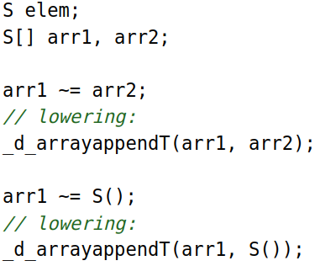
CommaExp, CommaExp, CommaExp

Slide 12
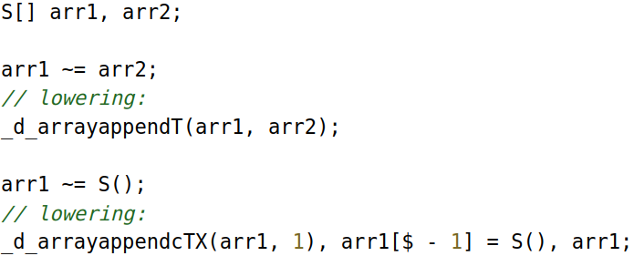
CommaExp, CommaExp, CommaExp

Slide 13
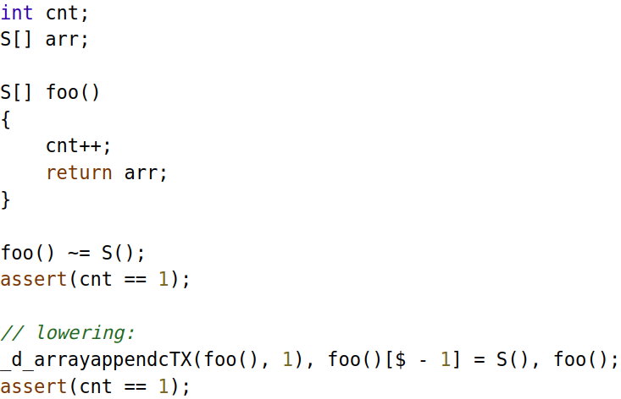
CommaExp, CommaExp, CommaExp

Slide 14
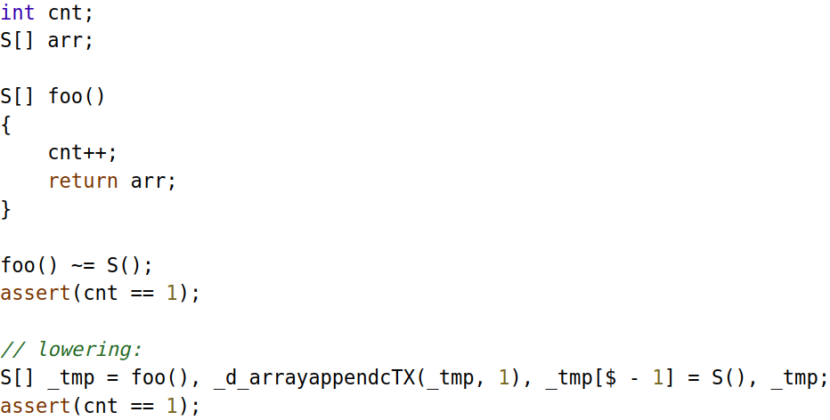
CommaExp, CommaExp, CommaExp

Slide 15
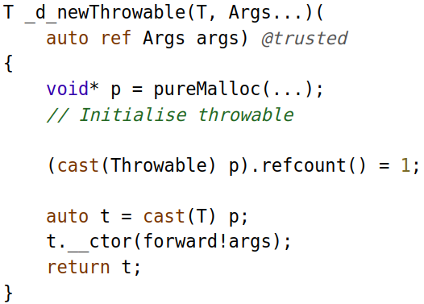
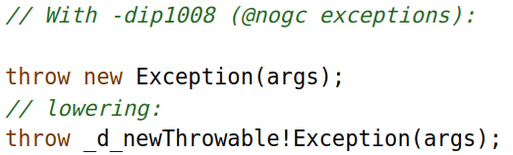
Forward!... to another CommaExp
Notes:
Exceptiile in mod normal sunt gestionate de GC
Dip1008 nu
Storage class attribs: ref, scope

Slide 16
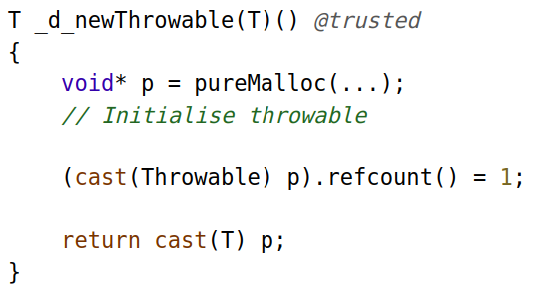
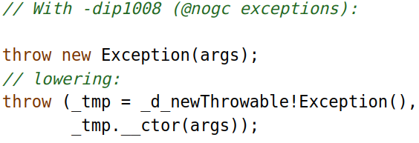
Forward!... to another CommaExp

Slide 17
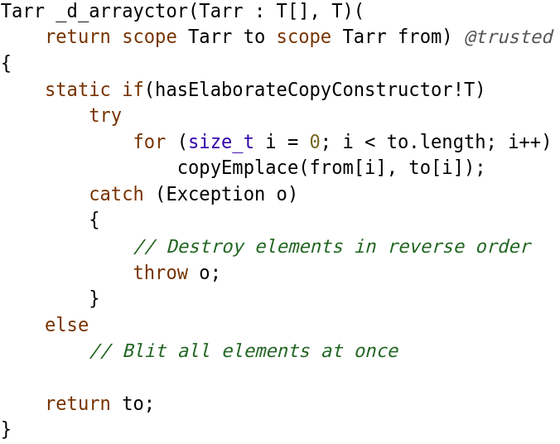
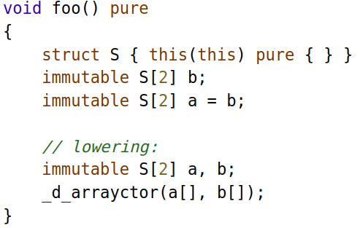
Who’s the Purest of Them All?

Slide 18
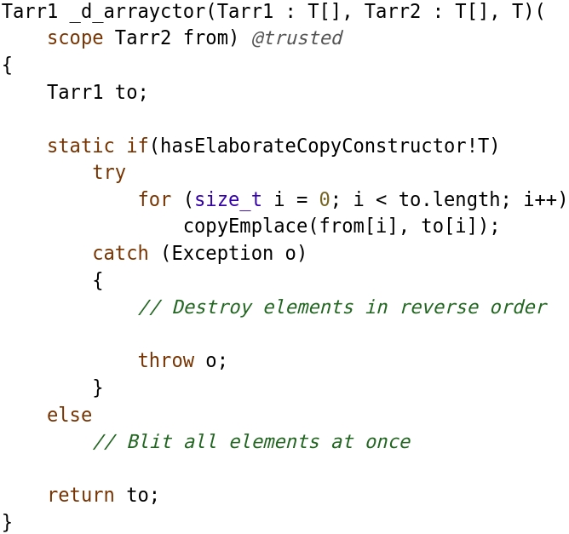
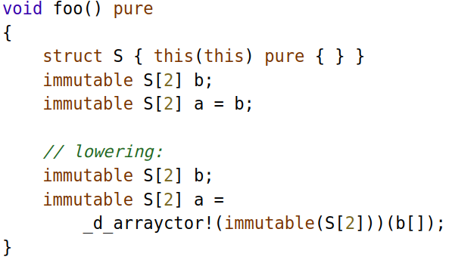
Who’s the Purest of Them All?

Slide 19
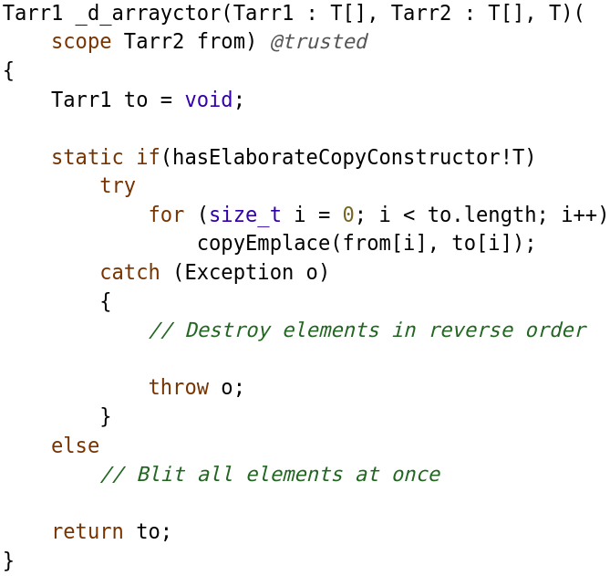
Who’s the Purest of Them All?

Slide 20
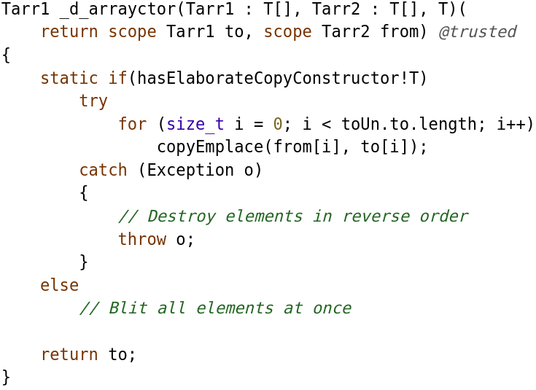
NRVO
Before NRVO
After NRVO

Slide 21
Who’s the Purest of Them All?

Slide 22
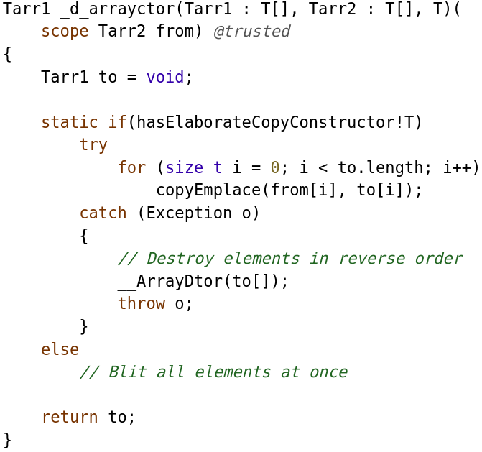
Who’s the Purest of Them All?

Slide 23
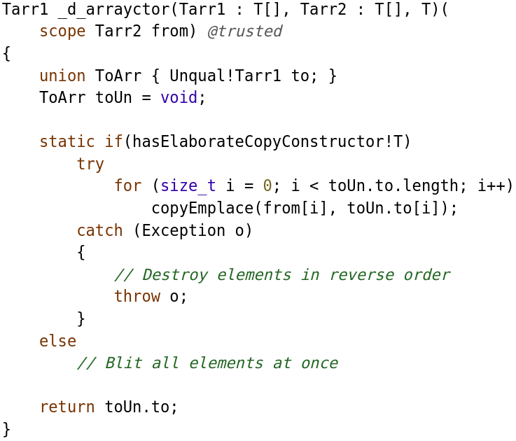
Who’s the Purest of Them All?

Slide 24
Who’s the Purest of Them All?

Slide 25
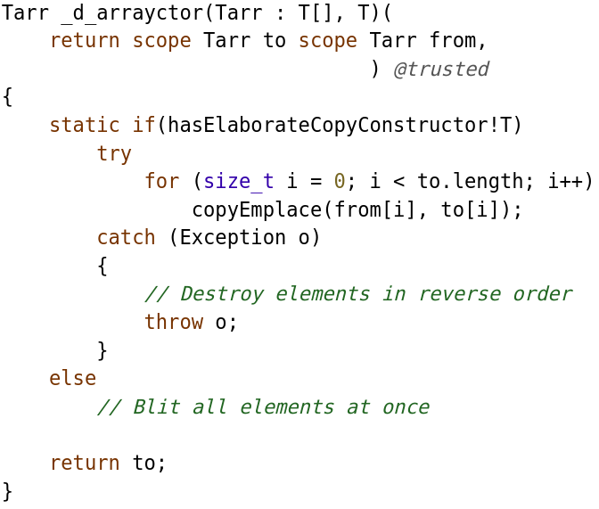
Who’s the Purest of Them All?

Slide 26
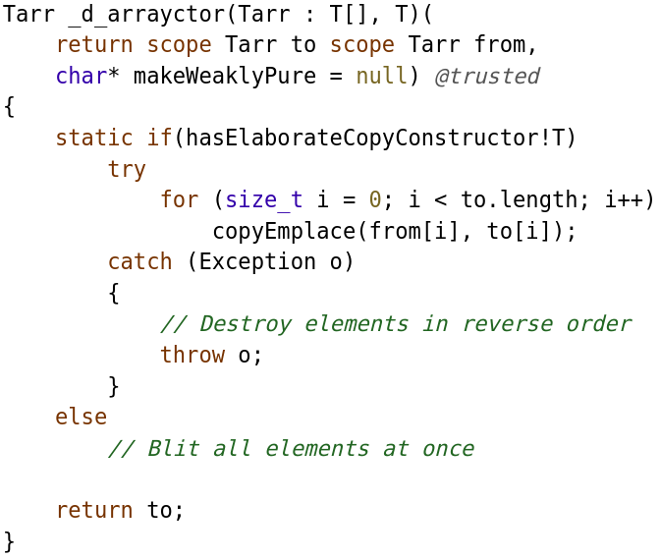
Who’s the Purest of Them All?

Slide 27
Battle of the Pures

Slide 28
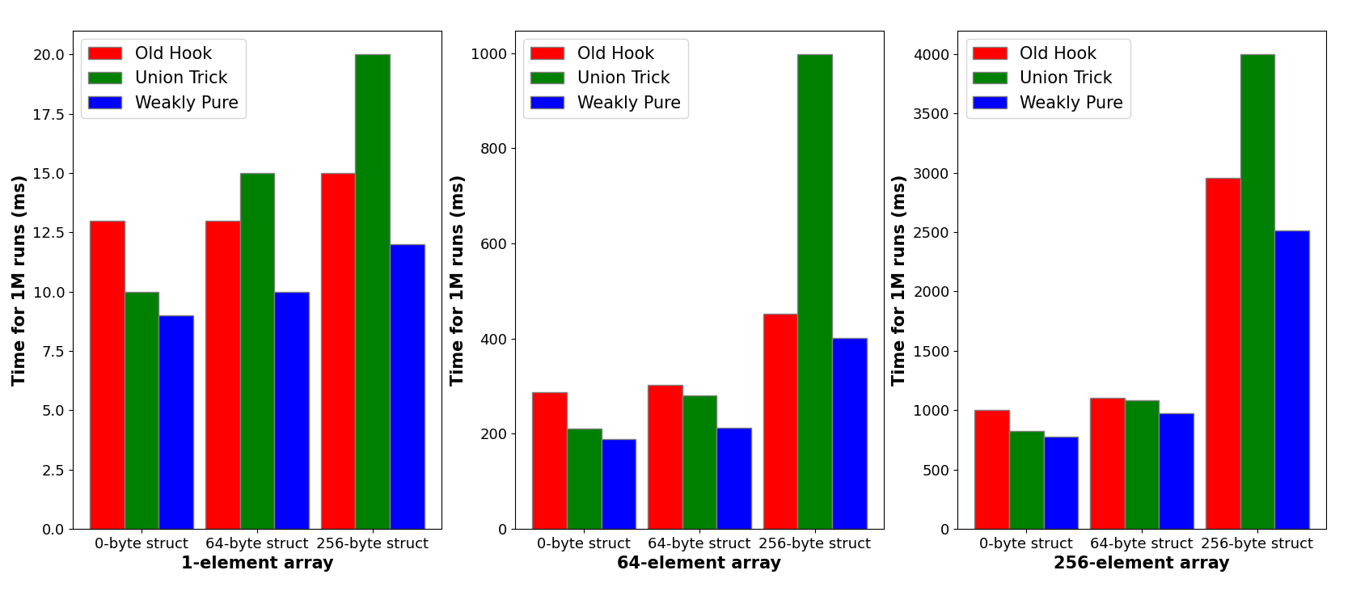
Battle of the Pures - Results

Slide 29
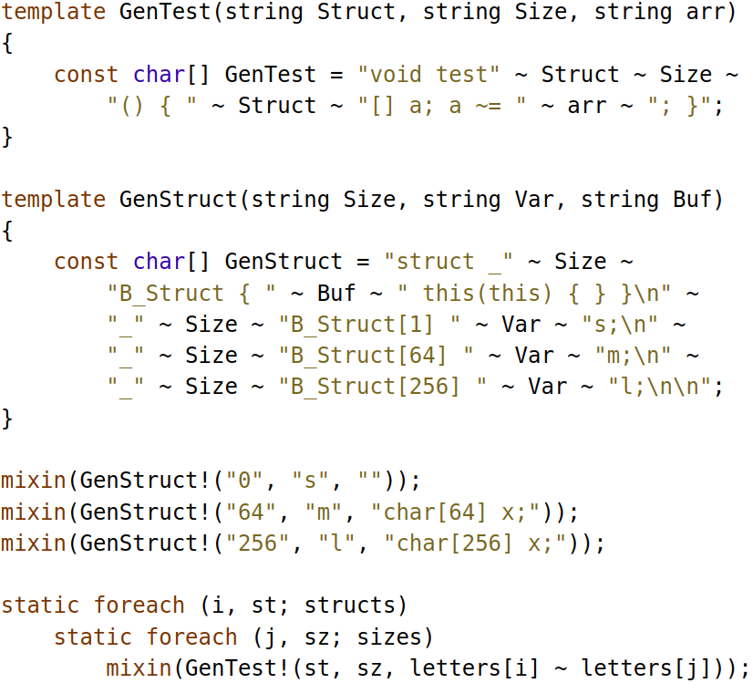
Benchmarks
https://github.com/teodutu/druntime-hooks-benchmarks/blob/master

Slide 30
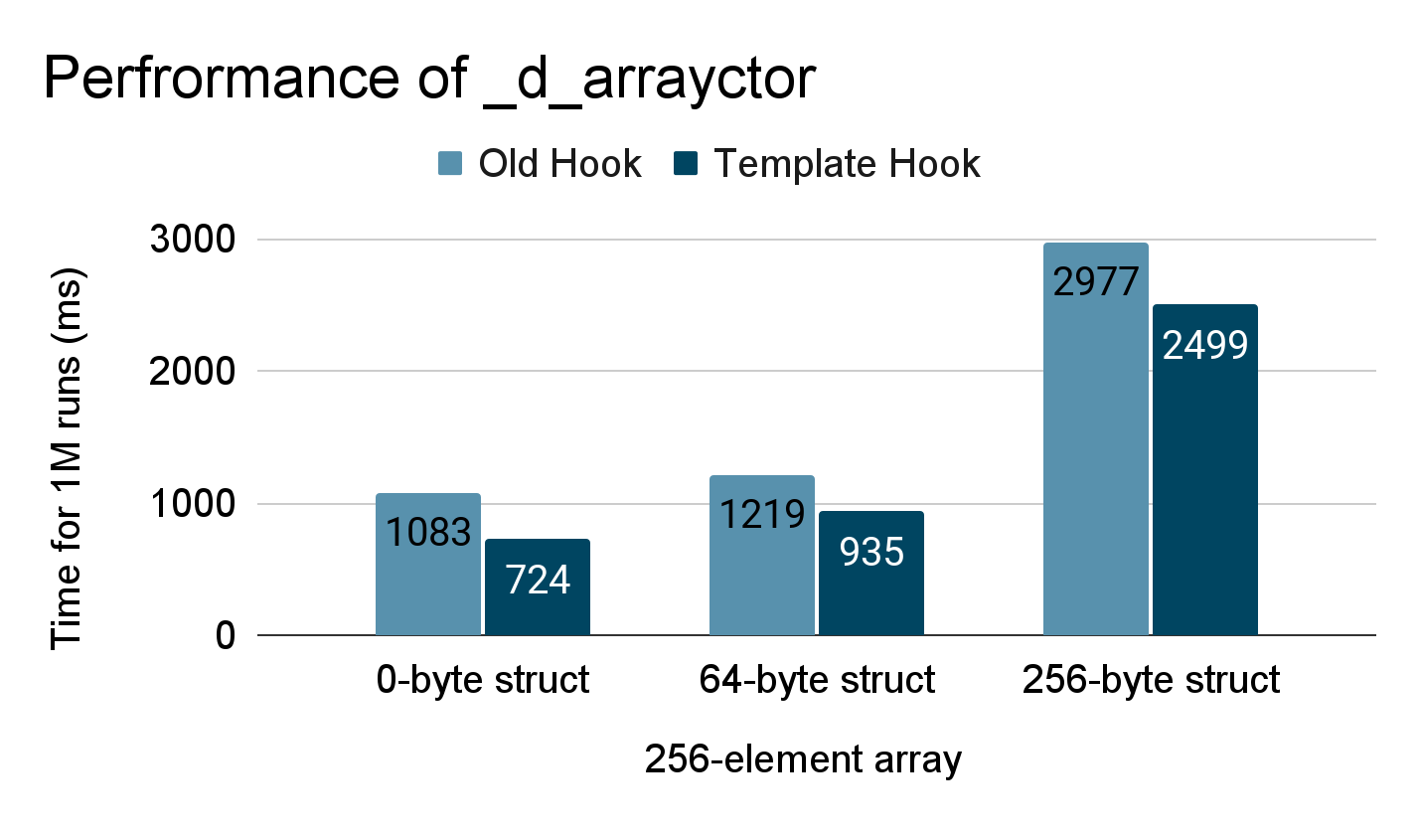
Good Results

Slide 31
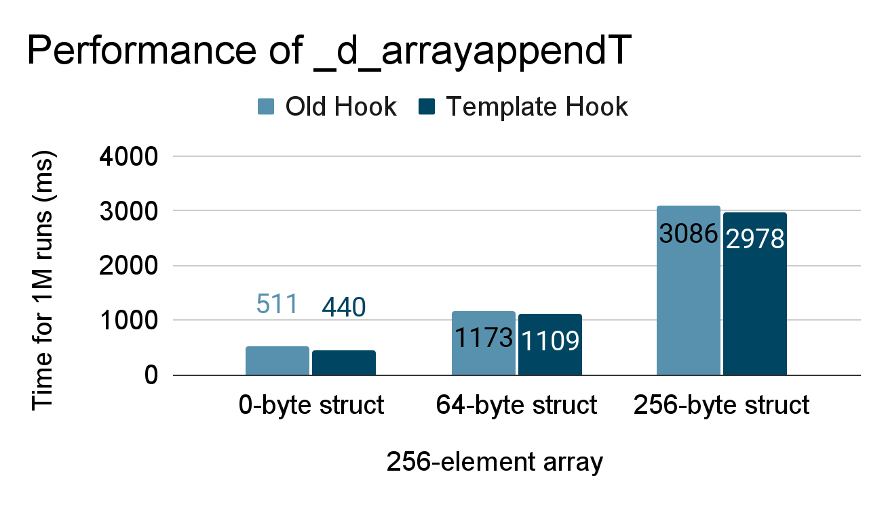
Meh Results

Slide 32
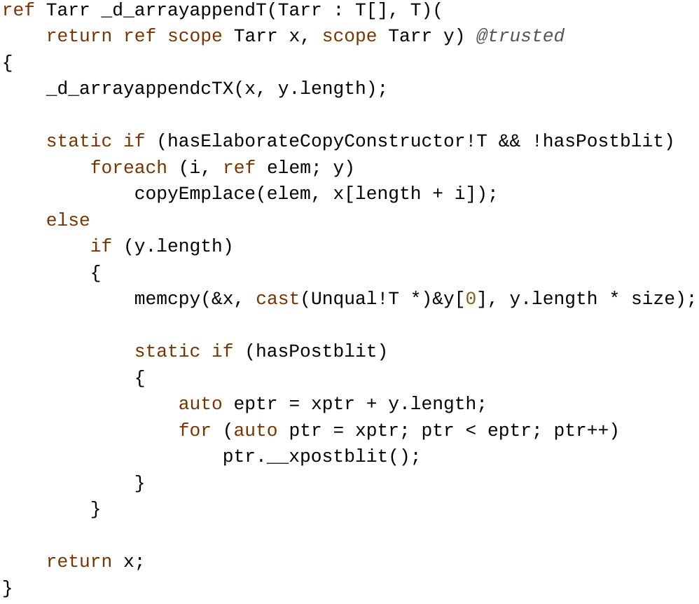
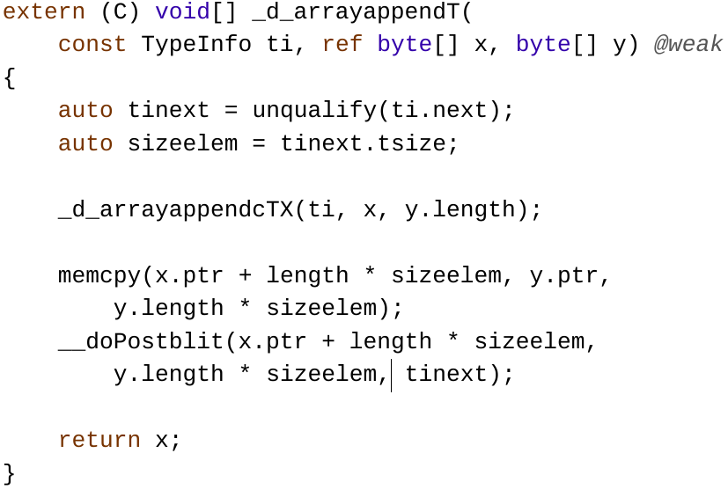
Meh Results

Slide 33
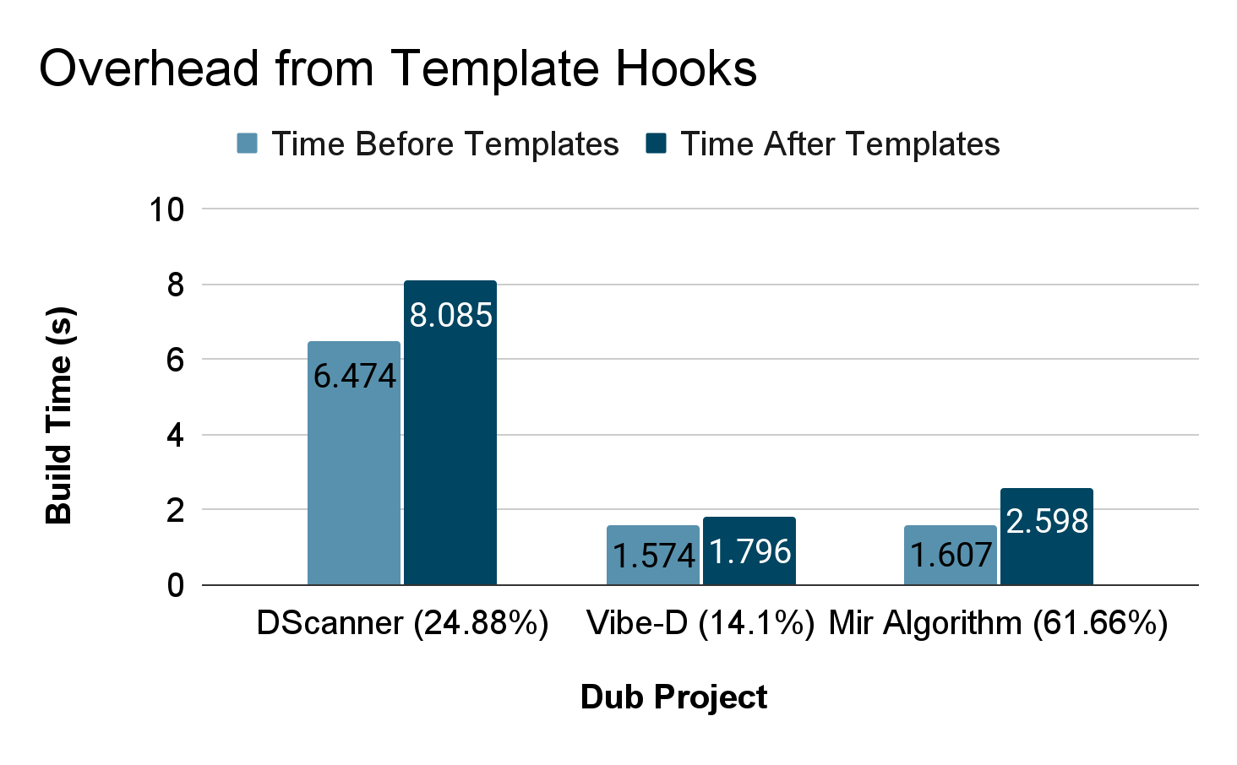
What About Compilation Time?

Slide 34
What about Embedded Systems?
Can a runtime library be pay-as-you-go?
_d_newclass is used for new A();
One _d_newclass instance per object creation?
Find a threshold for number of instances
D embedded applications vs C embedded applications

Slide 35
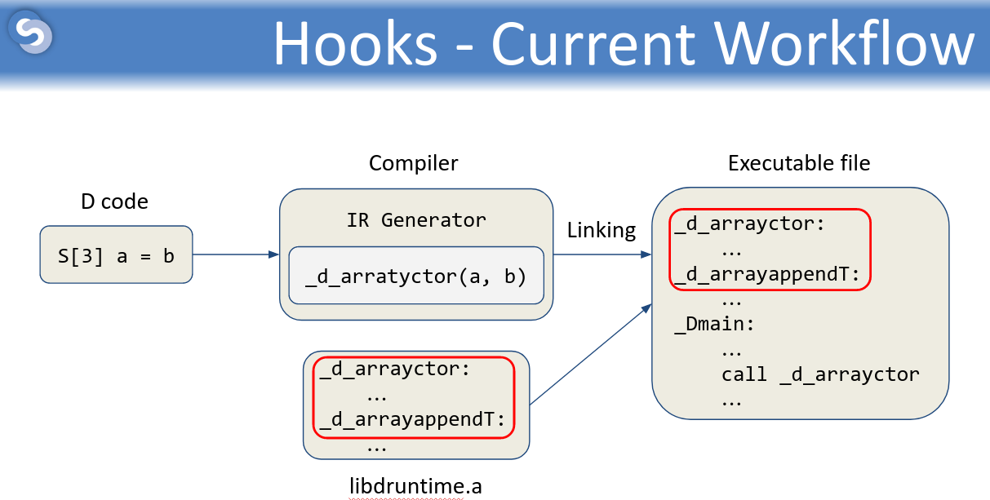
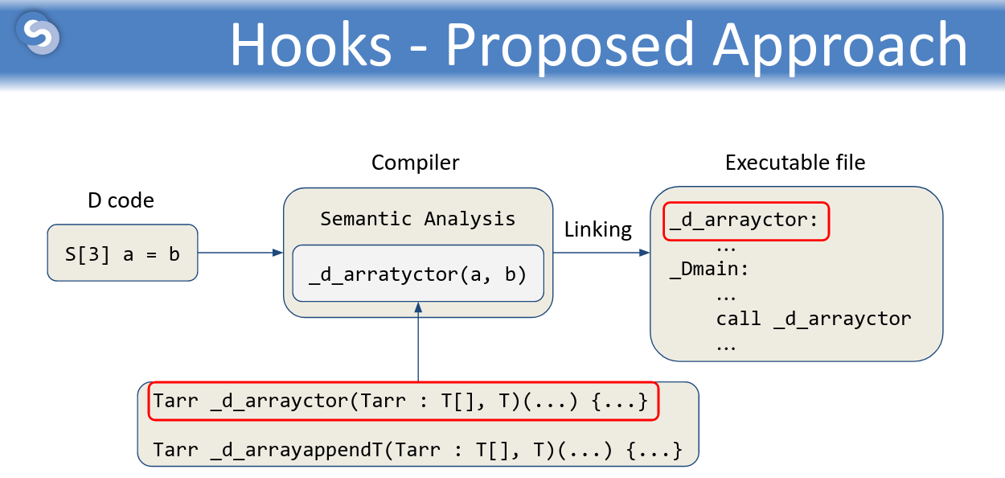
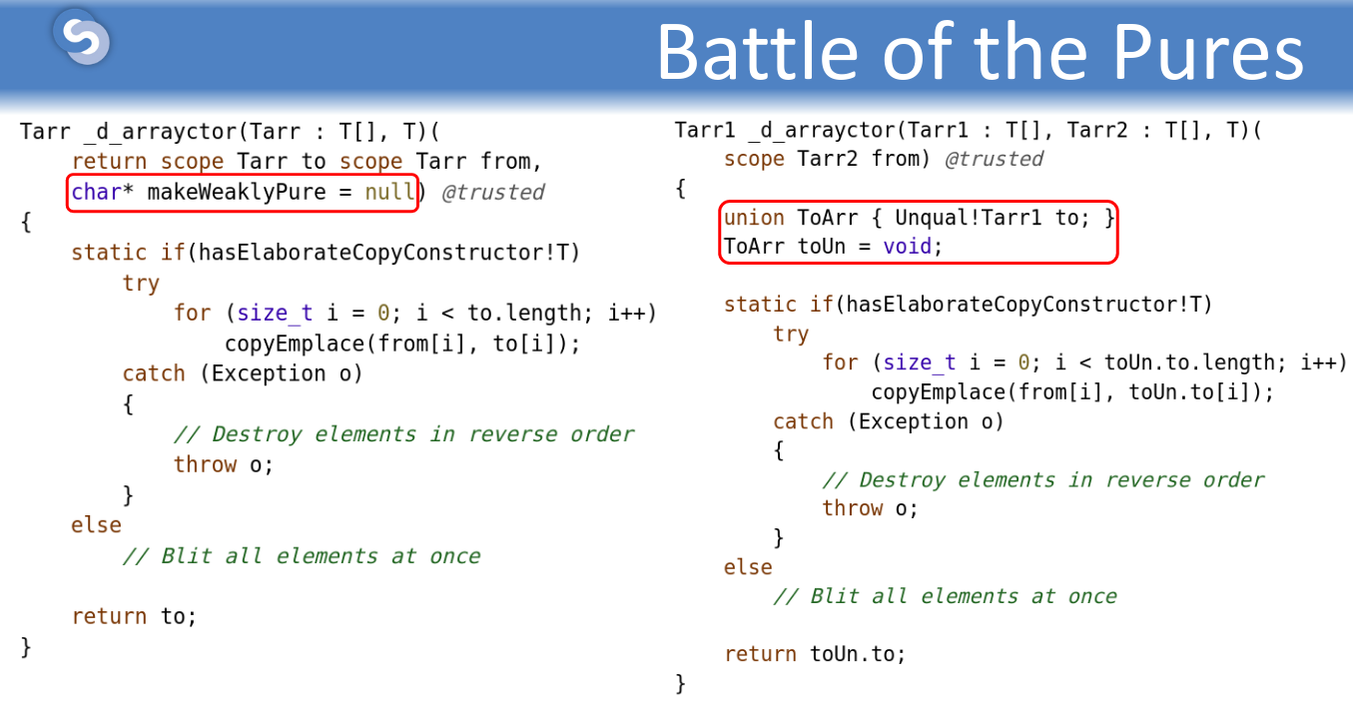
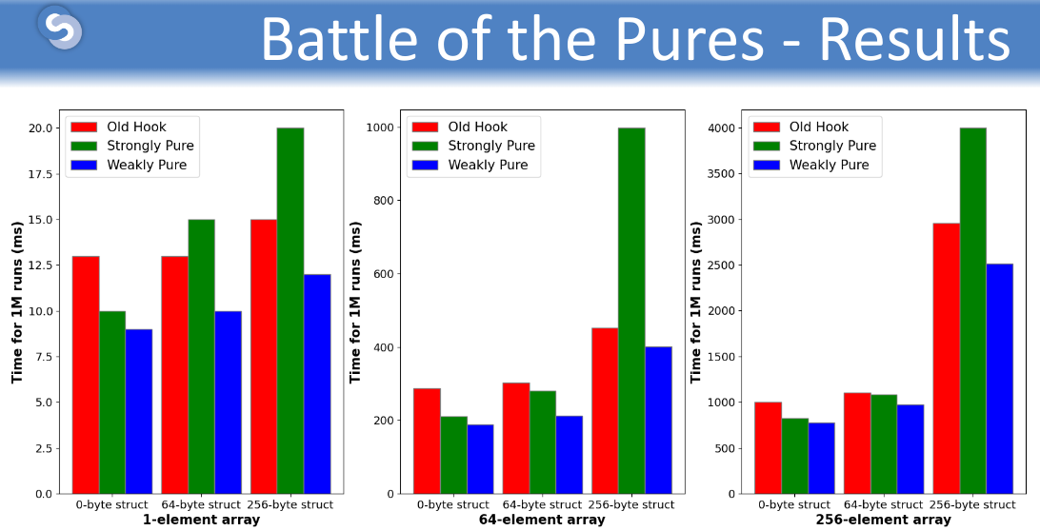
Takeaways

Slide 36
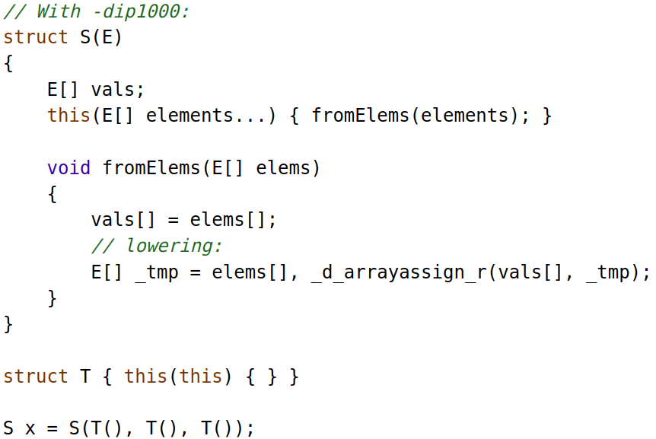
Scope CommaExps

Slide 37
Scope CommaExps
Notes:
Automem
De reinvestigat

