Slide 1


D Backend for GNU Bison
Adela Vais
adela.vais99@gmail.com
Dconf, 1 - 4 August 2022

Slide 2
Parser
Tool analyzing a symbol set, based on grammar rules
Used in:
Compilers and interpreters (GCC)
Command line tools (Bash, Shell, CMake)
Domain Specific Languages (Behavior-Driven Development)

Slide 3
GNU Bison
General-purpose parser generator
Given a grammar, Bison will create the parsing rules
Left-to-right, Rightmost derivation algorithms (LR):
One token Lookahead LR – LALR(1)
Generalized LR – GLR
Supports C, C++, Java, D
D language backend since version 3.8, September 2021
Notes:
Additionally I will talk about Bison’s history (2-3 sentences): used in the first C compiler; first version was written in the programming language B; parser introduced in the GNU suite which helped its popularization; stable interface and good documentation; projects that move away from Bison switch to handwritten parsers, rather than another general-purpose solution
, the de facto LR parser generator

Slide 4


Parser generators in D’s ecosystem
 | Supports other languages | Main disadvantage
ANTLR4-D |  | Unofficial fork
ANTLR3-D |  | No active support for this version
ALLPaGeD |  | No active support
Goldie |  | No active support
Lltool |  | Maintained by one person
The need for an established, official parser with active support
More variety in the types of parsers – introducing an LR parser
Easier to convince a user to try D when they can still use the parser of their choice
Notes:
Introduce D to new users angle: it is easier to convince a user to try D when they can still use the parser of their choice (1 new technology vs 2)

Slide 5
The Case of Pegged
A Parsing Expression Grammar (PEG) module, using Dlang
 | Pegged | Bison | Observations
Memoization proportional with | Input size | Depth of parsing tree | Pegged more likely to crash with an out-of-memory error
Time complexity | Linear time | Worst case O(n³) | Memoization makes Pegged faster compared to GLR
Needs a lexer | No | Yes | Faster to write a Pegged program

Slide 6
Pegged vs Bison
“(1 + 1) / (1 - 0)” X 1 million times
Bison (real)
Pegged (estimated)
5 seconds vs 6 minutes
Notes:
Example to show the speed of Bison for a simple arithmetic equation; the time of Pegged is estimated due to out of memory error for this input size; to explain that this is an “engineered” example to show LALR1 is faster than Pegged, time-wise I can probably find an example with the situation reversed when I will write the GLR

Slide 7
Features

Slide 8
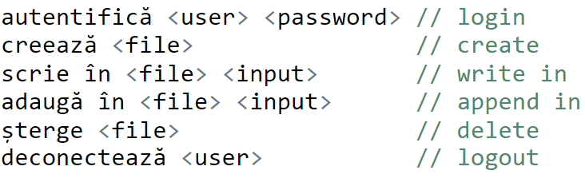
DSL grammar

Slide 9
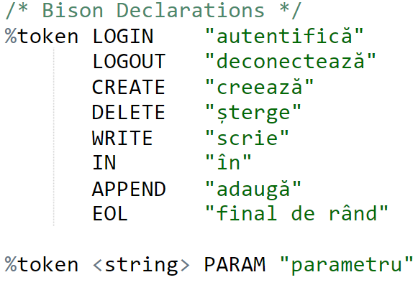
Token Kind
Notes:
Visible symbols

Slide 10
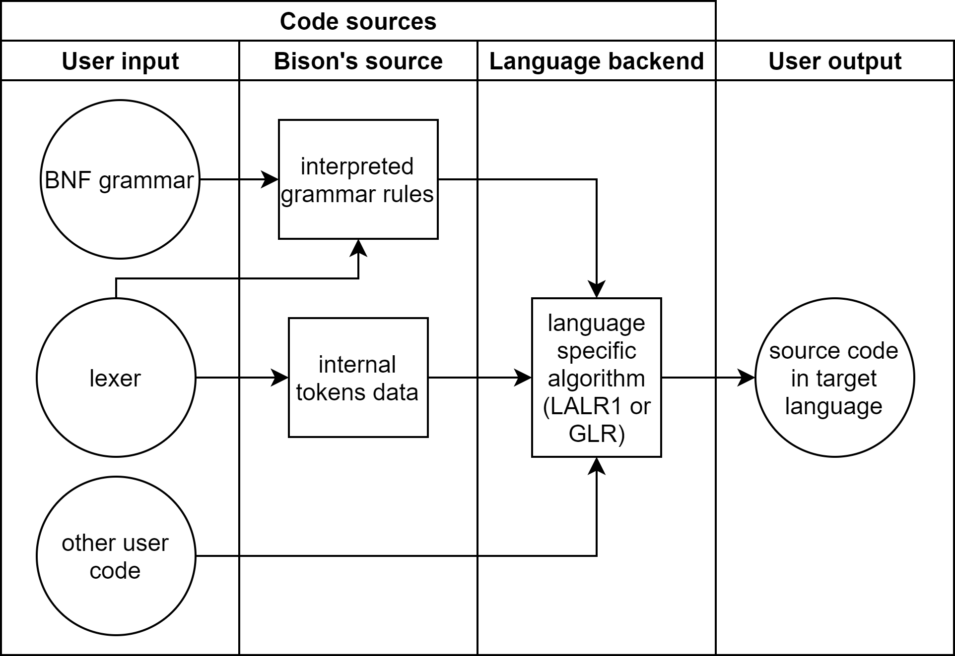

Slide 11
User perspective: LALr(1) vs GLR parser in input code
%glr-parser
Notes:
The difference is adding 1 line, which is why I prioritized having a stable customization interface – it will be used by the GLR too.

Slide 12
The Lexer’s API
Bison is a parser-generator without a lexer
The lexer’s method should be implemented by user
Alternatively, the user can work with a lexer generator

Slide 13
The Lexer’s API
TokenKind
Semantic value
Location
Return value
Variable/class attribute
Variable/class attribute
Notes:
TokenKind – user defined-type that contains the visible tokens – what can be seen in the input
This happens optionally in other parsers; for the D parser it’s the default

Slide 14
Token Kind

Slide 15

The Lexer’s API
TokenKind
Semantic value
Location
Return value
Variable/class attribute
Variable/class attribute
return Symbol(token, value, location); // default
Notes:
TokenKind – user defined-type that contains the visible tokens – what can be seen in the input
This happens optionally in other parsers; for the D parser it’s the default
Consolas font

Slide 16
The Default Lexer’s API
The D backend generates Symbol constructors for all the data types of the value (int, string, custom class, etc.)
Symbol(TokenKind, [any value data type accepted by the lexer], Location)
Accepted compile-time instructions:
return Symbol(TokenKind.Int, 9, location);
return Symbol(TokenKind.String, “my string”, location);
return Symbol(TokenKind.Int, “my string”, location);
Notes:
exemplu

Slide 17
Token constructors
Add the directive “%define api.token.constructor”
Generate compile-time errors

Slide 18
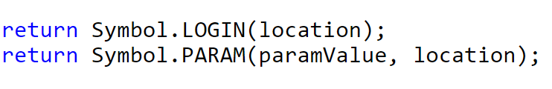
Default vs Token constructors
return Symbol(token, value, location) // default, run-time errors
return Symbol.Token(value, location) // token constructors, compile-time errors

Slide 19
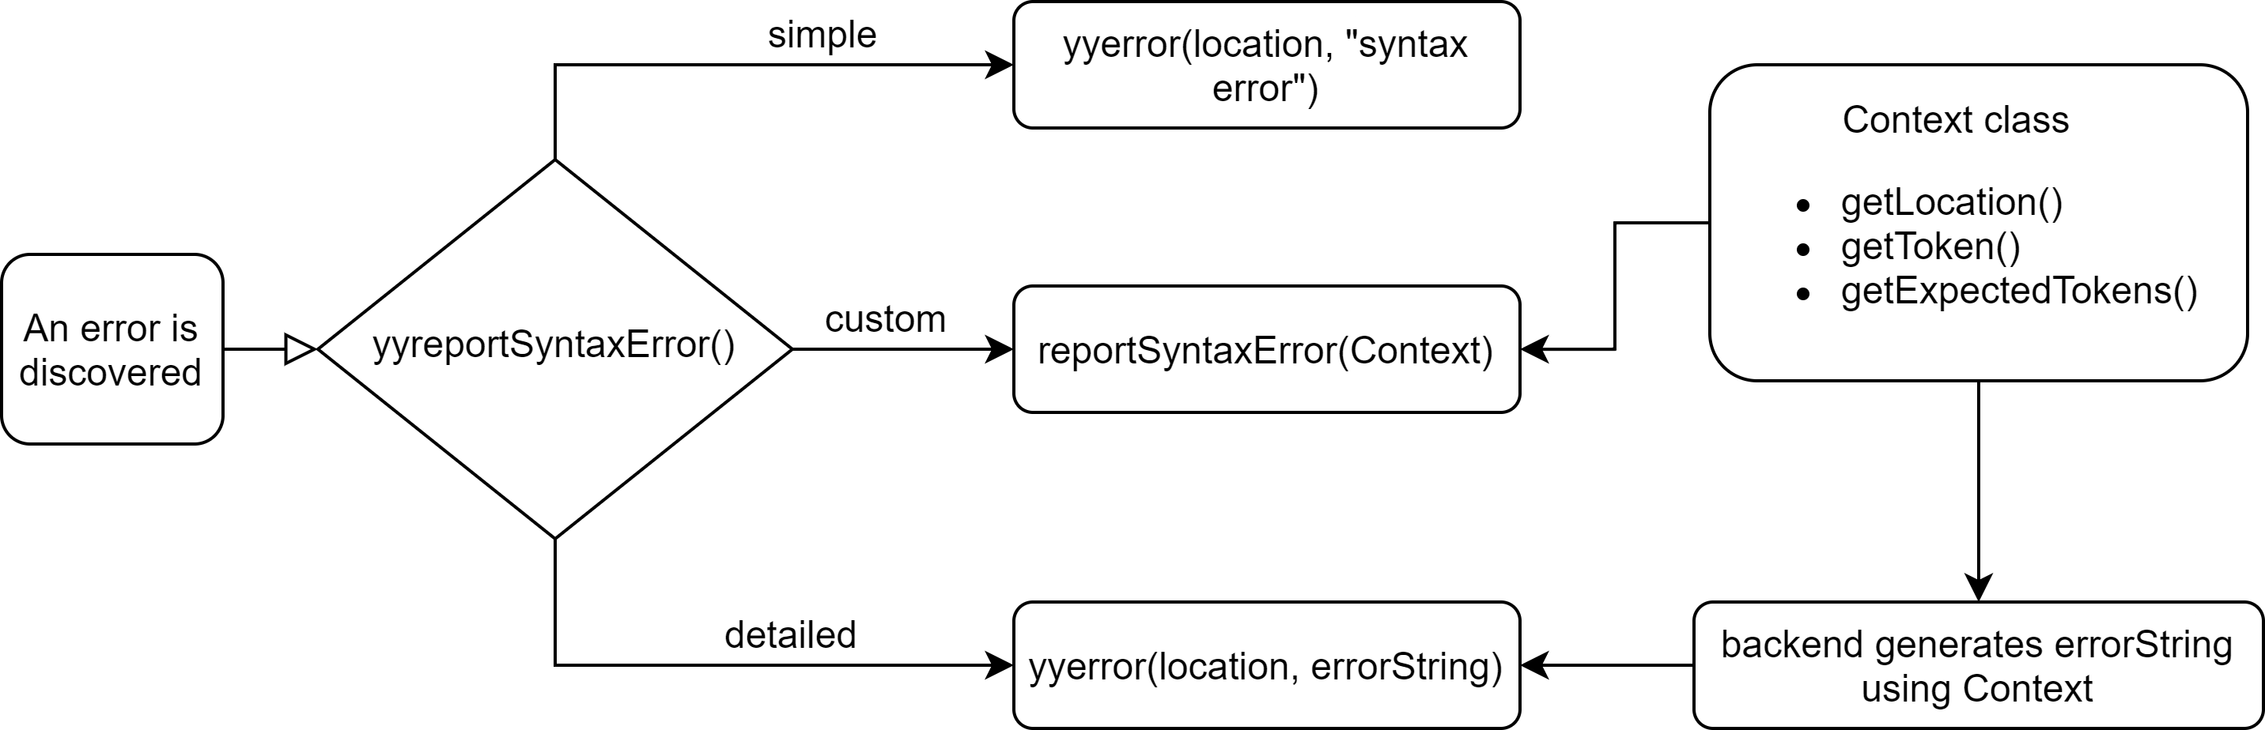
Error messages
Directive: %define parse.error [simple|detailed|custom]
Notes:
Simple: reports "syntax error" for each unexpected token
Detailed:
builds a complete error message
contains the unexpected token, its location, and maximum 5 expected tokens
message is sent to user-defined lexer method yyerror(location, message)
Custom:
uses the user-defined lexer method reportSyntaxError()
user has full access to the Context class API

Slide 20
Error recovery counter reset
Bison encounters an error
Outputs error message
The next tokens also produce errors (most likely due to the earlier error)
Bison skips outputting error messages for the next 3 tokens

Slide 21
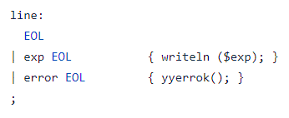
Error recovery counter reset
autentifică adela [new line] // 1.18-2.0: syntax error, unexpected end of line, expecting parameter
deconectează [new line] // nothing!
Notes:
Schimbat ordinea

Slide 22
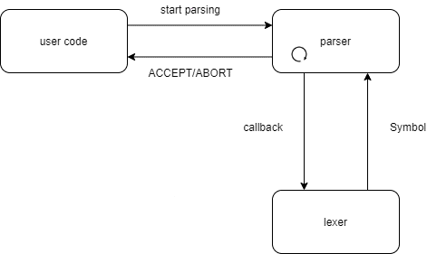
Pull vs push parsers: Pull parser
Time performance
Used in command line tools

Slide 23
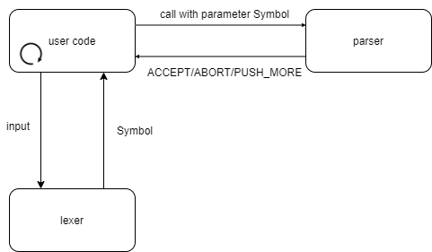
Pull vs push parsers: push parser
More granular control over the parsing process
Used in GUI programs (IDEs)

Slide 24
Internationalization
Adapting a program to be used in multiple languages and regions
Behind the scenes:
Gettext – also used by the C and C++ Bison backends
C language functions gettext() and dgettext() – imported using the extern(C) directive
D library for importing Gettext (found in the C99 header libintl.h) with examples: https://github.com/adelavais/libintl

Slide 25
Demo
Demo code:
https://github.com/adelavais/dconf22-demo
Google Drive API interactions:
https://github.com/Robert-Aron293/d-google-drive-client-example

Slide 26
History of the D backend
Port of the Java skeleton to the D language: Oliver Mangold
Improvements, especially regarding D-features: H. S. Teoh
User customization, extensive testing, documentation: Adela Vais
Experimental backend
LALR(1) officially supported!

Slide 27
Challenges
Ramp-up period: learn D and Bison
New technologies: M4, Autotest

Slide 28
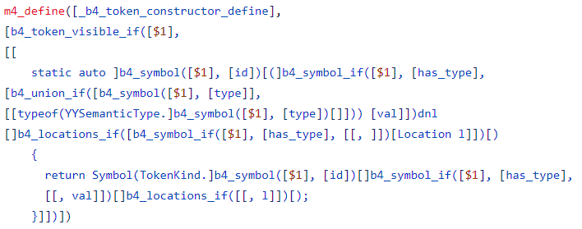
M4

Slide 29
Challenges
Ramp-up period: learn D and Bison
New technologies: M4, Autotest
Most challenging task: adding internationalization
Misjudged the number of missing features
Initial target was to write the GLR algorithm
Redefined to finish the customization features first
Notes:
Missing features: internationalization, custom error messages – were missing from the initial target and took me the longest to write

Slide 30
Review Process
Mentors:
Akim Demaille (Bison co-maintainer)
additional help from Eduard Stăniloiu, Răzvan Nițu, H. S. Teoh
Asked for input from the D community on the forum
Contributions: sending patches to Bison’s mailing list
Bison’s official repository: GNU Savannah
I used GitHub for reviews, questions, way to structure my own work

Slide 31
Symmetry Autumn of code 2020
Very positive experience
Weekly & monthly updates but I could manage my own time
Participated alongside full-time studies
Little experience in writing APIs before
Learned to use D (compile-time features, GC’s role in performance)
Made PRs to DMD and Phobos based on my interactions with Bison
Learned more about LR parsing
Enjoyed interacting with the D community

Slide 32
Conclusions
The D language LALR(1) parser is fully supported since version 3.8
Implements all customization features of the other parsers
I want to continue the work on the GLR
Notes:
* Not all C features made sense for an object-oriented language like D

Slide 33
Customization features
simple/detailed/custom error messages
internationalization
lookahead correction
push parser
token constructors
return from the lexer the token type, value and location as a unified symbol
allowing prefix change of the symbol and token types
resetting the error recovery counter
allowing the parser class to inherit another class or implement an interface

Slide 34
Overview of D’s LALR(1) backend
bison.m4
code used by all backends
mainly user options parsing
d-skel.m4
information used by Bison when choosing a D parser
now points only to LALR(1)
d.m4
general representations of data types, functions
can be used across multiple algorithms
lalr1.d
contains LALR(1) implementation

