Slide 1
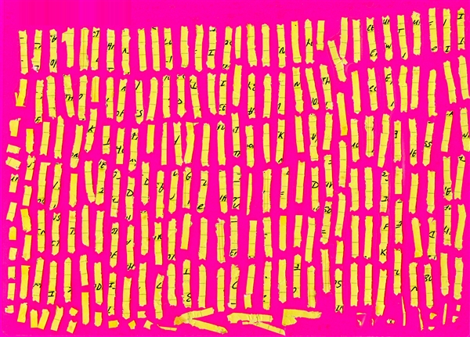
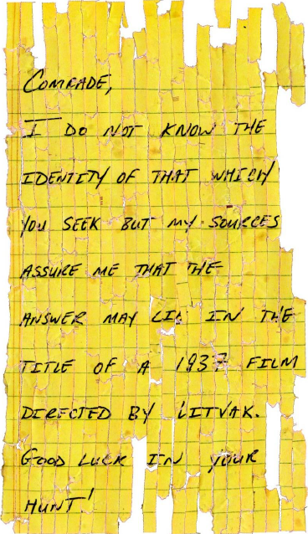
Unshredder
Razvan Ranca
===>

Slide 2
Recap
Fully automatic reconstruction of shredded documents
Problem broken down into 2 functions
  Cost function: evaluates how well two pieces match
  Search function: tries to find a permutation of pieces that minimizes the global cost (i.e sum of individual edge costs given by previous function)

Slide 3
Search functions
Greedy heuristics
Based on minimum spanning tree graph algorithms, Prim and Kruskal
No backtracking, once an error is introduced you’re stuck with it

Slide 4
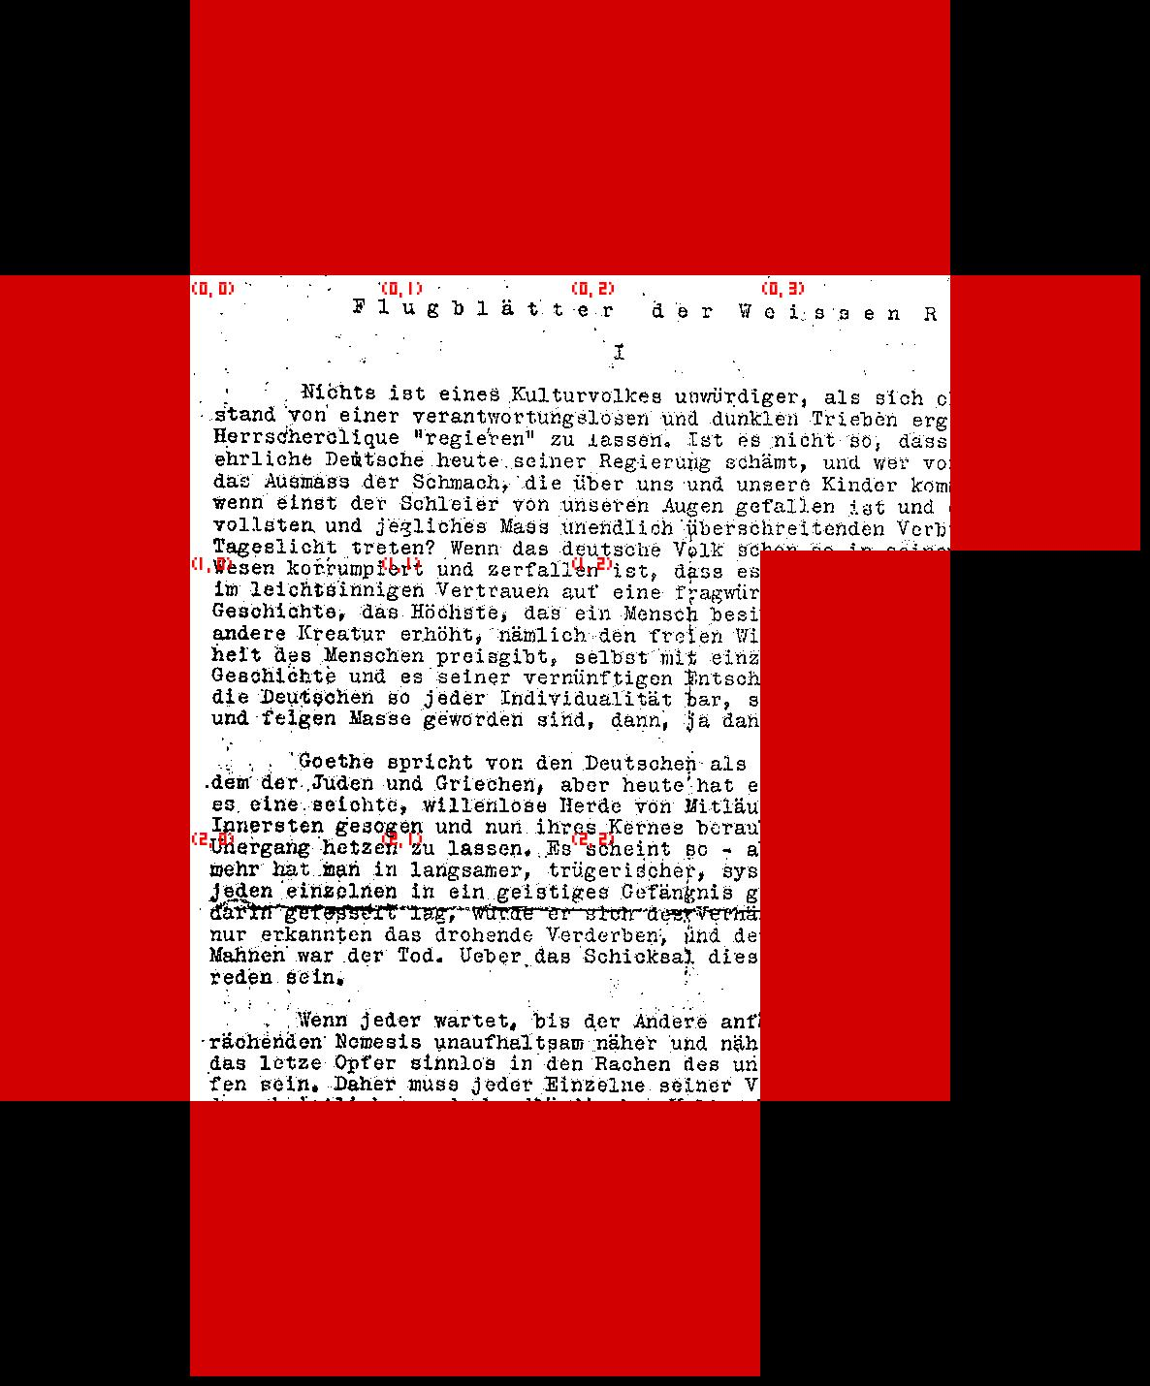
Prim

Slide 5
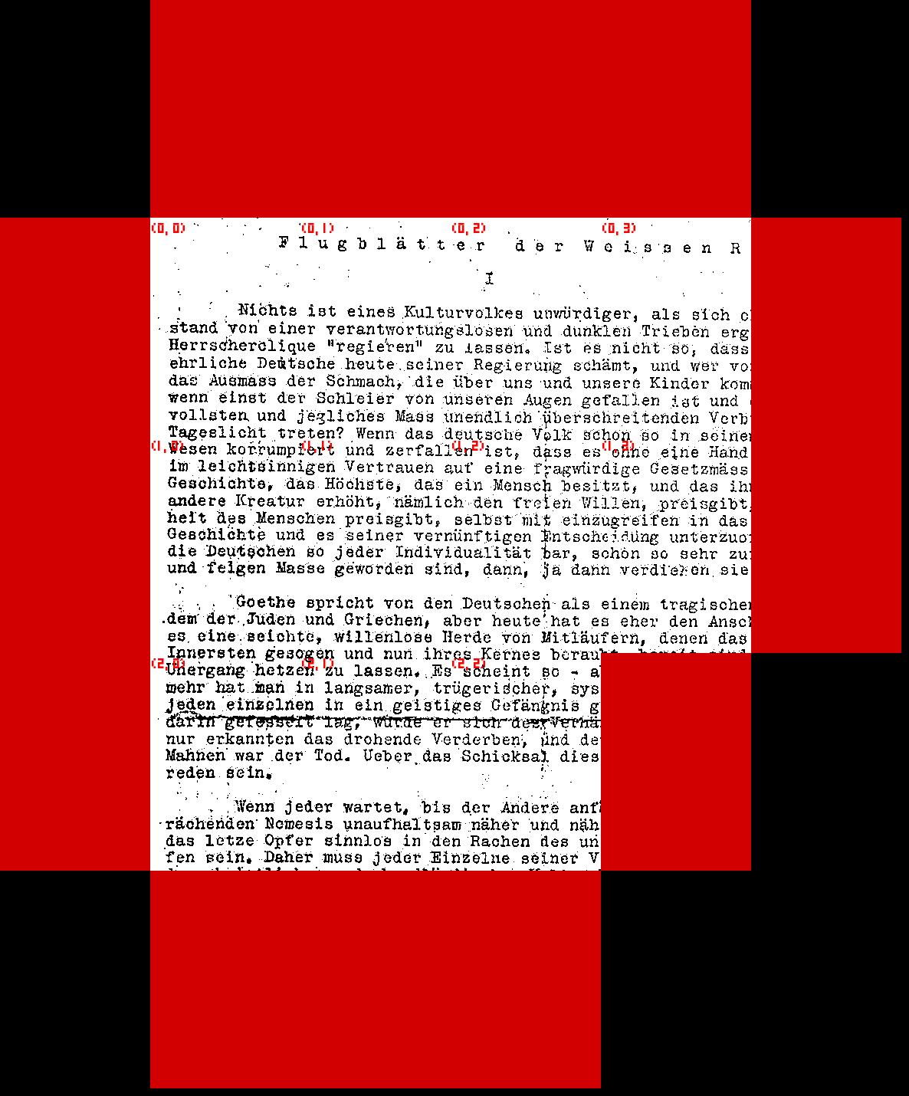
Prim

Slide 6
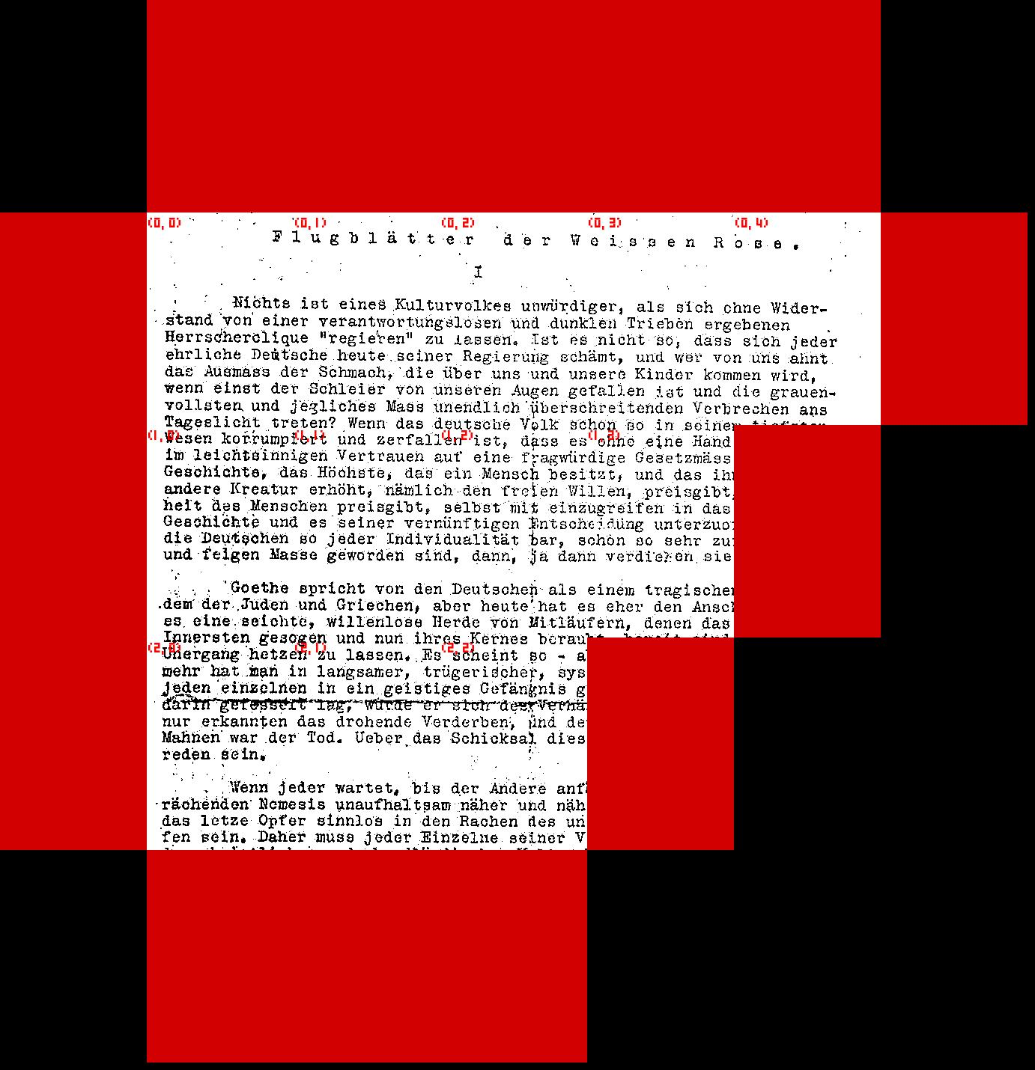
Prim

Slide 7
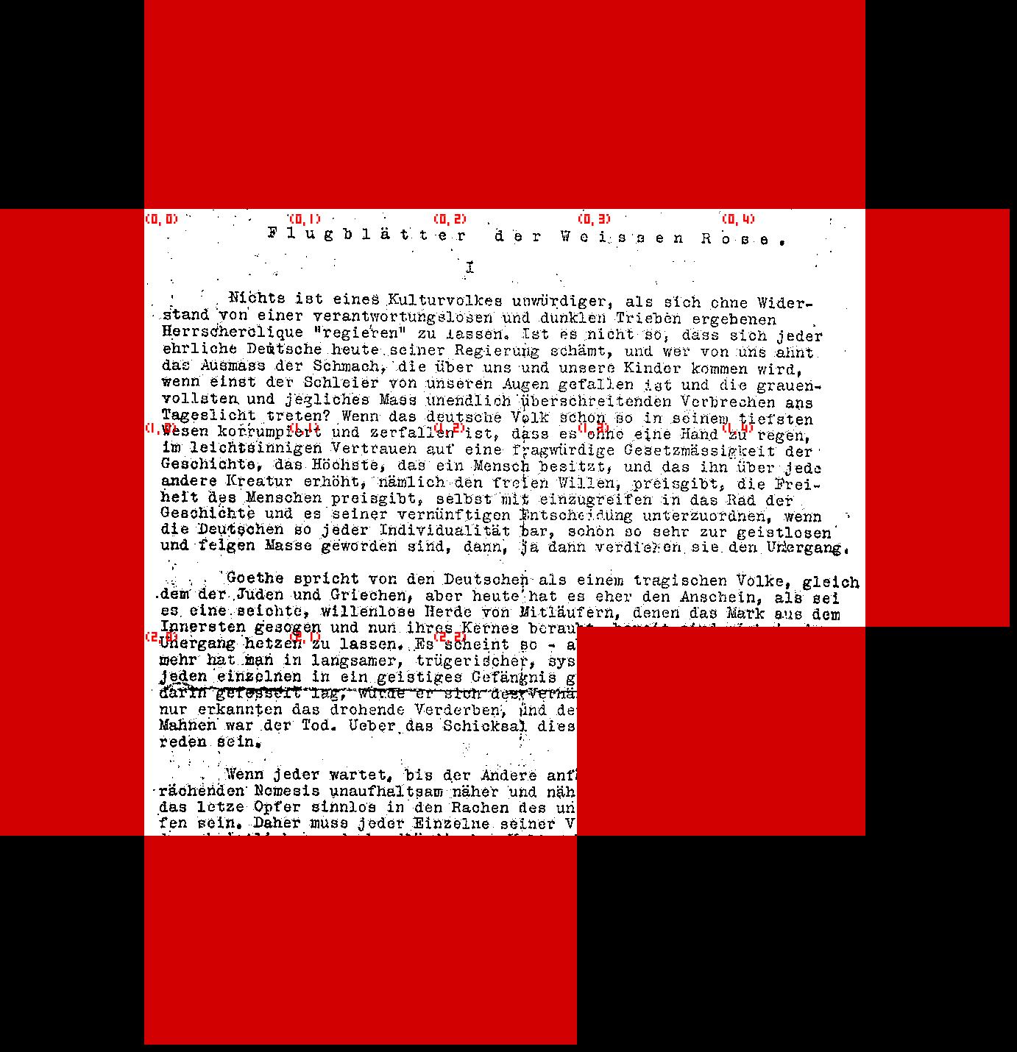
Prim

Slide 8
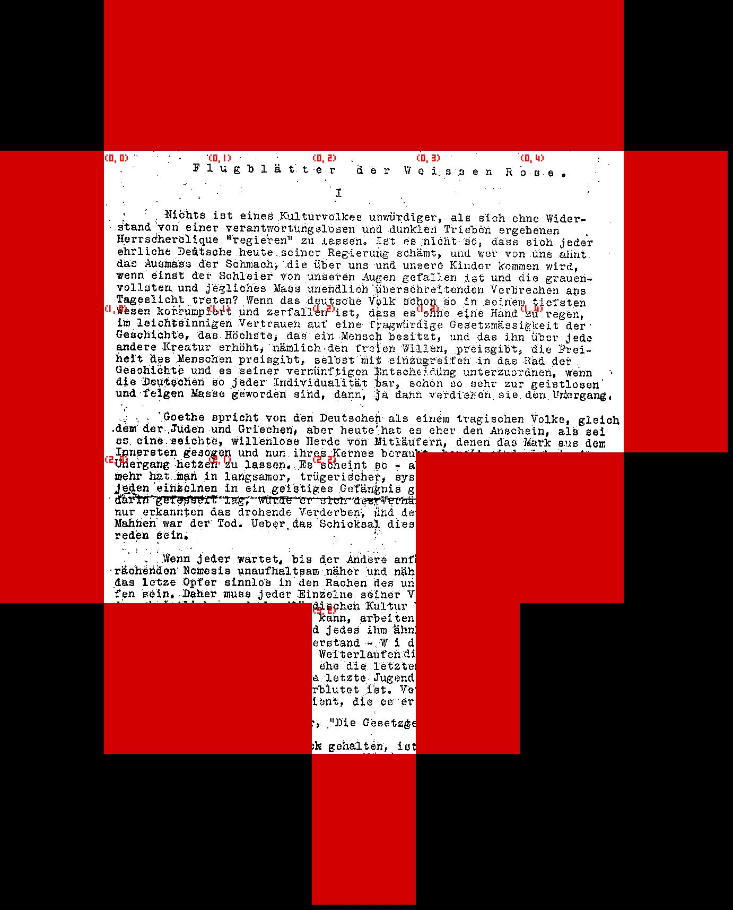
Prim

Slide 9
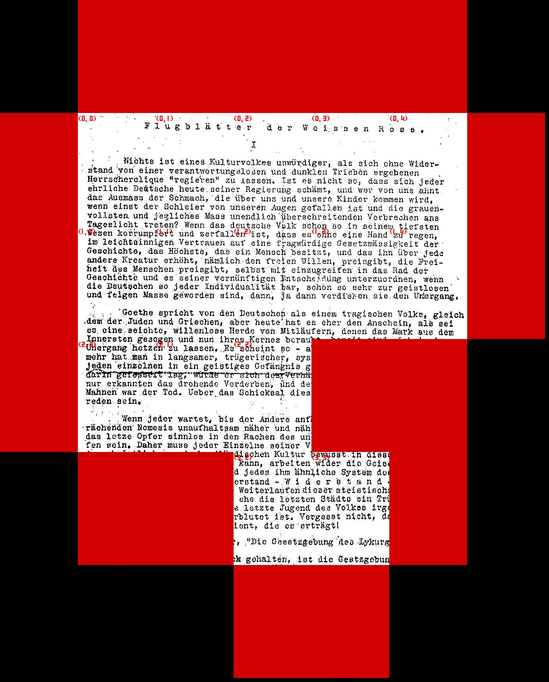
Prim

Slide 10
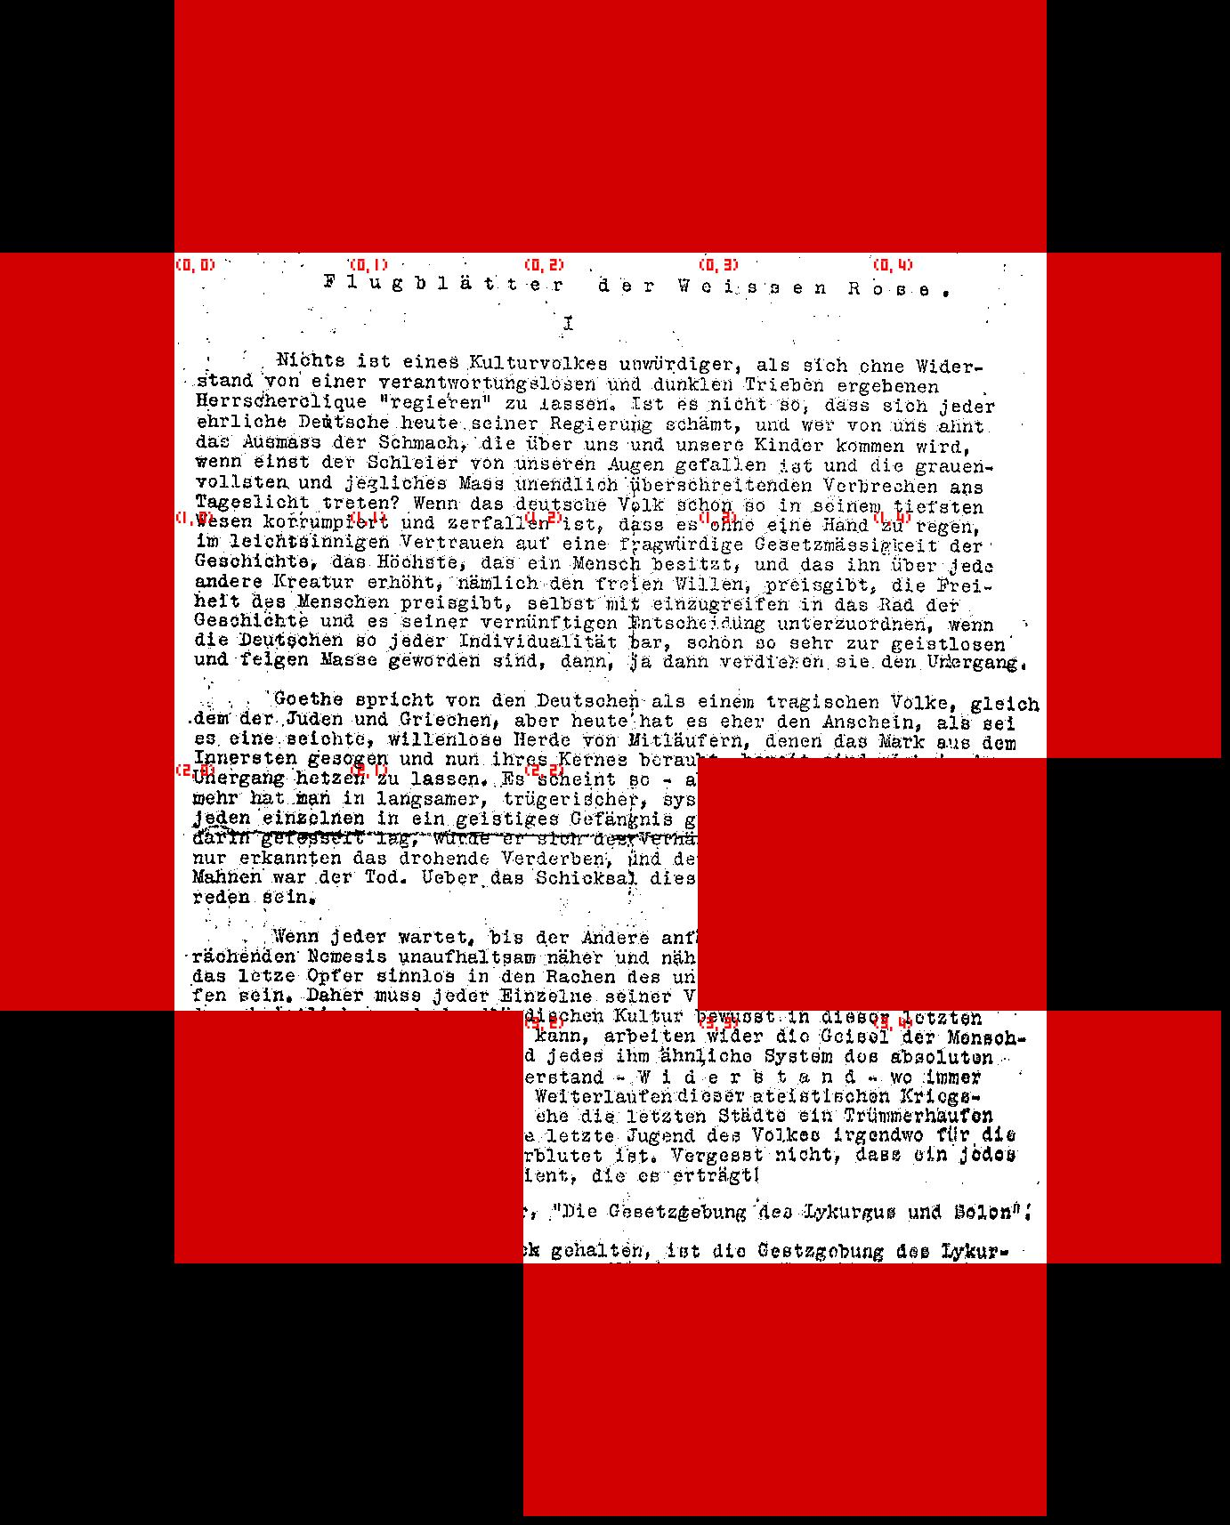
Prim

Slide 11
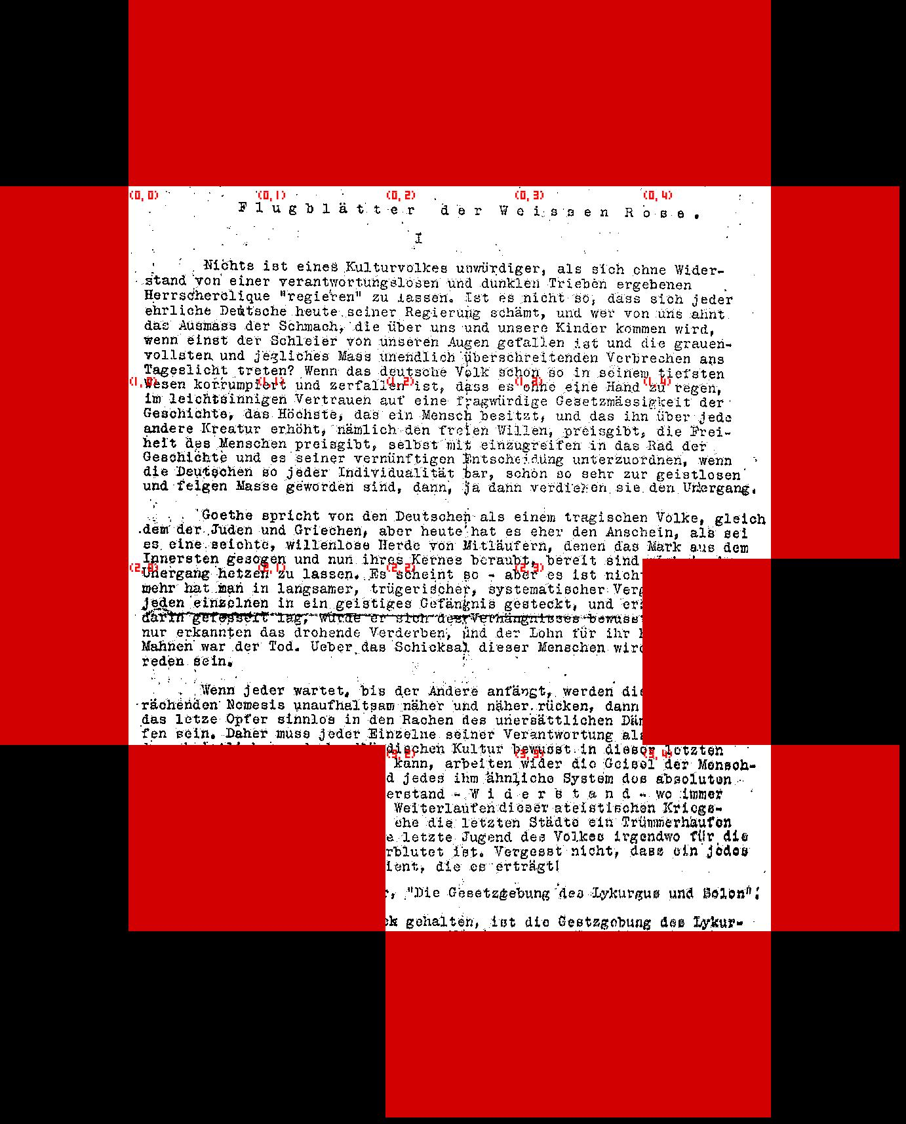
Prim

Slide 12
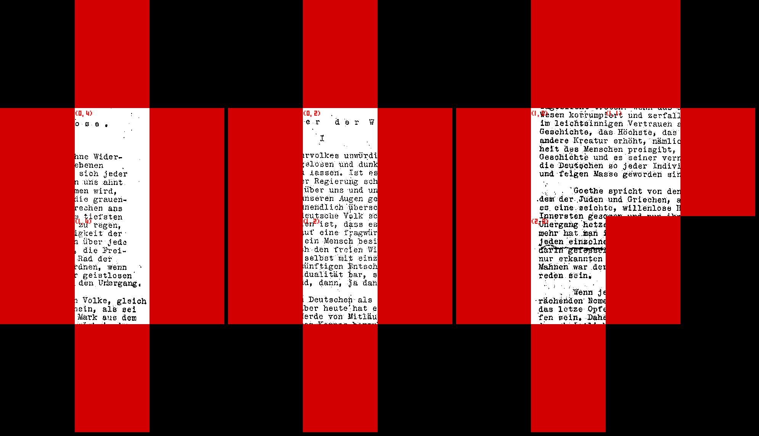
Kruskal

Slide 13
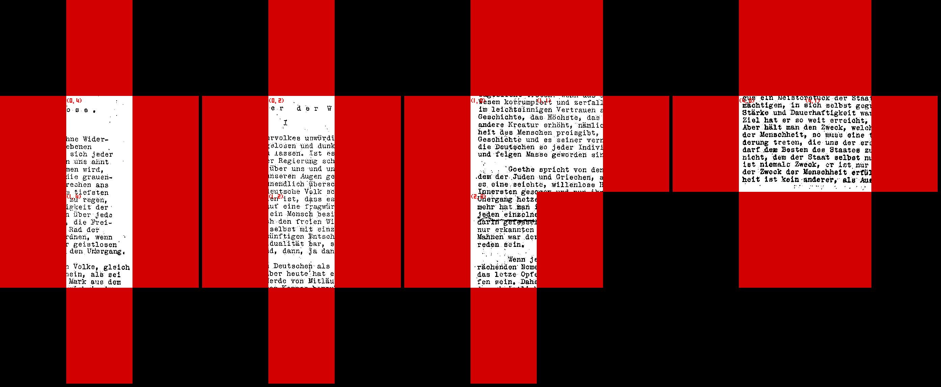
Kruskal

Slide 14
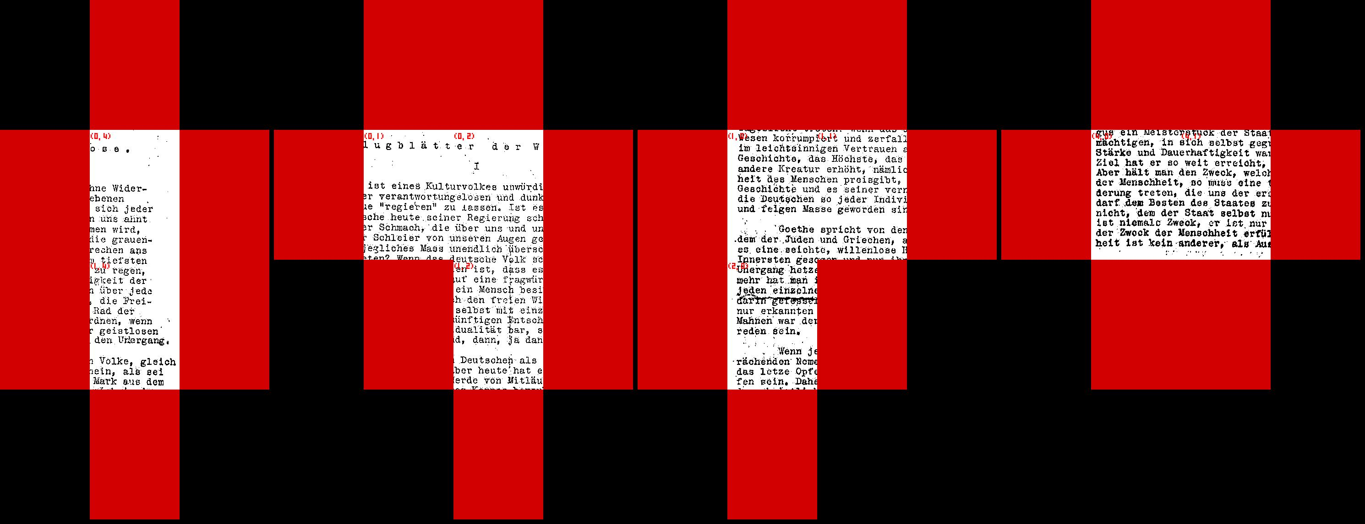
Kruskal

Slide 15
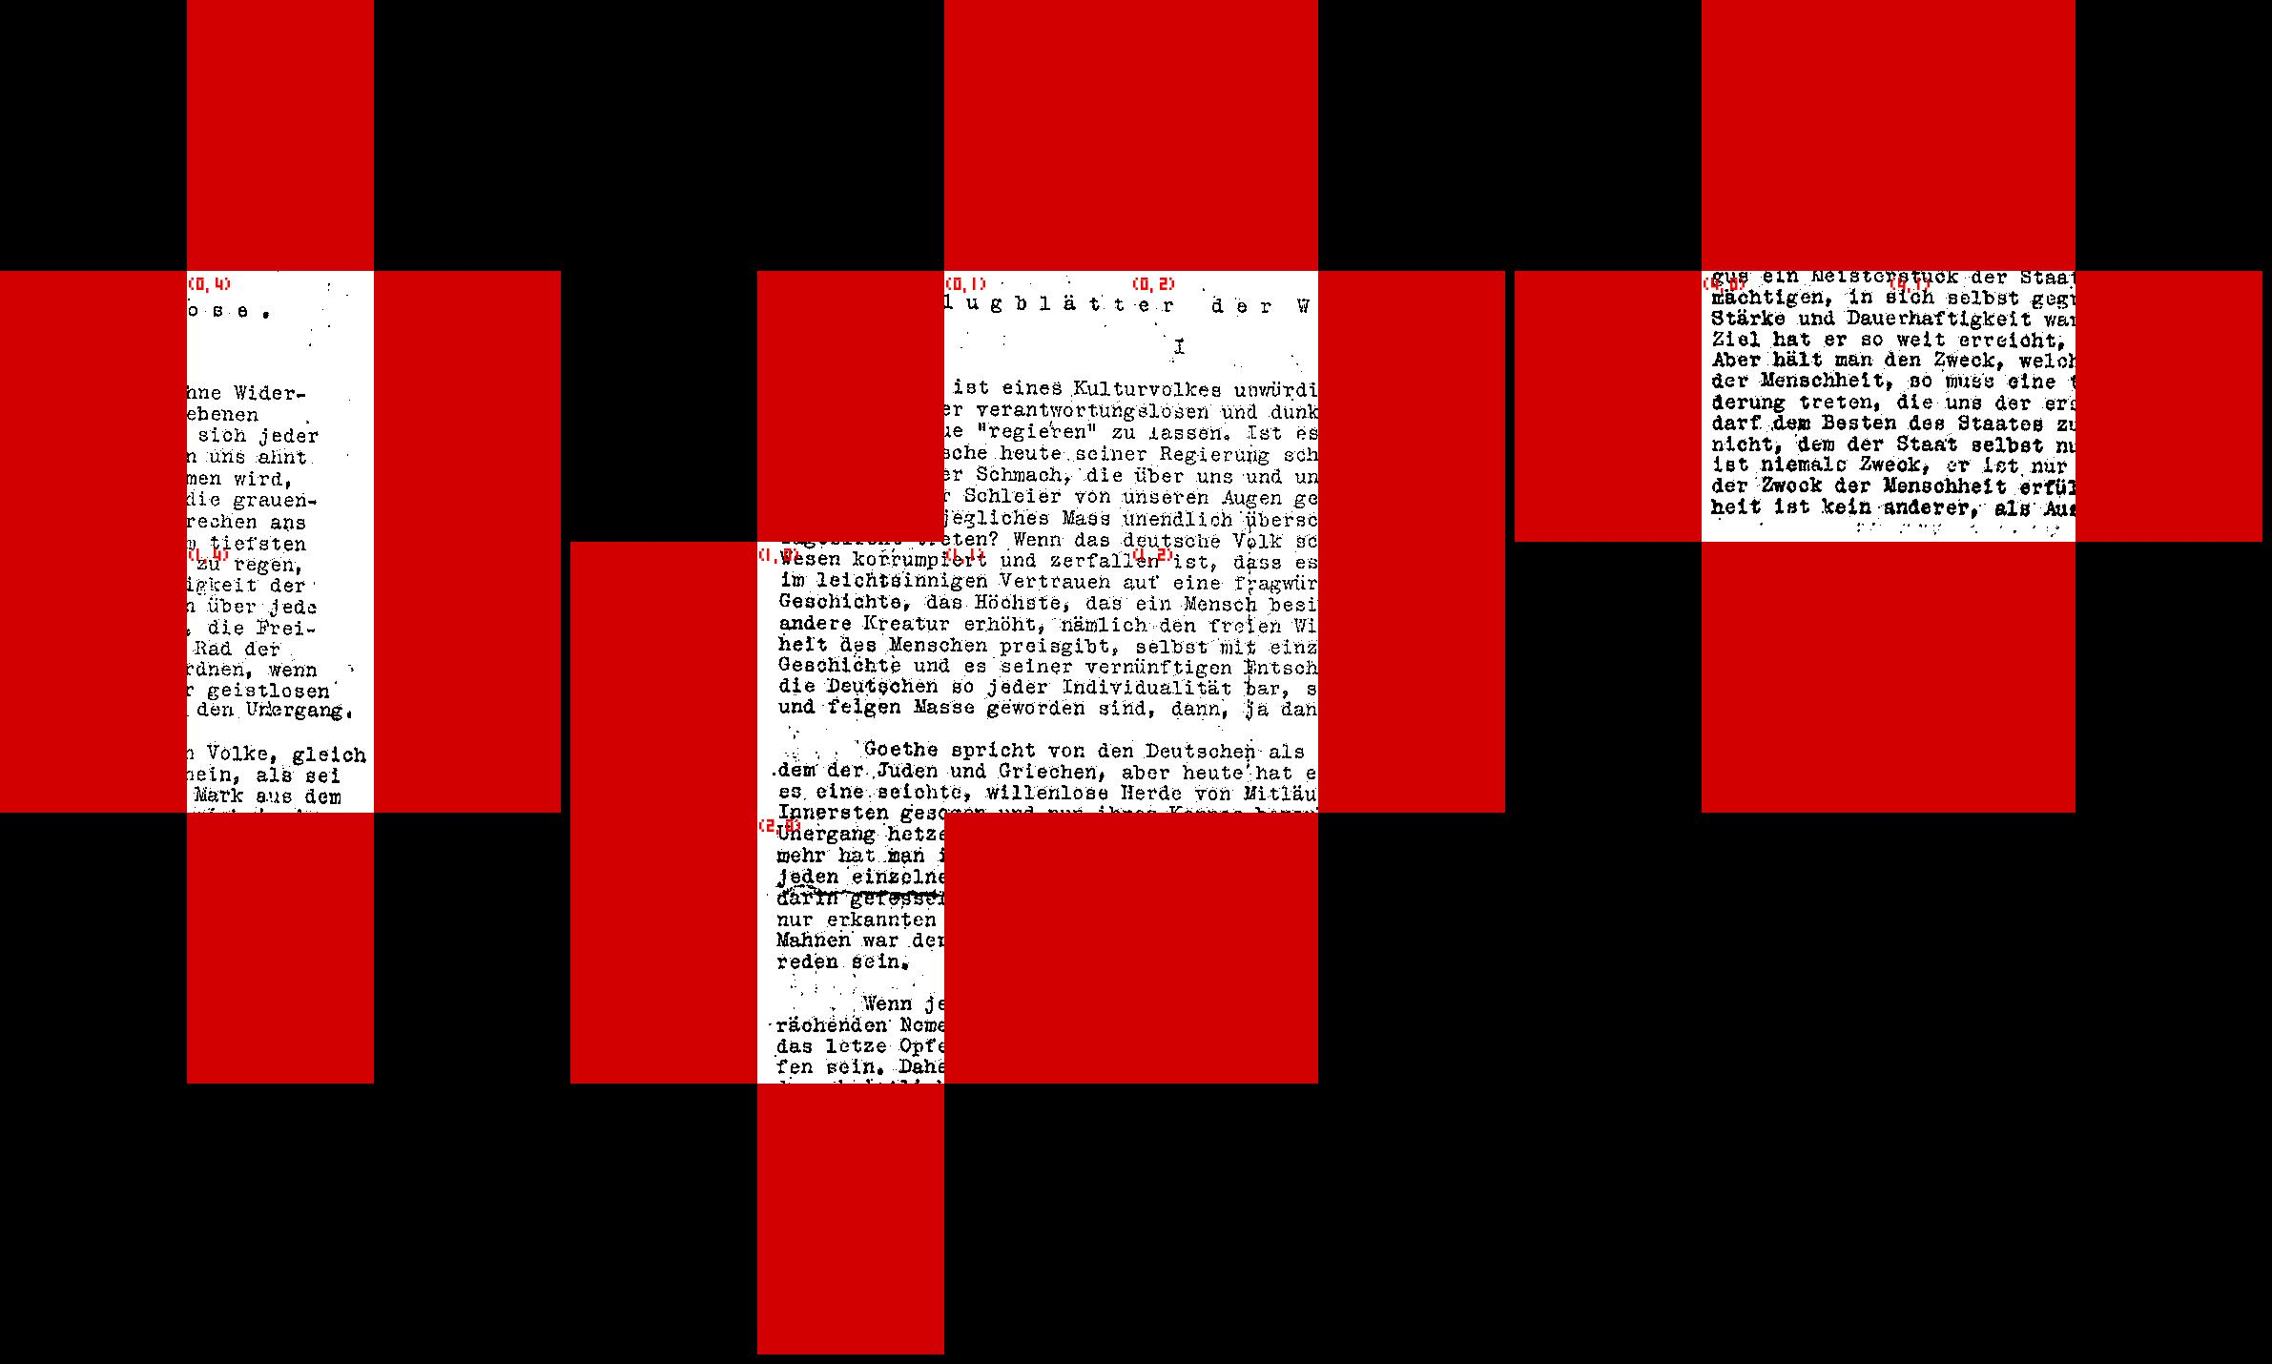
Kruskal

Slide 16
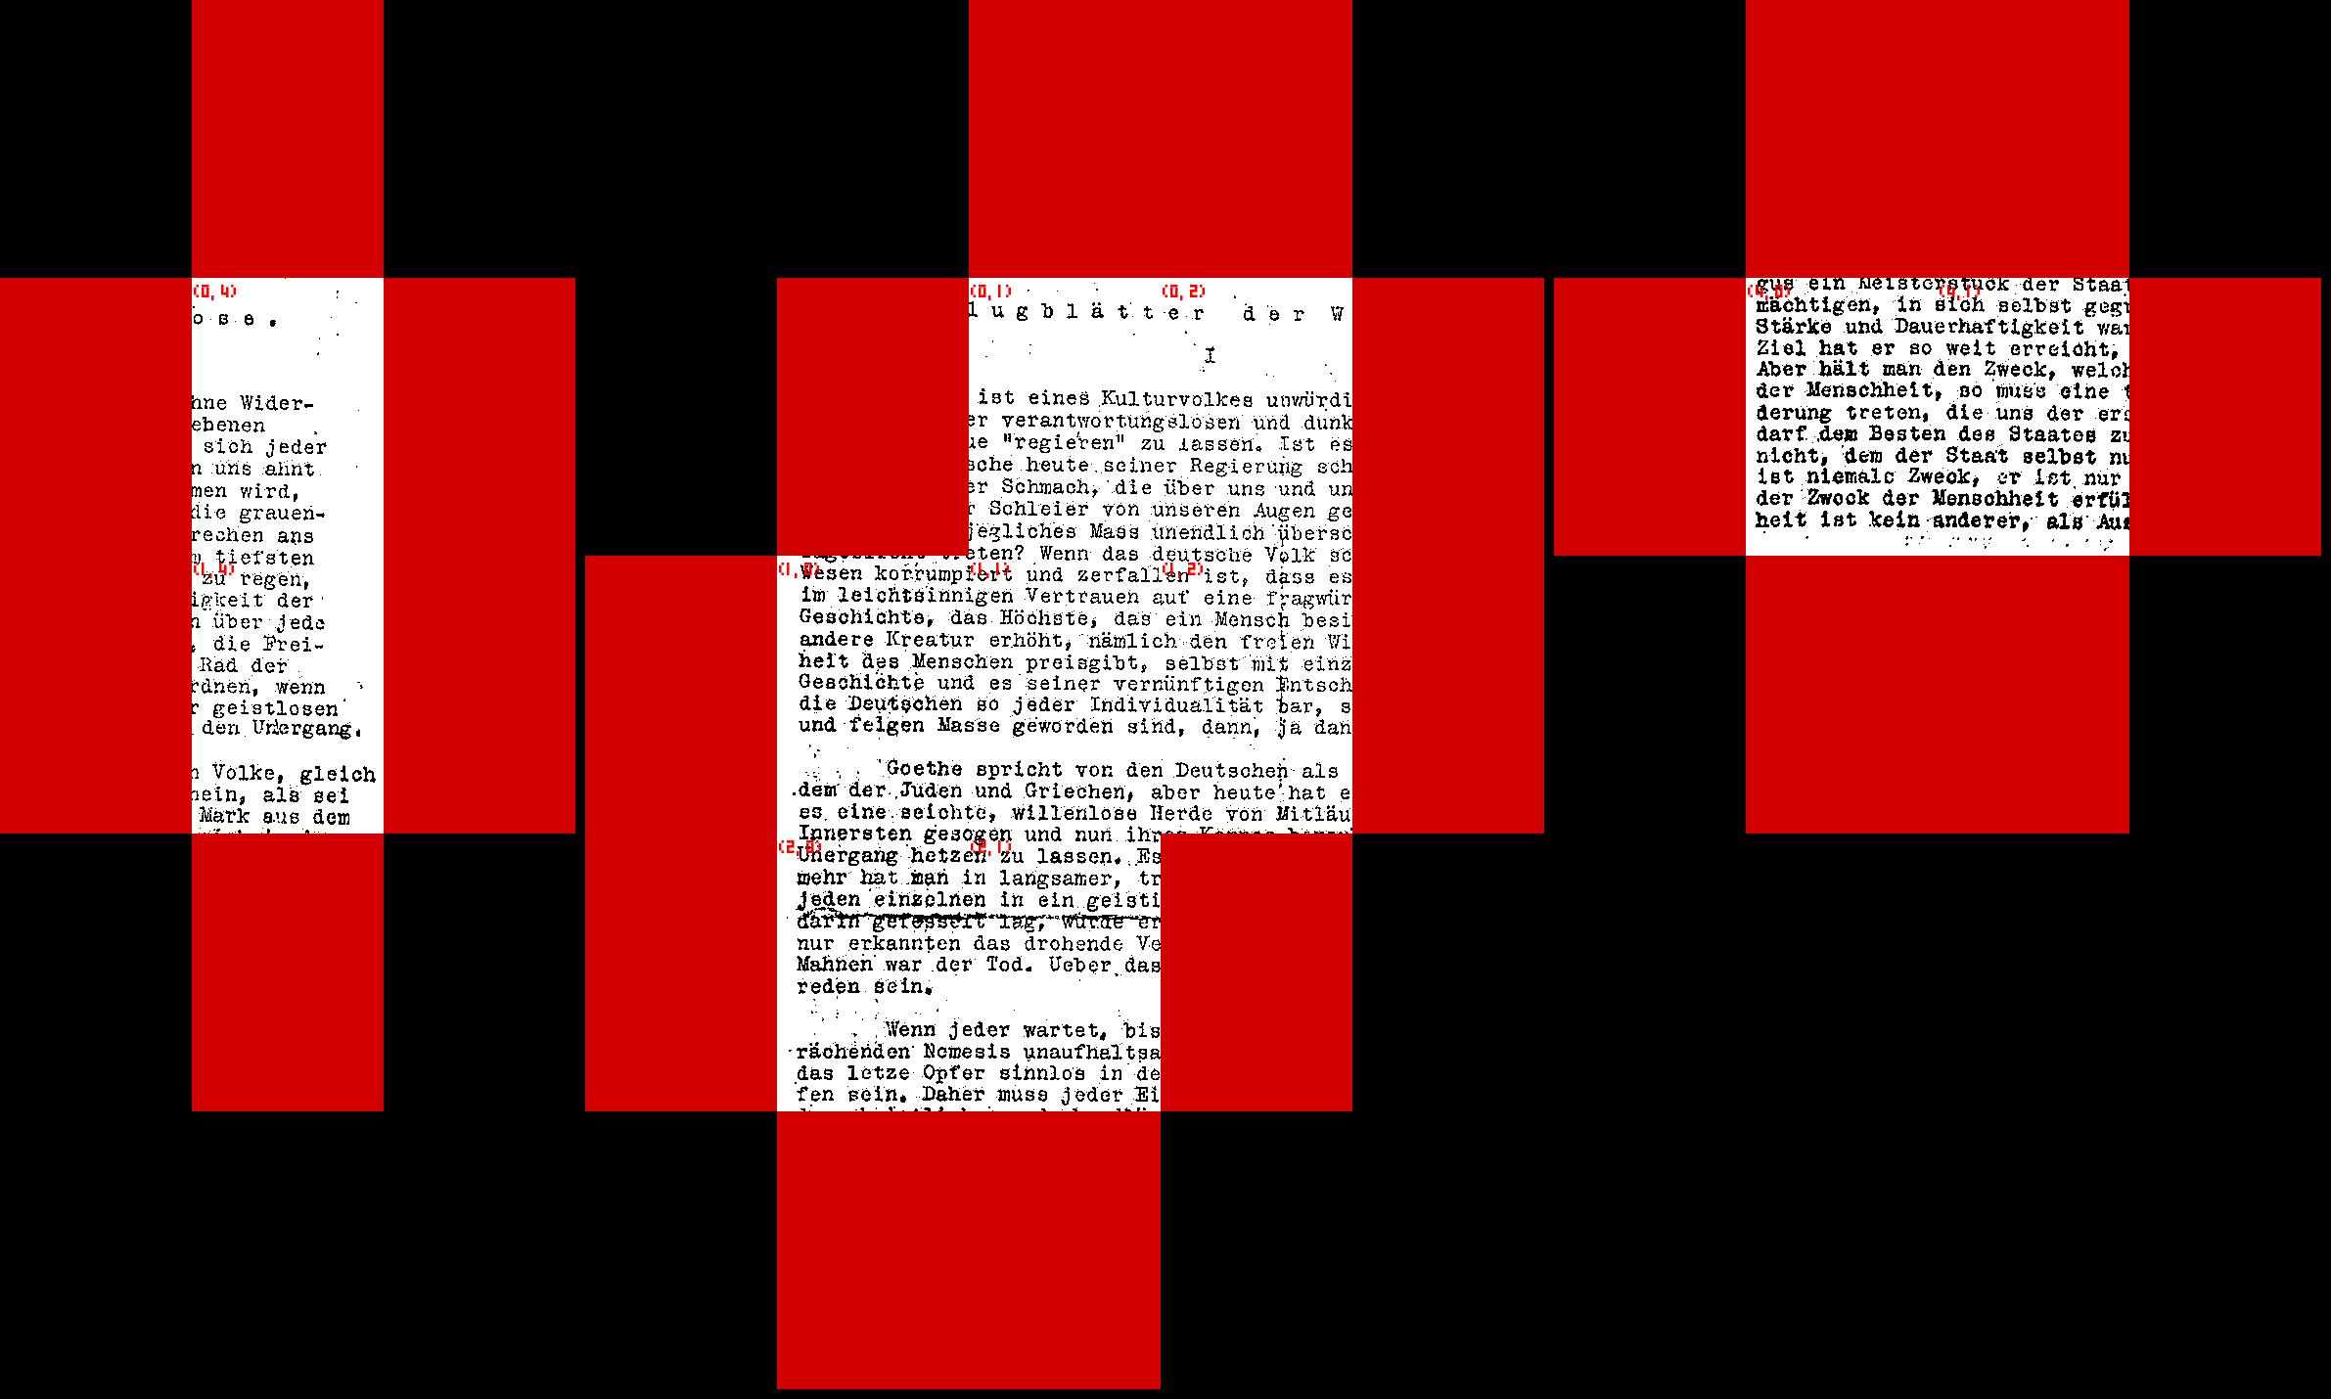
Kruskal

Slide 17
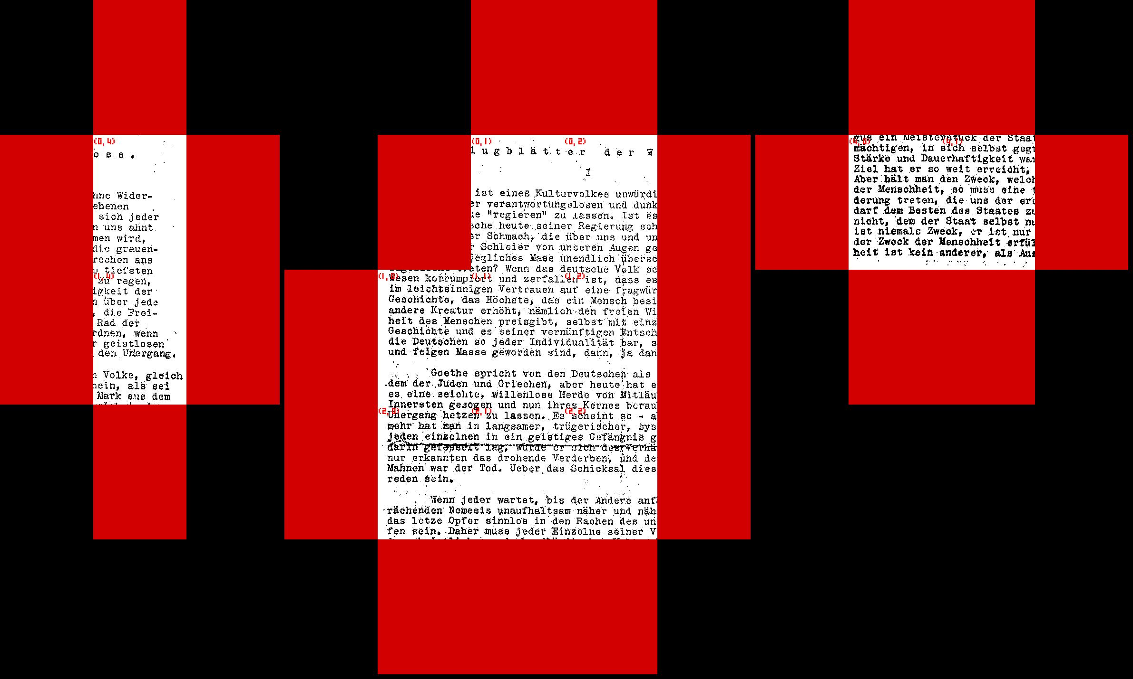
Kruskal

Slide 18
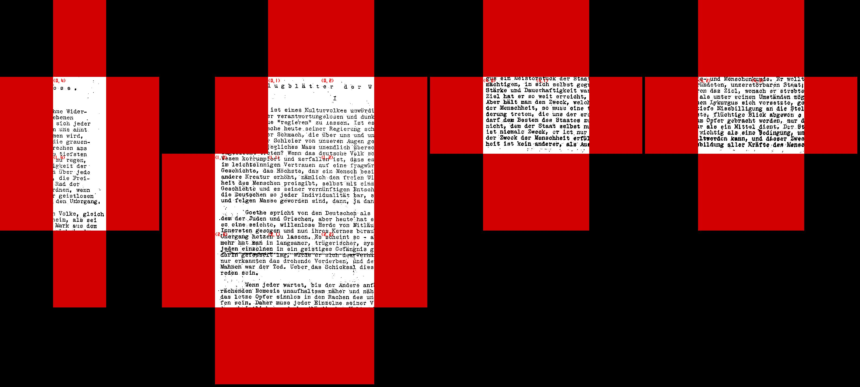
Kruskal

Slide 19
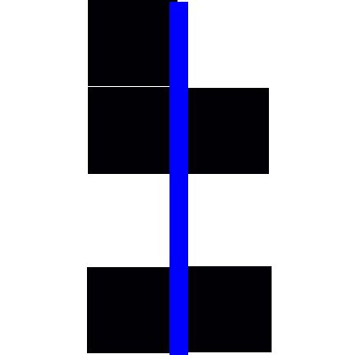
Cost functions
Simplest: Pixel by Pixel cost
  go along the edge of the two pieces you want to join
  for every pair of pixels that isn’t the same colour, add a penalty to the cost
  the edge with the lowest cost is best
  Eg:
  has cost 1

Slide 20
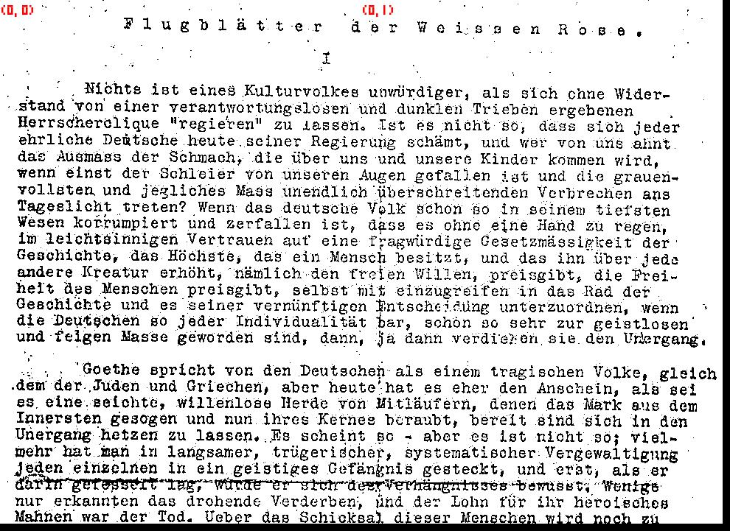
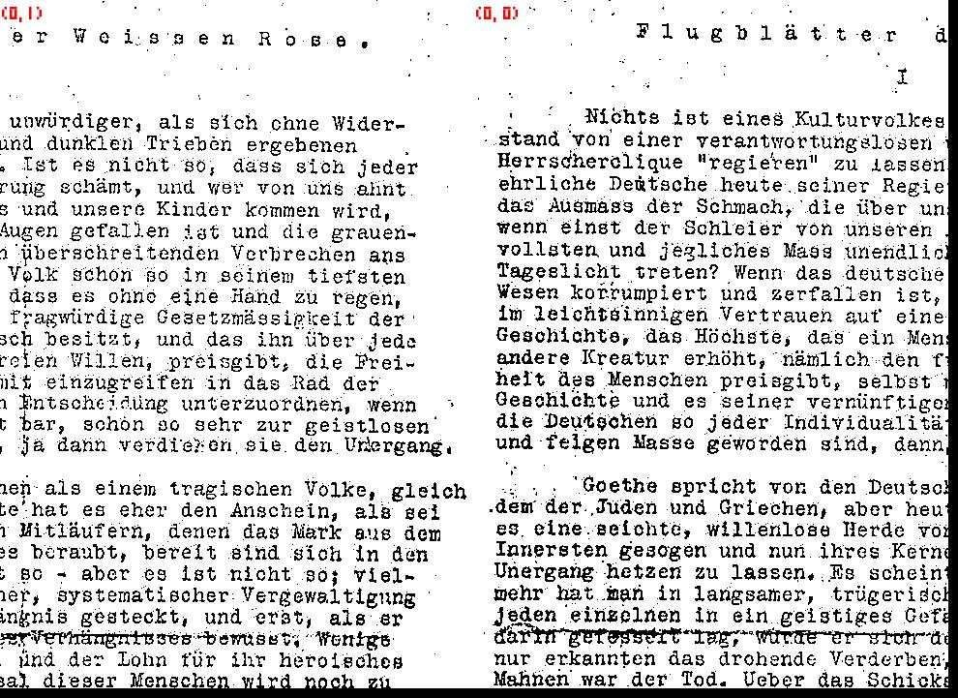
Cost functions
Problem with Pixel Cost : white on white edge always has cost of 0
worse
than

Slide 21
Cost functions
One solution used in literature:
  consider white on white pixels to be wrong
  Only pixel pair not incurring a penalty is now black on black
  Eg:
                has cost 2

Slide 22
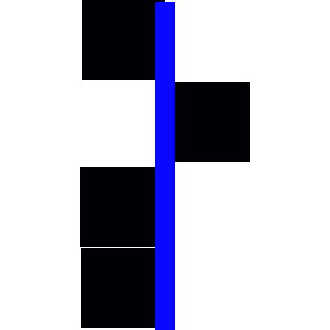
Cost functions
Black pixel cost mitigates the whitespace problem but still suffers from noise
Eg: has cost 4, but this
edge seems more
likely than a black
on white edge of
the same length

Slide 23
Cost functions
One solution is to use a gaussian to smooth the comparison by looking at several neighbouring pixels instead of just one
The distant neighbours are weighted as to contribute less to the result than the near ones
This is the most common method used in literature

Slide 24
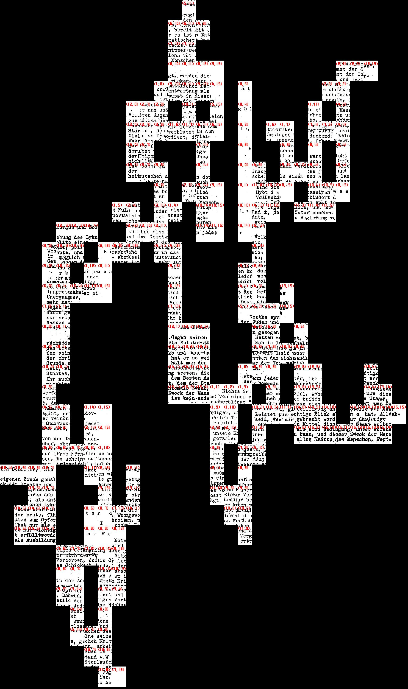
Gausian Cost function
Problem: produces this
  no cost for gaps
  search function favours
  gaps over pieces
  In middle of algorithm,
  not clear which gaps
  will be filled
  in a sense, the search
  finds a way to cheat

Slide 25
Probabilistic score
Possible solution: instead of edge with least cost pick edge most likely to be correct
  Calculate how unlikely each edge match seems based on probabilistic model
  For every edge normalize all potential matching scores so they add up to one
  Pick highest normalized probability

Slide 26
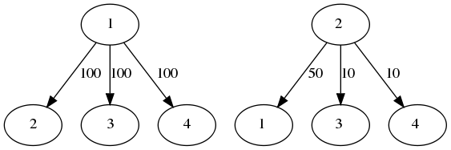
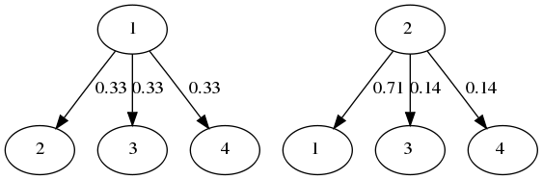
Probabilistic score
Eg:
  Before
  normalization
  After
  normalization
  Most likely edge is 2 -> 1 with a prob. of 71%

Slide 27
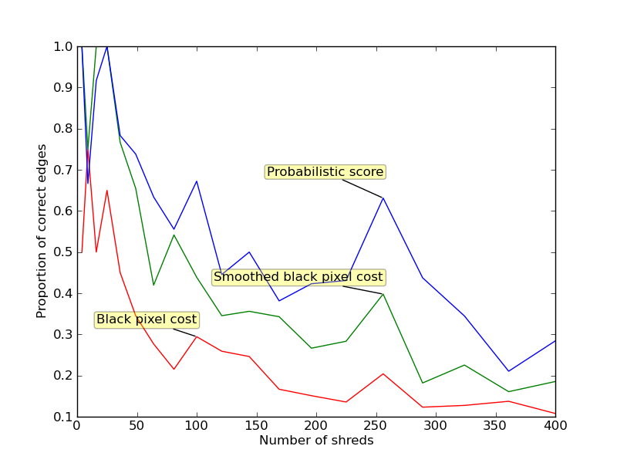
Results
Cut in n by n pieces

Slide 28
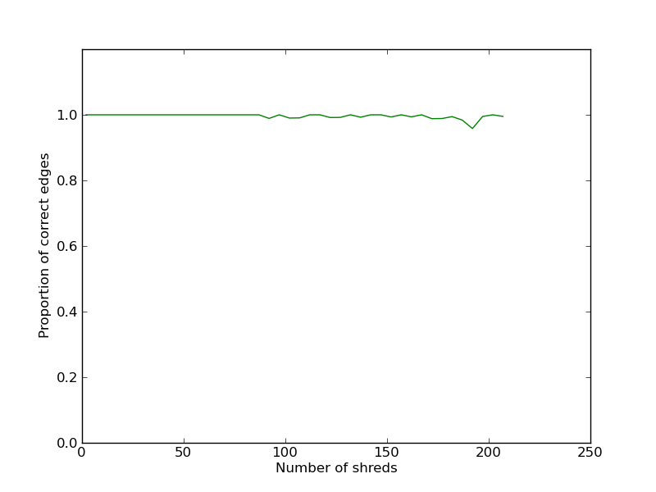
Results
Cut in 1*n pieces

Slide 29
Why the discrepancy?
The shorter the edge is the more prone to noise the score function is, as it has less pixels to compare
For text documents horizontal cuts have a significant chance of being between two lines of text, in this case score function is useless as it can only see a white on white edge
Search function is prone to cascading effect where 1 mistake leads to several others

Slide 30
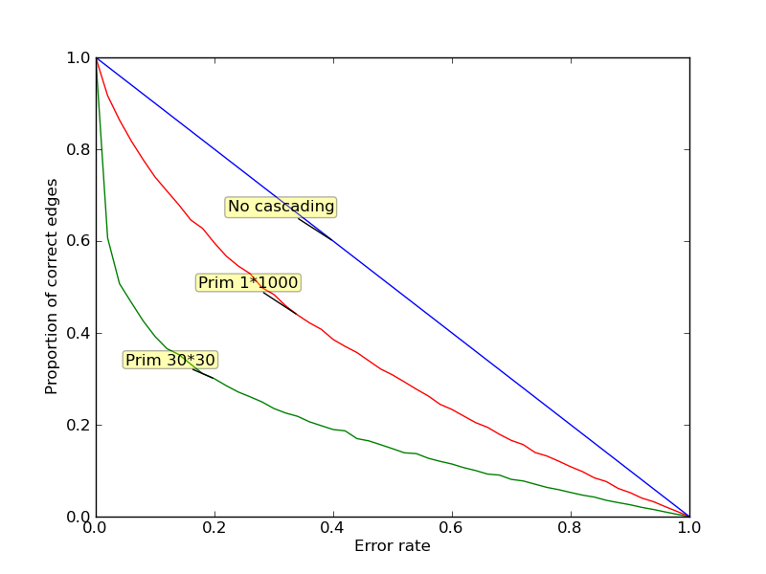
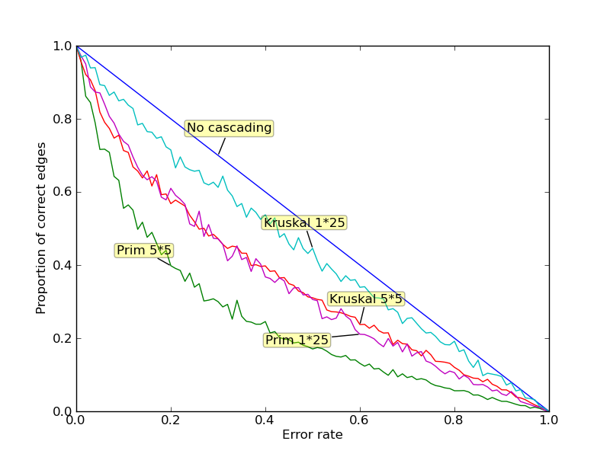
Robustness of search

Slide 31
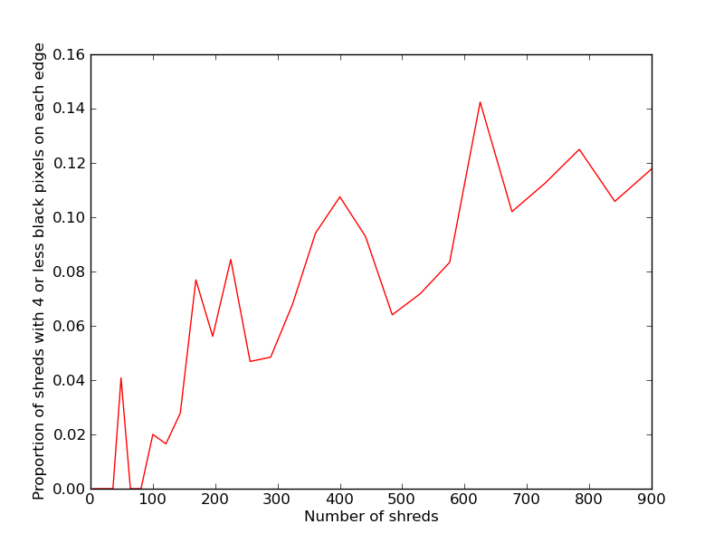
Quality of score

Slide 32
Timeline
Semester 1
  Week 11-12: Refactor; try to ameliorate the cascading problem (perhaps new heuristic which can recover from errors is needed)
Semester 2
    Week 1: Write up interim report
    Week 2-3: Look into integrating higher level features into cost function (eg: row placement, optical character recognition)
    Week 4-6: Look into Integer Linear Programming methods, analyse performance and feasibility for larger test cases
    Week 7-8: Test on real data, try to expand scope to different document types, if possible
    Week 9-12: Run any last experiments, finish report

