Slide 1
TypeScript decorators
Parautiu Razvan-sebastian

Slide 2
Topics
Introduction to decorators concept in TypeScript
Internal Slots and Internal Methods
Reflection API and Reflection Metadata API extension
Class decorator and demo examples
Method decorator and demo examples
Property decorator and demo examples
Example of dependency injection decorator
Q&A
Bibliography

Slide 3
1. Introduction to decorators concept in typescript
Decorators as experimental feature
What is a decorator
Decorator factories
Decorator composition
Evaluation order

Slide 4
Decorators as experimental feature
Stage 2 proposal for JavaScript available as experimental
Available from ES5
You have to enable this feature
tsc --target ES5 –experimentalDecorators
tsconfig.json
{
"compilerOptions": {
"target": "ES5",
"experimentalDecorators": true
}
}

Slide 5
What is a decorator?
Special kind of declaration attached to a class, method, accessor, property or parameter
Use the form @Expression where Expression evaluates a function called at runtime
Allows to add metadata

Slide 6
Decorator Factory
Allows to customize how a decorator is applied
Basically is a factory of functions that returns the function which will be called when expression is evaluated at runtime.
function Color(value: string) {
// this is the decorator factory, it sets up
// the returned decorator function
return function (target) {
// this is the decorator
// do something with 'target' and 'value'...
};
}

Slide 7
Decorators composition
Multiple decorators can be applied on a single line
Evaluation:
Expression (Decorator factory function) are evaluated from top-to-bottom
The functions results are called from bottom-to-top
@FirstDecorator
@SecondDecorator
someProperty
function FirstDecorator(): PropertyDecorator {
console.log("FirstDecorator(): factory evaluated");
return function (target: any, propertyKey: string, descriptor: PropertyDescriptor) {
console.log("FirstDecorator(): returned function called");
};
}
function SecondDecorator(): PropertyDecorator {
console.log("SecondDecorator(): factory evaluated");
return function (target: any, propertyKey: string, descriptor: PropertyDescriptor) {
console.log("SecondDecorator(): returned function called");
};
}
/*
FirstDecorator(): factory evaluated
SecondDecorator(): factory evaluated
SecondDecorator(): returned function called
FirstDecorator(): returned function called
*/

Slide 8
Decorator evaluation
There is a well defined order to how decorators applied to various declarations inside of a class are applied:
Parameter followed by Accessor or Property Decorators are applied for each instance member.
Parameter followed by Method, Accessor, or Property Decorators are applied for each static member.
Parameter Decorators are applied for the constructor.
Class Decorators are applied for the class.

Slide 9
2. Internal slots and internal methods
Specifications
Internal slots (properties)
Internal methods

Slide 10
2.1. Specifications
Introduced on ECMAScript 2015
Implemented by JavaScript engine
Abstracted away from the runtime (not accessible on objects like normal properties)
Represented by the [[<name>]] notation in ECMAScript specification where name is the name of the internal property (also called slot) or internal method
Objects have multiple internal slots and methods
ECMAScript specification (link here) doesn’t specify how these “exotic objects behaviours” are implemented

Slide 11
2.2. Internal slots
Correspond to internal state associated with objects
They are NOT objects properties and they are NOT inherited
They are allocated as part of the process of creating an object and may not be dynamically added to an object
Initial value of an internal slot is undefined

Slide 12
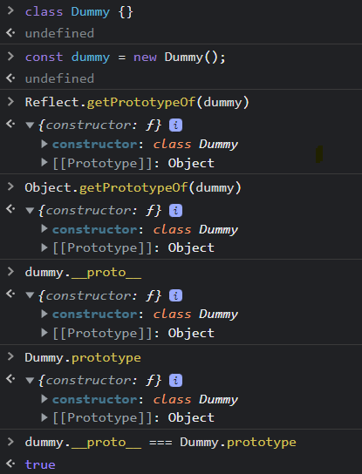
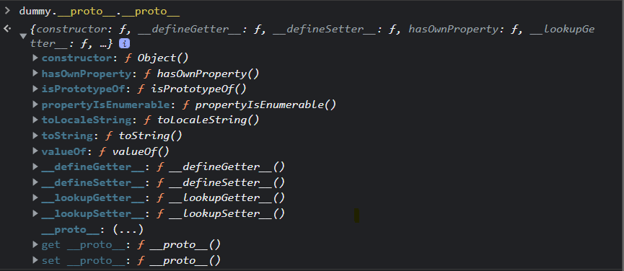
Example
obj.__proto__ points to the prototype of the obj and accessing it would be like accessing the [[Prototype]] internal slot ☺
Conclussion:
prototype is a property of the class/function which contains
Constructor
Root prototype (for example Object prototype)
__proto__ is an internal property (slot) of an object
Points to it’s prototype
Current standard to access it should be Object.getPrototypeOf(obj) or Reflect.getPrototypeOf(obj)

Slide 13
2.3. Internal methods
Methods names are polymorphic; different object values may perform different algorithms when a common internal method name is invoked
Actual object upon which internal method is invoked is the “target” of the invocation
TypeError might be thrown, if the target object doesn’t support the internal method

Slide 14
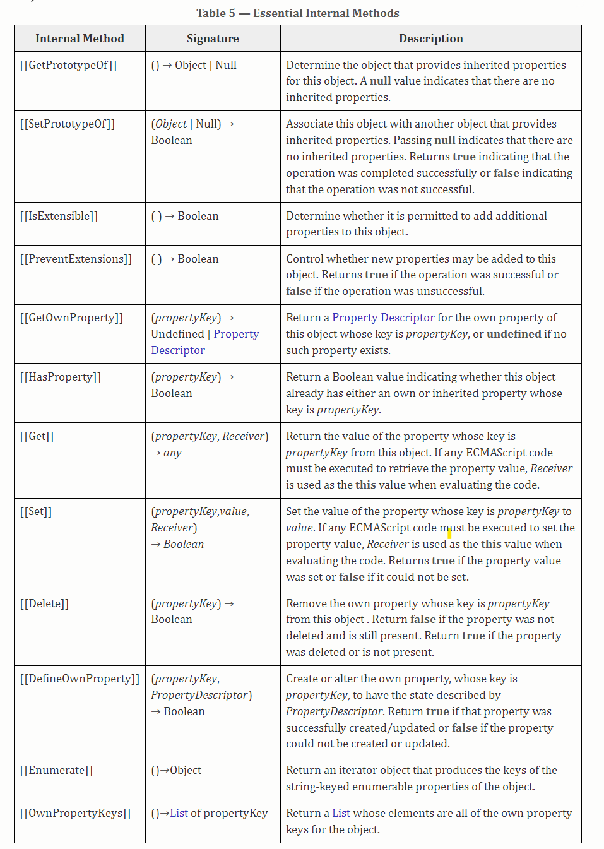
Reflect API this what it does under the hood. Whenever a method of it will be called, an internal method will be called.
Example:
Reflect.has(target, propertyKey) the engine will call [[HasProperty]] internal method
Link to docs

Slide 15
3. Reflection API and Reflection metadata API
Reflection ability explained
Internal slots (properties)
Internal methods

Slide 16
3.1. reflection
The ability of writing code which is able to “look at itself” by:
Examine or introspect it’s data structures and behaviours
Modify it’s own structure and behaviour
Before ES2015 only a few tools where available such as Object.keys or instanceof among many.

Slide 17
3.2. Reflection api
JavaScript provides Reflection API (from ES2015/ES6) which provides Reflect object.
“Reflect is a built-in object that provides methods for interceptable JavaScript operations” (mdn docs).
Every time a static method of Reflect object is called, some internal method is executed or an internal slot is accessed on the target object.
Might return the state of the object or change the behaviour of the object.

Slide 18
Introspection methods
Get returns the value of the property
Reflect.get(target, propertyKey)
Check if target object or it’s prototype contains provided property
Reflect.has(instance, propertyKey)
Get keys (props + non-enumerable + symbols)
Reflect.ownKeys(instance)
Get PropertyDescriptor
Reflect.getOwnPropertyDescriptor(instance, propertyKey)
Is extensible (new props can be added)
Reflect.isExtensible(target)
Get prototype
Reflect.getPrototypeOf(target)
Modification methods
Add new property
Reflect.defineProperty(instance, newPropertyKey, {
configurable: true,
enumerable: true,
value: 'new property value',
writable: true,
});
Update property value
Reflect.set(instance, propertyKey, newValue);
Delete property
Reflect.deleteProperty(dummyExample, propertyKey);
etc
For more details and methods, check this mdn docs

Slide 19
3.3. Reflection metadata api
Reflection Metadata API (Metadata Proposal – ECMAScript link here) is a proposed addition to Reflection API adding metadata functionality (tied to decorators proposal).
Extends Reflection object from Reflection API by adding Metadata API => Reflection Metadata API
New internal slot [[Metadata]] that will contain a Map
New internal methods
[[DefineOwnMetadata]]
[[GetOwnMetadata]]
[[HasOwnMetadata]]

Slide 20
This library is not part of ECMAScript standard; has to be manually installed
npm i reflect-metadata --save
tsc --target ES5 --experimentalDecorators --emitDecoratorMetadata
tsconfig.json
{
"compilerOptions": {
"target": "ES5",
"experimentalDecorators": true,
"emitDecoratorMetadata": true
}
}

Slide 21
demo

Slide 22
4. Class decorator

Slide 23
Declared before class declaration
Expression called as a function at runtime
The expression calls a ClassDecorator function
ClassDecorator function parameters:
Constructor of the decorated class
Used to: observe, modify or replace class definition

Slide 24
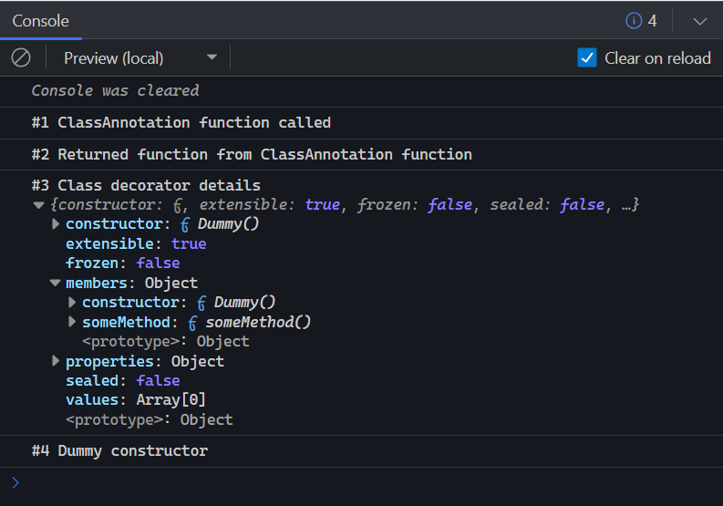
@ClassAnnotation('someValue')
export class Dummy {
dumyProperty: string = 'default';
constructor() {
console.log('#4 Dummy constructor');
}
someMethod(): string {
return 'string';
}
}
export function ClassAnnotation(param: string): ClassDecorator {
console.log('#1 ClassAnnotation function called');
return function (constructor: Function) {
console.log('#2 Returned function from ClassAnnotation function');
const constructorProperties = {
constructor,
extensible: Object.isExtensible(constructor),
frozen: Object.isFrozen(constructor),
sealed: Object.isSealed(constructor),
values: Object.values(constructor),
properties: Object.getOwnPropertyDescriptors(constructor),
members: {},
};
for (const key of Object.getOwnPropertyNames(constructor.prototype)) {
constructorProperties.members[key] = constructor.prototype[key];
}
console.log(`#3 Class decorator details `, constructorProperties);
};
}
const dummy = new Dummy();

Slide 25
Demo

Slide 26
5. Method decorator

Slide 27
Declared before method declaration
Expression called as a function at runtime
The expression calls a MethodDecorator function
MethodDecorator function parameters:
Constructor or prototype of the class
Name of the member
PropertyDescriptor for the member
Used to: observe, modify or replace method definition

Slide 28
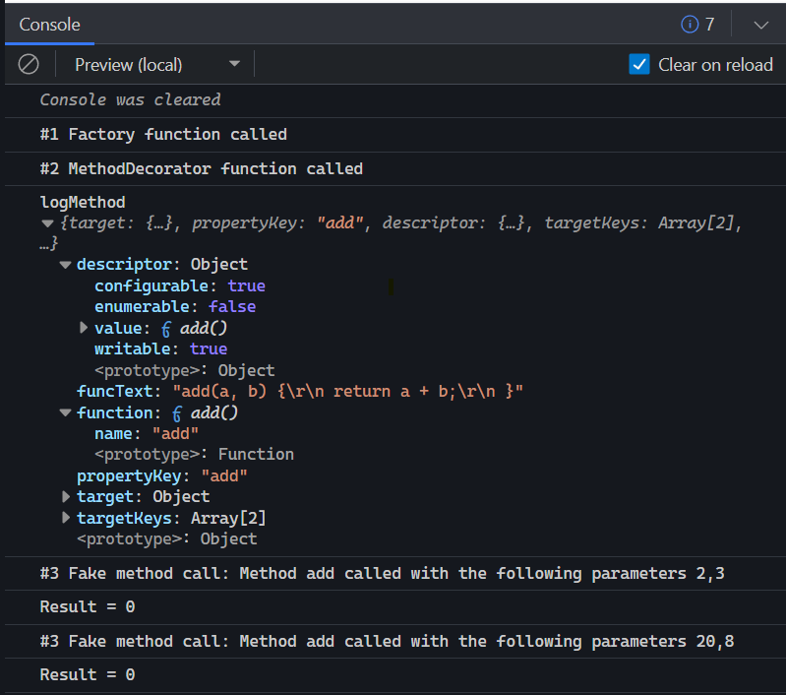
export function MockMethod(mockValue: any): MethodDecorator {
console.log('#1 Factory function called');
return function (
target: Object, // The prototype of the class
propertyKey: string, // Name of the method
descriptor: PropertyDescriptor
): PropertyDescriptor | void {
console.log('#2 MethodDecorator function called');
console.log(`logMethod`, {
target,
propertyKey,
descriptor,
targetKeys: Object.getOwnPropertyNames(target),
function: descriptor.value,
funcText: descriptor.value.toString(),
});
// Mock the function
descriptor.value = (...args: any) => {
console.log(
`#3 Fake method call: Method ${propertyKey} called with the following parameters ${args}`
);
return mockValue;
};
};
}
export class Dummy {
@MockMethod(0)
add(a: number, b: number) {
return a + b;
}
}
const dummy = new Dummy();
console.log(`Result = ${dummy.add(2, 3)}`);
console.log(`Result = ${dummy.add(20, 8)}`);

Slide 29
demo

Slide 30
6. Property decorator

Slide 31
Declared before class property declaration
Expression called as a function at runtime
The expression calls a PropertyDecorator function
PropertyDecorator function parameters:
Constructor or prototype of the class
Name of the property
Most of the time, used to add metadata to the target

Slide 32
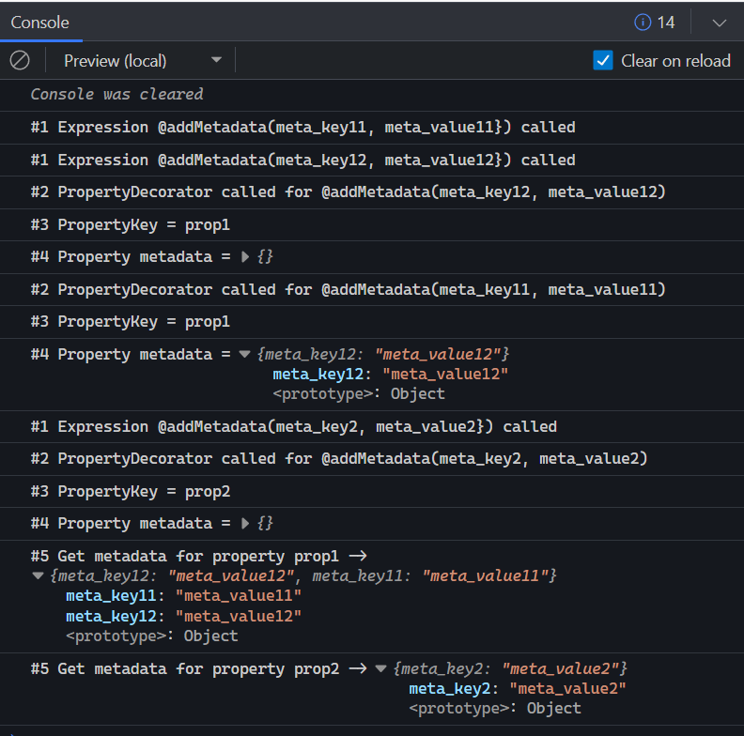
export const PROPERTY_METADATA_KEY = Symbol('propMeta');
export function addMetadata(
metadataKey: string,
metadataValue: any
): PropertyDecorator {
console.log(
`#1 Expression @addMetadata(${metadataKey}, ${metadataValue}}) called`
);
return function (constructor: Function, propertyKey: string | symbol): void {
console.log(
`#2 PropertyDecorator called for @addMetadata(${metadataKey}, ${metadataValue})`
);
console.log(`#3 PropertyKey = ${propertyKey as string}`);
let metadataOnProperty =
Reflect.getMetadata(PROPERTY_METADATA_KEY, constructor, propertyKey) ||
{};
console.log(`#4 Property metadata = `, metadataOnProperty);
if (metadataOnProperty) {
metadataOnProperty = {
...metadataOnProperty,
[metadataKey]: metadataValue,
};
}
Reflect.defineMetadata(
PROPERTY_METADATA_KEY,
metadataOnProperty,
constructor,
propertyKey
);
};
}
export class Dummy {
constructor() {}
@addMetadata('meta_key11', 'meta_value11')
@addMetadata('meta_key12', 'meta_value12')
public prop1: string;
@addMetadata('meta_key2', 'meta_value2')
public prop2: string;
}
const dummy = new Dummy();
dummy.prop1 = 'prop1';
dummy.prop2 = 'prop2';
const props = Reflect.ownKeys(dummy) as string[];
for (let prop of props) {
console.log(
`#5 Get metadata for property ${prop} -> `,
Reflect.getMetadata(PROPERTY_METADATA_KEY, dummy, prop)
);
}

Slide 33
demo

Slide 34
7. Example of dependency injection

Slide 35
8. Q&A

Slide 36
9. Bibliography
https://www.typescriptlang.org/docs/handbook/decorators.html
https://262.ecma-international.org/6.0/#sec-ordinary-object-internal-methods-and-internal-slots-isextensible
https://techsparx.com/nodejs/typescript/decorators/introduction.html
https://medium.com/jspoint/what-are-internal-slots-and-internal-methods-in-javascript-f2f0f6b38de
https://medium.com/jspoint/introduction-to-reflect-api-for-metaprogramming-in-javascript-8b5a2bb84282

