Slide 1

HarvestGnosis: Neural Networks in Disease Detection for Pomegranate Fruits
Innovative Application
Leveraging convolutional neural networks to automate pomegranate disease detection.
Agricultural Advancement
Addressing key agricultural challenges through AI-driven solutions.
Research Impact
Establishing a baseline for future agricultural AI applications and research.
Authors: Răzvan Călăuz & Octavian Coșofreț Babeș-Bolyai University Cluj-Napoca | 2025

Slide 2
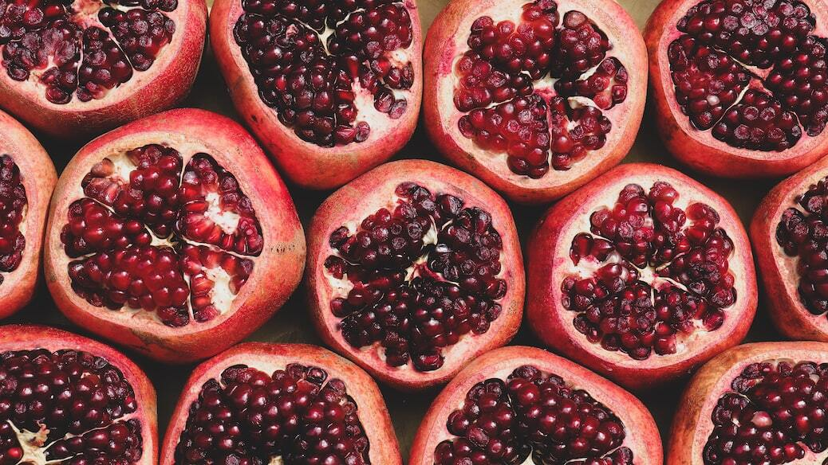
Project Motivation
Agricultural Challenges and AI Solutions for Pomegranate Disease Detection
Agricultural Challenges: Manual disease detection is labor-intensive, inconsistent, and costly.
Economic Impact: Pomegranate diseases significantly reduce yield and quality, leading to financial losses.
Need for Automation: High demand for real-time, reliable, and scalable disease detection systems.
Project Objectives: Detect 5 diseases, ensure real-time classification, and develop a user-friendly application.

Slide 3
Pomegranate Disease Dataset
High-Quality Dataset for Neural Network Training
Dataset Source: Collected from Kaggle, featuring curated pomegranate disease images.
Dataset Composition: 5,125 images post-cleaning, classified into 5 disease categories.
Class Imbalance: Unequal distribution among classes; requires mitigation strategies.
Visual Samples: Image examples highlight visual cues of disease differentiation.

Slide 4
Data Preprocessing Pipeline
Preparing Pomegranate Images for Neural Network Training
Image Resizing: Original images resized from 3120x3120 to 224x224 pixels.
Normalization: Pixel values scaled between 0 and 1 using MinMaxScaler.
Outlier Removal: Erroneous or mislabeled samples were eliminated from the dataset.
Data Split: 80% training, 20% testing split to ensure robust model evaluation.

Slide 5
Simple CNN Architecture
Initial Model for Pomegranate Disease Classification
2 Convolutional Blocks: Each block includes convolution, ReLU activation, and max pooling layers.
Key Parameters: Learning rate: 0.01, Dropout rate: 0.8, Epochs: 5, Batch size: 64.
Model Simplicity: Designed for quick prototyping and initial benchmark results.
Architectural Diagram: Visualization of input-output flow through convolutional and pooling layers.

Slide 6
Improved CNN Architecture
Enhanced Deep Learning Model for Higher Accuracy
3 Convolutional Blocks: Extended architecture with deeper feature extraction.
Enhanced Parameters: Filters increased to 32→64→128, reduced dropout to 0.5.
Learning Rate Optimization: Lowered to 0.001 to improve convergence and model stability.
Training Duration: Increased epochs to 30 for more thorough learning.

Slide 7
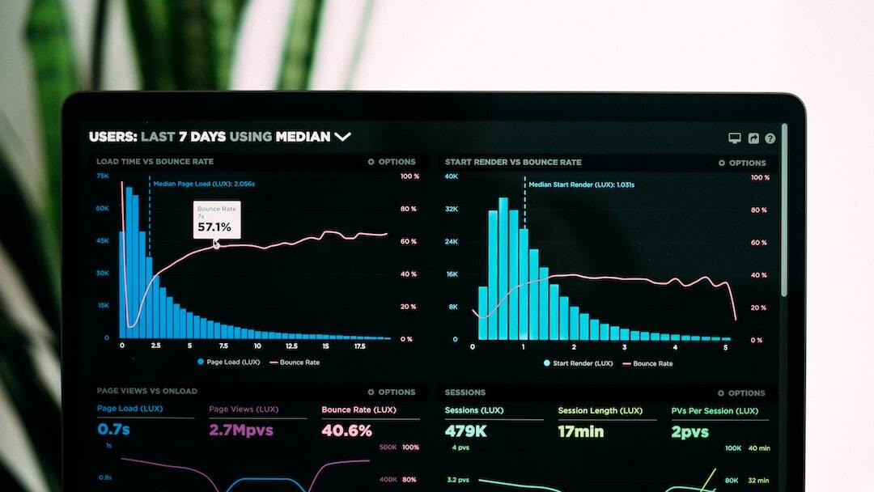
Performance Metrics
Comparative Results of Simple and Improved CNN Models
Simple CNN: Achieved 49.51% accuracy after 5 epochs.
Improved CNN: Boosted performance to 66.94% accuracy after 30 epochs.
Metrics Overview: Precision, recall, F1-score, and loss detailed for both models.
Performance Gain: Accuracy improved by 17.43% through architectural enhancements.

Slide 8

HarvestGnosis Application
System Architecture and Key Features
Architecture Overview: Backend: Flask; Frontend: Vue.js; Integrated for real-time processing.
Key Features: Drag-and-drop image upload, real-time disease prediction, confidence scoring.
Deployment Strategy: Packaged using PyInstaller for easy execution on user systems.
Interface Design: User-friendly and intuitive, facilitating quick adoption by non-experts.

Slide 9
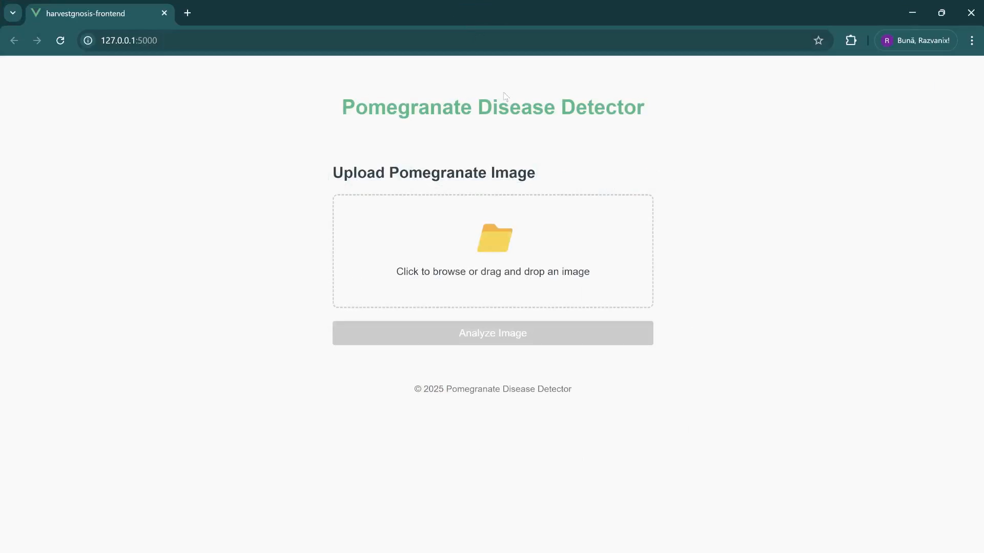
Application Demonstration

Slide 10
Current Limitations & Improvements
Challenges and Future Directions for HarvestGnosis
Dataset Imbalance: Class imbalance affects model generalization and bias.
Current Accuracy Gap: Achieved 66.94% vs. 97% in state-of-the-art benchmarks.
Proposed Improvements: Data augmentation, transfer learning (ResNet, EfficientNet), mobile app deployment.
Real-Time Segmentation: Future goal to implement fine-grained lesion segmentation.

Slide 11
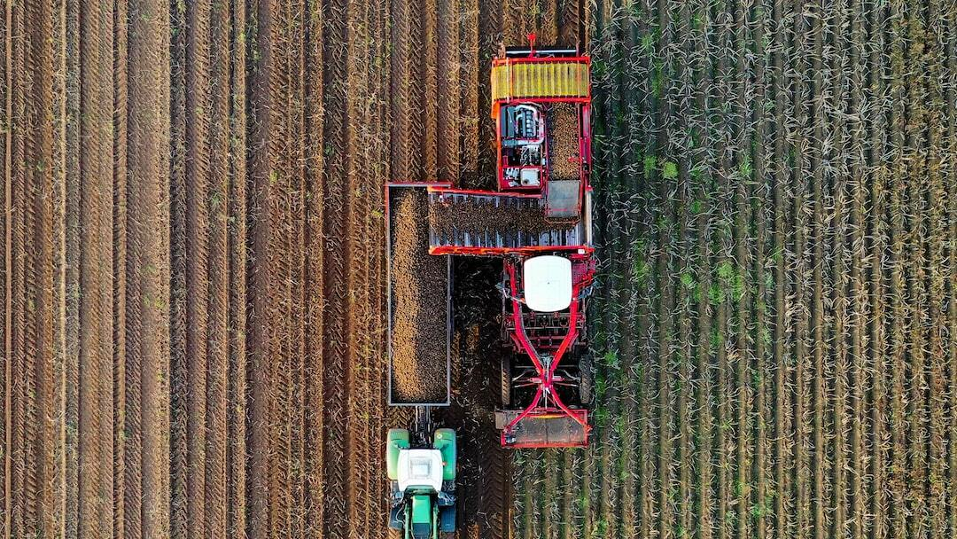
Key Takeaways
Summary of Achievements and Contributions
Successful Demonstration: CNNs effectively classified pomegranate diseases with real-world applicability.
Accuracy Enhancement: Architecture optimizations resulted in a 17.43% performance boost.
Application Development: HarvestGnosis provides a practical, accessible AI solution for agriculture.
Foundation for Future Work: Established a robust baseline for ongoing research and innovation.

Slide 12
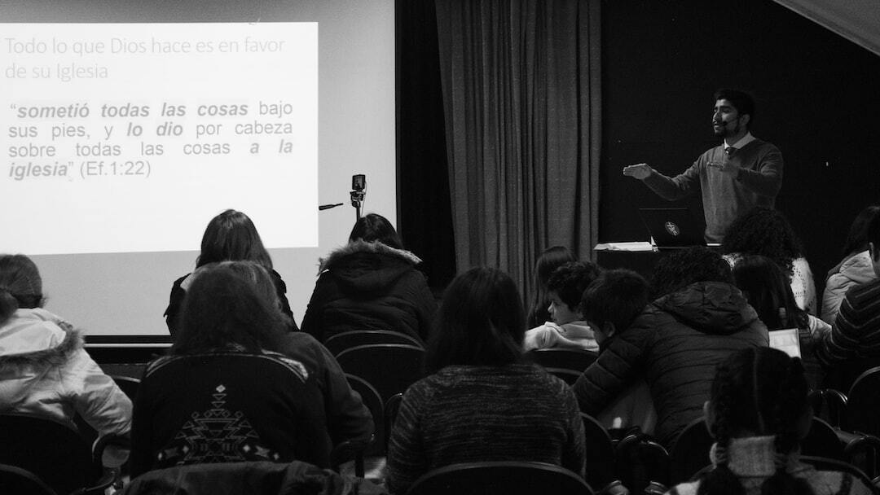
Q&A
Thank You for Your Attention!
Acknowledgments: Special thanks to project contributors and Babeș-Bolyai University.
Invitation to Collaborate : Open to feedback, suggestions, and future research partnerships.
GitHub Repository: Access code and resources: github.com/Razvanix445/MIASC/tree/main/HarvestGnosis.
Release Version: HarvestGnosis v1.0.0 available for download and testing.

