Slide 1
BScan and SMART ICT – Overview and Classification
V0.3
Kristian Trenkel

Slide 2
SMART ICT – Idea
Extension of the flash system with possibilities of testing
Extension of the benefit of the stations for the customer
Boundary Scan (BScan) using JTAG
Separate topic – also possible
SMART ICT includes/unites two area
Using Ideas of ICT to check the presence of components
Functional test based on the ProMik bootloader

Slide 3
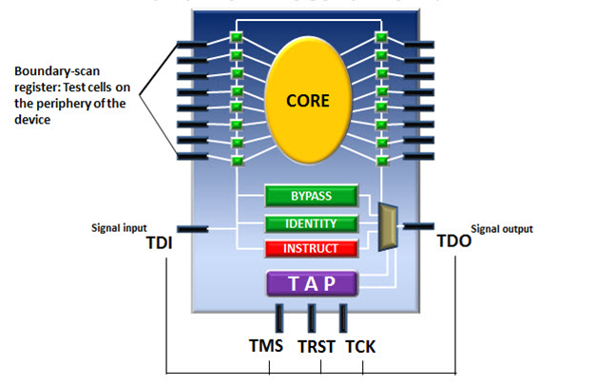
Boundary Scan Introduction
Defined in the JTAG standard IEEE Std. 1149.1 2001 (no major changes in 2013)
Main purpose is PCB production testing: solder joints, open IOs, shorts, etc.
The IO cells of boundary scan enabled ICs can be isolated from the Core and can be controlled via JTAG scan chains.
JTAG defines dedicated instructions (IR register) for boundary scan registers to control the IC’s IO cells (mandatory for JTAG compliance)
JTAG also defines some optional instructions to test the internal logic of ICs
See also T:\09_Development\04_Training\Martin_Raubuch_Boundary_Scan.pptx

Slide 4
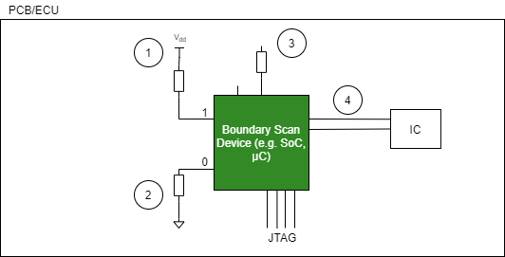
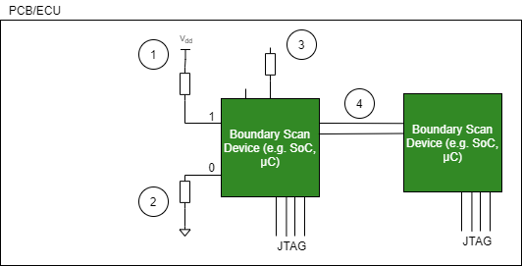
Boundary Scan Use Cases
One JTAG Device Two or more JTAG Devices
Infrastructure test – read/check the Device ID

Slide 5
Boundary Scan Use Cases
One JTAG Device Two or more JTAG Devices
Interconnection test – Check for Pullup (1), Check for Pulldown (2), Connection to logic (3), Connection zu IC or other Boundary Scan Devices (4)

Slide 6
SMART ICT – Functional Testing
Execution of functional tests by means of ProMik bootloader and function units of the µC or SoC
For large SoCs, Linux can and should also be used to execute the tests – reusability
Functional Tests can be:
RAM test
ADC test
Communications tests (e.g. CAN, CAN-FD, Ethernet, …)
…

Slide 7
BScan and SMART ICT – What can we do
BScan:
Identification of the JTAG device(s)
Checking the connections - Interconnection test
Functional Tests:
Everything which is connected to the µC/SoC
Test coverage depends on measurement capabilities (e.g. Values of an DAC)

Slide 8
BScan and SMART ICT – What we do not
BScan:
Functional testing of devices like RAM, Flash, Logical Gates, …
Functional Tests:
?
ICT:
No testing possibilities, as for example with the Flying Probe Test
→ Measurement of special component values (e.g. value of a resistor)

Slide 9
BScan and SMART ICT – Advantages for the customer
Faster Test of the ECU
High speed JTAG connection with ProMik hardware – Speedup of the BScan tests
Functional Testing using the µC/SoC hardware is faster and more efficient then using BScan (shifting bit pattern)
Test of modern interfaces like PCIe or DDR4 not possible with Bscan (trainings sequences needed)
No additional hardware for BScan needed
No effort for development of own functional testing software
Reduced number of steps/stations in production

