Slide 1
AWS Lambda
By Abdul Razzak Mohammed.

Slide 2
Introduction to AWS Lambda:
AWS Lambda is a serverless computing service.
It lets you run code without provisioning or managing servers.
We just have to upload our code and AWS automatically handles the rest.
It only charges for the time our code runs.
If we have created our function and haven’t used it, then there will be no cost.

Slide 3
Key Features of AWS Lambda:
Event-Driven:
Triggered by events like HTTP requests, file uploads, or database updates.
Automatic Scaling:
Scales horizontally in response to incoming requests.
Pay-As-You-Go:
Charges only for compute time used (no idle charges).
Multi-Language Support:
Supports languages like Python, Node.js, Java, Go, Ruby, and .NET.

Slide 4
Event-Driven Execution:
Lambda is an event-driven service, meaning that it runs our code in response to certain triggers or events.
These events can come from many different AWS services like:
S3(file uploads)
HTTP requests
CloudWatch (scheduled events) etc.

Slide 5
How AWS Lambda Works:
Trigger Setup: Configure triggers such as S3, DynamoDB, API Gateway, etc.
Function Creation: Write code and upload to AWS Lambda.
Trigger Setup: Configure triggers such as S3, DynamoDB, API Gateway, etc.
Execution: Lambda runs the code in response to triggers.
Monitoring: Integrated with AWS CloudWatch for logging and monitoring.

Slide 6
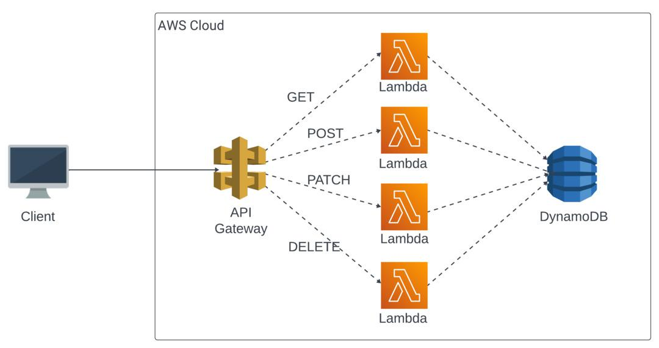
Functional Diagram with API Gateway as trigger:

Slide 7
Benefits:
No server management.
Automatic scaling.
Cost-efficient.
Can be integrated with AWS services.

Slide 8
Limitations:
Execution timeout: Lambda functions can only run for a maximum of 15 minutes.
Cold starts Delays: If Lambda function hasn’t run in a while, there’s sometimes a slight delay when it starts up. This can cause a little latency.

Slide 9
Uses of Lambda:
Image Processing: Let’s say users upload images to your app. You can set up Lambda to automatically resize, compress or even to apply filters to each image.
Data Transformation: If you need to clean up or process data before storing it in a database, a Lambda function can handle that transformation automatically.
Real Time Notifications: If an event happens- Like a new user signing up- you can use Lambda to trigger a notification through email or SMS.

