Slide 1
Charting COVID Vaccinations, Morbidity + Mortality
Linea Fuller, Christine Li, Ryan Apolonio, Raymon Faylona, Christine Newkirk

Slide 2
Motivating Question
What is the relationship between cumulative positive COVID cases, cumulative COVID deaths, and cumulative number of vaccines administered over time in the Southwest?
Do spikes in COVID cases and/or deaths seem to motivate an acceleration in vaccine uptake throughout the pandemic?

Slide 3
Data Sources
Centers for Disease Control
-Cumulative number of vaccines administered by state, as reported by local health agencies and compiled by the CDC, starting December 14, 2020
New York Times COVID 19 GitHub Data
-Cumulative cases and deaths by state for each day, starting January 21, 2020
Notes:
CDC Source: https://data.cdc.gov/Vaccinations/COVID-19-Vaccinations-in-the-United-States-Jurisdi/unsk-b7fc
NYTimes Source: https://github.com/nytimes/covid-19-data

Slide 4
Extract
Transform
Downloaded as CSV files
Two initial tables created by reading the CDC and NYTimes CSV files into Jupyter Notebook
Fields included: Date, State, Cumulative Vaccinations Administered, Cumulative COVID Cases, Cumulative COVID Deaths
Records before January 14, 2020 dropped
Transformed records by date by state into records by date by region, for the Southwest only
New Cumulative Vaccinations, Cumulative COVID Cases + Cumulative COVID Deaths calculated totaling values for CA, NV, UT and AZ for each date in the datasets

Slide 5
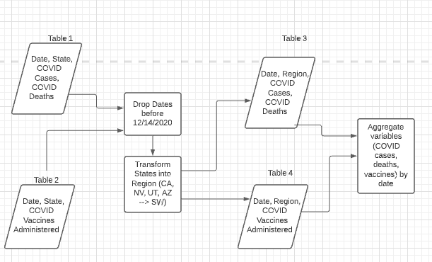
Transform

Slide 6
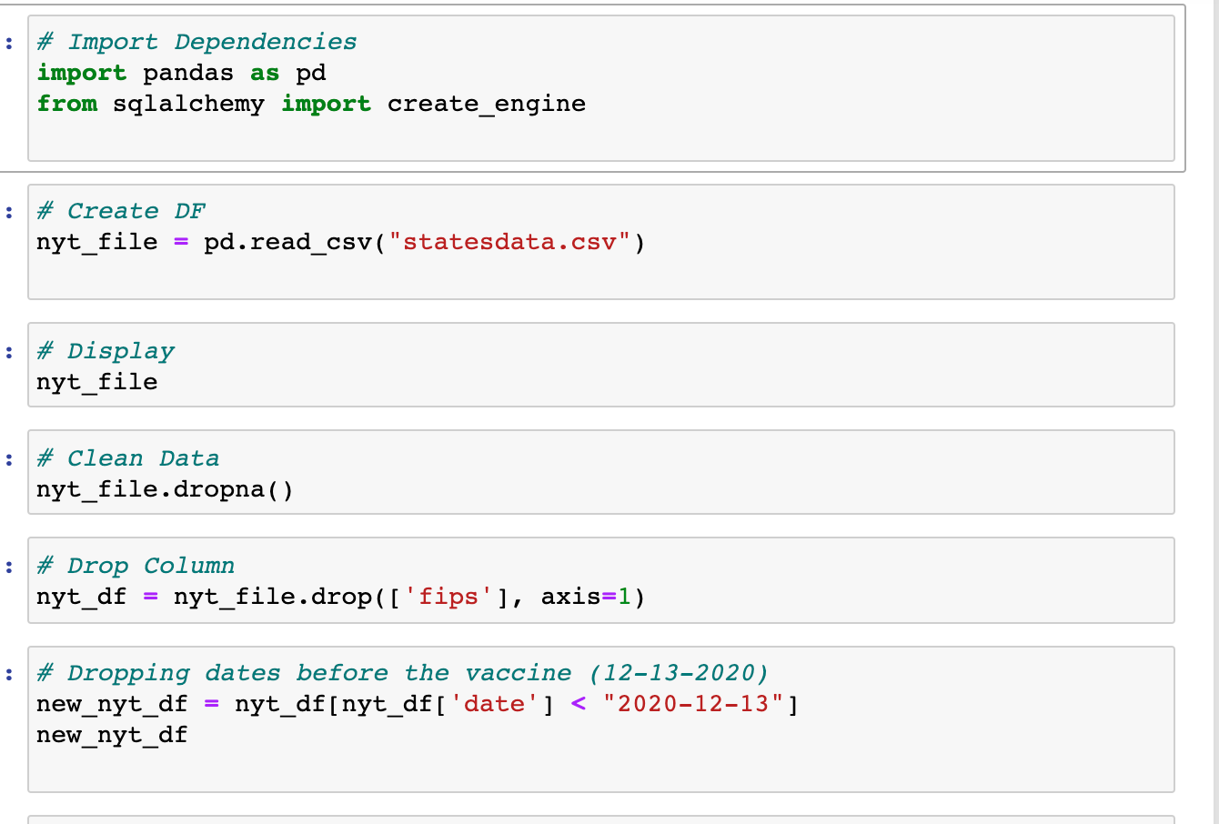
Extracting, Cleaning NY Times data

Slide 7
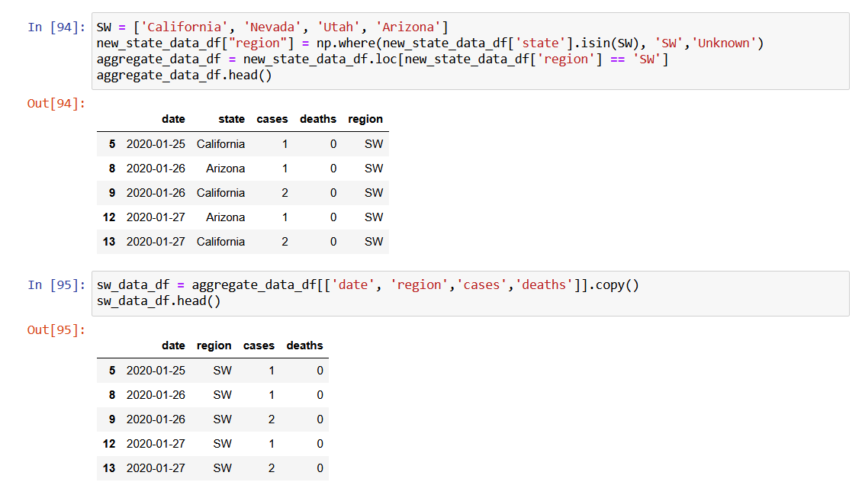
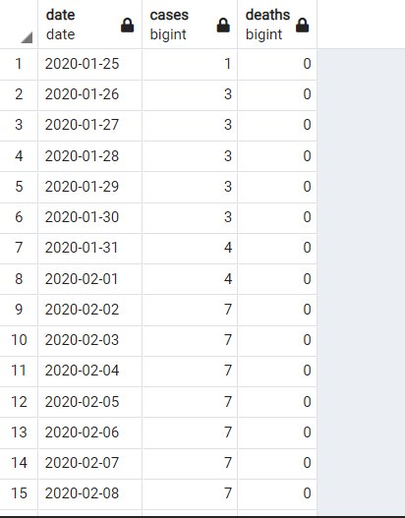
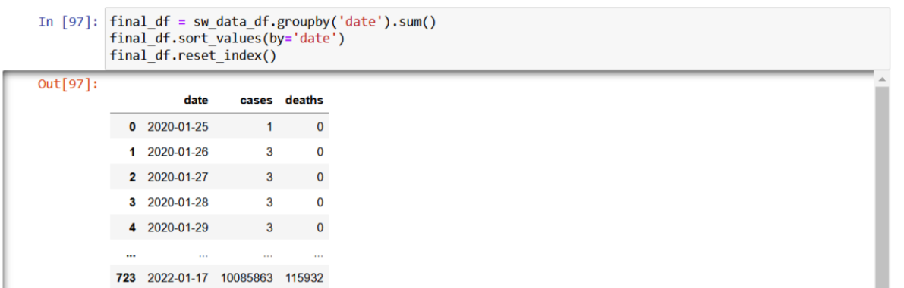

Transforming,Loading NY Times data

Slide 8
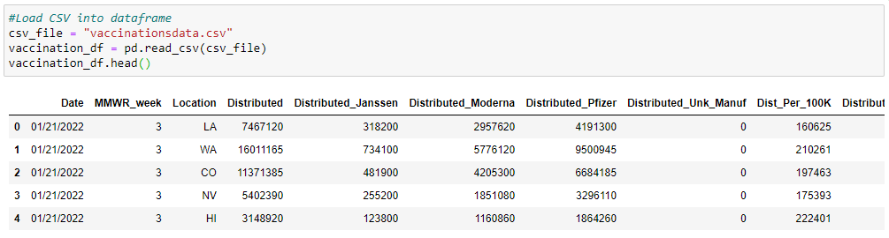
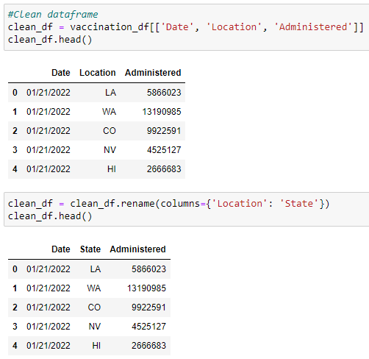
Extracting, Cleaning CDC data

Slide 9
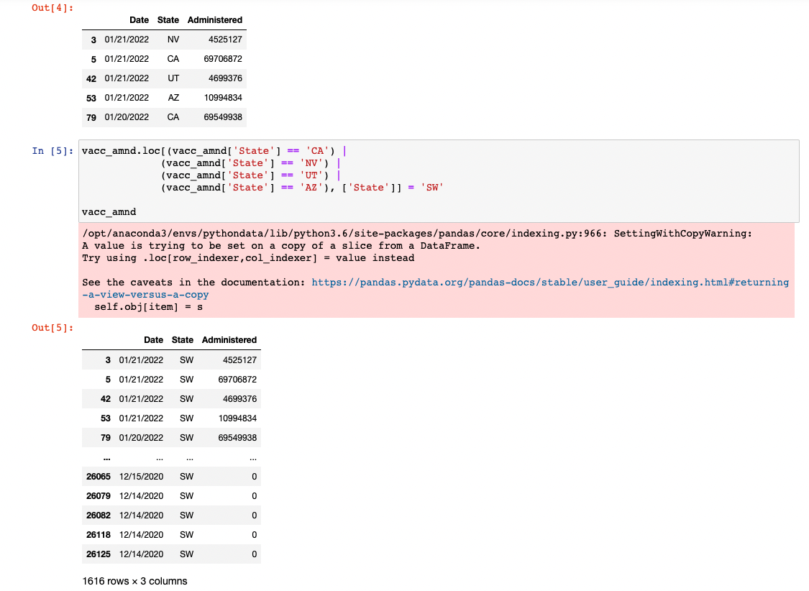
Transforming CDC data

Slide 10
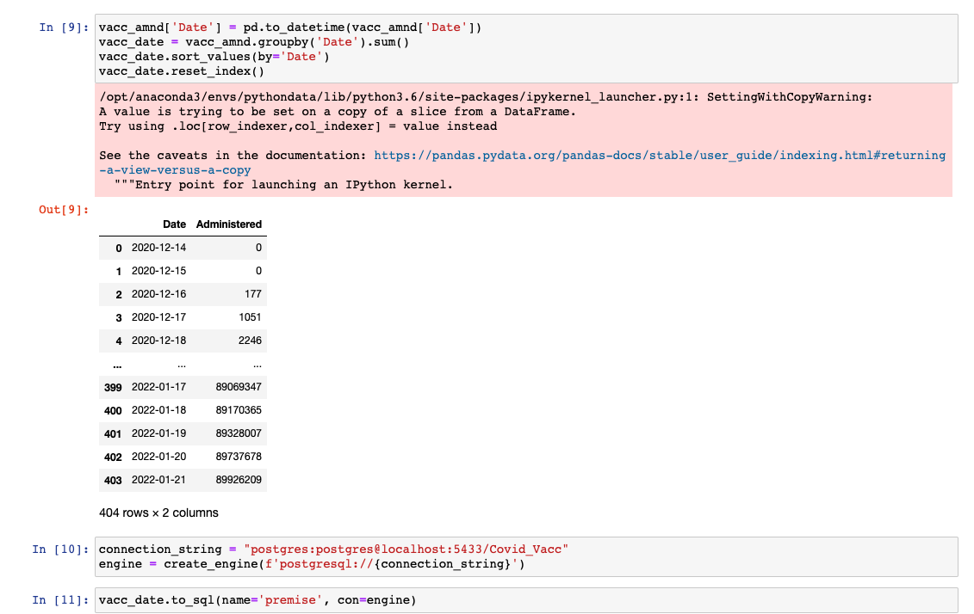
Loading CDC data

Slide 11
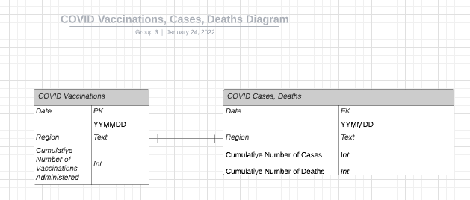
Join
Data tables are joined using an outer join

Slide 12
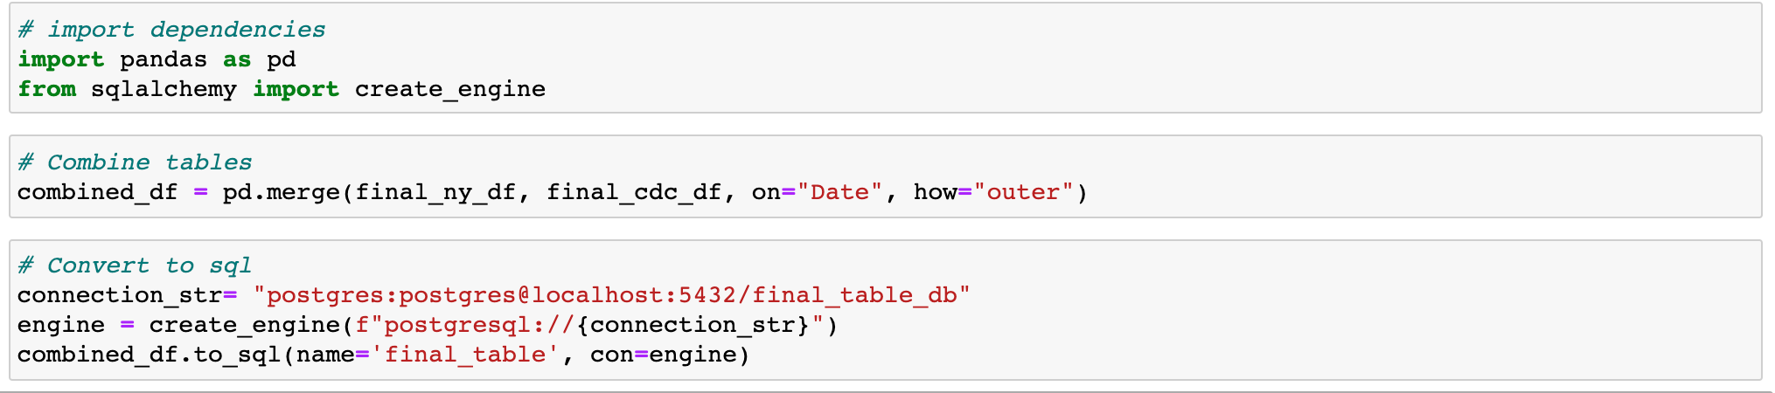
Merge to final database

Slide 13
Planned Visualizations and Analyses:
Line graph plotting cumulative vaccinations against cumulative positive cases and deaths
Test for statistically significant correlation between cumulative positive cases/deaths and vaccinations

