Slide 1


Slide 2
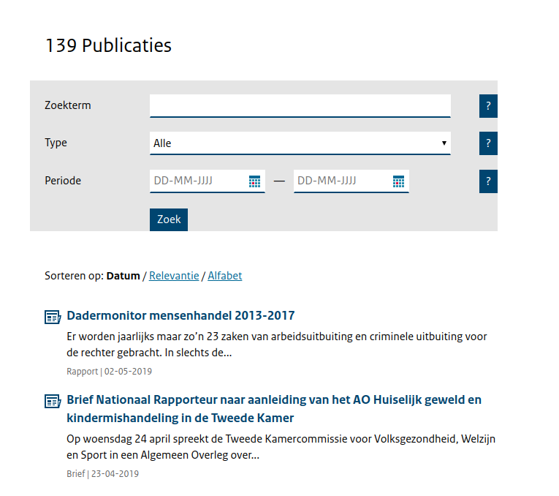
Problem
Notes:
Although the database and the documents are searchable,
search results only show the report in which the information is found.
information in this database needs to become more accessible.

Slide 3
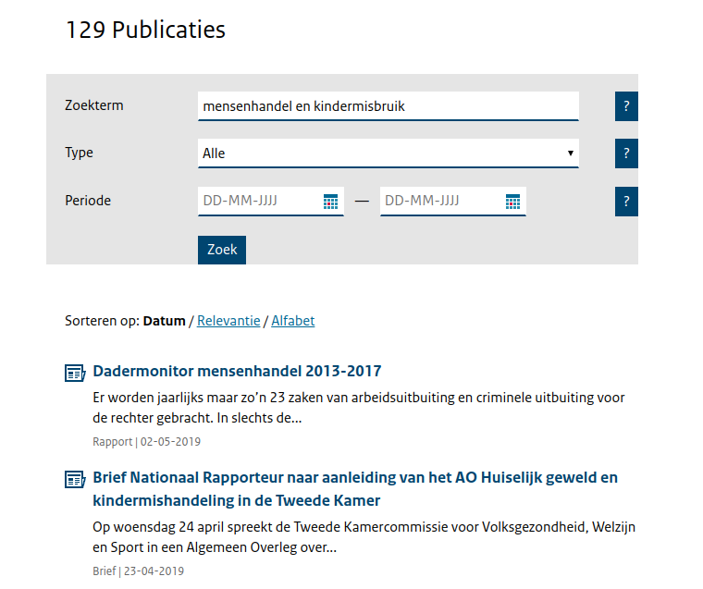
Problem
Notes:
-example: if you search for mensenhandel en kindermisbruik
- it returns almost all

Slide 4
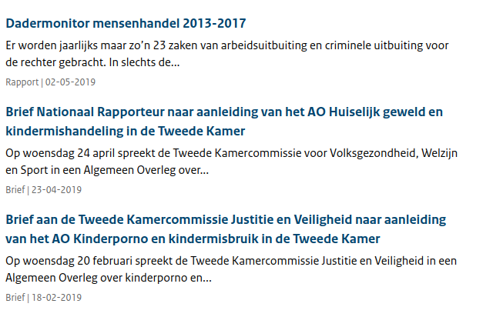
Problem
Notes:
Problem: only first sentence displayed of document

Slide 5
Goal
Develop an algorithm to facilitate the flow of information between the National Rapporteur and interested parties
Notes:
Talk about different parties: law, media, researcher

Slide 6
Approach
Instead of clicking through each file manually, we built a dashboard to quickly gain insights based on your preferences
Notes:
Concise Representation of the document by measuring the most important paragraphs
Solution allows valuable insight over multiple document types (word cloud), tailor made not only for the general public but also for the media (filters with kewl ranking)
-gen pub: relevance ranking
-media: opinion ranking (opinion detection)

Slide 7
PDF Parsing:
Automatically parse pdfs
Extract individual paragraphs
Extract metadata (title, date, language)
Notes:
139 large documents, 250 pages, 1000s para

Slide 8
Ranking technique:
Paragraph scoring based on pagerank algorithm (top 3)
Date of publication
Filters:
Search term
Purpose: opinion, relevance
Document type: brief, jaarplan, publicatie, toespraak, rapport
Language: Dutch, English
Notes:
explain pagerank
Opinion Mining - sentiment analysis

Slide 9
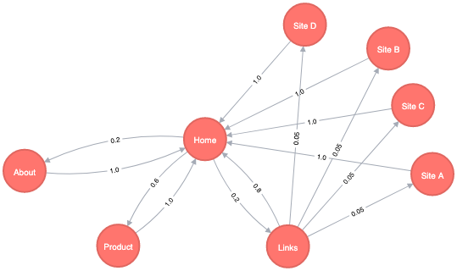
Notes:
explain pagerank
Opinion Mining - sentiment analysis

Slide 10
Dashboard demo

Slide 11
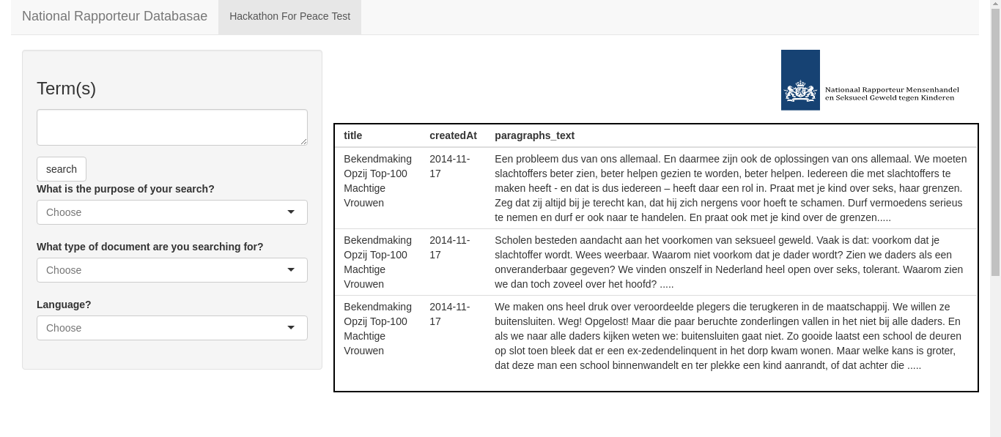

Slide 12
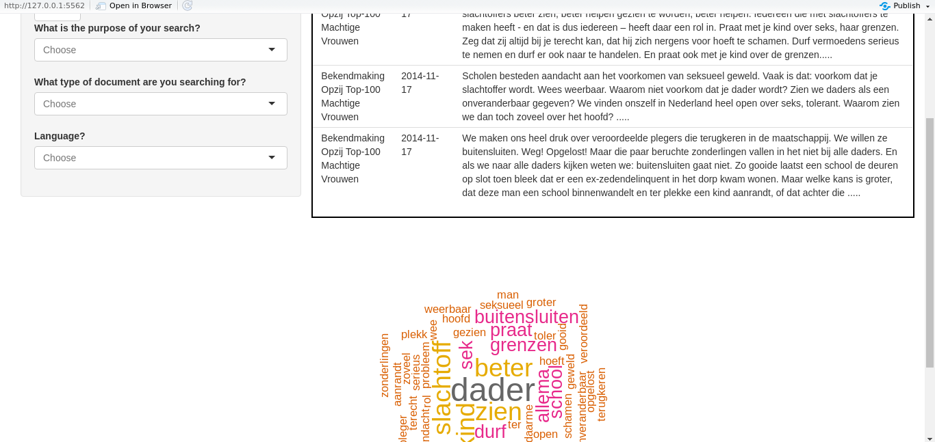

Slide 13
