Slide 1
LET’S HUMANIZE TECHNOLOGY

Slide 2
Get your phones ready!

Slide 3
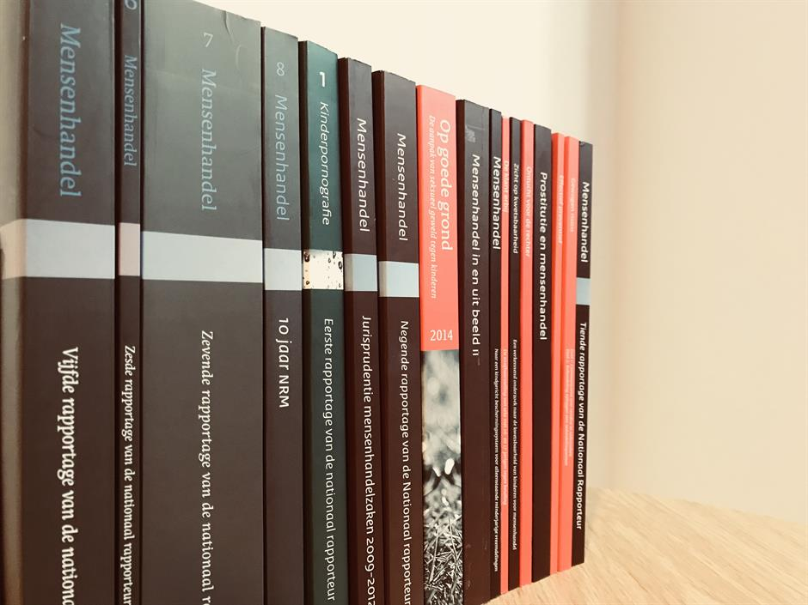


Slide 4

Mission
Decision making
Knowledge accessible to everyone
Human-in-the-loop

Slide 5
This is how we do it!

Slide 6
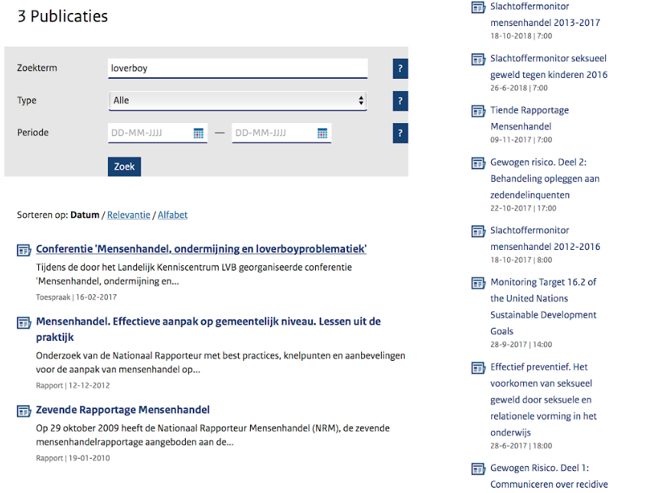

Slide 7
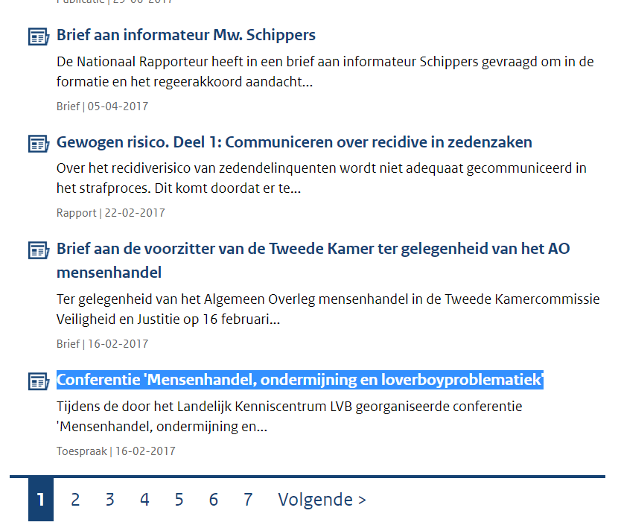

Slide 8
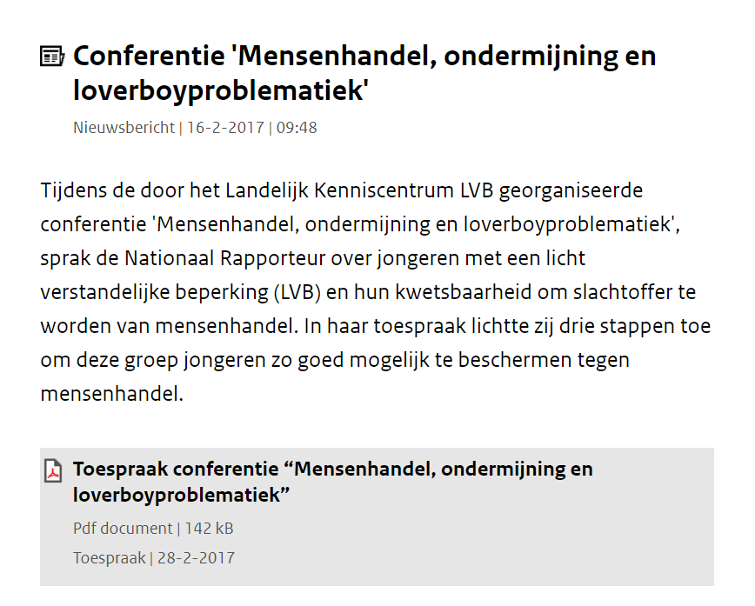

Slide 9
Show me what you got!

Slide 10




External Users
National Rapporteur
Relevant results
User-friendly
Easily interpretable
Efficient
Scalable
Usable
Notes:
<div>Icons made by <a href="https://www.flaticon.com/authors/monkik" title="monkik">monkik</a> from <a href="https://www.flaticon.com/" title="Flaticon">www.flaticon.com</a> is licensed by <a href="http://creativecommons.org/licenses/by/3.0/" title="Creative Commons BY 3.0" target="_blank">CC 3.0 BY</a></div>

Slide 11
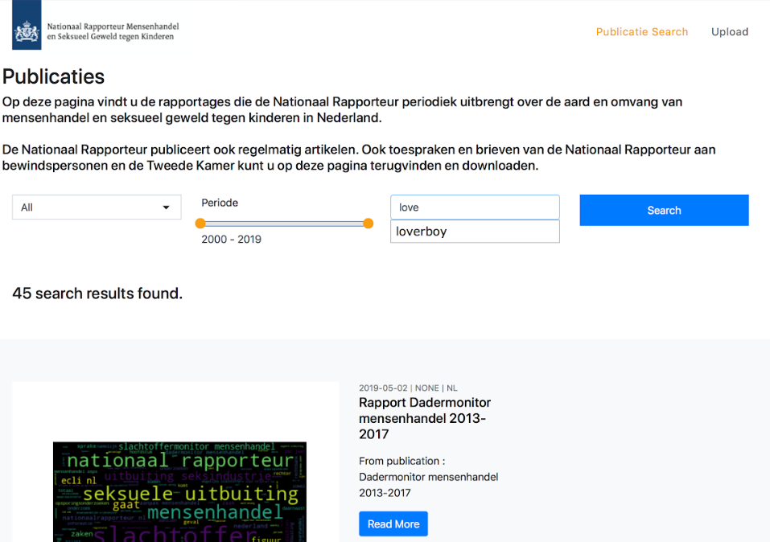

Slide 12
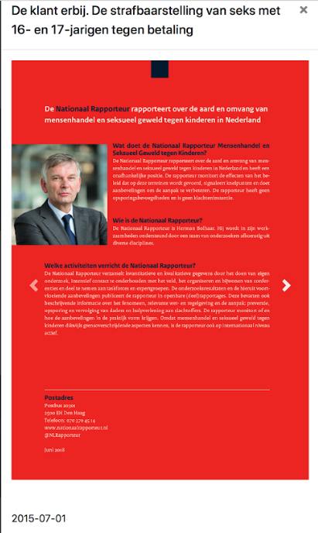


Slide 13
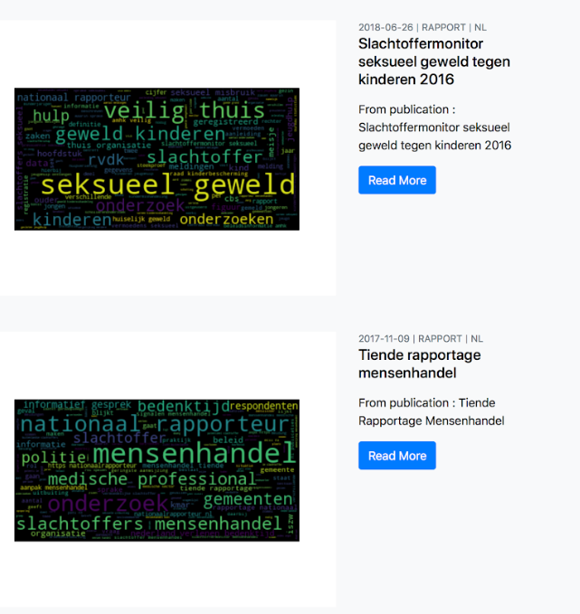

Slide 14
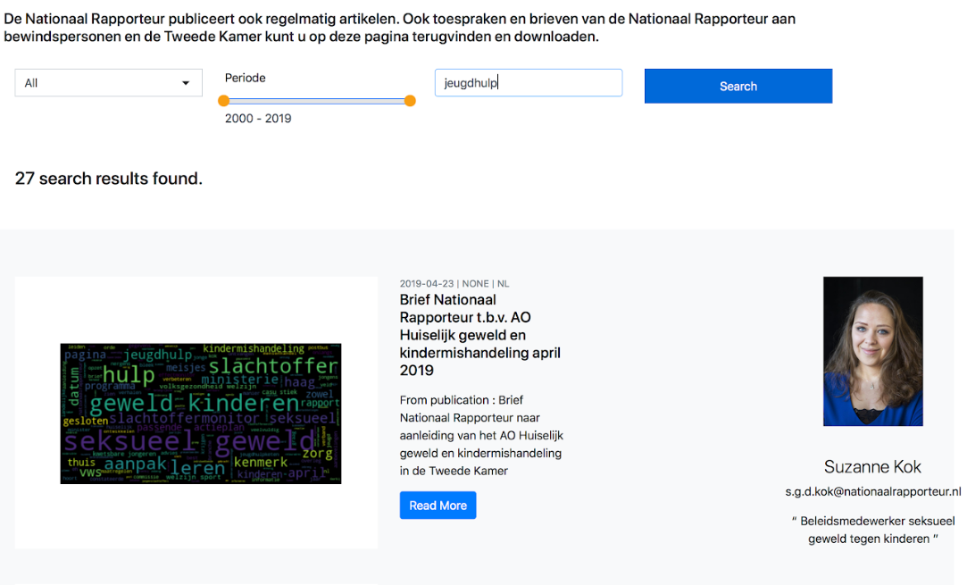

Slide 15
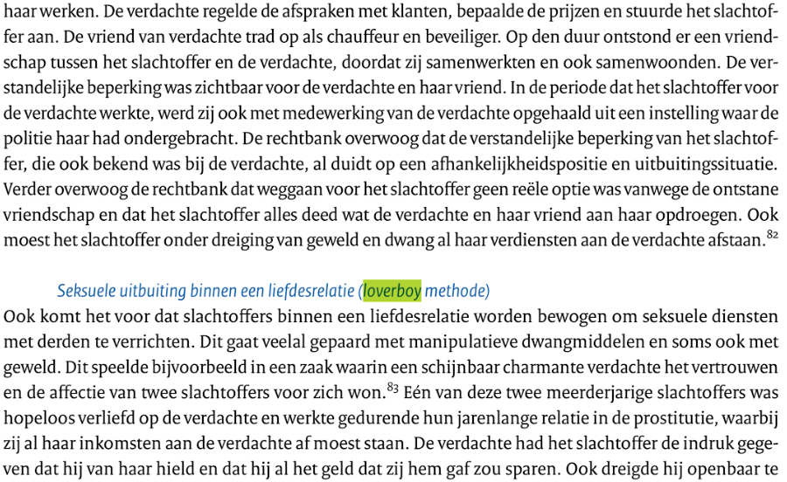

Slide 16
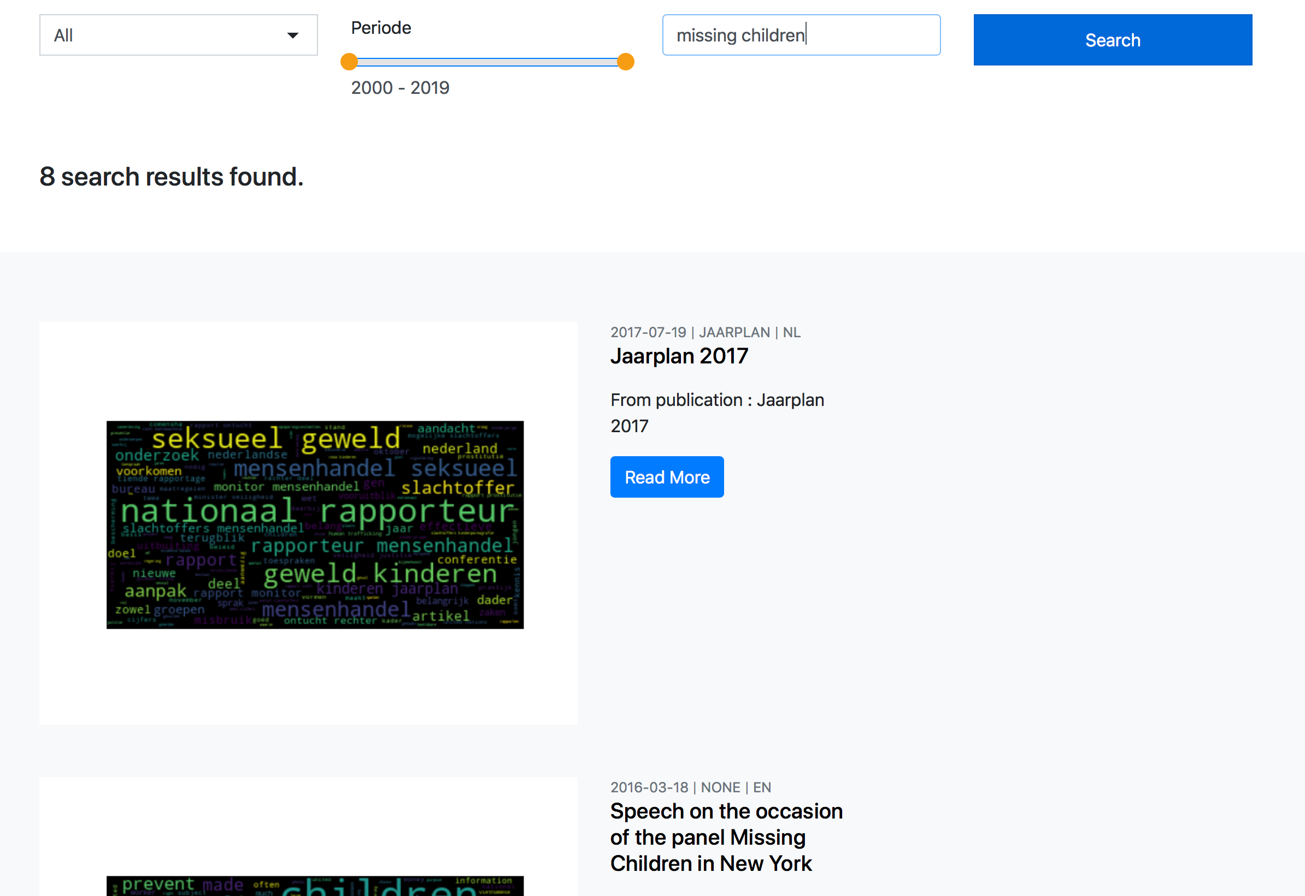

Slide 17
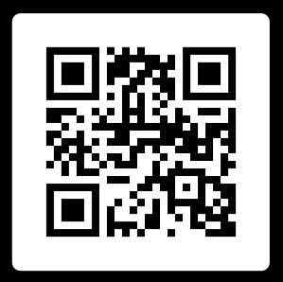
Scan me!

