Slide 1

Strategies and Insights To Minimize Costs and Maximize Revenue in 2019

Slide 2
Key Strategies
Strategy 1
Increase Sales by 10% While Reducing Rental Vehicle Price Per Day by 5%
Strategy 2
Replace Low-Revenue/High-cost Vehicles With High-Revenue/Low-Cost Vehicles
Strategy 3
Increase Total Fleet Size

Slide 3
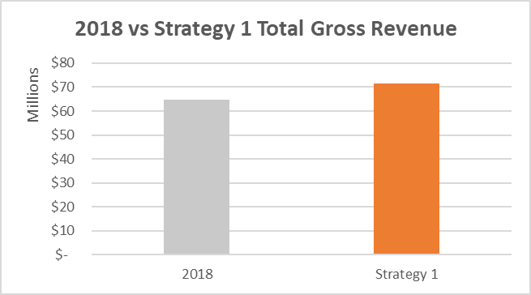
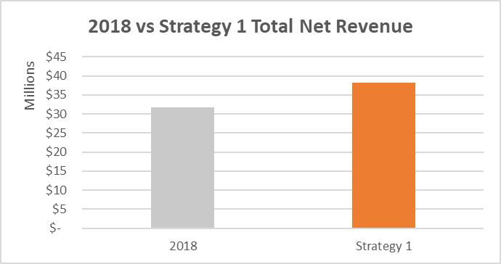
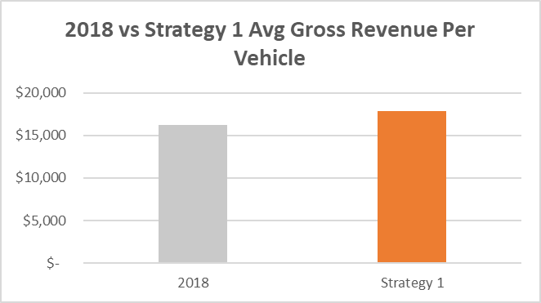
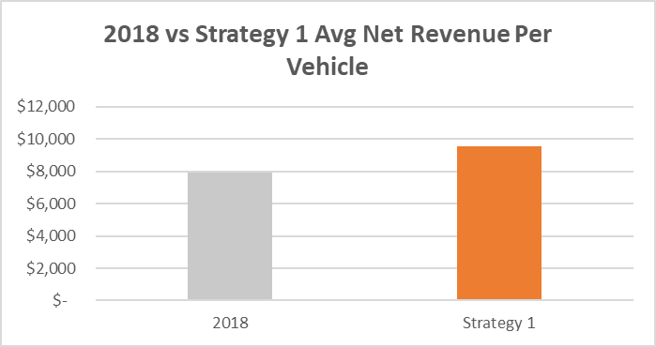
Strategy 1 Increase Sales 10% + Reduce Rental Price Per Day 5%

Slide 4
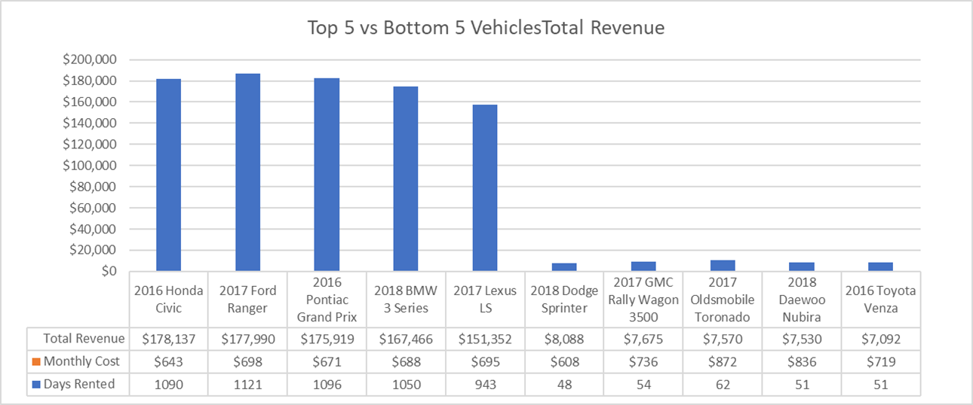
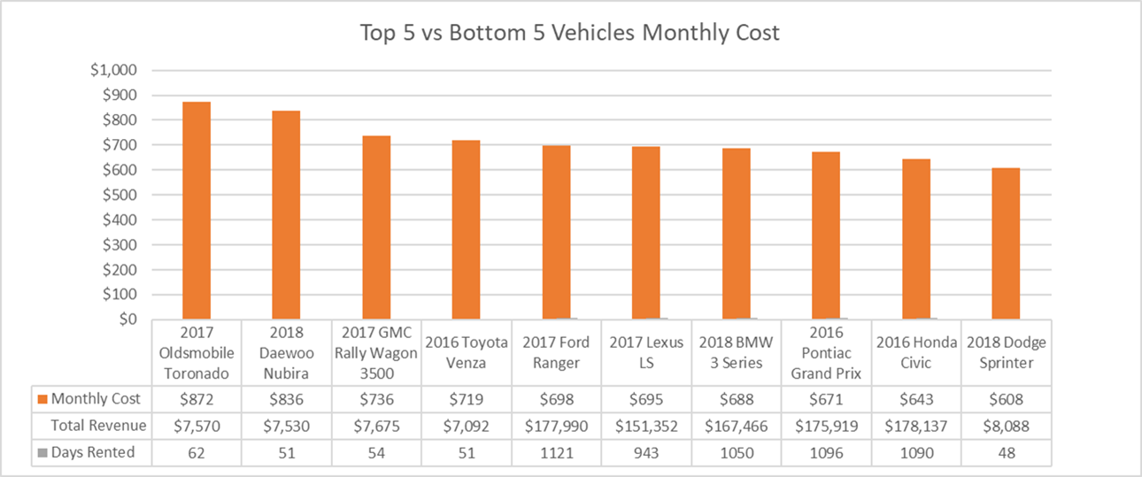
Strategy 2 Replace The 5 Lowest-Revenue/High-Cost Vehicles With The Highest Earning Vehicle (2016 Honda Civic)

Slide 5
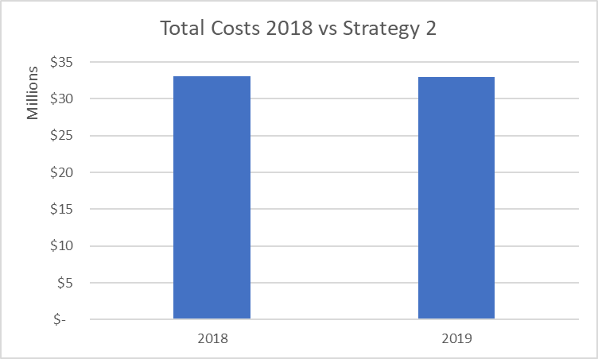
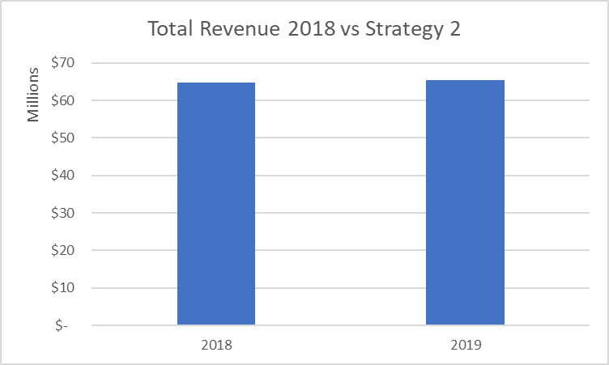
Strategy 2 Replace The 5 Lowest-Revenue/High-Cost Vehicles With The Highest Earning Vehicle (2016 Honda Civic)

Slide 6
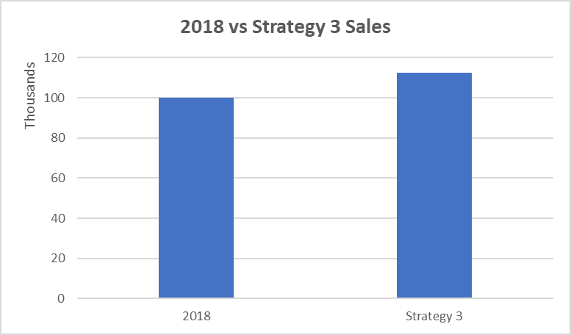
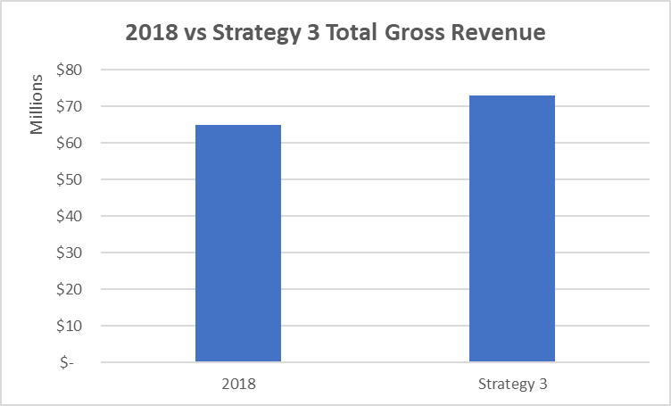

Strategy 3 Increase Fleet Size by 12.5% (+500 Vehicles)

Slide 7

Additional Insights **Further Analysis To Be Done**
Increase Sales In The Months of Nov-Dec With Promotions/Special Pricing
Add/Move Additional Vehicles To Under-Performing Branches To Boost Revenue

Slide 8
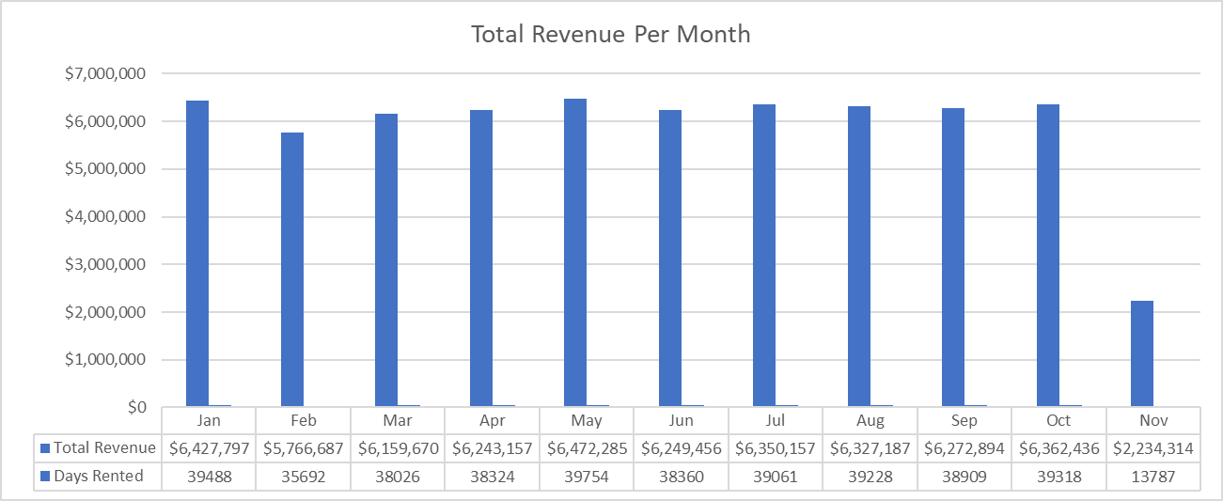
Insight 1
Offer Promotions/Special Pricing To Bring In New Business In November and December
**No Revenue in December**

Slide 9
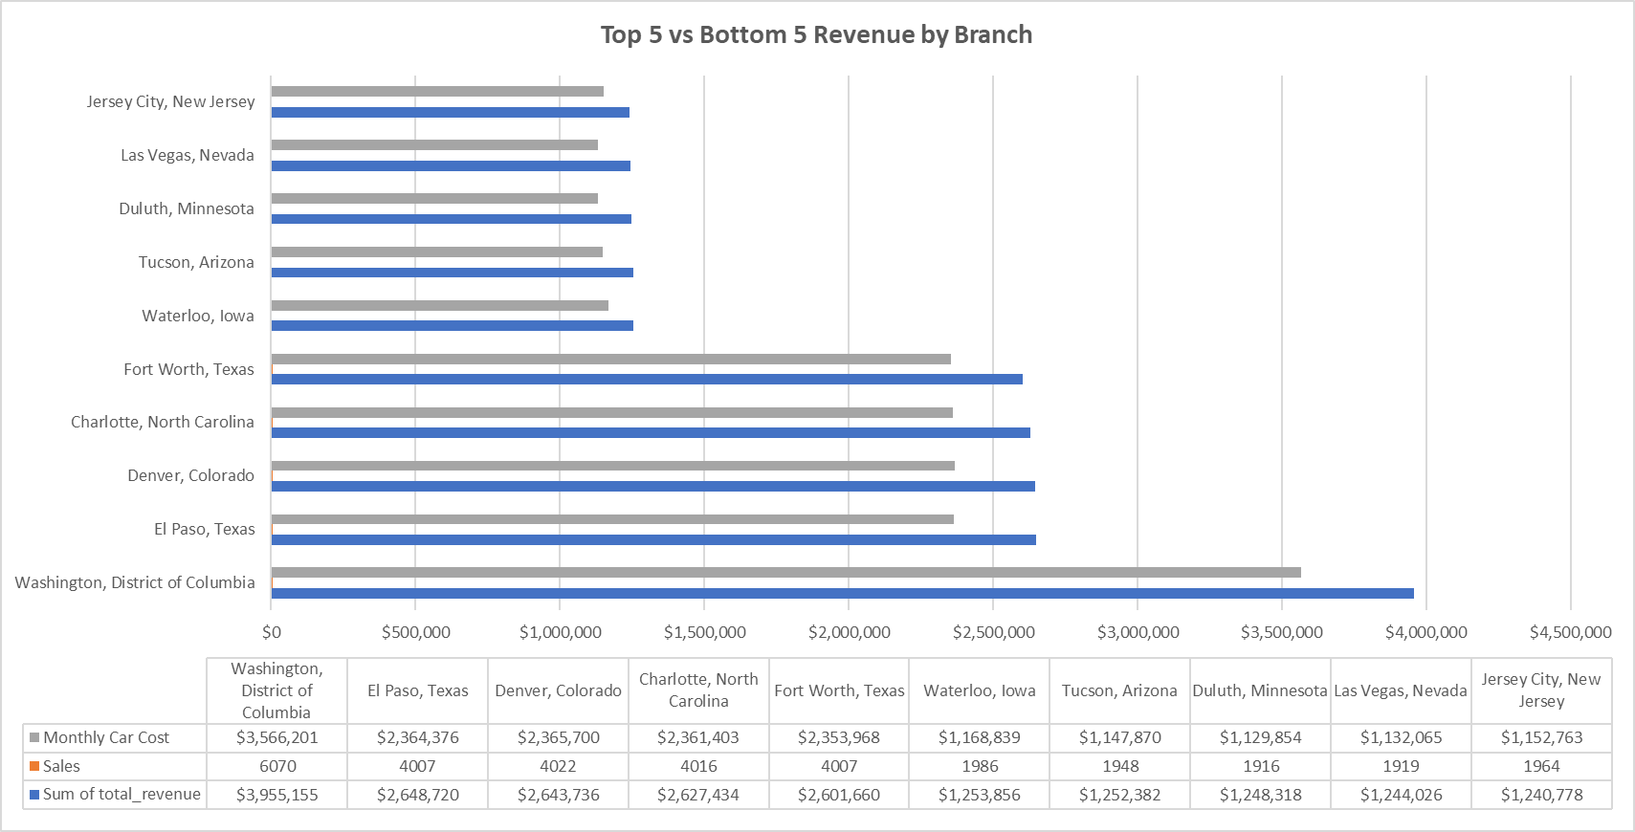
Insight 2
Increase Fleet Size At Low-Revenue Branches To Help Boost Sales

Slide 10
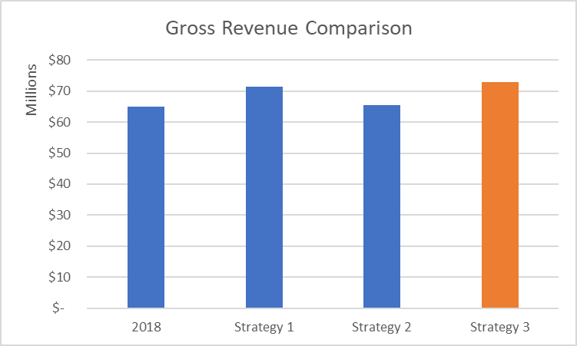
Recommendations
Implementing Strategy 3 (Increase Fleet Size by 12.5% - 500 Vehicles) Would Potentially Generate the Most Revenue

Slide 11

Thank You For Your Time
Any Questions or Concerns?

