Slide 1
Suicide Rates Analysis
What Factors Contribute To Suicide Rates and Which Groups Are Most At-Risk

Slide 2
Key Questions
Are Males More Likely To Commit Suicide Than Females?
Does Being Born In A Different Generation Influence The Suicide Rate Of An Individual?

Slide 3
Data Preface
The Data Used In This Analysis Was Pulled From “Suicide Rates Overview 1985 to 2016” Dataset From Kaggle.com
The Features Included in the Dataset include: Country, Year, Sex, Age, Suicides No, Population, Suicides/100k pop, Country-Year, HDI for year, GDP for year, GDP per Capita, and Generation.

Slide 4
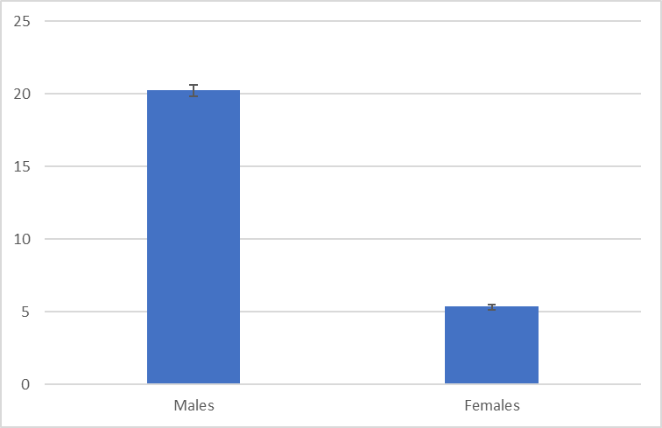
Males vs Females
We Can Observe a 375% Increase In Average Suicides/100k Population In Males Compared To Females.
Alpha: 0.5
p-value: 0
Mean Difference: 14.85

Slide 5
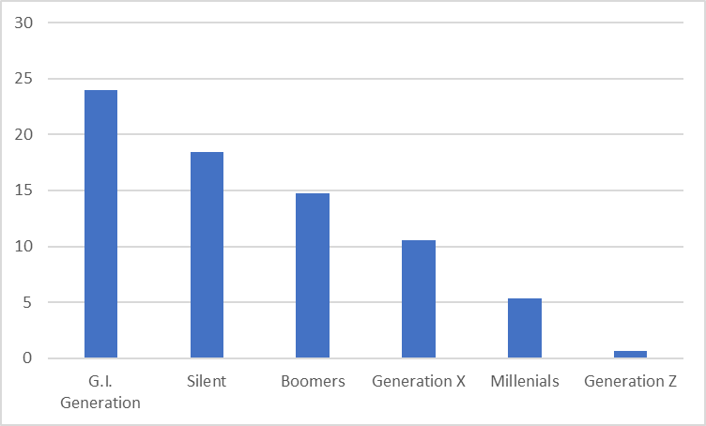
Generations Most at-risk
As We Can See From The Chart, the “G.I. Generation and “Silent” Generations Have The Highest Average Suicides/100k Population.

Slide 6
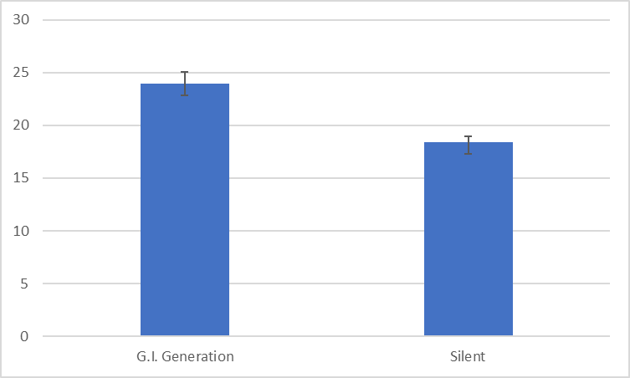
G.I. Generation vs Silent Generation
We Can Observe a 375% increase in Average Suicides/100k Population In Males Compared To Females.
Alpha: 0.5
p-value: 1.16E-21
Mean Difference: -5.52

Slide 7
Additional Analysis
Does The GDP Per Capita Influence The Suicide Rates In a Given Country?
Alpha: 0.5
P-value: 0.36
Result: Fail To Reject The Null That There Is No Difference In Suicide Rates In Countries With Varying GDP.

Slide 8
Insights
Based On The Findings From The Analysis Of The Dataset, I Can Conclude The Following:
Males Are More Likely To Commit Suicide Than Females
Being Born In A Different Generation Has An Influence On An Individual’s Suicide Rate
The World Health Organization Can Use The Insights Derived From My Analysis To Target At-Risk Groups Who Are More Likely To Commit Suicide and Concentrate Their Efforts To Provide Aid and Help To These Groups.

Slide 9

Questions or Concerns?

