Slide 1
Suicide Rates Analysis
What Factors Contribute To Suicide Rates and Which Groups Are Most At-Risk

Slide 2
Key Questions
Are males more Likely to commit suicide than females?
Does being born in a different generation influence the suicide rate of an individual?

Slide 3
Data Preface
The data used in this analysis was pulled from Kaggle.com. The dataset is called “Suicide Rates Overview 1985 to 2016”.
The features included in the dataset include: Country, Year, Sex, Age, Suicides No, Population, Suicides/100k pop, Country-Year, HDI for year, GDP for year, GDP per Capita, and Generation.

Slide 4
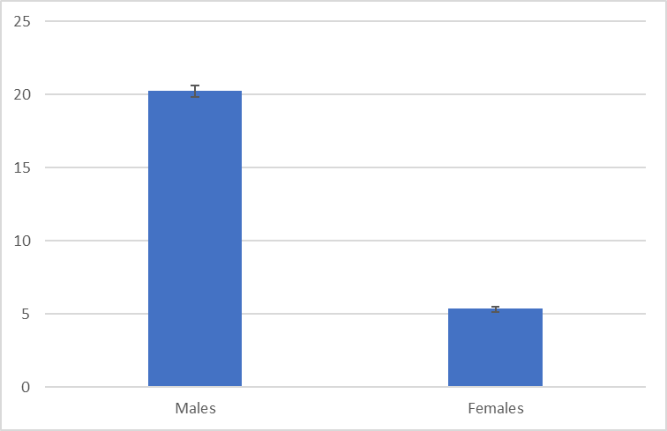
Males vs Females
We can observe a 375% increase in average suicides/100k population in males compared to females.
Alpha: 0.5
p-value: 0
Mean Difference: 14.85

Slide 5
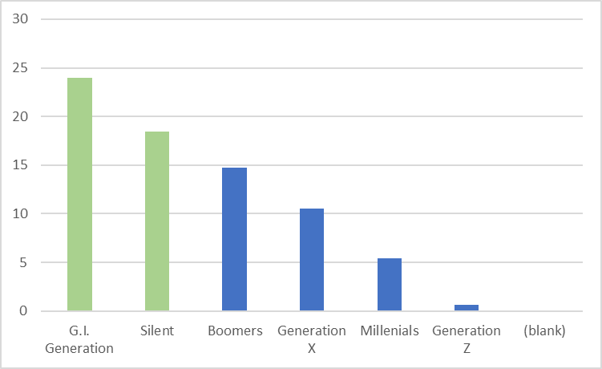
Generations Most At-Risk
As we can see from the chart, the “G.I. Generation” (75+ years) and “Silent” generation (35-54 years) have the highest average suicides/100k population.

Slide 6
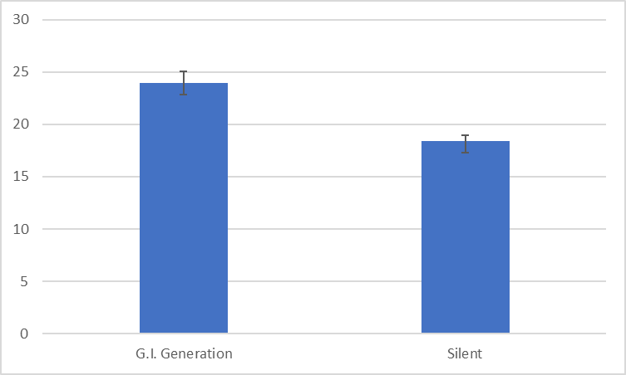
G.I. Generation vs Silent Generation
We can observe a 30% increase in average suicides/100k population in the G.I. Generation compared to the Silent generation.
Alpha: 0.5
p-value: 1.16E-21
Mean Difference: -5.52

Slide 7
Additional Analysis
Does the GDP per capita influence the suicide rates in a given country?
Alpha: 0.5
P-value: 0.36
Result: Fail to reject the null that there is no difference in suicide rates in countries with varying GDP.

Slide 8
Insights
Based on the findings from my analysis of the dataset, I can conclude the following:
Males Are More Likely To Commit Suicide Than Females
Being Born In A Different Generation Has An Influence On An Individual’s Suicide Rate
The World Health Organization can use the insights derived from my analysis to target at-risk groups who are more likely to commit suicide and concentrate their efforts to provide aid and help to these groups.

Slide 9

Questions or Concerns?

