Slide 1
Initial Prototype
Group 2
Rocamora,Eunace B.
Navida, Vince
Genete, Ray Alexander
Ebrada,Ismael

Slide 2
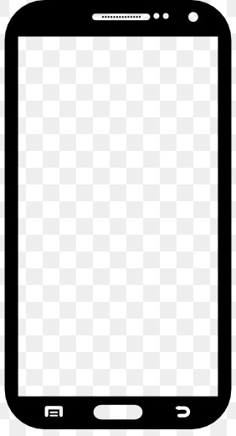
or
APP NAME and LOGO
Log In Using Google Account
Log In Using Facebook
*We will send a verification code to the email that you had entered during the registration/sign up
APP NAME and LOGO
APP NAME and LOGO
App logo
Logged In Successfully!
Log In
Forgot Password:
WELCOME TO
<APP NAME>
Email/username:____________
Password:__________________
Forgot password? Please Click here.
Enter your email:____________
Log In
Enter
Send Code
SIGN UP
TEAMPAGE

Slide 3
APP NAME and LOGO
APP NAME and LOGO
APP NAME and LOGO
__ __ __ __ __ __ __
Log In Using Google Account
Log In Using Facebook
APP NAME and LOGO
Logged In Successfully!
Log In
Please Enter the Code
Successful!
Email/username:____________
Password:__________________
Forgot password? Please Click here.
Enter New Password:__________
Re-type Password:____________
Enter
Enter
Confirm

Slide 4
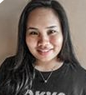
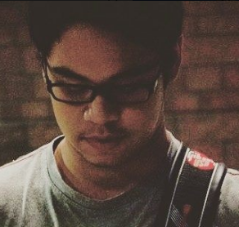
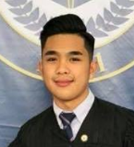
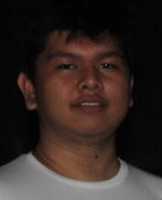
APP NAME and LOGO
APP NAME and LOGO
1/2
2/2
You have successfully Registered!
APP NAME and LOGO
APP NAME and LOGO
SIGN UP
SIGN UP
TEAMPAGE
Cellphone Number: ________
Telephone Number:_________
Address:__________________
*Please Take Note that those details that you have entered above are correct and accurate.
*For your Safety: Changing details might cause you inconvenience.
Enter Full Name:________________
Birthday:______________________
Username:_____________________
Email:_________________________
Password:_____________________
Name: Eunace Rocamora
Course: BSIT
Specialization: Mobile and Internet Technology
Name: Vince Navida
Course: BSIT
Specialization: Mobile and Internet Technology
Continue
Next
Name: Ismaek Ebrada
Course: BSIT
Specialization: Mobile and Internet Technology
Name: Ray GEnete
Course: BSIT
Specialization: Mobile and Internet Tecchnology
Confirm

Slide 5
Forgot Password? Click here
Do not have an account?
TEAMPAGE
App LOGO
Welcome to <APP NAME>
Email/Username
Password
Log IN
SIGN UP

Slide 6
SIGN UP
Enter Full Name:________________
Birthday:______________________
Username:_____________________
Email:_________________________
Password:_____________________
Cellphone Number: _____________
Telephone Number:_____________
Address:______________________
*Please Take Note that those details that you have entered are correct and accurate.
*For your Safety: Changing details might cause you inconvenience.
Confirm

Slide 7
Advertisement
Forgot Password:
Enter Your Email:____________________
Advertisement
Send Code
Advertisement

Slide 8
Advertisement
Please Enter Code
__ __ __ __ __ __ __
Advertisement
Confirm
Advertisement

Slide 9
Logged In Successfully!
Continue

Slide 10
You have successfully Registered!
Continue

Slide 11
TEAMPAGE
APP LOGO
Name: Eunace Rocamora
Course: BSIT
Specialization: Mobile and Internet Technology
Name: Vince Navida
Course: BSIT
Specialization: Mobile and Internet Technology
Name: Ismael Ebrada
Course: BSIT
Specialization: Mobile and Internet Technology
Name: Ray Genete
Course: BSIT
Specialization: Mobile and Internet Tecchnology

