Slide 1

Auditing and Repairing a Published Nepali ASR Model
A Speaker-Diversity Case Study on XLS-R
ST7088CEM — Artificial Neural Networks
Bimochan Raj Kunwar | Coventry ID: 17108924
MSc7-S2 | Softwarica College of IT & E-Commerce
Notes:
Hi, I'm Bimochan Raj Kunwar. This is my ST7088CEM Artificial Neural Networks project: auditing a published Nepali speech recognition model, and then repairing it. There's a public Nepali ASR model on Hugging Face that claims a 5.97% word error rate — remarkably good for a low-resource language. I wanted to find out: does that number actually hold up on real, diverse speech? Spoiler — it doesn't, by a lot. Let me show you.

Slide 2
The Problem
A single-speaker benchmark, cited as general-purpose quality
Two Research Questions
gagan3012/wav2vec2-xlsr-nepali
Published Hugging Face XLS-R (wav2vec2)
checkpoint for Nepali ASR
RQ1 (Benchmark Audit)
Does the published claim survive contact with genuinely diverse, multi-speaker speech?
5.97%
self-reported Word Error Rate (WER)
RQ2 (Fine-tuning Repair)
If not, can fine-tuning repair it — and is the improvement genuine, or an artefact of evaluation leakage?
measured on OpenSLR-43 — a single female speaker's read-speech corpus
Notes:
This model was benchmarked on OpenSLR-43 — a dataset recorded by a single female speaker. That's the problem: a benchmark on one voice tells you almost nothing about how the model handles different speakers, accents, or recording conditions. This is a common issue in low-resource ASR research generally, not just this one model. So I framed two research questions: RQ1 — does the published claim survive contact with genuinely diverse speech? RQ2 — if not, can I repair the model by fine-tuning it, and is any improvement genuine or just a measurement artefact?

Slide 3
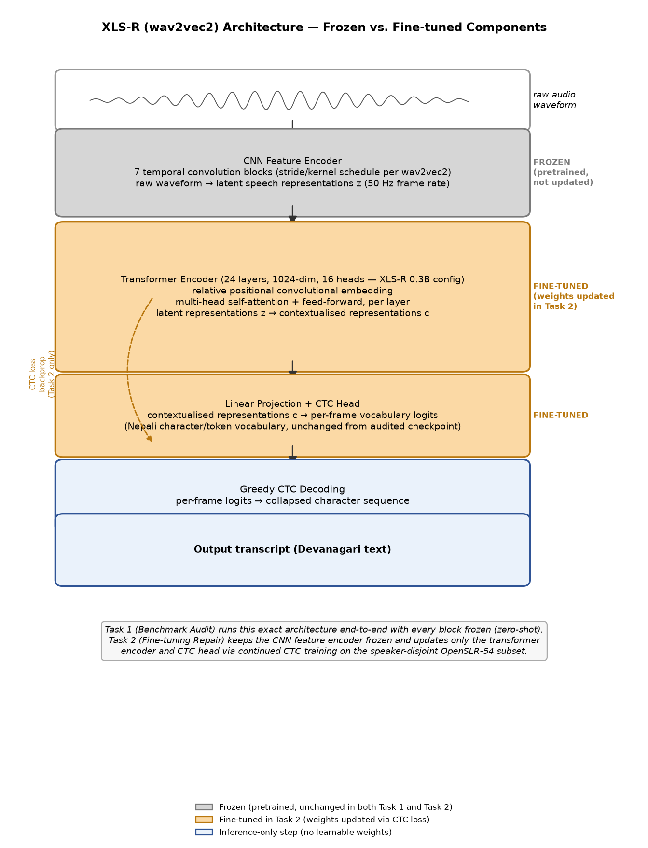
Model Architecture — XLS-R (wav2vec2)
Frozen convolutional encoder — fine-tuned transformer encoder + CTC head
Notes:
Here's the model architecture — XLS-R, a wav2vec2 variant. Raw audio goes through a convolutional feature encoder — seven conv layers that turn the waveform into a sequence of latent frames. That feeds a 24-layer transformer encoder, which builds contextualised representations using self-attention. Finally a linear layer plus a CTC head produces per-frame character probabilities, decoded into Devanagari text. The important part for this project: I kept the CNN feature encoder frozen the whole time — in both the zero-shot audit and the fine-tuning. When I fine-tune, I only update the transformer encoder and the CTC head, using the CTC loss. I also keep the checkpoint's own vocabulary — I'm repairing this exact model, not training a new one or swapping in a different architecture like Whisper, which I actually considered and dropped early on, because changing architecture would confound the comparison.

Slide 4
Task 1 — Benchmark Audit
Zero-shot evaluation of the unmodified published checkpoint
Evaluation | WER | CER
Self-reported (published) | 5.97% | —
Measured, in-domain (OpenSLR-43) | 4.91% | 0.87%
Measured, out-of-domain (OpenSLR-54) | 62.30% | 17.38%
A more than twelve-fold degradation on genuinely diverse, multi-speaker speech — the published figure does not describe real-world performance.
Notes:
Task 1: I reproduced the published number in-domain and got 4.91% WER — actually slightly better, so the claim technically holds on its own data. Then I ran the exact same checkpoint, zero-shot, on OpenSLR-54 — a completely different, multi-speaker Nepali corpus, 160 speakers. WER jumped to 62.30%. That's a twelve-fold degradation. So RQ1's answer is no — the published number does not describe real-world, multi-speaker performance.

Slide 5
Task 2 — Fine-tuning Repair
15-hour, 160-speaker, speaker-disjoint fine-tuning on OpenSLR-54
Checkpoint | In-domain (SLR-43) | Out-of-domain (SLR-54)
Original | 4.91% WER | 62.30% WER
Fine-tuned (speaker-disjoint) | 16.40% WER | 38.17% WER
Out-of-domain WER falls 39% relative (62.30% → 38.17%) — at a disclosed, expected cost to in-domain performance (4.91% → 16.40%).
Notes:
Task 2: I fine-tuned that same checkpoint on a 15-hour, 160-speaker, speaker-disjoint subset of OpenSLR-54 — meaning zero speaker overlap between train, validation, and test. Out-of-domain WER fell from 62.30% to 38.17% — a 39% relative improvement. I'm also honest about the cost: in-domain WER rose from 4.91% to 16.40%, because the model is now adapted toward diverse speech rather than that one original speaker. That's an expected specialisation trade-off, not a bug.

Slide 6
Speaker-Leakage Ablation
Matched-budget: speaker-disjoint split vs. leaky (utterance-random) split
Checkpoint | In-domain (SLR-43) | Out-of-domain (SLR-54)
Fine-tuned, speaker-disjoint | 16.40% WER | 38.17% WER
Fine-tuned, leaky | 16.96% WER | 32.55% WER
The leaky split scores 5.62 points better — not real improvement, but leakage: many of its "unseen" speakers were already seen in training. This confirms the project's speaker-disjoint methodology was the correct choice.
Notes:
Here's the part I think matters most methodologically. I trained a second model, identical setup, identical budget — but on a leaky split, where each speaker's utterances are scattered randomly across train, validation, and test instead of being kept separate. That leaky model scored 32.55% — better than the properly disjoint model's 38.17%. But that's not a real improvement — it's leakage. The leaky test set isn't truly unseen, because the model has already partially learned those speakers' voices during training. This confirms that if I — or anyone else — evaluates without controlling for speaker overlap, the reported number is inflated. It's the same failure mode that produced the original misleading 5.97% benchmark, just demonstrated at a smaller scale on my own data.

Slide 7
Deployment Efficiency Benchmark
FP32 vs. dynamic INT8 quantization — a mixed result, reported honestly
 | Model Size | Mean Latency | WER | CER
FP32 | 1,203.6 MB | 204.7 ms | 35.81% | 7.17%
Dynamic INT8 | 48.5 MB | 335.2 ms | 36.49% | 7.49%
96.0% size reduction, but 1.64× slower — not faster — on this Apple Silicon hardware. Quantization here is a storage optimisation, not a latency one.
Notes:
Last piece: I also benchmarked deployment efficiency. Dynamic INT8 quantization shrank the model by 96% — from about 1.2GB to 48.5MB. But it was actually 1.64 times slower on this Apple Silicon hardware, not faster, because the fast quantized kernels aren't available outside x86. I'm reporting that honestly rather than only showing the size win — a deployment optimisation that looks good on paper doesn't automatically transfer to every platform.

Slide 8
Conclusion
RQ1 — No.
5.97% claim does not generalise:
62.30% WER on diverse speech
RQ2 — Yes, genuinely.
Fine-tuning repairs the gap to
38.17% WER — confirmed genuine by the leakage ablation
An open, reproducible Nepali ASR audit-and-repair case study, with an honestly reported efficiency benchmark.
Code, MLflow logs, data manifests & full report:
github.com/Rbimochan/NSTT-Lite
Thank you for watching.
Notes:
So: RQ1 — the published 5.97% claim does not generalise to diverse speakers, degrading to 62.30% WER. RQ2 — yes, fine-tuning genuinely repairs a large share of that gap, down to 38.17%, and the speaker-leakage ablation confirms that improvement is real, not a measurement artefact. Everything here — code, MLflow experiment logs, data manifests, and the full report — is public on GitHub, link on screen and in the description. Thanks for watching.

