Slide 1
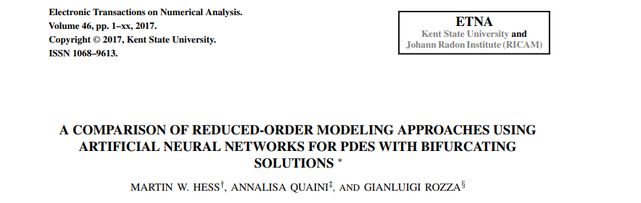
arXiv:2010.07370v2

Slide 2
problem definition

Slide 3
How to choose the cluster to use
a) Distance to parameter centroid
b) Distance to closest snapshot location

Slide 4
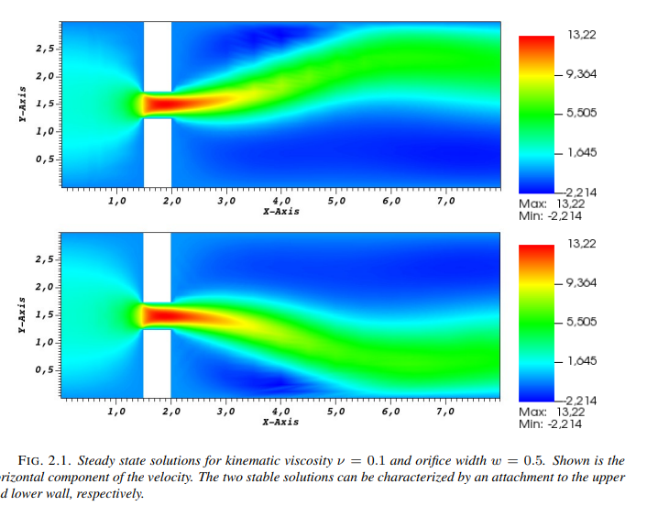

Slide 5
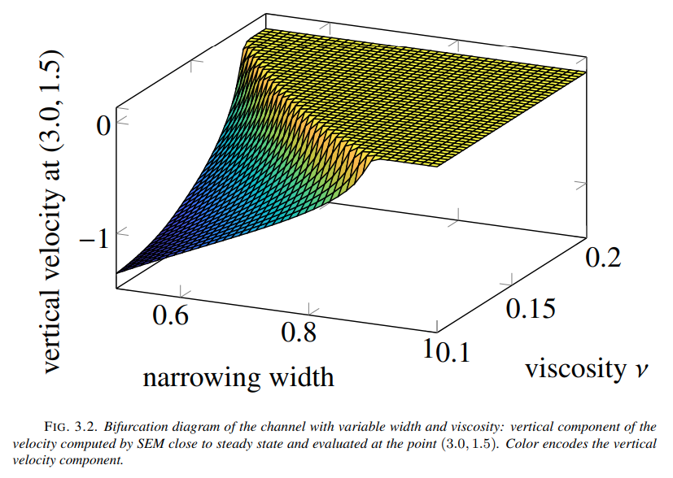
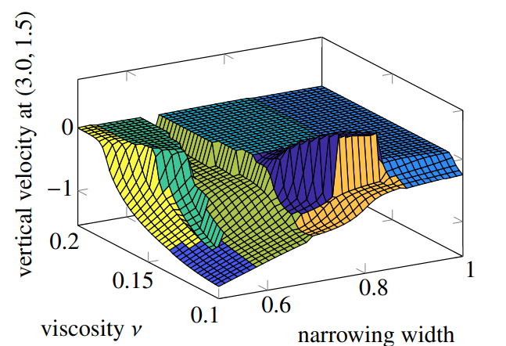
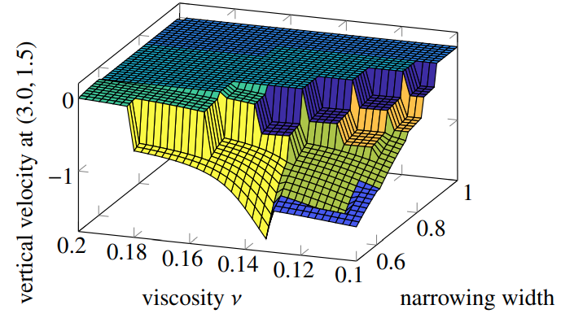
a)
b)

Slide 6
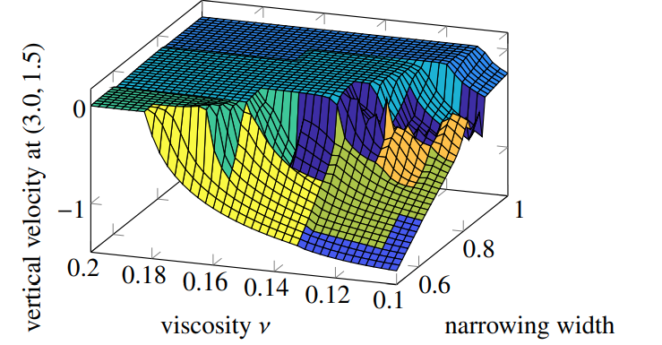
a)
b) with overlapping

Slide 7
How to choose the cluster to use
a) Distance to parameter centroid
b) Distance to closest snapshot location
c) ANN

Slide 8
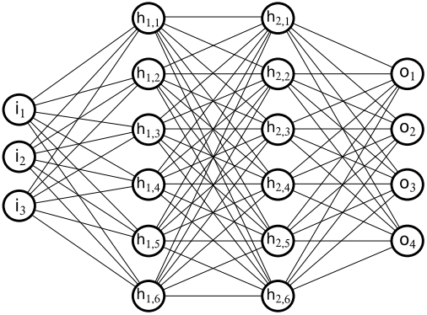
c) ANN
ReLu
ReLu
SoftMax
[mu_1,… ,mu_p]
[ prob_1,…,prob_k ]
#Params Neurons
#clusters Neurons

Slide 9
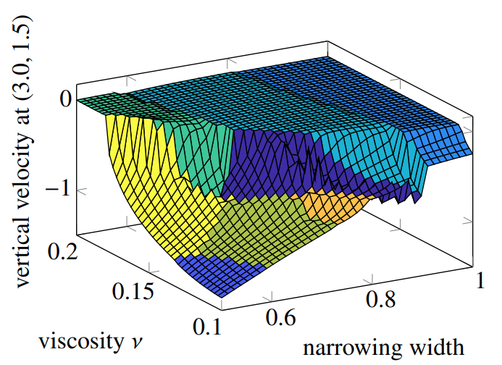
c)
b) with overlapping

Slide 10
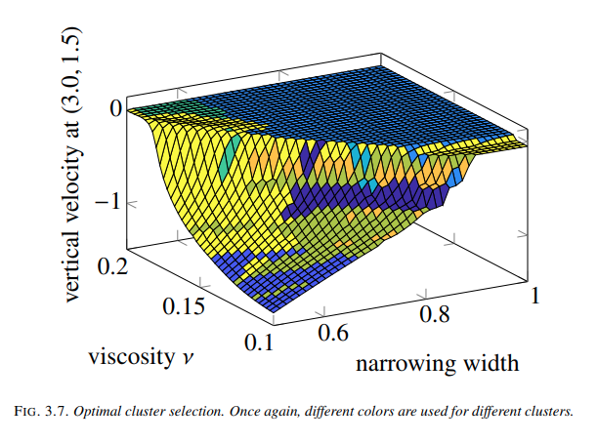
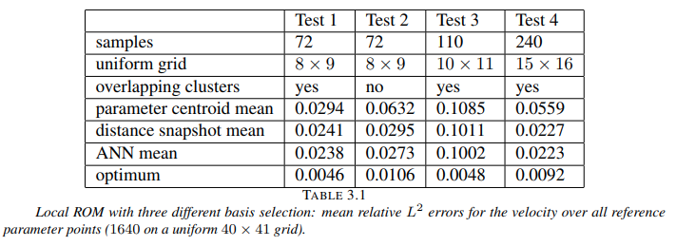

Slide 11
1. Optimal clusters are not contiguous in parameter space
2.Best approx of a snapshot is not necessarily given by the cluster it belongs to
3.There is room for improvement

Slide 12
c) regression ANN
ReLu
ReLu
SoftMax?
[mu_1,… ,mu_p]
[ error_1,…, error_k ]
#Params Neurons
#clusters Neurons

Slide 13
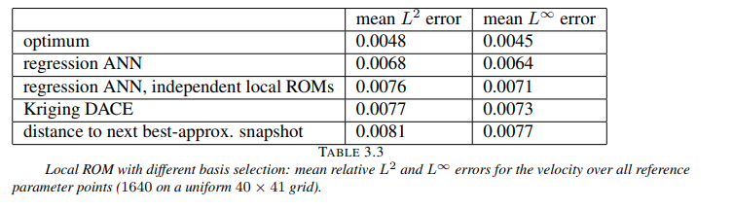

Slide 14
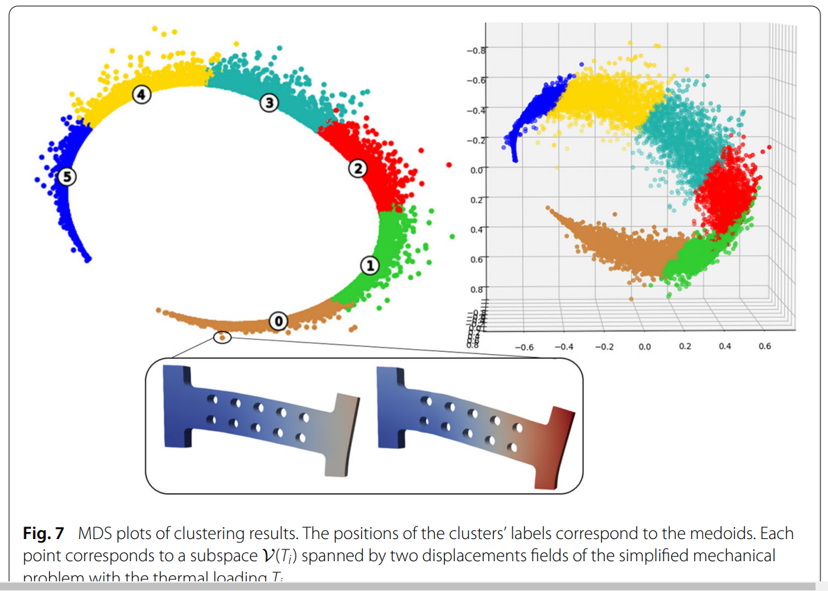
Other techniques
PEBL clustering and selection of cluster
Grassmann manifold distance?
https://doi.org/10.1186/s40323-020-00153-6

Slide 15
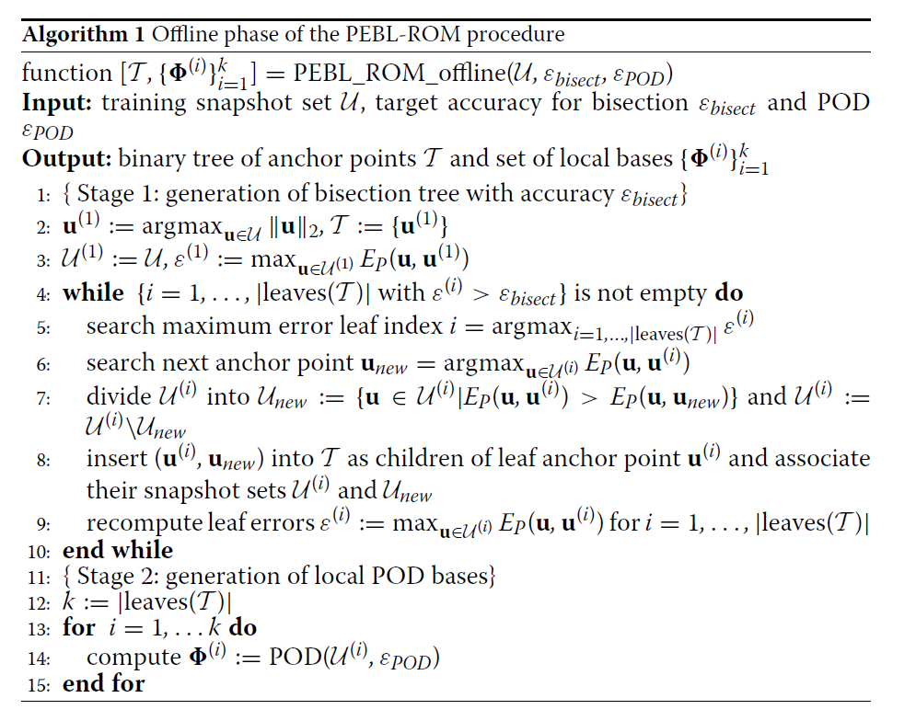
PEBL DOI 10.1186/s40323-016-0059-7

Slide 16
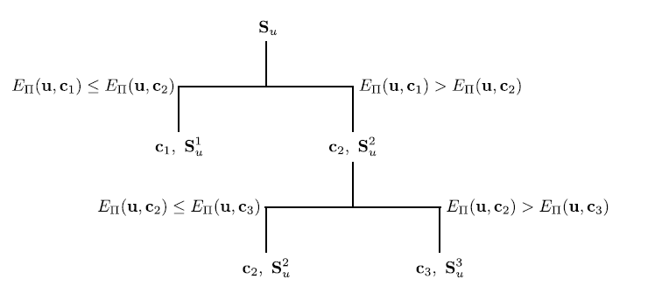
PEBL DOI 10.1186/s40323-016-0059-7
https://doi.org/10.1016/j.cma.2018.06.003

Slide 17
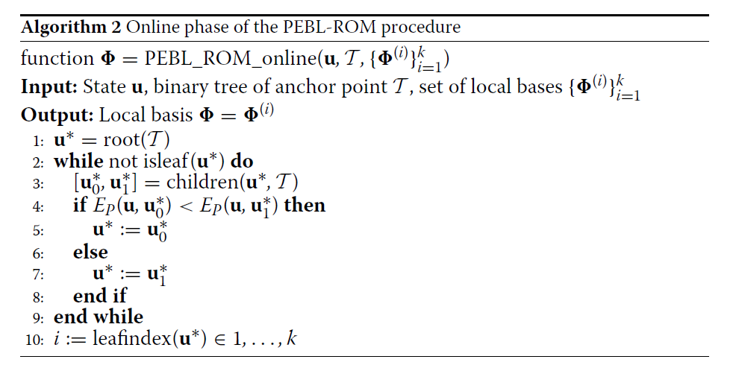
PEBL DOI 10.1186/s40323-016-0059-7

