Slide 1

Real Time News Dashboard Topic modeling and sentiment analysis
CUS 635 Web Data Mining
Prof. Giancarlo Crocetti
Reyes ceballos,
arjun reddy,
anna JADONATH

Slide 2
Data extraction
Our dataset is comprised from NY Times Articles dated 2016-2018
Within those years, we choose the topics relating to U.S. / Politics to populate 21,461 articles like Education, Immigration, International Relations, Daily News, etc.
The retrieval method used was New York Times API

Slide 3
Web Scraping
Web Scraping is the automatic extraction of useful data from a website for analysis.
This is used to monitor political news and performs an analysis on a rhetoric being used, the ads being displayed, and the sentiment of certain topics to identify any bias in the copy being analyzed.

Slide 4
Pre-processing the data
In the pre-processing phase, we removed symbols and duplicate/irrelevant article entries.
Merged Headline and Snippet
Filtered for Newsdesk; National, Washington, Politics, U.S., U.S. / Politics
nltk.Tokenize
Removed punctuation and converted to all lowercase
Removed nltk. stopwords and len < 2
Stemming and Lemmatization
Notes:
Chose Lemmatization

Slide 5
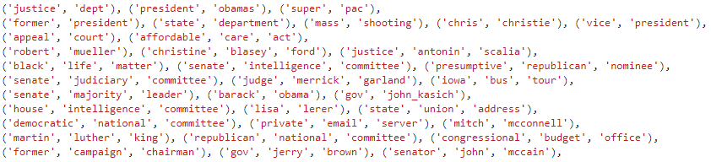
Analysis
Bag of Words for Frequency distribution
Removed hapaxes
Collocations (bigrams, trigrams) use for Multi-Word Expressions
Notes:
Hapaxes = words that occur only once

Slide 6
Analysis (cont…)
Removed frequent but irrelevant words.
blacklist = ['mr.','could','may','82117','said','say','8216','mrs','mrs.' 'would','...', '8217', 'went', 'many', 'take', 'make', 'like','see','even','get', 'come','also', 'also','ms.’ ]
Removed the below because they skewed all the topics
'president_trump','donald_trump','trump’
TfidfVectorizer for document term matrix
T-SNE on the document term matrix
Notes:
TfidfVectorizer for document term matrix – Normalized frequency of words

Slide 7
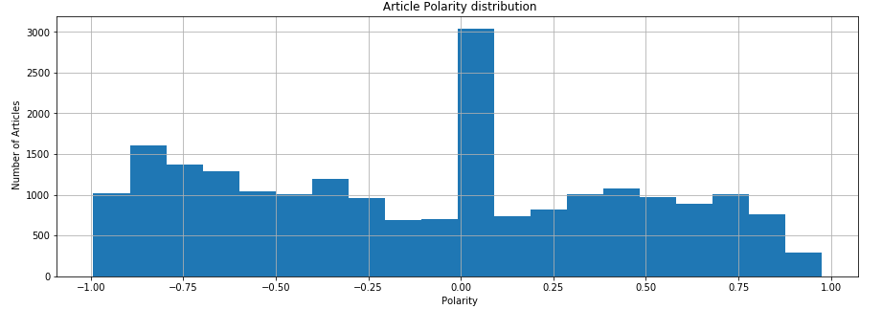
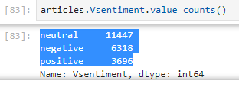
Sentiment Analysis (vader Sentiment)
Notes:
2 different types of sentiment analyzers.
Vader Sentiment and SentiWordNet Dictionary
> 0.5 is positive
< -0.5 is negative

Slide 8
TOPIC MODELING
Word2vec and t-SNE mapped to individual documents
LDA – topic modeling
Number of topics K = 2 – 12
Model Evaluation
Perplexity
Coherence
Notes:
Used word2vec model. pre-trained by Google on a 100 billion word Google News corpus. Which has 300 dimensions
LDA – genism
perplexity - describes how well a model predicts a sample, lower the better
coherence score - average similarity between top word context vectors and their centroid. The higher the better

Slide 9
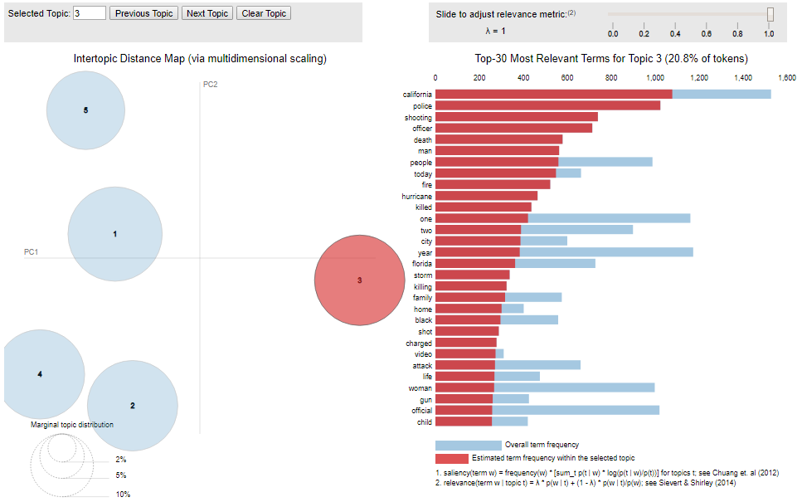
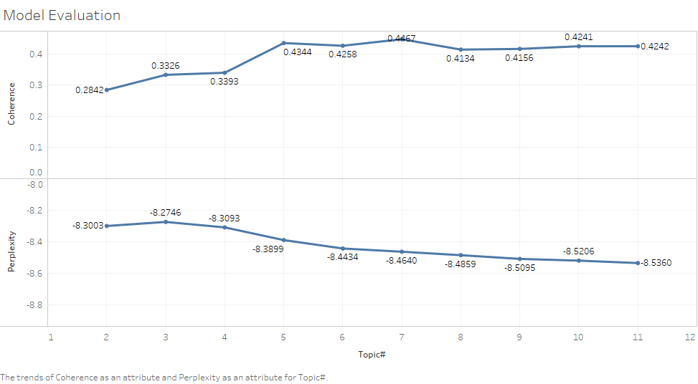
Topic Modeling: choosing K
Notes:
Chose K = 5 based on LDA vis and high coherence score and low perplexity

Slide 10
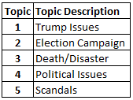
DASHBOARD/Topic Key
1 – Government, Supreme Court, Administration, Federal
2 – Hillary Clinton, Bernie Sanders, primary, election, campaign
3 – shooting, fire, hurricane, killed, police, black
4 – nominee, immigration, tax, trade, border
5 – Russia, investigation, inquiry, FBI, email

