Slide 1

Hostel Management System
-By Charmy Raj

Slide 2
Introduction
In this project, I designed and developed a multidimensional cube-based analysis system for managing hostel room allocations and fee payments.
Using SQL and SSAS, I modeled and deployed two OLAP cubes that provide detailed, structured insights into hostel operations and student demographics.

Slide 3
Business Problem
Before this project, the hostel system had no way to analyze data in a meaningful way.
There was no centralized view of room occupancy, fee collection trends, or student profiles.
As a result, decisions about resource planning and student management were being made without data support, leading to inefficiencies.

Slide 4

Project Objectives
My goal was to build an analytical solution that could answer key questions like:
Which rooms are under or over-utilized?
How many students are paying fees on time?
What are the demographic trends among hostel residents?
I aimed to deliver a clean, query able cube model that would allow hostel administrators to explore data and take action accordingly.

Slide 5
Business Solution
I created two complete star-schema cubes:
Fee Payment Cube: To track student payments, due dates, and amounts over time.
Room Allocation Cube: To analyze how rooms are assigned based on student demographics and room types.
I used Microsoft Access for ER modeling and sample data, SQL for transformation, SSAS for cube design, and Excel for building PivotTable reports.

Slide 6
Resulted Outcome
After building the cubes, I was able to:
Identify room types that are most and least utilized.
Measure total fees collected vs pending.
Find which cities most hostel students come from.
Analyze occupancy trends by gender and student age.
Track peak room allotment months and fee payment delays.

Slide 7
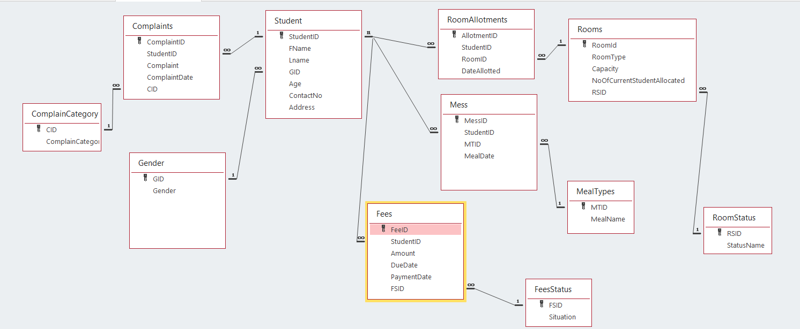
Original ERD

Slide 8
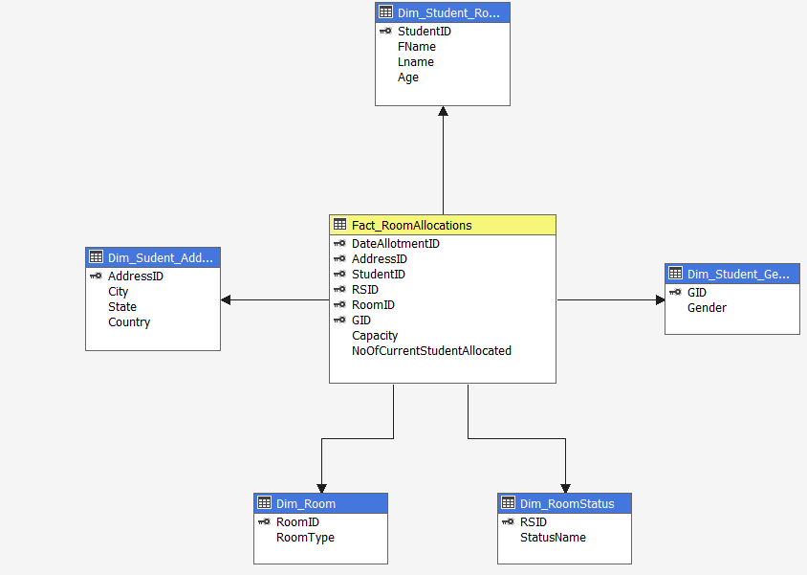
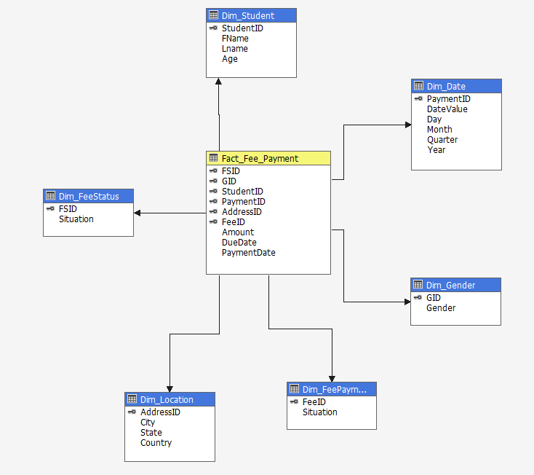
New Star Schema

Slide 9
Live Data Demonstrations
Fee Payment Overview by Hometown
Room Allocation by Gender & Room Type
Available Room Capacity Filtering
Year-Wise Student Fee Payment Tracking

Slide 10
Lessons Learned-3Ws

Slide 11
What Went Well?
I successfully built normalized star schemas with clear dimension relationships.
Both cubes deployed without error in SSAS.
PivotTables in Excel made insights easy to generate.
I handled data mapping and relationship building.
My understanding of multidimensional modeling improved significantly.

Slide 12
What Did Not Go Well?
I faced data type mapping errors while exporting from Access to SSAS.
I was not able to figure out how to use the PaymentDate to identify students who did not pay their fees, since missing dates can't be easily queried in a cube.
I faced challenges while connecting the room allocation dimension to the fact table without causing cross joins or Cartesian products.

Slide 13
What Would I Do Differently Next Time!
Conduct a thorough assessment of source data and its format before starting the project.
I realized that every time I made a small change in the database, I had to redo the entire ETL manually.
So next time, I will invest time in creating reusable templates and scripts for ETL tasks to save effort and reduce errors.

Slide 14
Future Improvement
I want to connect this cube to Power BI and build a live dashboard.
I’d also love to automate fee reminders or room allocation alerts.
Eventually, I’d like to build a full BI platform for hostel operations, including attendance, maintenance, and service feedback.

Slide 15

Thank You!

