Slide 1
Classification of Water Consumer Types

Slide 2
About Dataset
The dataset is collected from the water consumption records in a municipality
This dataset comprises a monthly record of water consumption by all the measuring devices installed in the region
Each data entry is annotated with the type of consumer, among 9 different classes
The records are from 2013 and 2020 (one year is missing – 2015)

Slide 3
Features
Year – the year of the record
Month – the month of the consumption record
Consumer_type – the type of the consumer (categorical)
Consumption – water consumption in cubic meters
Consumer_number – the ID of the consumer (text)
Installation_zone – the area in the region where the water was consumed (text)

Slide 4
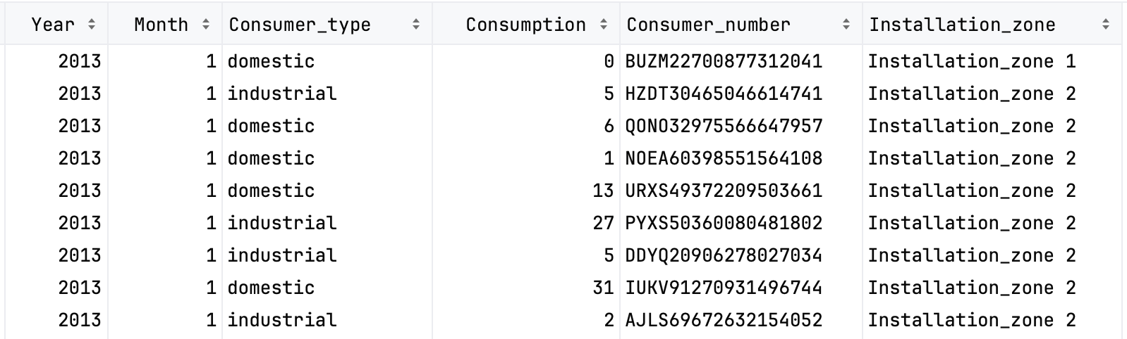
Features

Slide 5
Assignment

Slide 6
Goal
Your task is to use multiclass classification to classify a water consumer type, given information about the monthly consumption pattern of the previous 10 years (give or take). Good luck!

Slide 7
Evaluation
This competition is evaluated on the categorization accuracy of your classifications (the percentage of consumers you correctly classify).

Slide 8
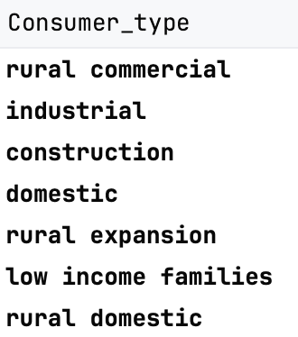
Files
train.csv
a properly annotated training dataset
competition.csv
the file that students should use to classify the consumers
Class labels
Installation zone
Installation_zone 1
...
Installation_zone 49

Slide 9
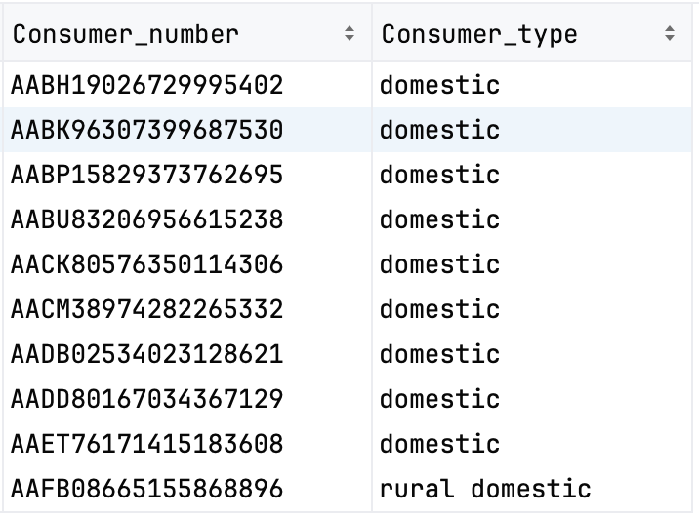
Submission File Format
The file should contain a header and have the following format:

