Slide 1

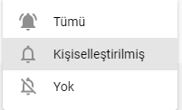




CODİNATOR
ABONE OLUNDU
ABONE OL
306 abone

