Slide 1




NEXT GEN EMPLOYABILITY PROGRAM
Creating a future-ready workforce
Team Members
College Name
Student Name : Chermaraja R
Student ID : au951221104009
JP College Of Engineering

Slide 2

CAPSTONE PROJECT SHOWCASE
Project Title
Voting Web Application using Django Framework
Abstract | Problem Statement | Project Overview | Proposed Solution | Technology Used | Modelling & Results | Conclusion

Slide 3
Abstract
The web-based voting application developed using the Django framework offers a robust solution for organizations and communities seeking to modernize and optimize their voting processes. Through intuitive user interfaces and secure authentication mechanisms, users can conveniently participate in polls while administrators efficiently manage and monitor voting activities. Leveraging Django's scalability and performance optimization features ensures the application's adaptability to varying user demands. The integration of real-time updates and comprehensive reporting enhances transparency and accountability in the voting process. Future enhancements such as blockchain integration and AI implementation hold promise for further advancing the application's capabilities. Overall, this voting application represents a significant step towards fostering democratic engagement and trust in the electoral process.
Source :

Slide 4
Problem Statement
The task is to create a web-based voting system using Django, designed to meet the dynamic requirements of organizations, institutions, and communities in conducting fair and efficient voting procedures. The primary goal involves implementing secure user authentication, enabling intuitive poll creation and management, and ensuring seamless real-time updates and reporting features. Overcoming obstacles such as potential security risks, intricate technical configurations, and user adoption challenges is imperative to deliver a dependable and accessible voting platform. Ultimately, the objective is to instill confidence, participation, and transparency within the electoral process, fostering democratic principles and societal trust.
Source :

Slide 5
Project Overview
The project aims to develop a robust web-based voting application utilizing the Django framework, catering to the diverse needs of organizations, institutions, and communities. Key components include secure user authentication, intuitive poll creation and management functionalities, and real-time updates with comprehensive reporting features. Challenges such as security vulnerabilities, technical complexities, and user adoption barriers will be addressed to ensure the reliability and accessibility of the voting platform. The overarching goal is to promote democratic engagement, transparency, and trust in the electoral process through innovative and scalable solutions.
Source :

Slide 6
Proposed Solution
.
The proposed solution involves the creation of a robust web-based voting application using the Django framework. This application will offer a comprehensive set of features including user authentication, poll management, real-time updates, and reporting capabilities. By leveraging Django's powerful tools and adhering to best practices in security and scalability, the solution aims to provide an efficient, transparent, and user-friendly voting platform. Through careful design and implementation, the solution will address challenges such as security risks, technical complexity, and user adoption barriers, ultimately delivering a reliable and accessible voting solution for organizations, institutions, and communities.
Source :

Slide 7
Advantages
Efficiency: Utilizing the Django framework streamlines development, ensuring efficient creation of a scalable voting application.
Security: Leveraging Django's built-in security features ensures robust protection of user data, safeguarding against unauthorized access or tampering.
Scalability: The application's architecture allows for seamless scalability, accommodating growth in user base and voting demands without sacrificing performance.
User Experience: With an intuitive design, the application offers a seamless user experience, encouraging higher participation rates and building trust in the voting process.
Source :

Slide 8
Disadvantages
Security Risks: Despite implementing security measures, the system may still be vulnerable to cyber threats, potentially compromising user data and the integrity of the voting process.
Technical Complexity: Developing and maintaining a comprehensive voting application requires significant technical expertise and resources, posing challenges for smaller organizations or teams.
User Adoption Barriers: Users unfamiliar with online voting platforms may face difficulties navigating the system, leading to lower participation rates and potential mistrust in the voting process.
Dependence on Internet Connectivity: The reliance on internet access for voting may exclude individuals or communities with limited or unreliable internet connections, hindering their participation.
Source :

Slide 9



Technology Used
Frontend
Backend
Source :

Slide 10
Modelling & Results
Data Modeling: The development of a robust data model ensures accurate representation of user profiles, polls, votes, and other relevant entities, facilitating efficient data management and analysis.
Algorithmic Design: Implementing efficient algorithms for real-time updates, notifications, and result calculations ensures the accuracy and responsiveness of the voting system, enhancing user experience.
Testing and Validation: Rigorous testing and validation procedures verify the functionality, reliability, and security of the application, mitigating risks associated with errors or vulnerabilities.
Performance Evaluation: Continuous monitoring and evaluation of the system's performance metrics
allow for the identification of bottlenecks and optimization strategies, ensuring optimal performance under varying loads.
Source :

Slide 11
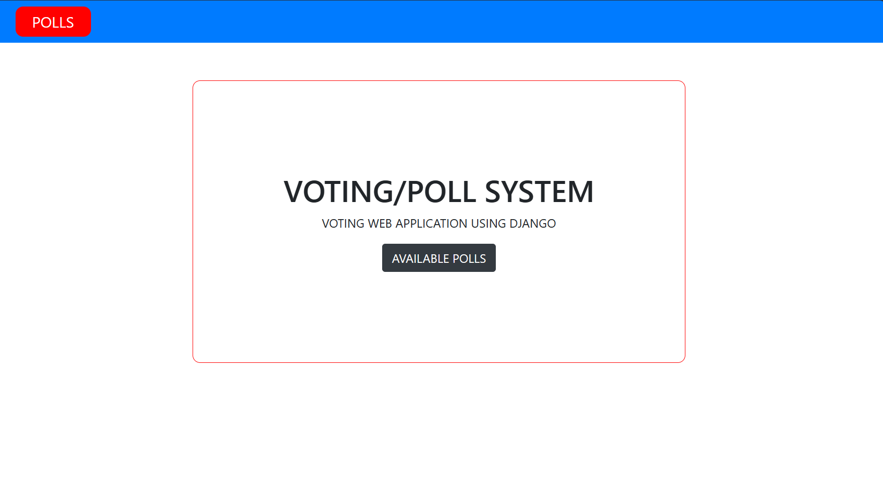
Homepage

Slide 12
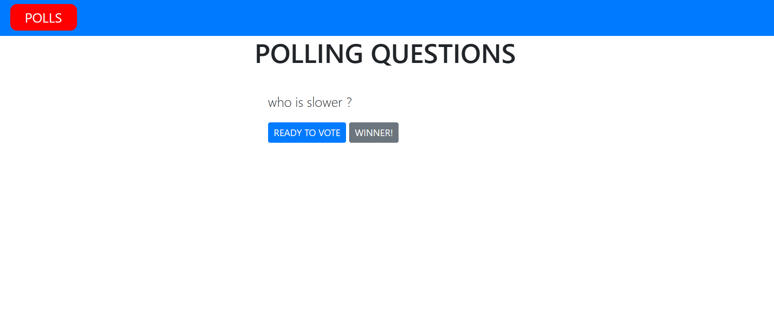
Polls Page

Slide 13
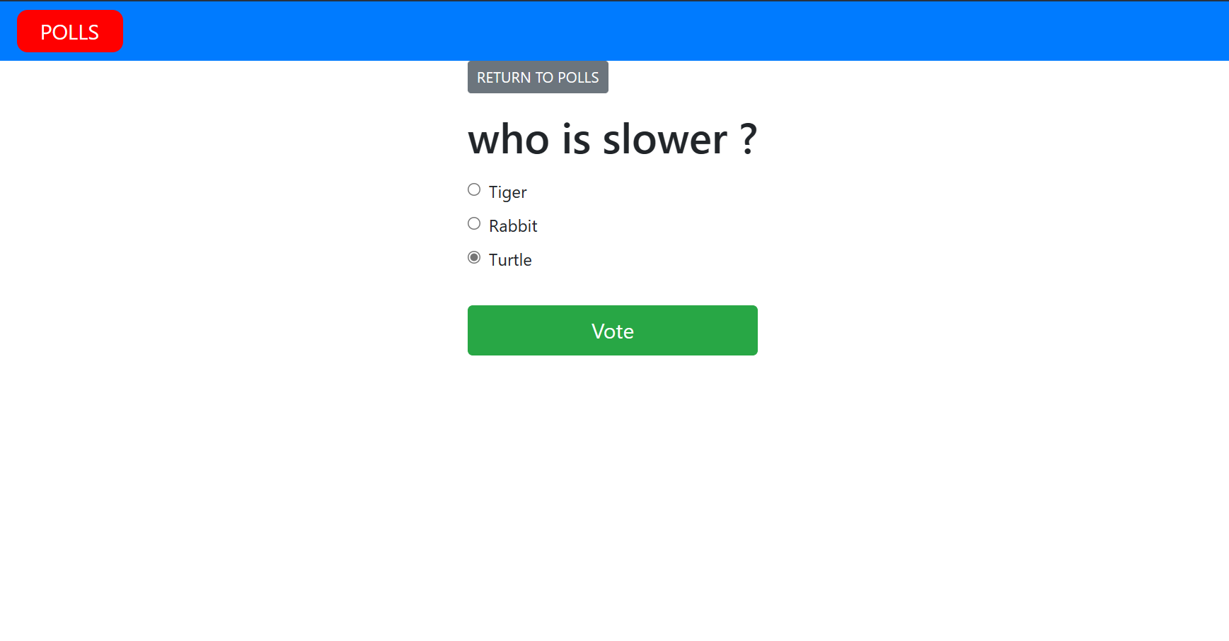
Voting Page

Slide 14
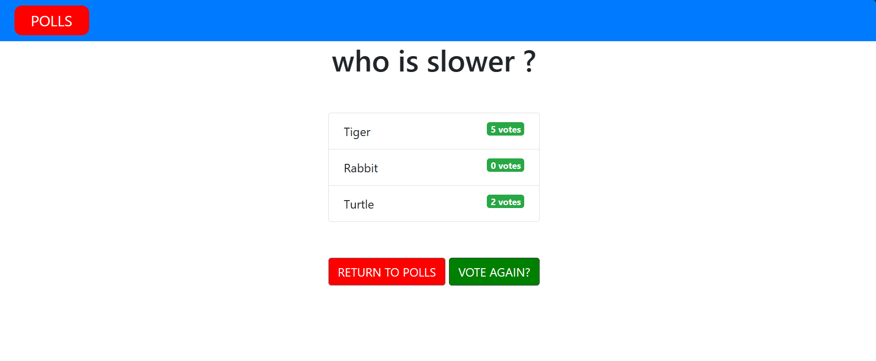
Vote Result Page

Slide 15
Future Enhancements:
Biometric Authentication Integration: Exploring the implementation of biometric authentication methods such as fingerprint or facial recognition to enhance security and streamline the login process for users.
Multilingual Support: Introducing multilingual support to accommodate users from diverse linguistic backgrounds, improving accessibility and inclusivity in the voting process.
Blockchain-Based Voting System: Developing a blockchain-based voting system to provide a decentralized and immutable ledger for storing voting records, ensuring transparency and integrity in the electoral process.
Voter Education Initiatives: Implementing voter education initiatives within the platform to provide users with information on voting rights, procedures, and candidate profiles, promoting informed decision-making and civic engagement.

Slide 16
Conclusion
In conclusion, the development of a web-based voting application using the Django framework presents a significant opportunity to modernize and enhance the electoral process. Despite potential disadvantages such as security risks and technical complexities, the project's advantages in efficiency, scalability, and user experience outweigh these challenges. Through meticulous modeling, rigorous testing, and continuous improvement efforts, the application can achieve reliability, accuracy, and security in handling voting activities. Moreover, future enhancements such as blockchain integration, biometric authentication, and multilingual support promise to further elevate the platform's capabilities and inclusivity
Source :

Slide 17
Thank You!
Notes:
Thank You !!

