Slide 1
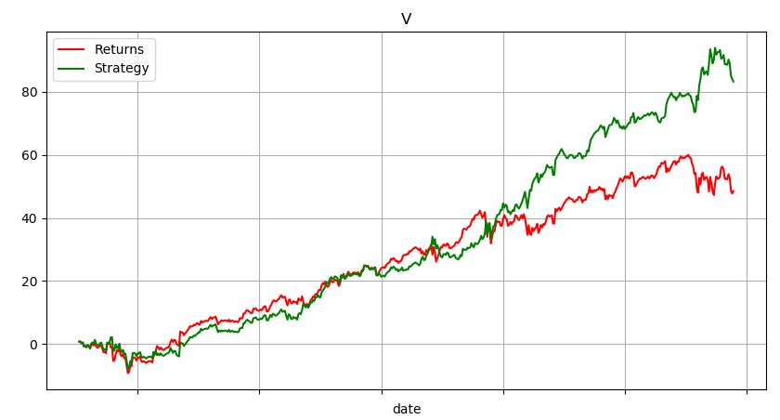
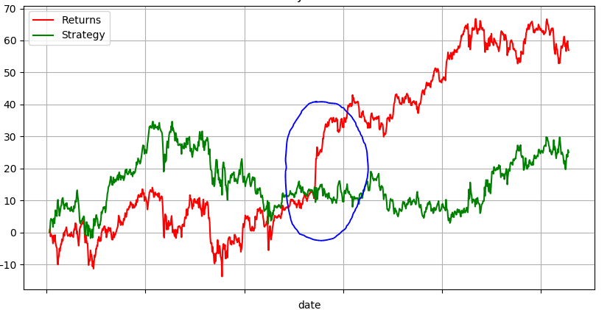
Stock Market Prediction w/ News Article Reaction
Purpose
Features
Results
Historical prices aren’t tell-all
Faster reaction times to reported events
SVM – RBF Kernel
Neural Networks
Activation Func.: Identity, Sigmoid, RELU, Tanh
Adaptive learning rates
Feature Selection
False positive, false discovery, family-wise error
Daily SVM: 50.45%, 54.94%
Daily Nnet: 50.03%, 55.02%
Daily SVM w/ news: 52.12%, 53.16%
Daily Nnet w/ news: 51.13%, 57.73%
Implementation
Scan, summarize, and extract keywords
Evaluate the impact on stock price
Generate model
Pass in recent/new articles
Add predictions to price dataset
Model and predict with new dataset

