Slide 1
Problem Statement
How to maximize profits for Big Mountain to :
a)cutting those facilities which will not undermine the current ticket price, or
b)cover operating costs of 1.54 million of recently installed chair lift
Context:
Big Mountain Ski Resort, Montana is visited by 350,000 people every year. The resort's pricing strategy has been to charge a premium above the average price of resorts in its market segment. They feel that Big Mountain is not capitalizing on its facilities as much as it could. They want to get a sense of how important some facilities are compared to others. They have recently installed chair lift which increased operating costs by $1,540,000 for this season.
Criteria for success:
To be able to deliver a data driven pricing strategy for Big Mountain Resort
Scope of solution space:
We will focus on 330 ski resorts in U.S. which can be considered as the part of the same market segment.
Constraints within solution space:
Not having information about the other resorts in the market segment
Stakeholders to provide key insight:
Decision Maker: Investors, Jimmy Blackburn, Director of Operations

Slide 2
Recommendation and key findings
Big Mountain should change ticket price from $81 to $95.87.
According to our model, given the existing facilities and considering the ticket prices of Big Mountain's competitors, Big Mountain should have a ticket price between $85.48 to $106.26.
The additional cost of 1,540,000 of installing chair can be easily covered with the increased ticket price of $95.27.
Every year about 350,000 people visit Big Mountain. The additional cost comes out to be 88 cents per ticket considering each visitor on average buys 5 day tickets.
If the cost of adding a run, increasing the vertical drop by 150 feet, and installing an additional chair lift is less than $3,474,638 + minimum profit margin of 9.2% for investors, then Big Mountain should make these changes.
It can increase the ticket price by $1.99.
The business should not spend money on scenarios where adding resources don't lead to an increase in revenue.
As Big Mountain's ticket price is almost highest in Montana, they should focus on reducing operating costs which add no value to the revenue. For an example: increasing snow making area by 2 acres
Big Mountain should close at least 1 run because it is not adding any value to the revenue but might bring down operating costs
For the decision of closing more runs, we would like to have information on the operating cost of the runs to compare the decrease in revenue vs decrease in operating costs.

Slide 3
Modeling Results
We built ticket prediction model using two approaches.
Linear regression
Model showed the highest mean R-square highest with 8 features. Coefficients of those 8 features are :
vertical_drop 10.767857
Snow Making_ac 6.290074
total_chairs 5.794156
fastQuads 5.745626
Runs 5.370555
LongestRun_mi 0.181814
trams -4.142024
SkiableTerrain_ac -5.249780
Vertical Drop and snow_making_ac showed the most positive impact on Ticket Price while trams and skiableTerrian_ac seemed to have negative impact on the target feature.
Random Forest
The model outputted 4 most important features to be:
fastQuads
Runs
Snow Making_ac
vertical_drop

Slide 4
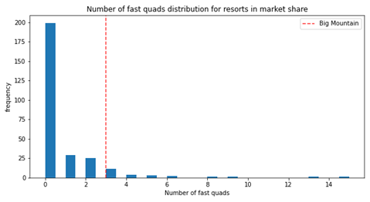
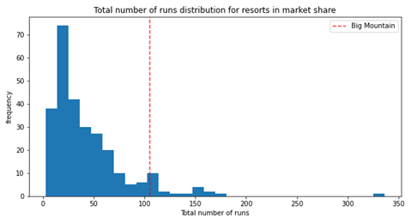
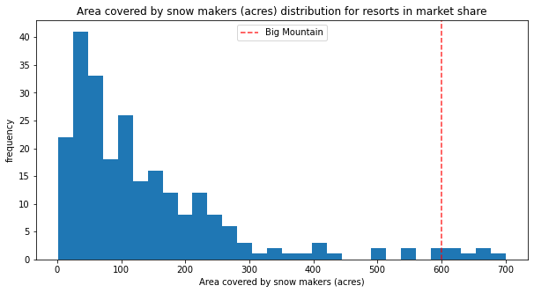
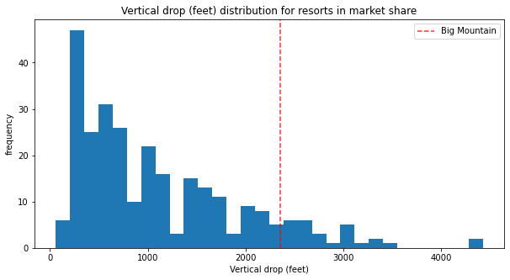
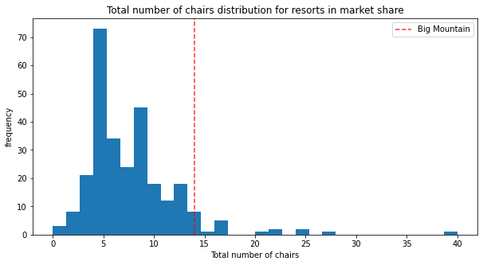
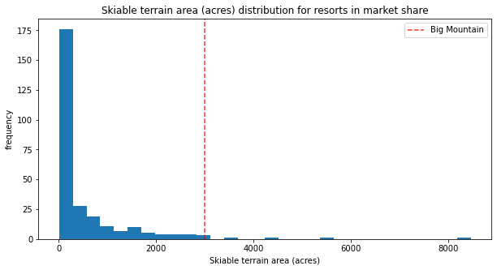
Modeling analysis
Big Mountain is fairly high on some of the league charts of facilities offered.

Slide 5
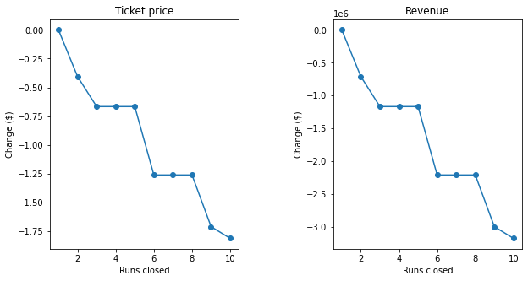
Investment Scenarios
Scenario 1: Permanently closing down up to 10 of the least used runs. This doesn't impact any other resort statistics.
Analysis: The model says closing one run makes no difference. Closing 2 and 3 successively reduces support for ticket price and so revenue. If Big Mountain closes down 3 runs, it seems they may as well close down 4 or 5 as there's no further loss in ticket price. Increasing the closures down to 6 or more leads to a large drop.
Scenario 2: Increase the vertical drop by adding a run to a point 150 feet lower down but requiring the installation of an additional chair lift to bring skiers back up, without additional snow making coverage
Analysis: This scenario increases support for ticket price by $1.99. Over the season, this could be expected to amount to $3474638.

Slide 6
Scenario 3: Same as number 2, but adding 2 acres of snow making cover
Analysis: Such a small increase in the snow making area makes no difference to revenue w.r.to scenario 2.
Scenario 4: Increase the longest run by 0.2 mile to boast 3.5 miles length, requiring an additional snow making coverage of 4 acres
Analysis: This doesn’t add any value to the revenue or ticket price.

Slide 7
Summary and conclusion
Big Mountain should increase their price to $95.87.
The additional cost of 1,540,000 of installing chair can be easily covered with the increased ticket price of $95.27.
The model outputted 4 most important features to be:
fastQuads
Runs
Snow Making_ac
vertical_drop
We would like to following information to make better informed decisions:
Operating cost of each run
Cost of adding 4 acres of snow making capability
Cost of increasing a run
Cost of increasing vertical drop by 150 feet
The suspicion that Big Mountain is not capitalizing on its facilities as much as it could seems to be correct. Big Mountain’s modeled price is so much higher than its current price because it offers great facilities in comparison to its competitors.

