Slide 1
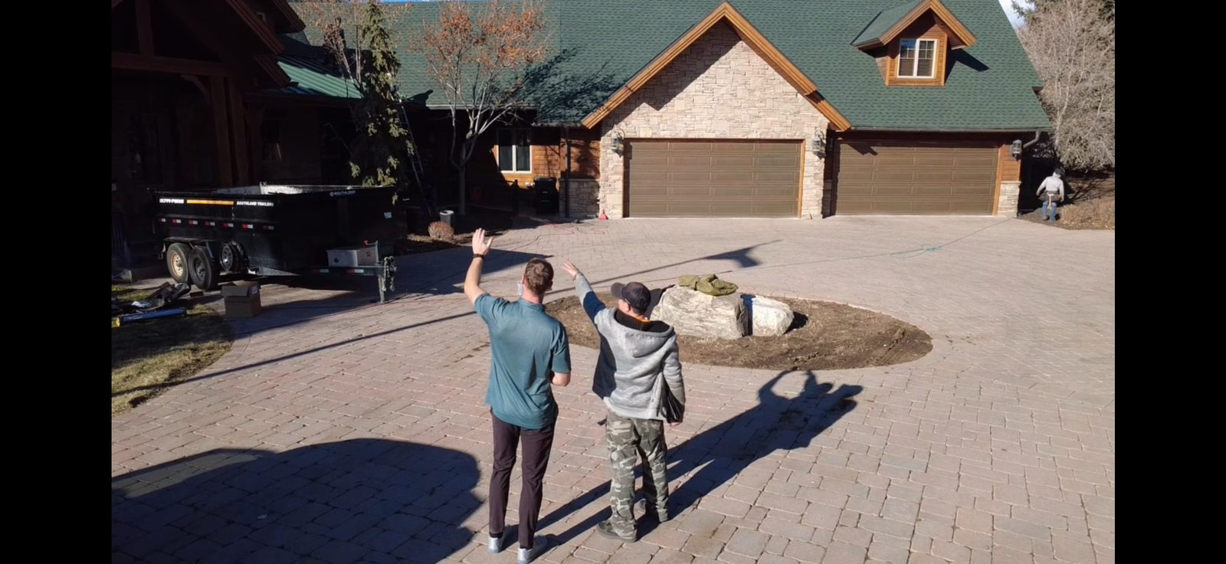

DIGITAL PROJECT
PORTFOLIO
Frame Restoration Utah
Website Design, Development & Digital Strategy
March 2026

Slide 2





PROJECT OVERVIEW
WHAT WE BUILT
KEY NUMBERS
Custom-designed responsive website
93
Verified Links
(0 Broken)
DJI drone footage production (2 videos)
Interactive project showcase pages
57
Mobile CSS Rules
(4 Breakpoints)
Lead capture & conversion system
Blog & content marketing platform
40+
Utah Cities
Covered
SEO foundation & local optimization
40+ Utah service area pages
2
Drone Videos
(109 sec total)

Slide 3
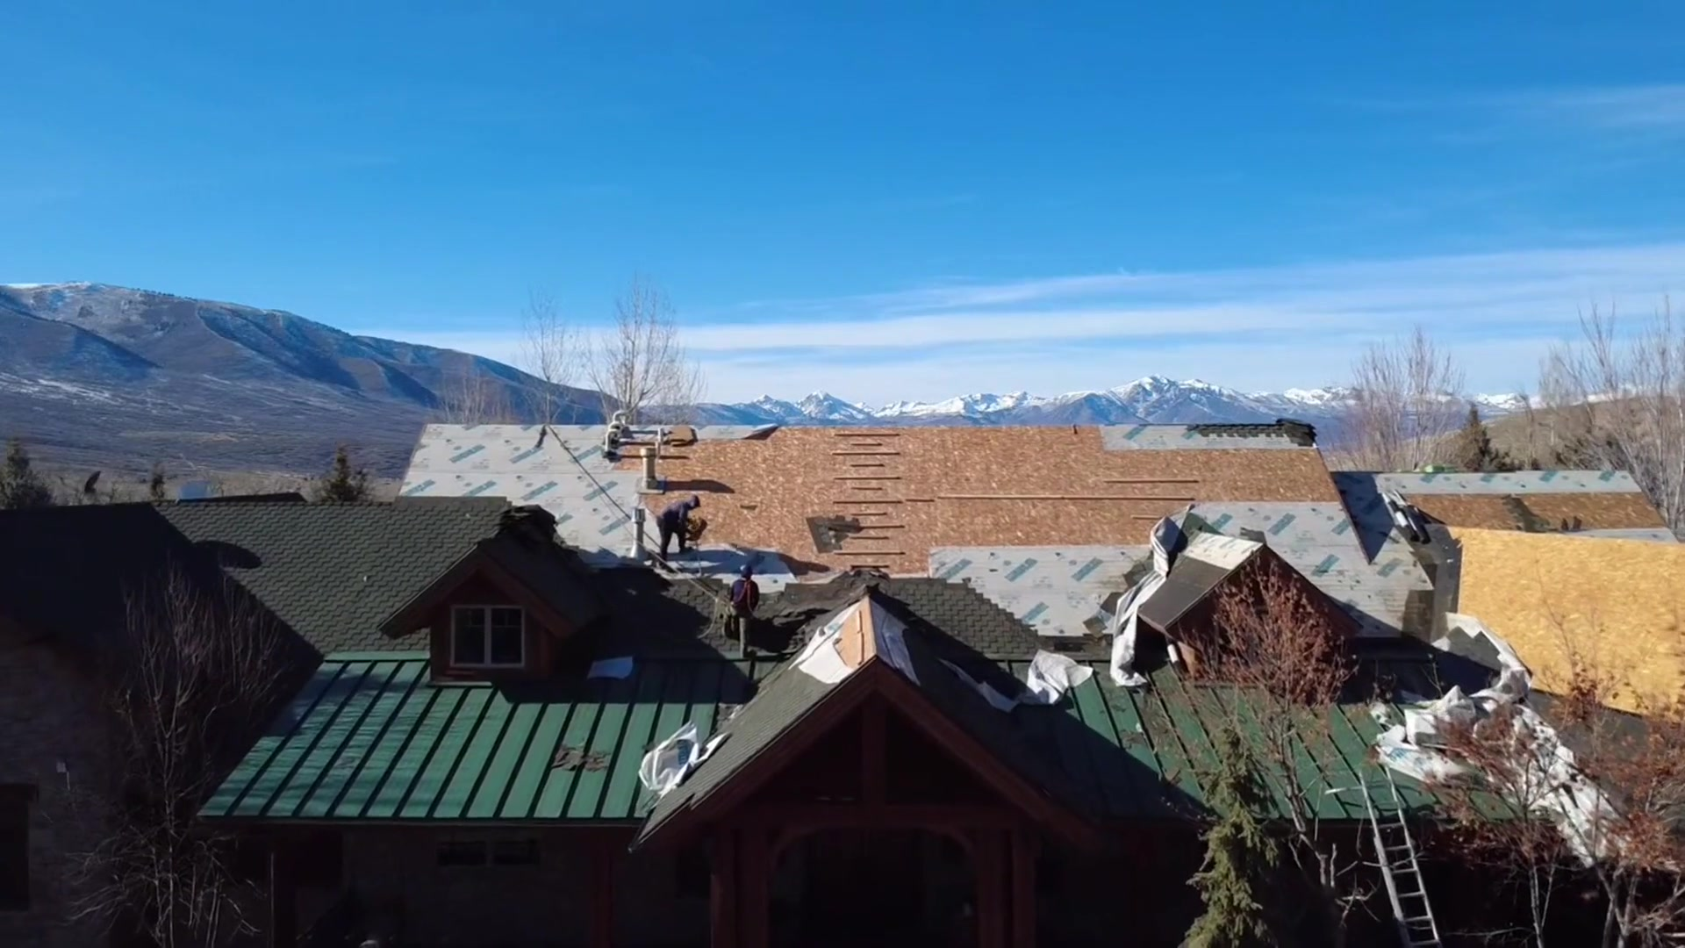





HOMEPAGE DESIGN
LEAD CAPTURE FORM
Above-the-fold form with name, phone, email, city, ZIP. Generates instant leads.
TRUST SIGNALS
5.0★ rating, A+ BBB, 40+ cities badge. Insurance claim handling, 5-year warranty.
6 SERVICE CARDS
Roof replacement, storm damage, repairs, inspections, gutters, insurance claims.
TESTIMONIALS
frame-restoration-utah.vercel.app
Real customer reviews with star ratings build social proof and credibility.
AUTOPLAY DRONE VIDEO HERO
32-second DJI aerial loop creates an immediate professional impression. No controls — seamless background experience.
FAQ ACCORDION
Answers top roofing questions. Keeps visitors on page, reduces bounce rate.

Slide 4
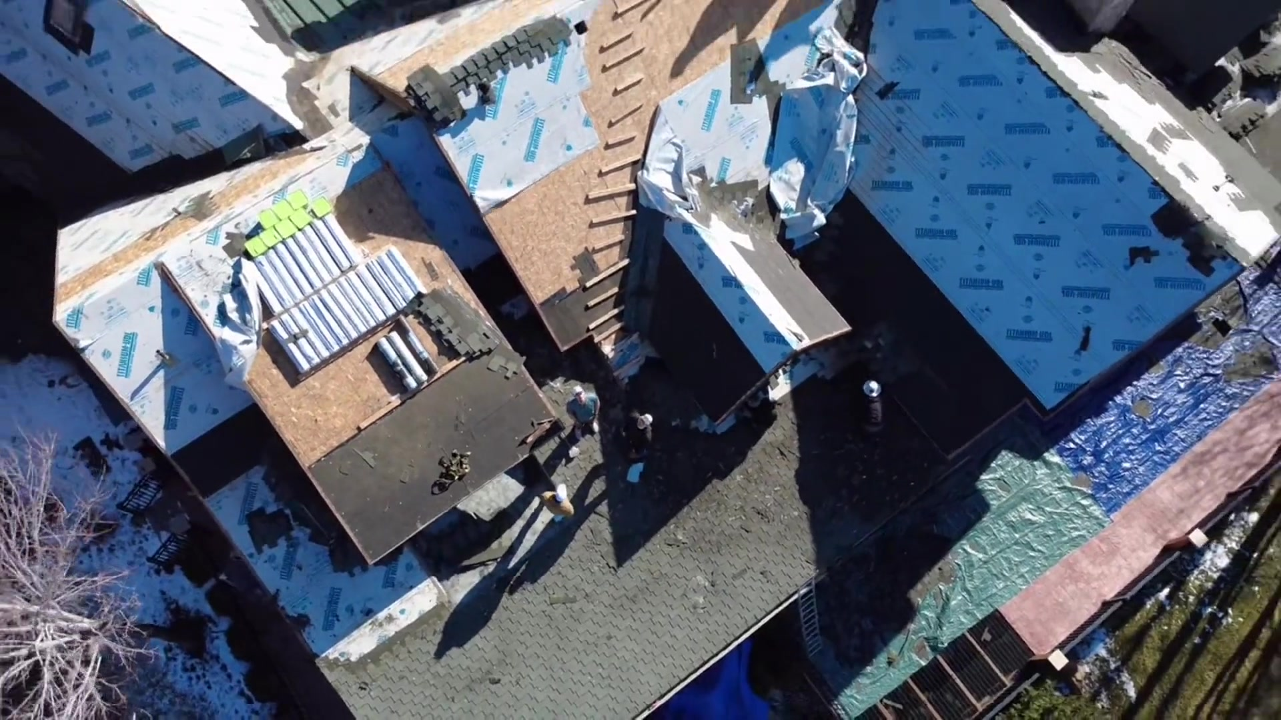
DRONE VIDEO PRODUCTION
Professional DJI aerial footage showcasing real project work
HOMEPAGE HERO LOOP
PROJECT SHOWREEL
32 seconds • Autoplay • 11 MB
Seamless background loop, no controls
77 seconds • User Controls • 25 MB
Detailed walkthrough with full playback
H.264 encoding • CRF 28 • 1920×1080 • Web-optimized with faststart

Slide 5
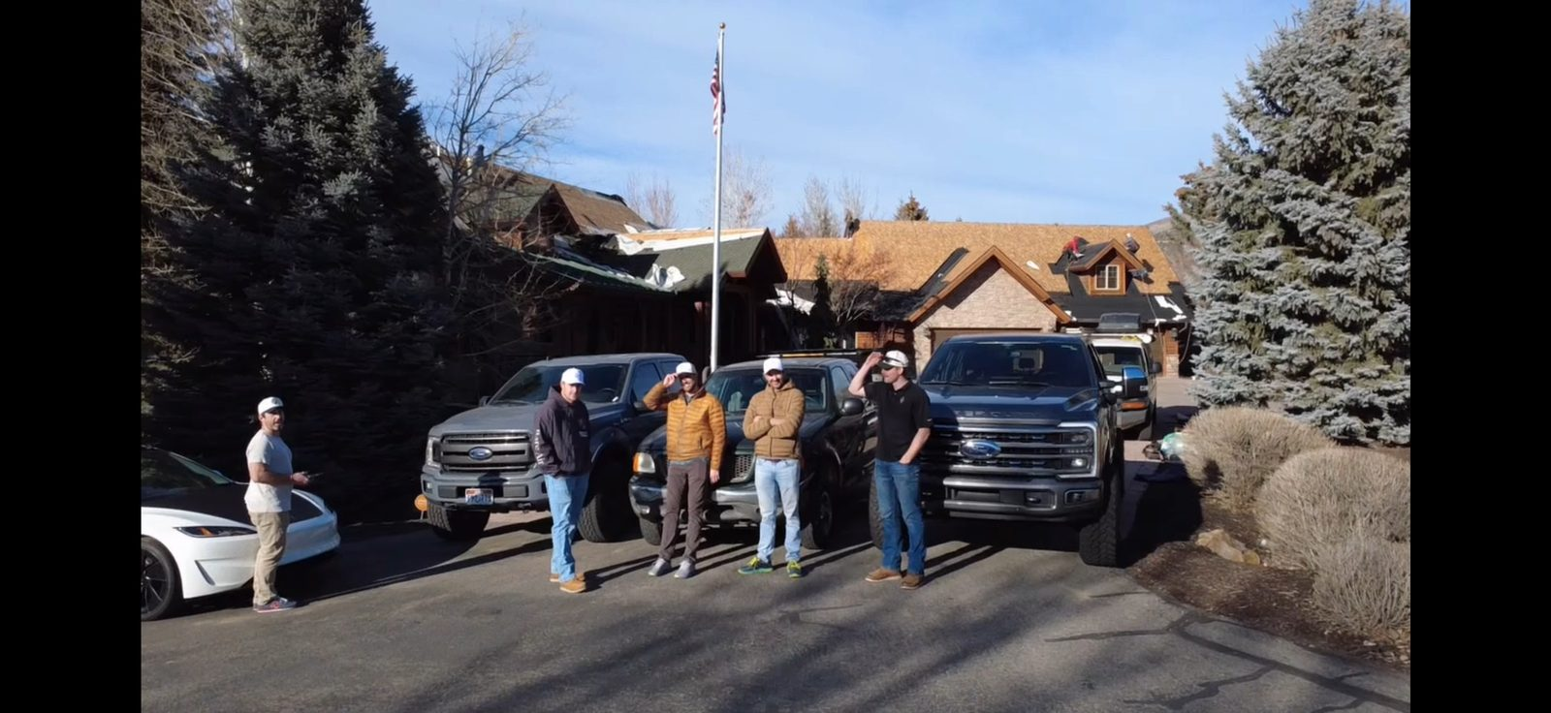
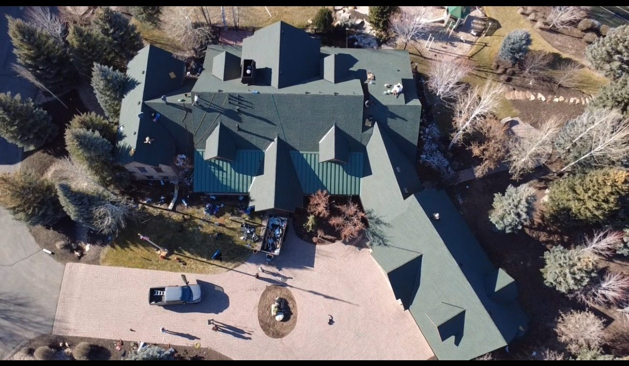
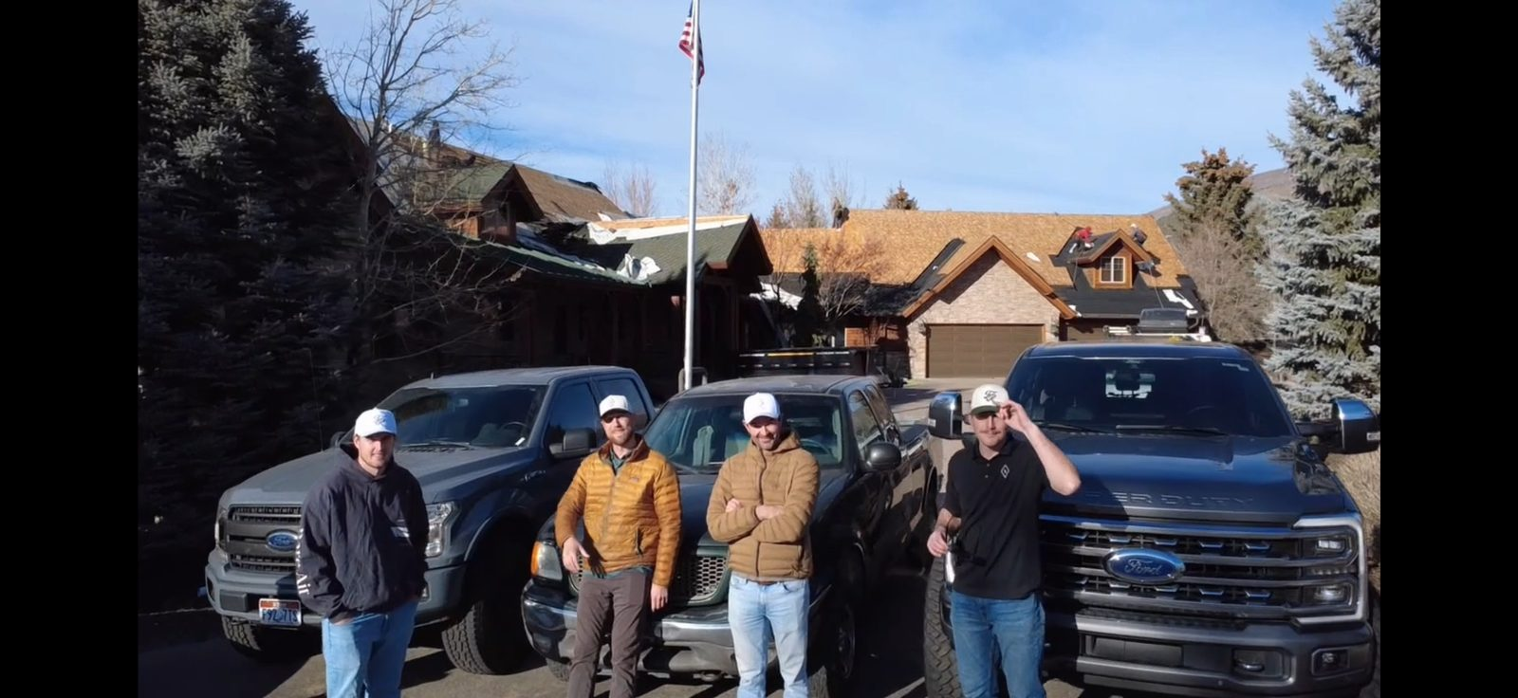
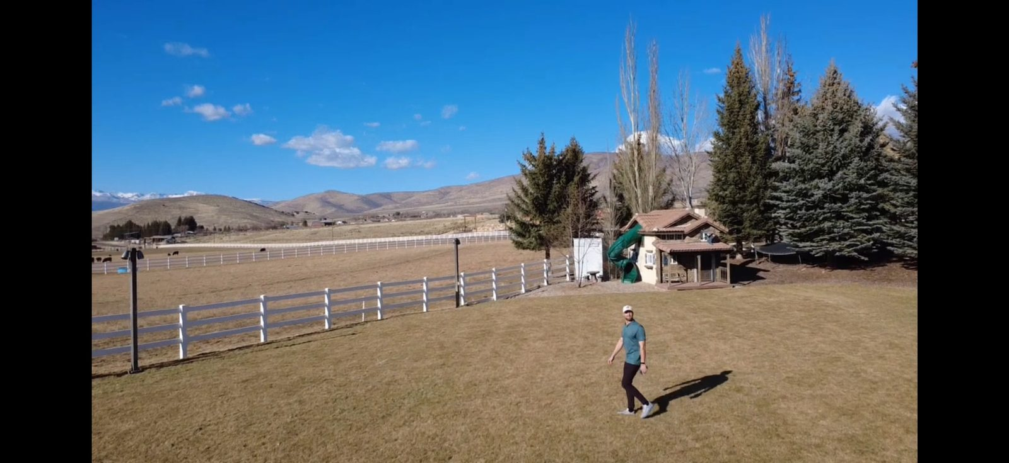
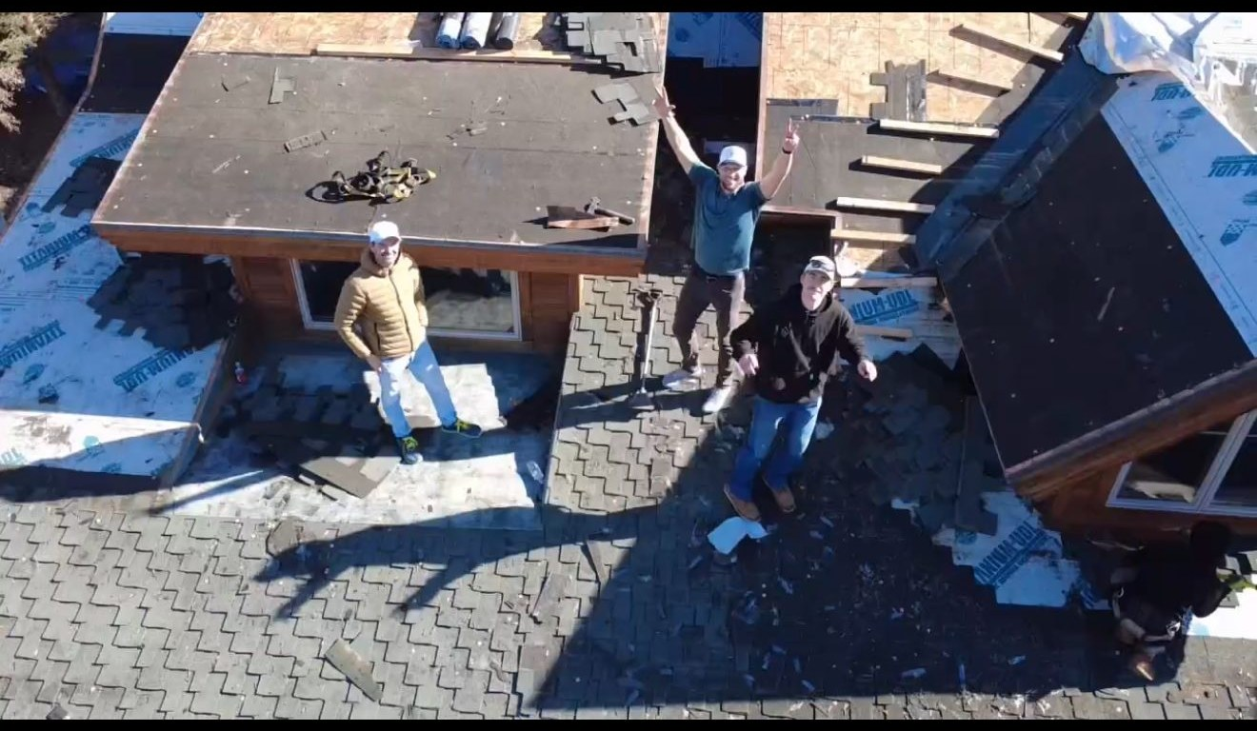

PROJECT SHOWCASE PAGE
6-Photo Gallery with Lightbox
77-Second Drone Showreel
Interactive Leaflet.js Map
Project Details Bar (Materials, Timeline, Scope)

Slide 6

LEAD GENERATION SYSTEM
ABOVE-THE-FOLD
LEAD CAPTURE
MULTI-CHANNEL
CONTACT OPTIONS
TRUST &
CREDIBILITY
Form visible without scrolling
Click-to-call: 435-302-4422
5.0★ rating badge in hero
5 fields: Name, Phone, Email, City, ZIP
Sticky mobile call bar
A+ BBB accreditation
"Call within 15 min" promise
Contact section with full form
"40+ Utah Cities" coverage
Gold CTA button stands out
Emergency tarping 24/7 messaging
5-year workmanship warranty

Slide 7

MOBILE-FIRST RESPONSIVE DESIGN
108
4
96
CSS Rules
Media Queries
Pages Optimized
900px
Tablet — Hamburger nav, single-column hero, sticky call bar, full-width CTAs, service cards stack
640px
Small tablet — Blog cards stack vertically, image thumbnails resize, content reflows to single column
600px
Mobile — Section padding tightens, nearby-city grid goes 2-column, chip touch targets expand
Touch
hover:none — Active states replace hover effects, 48px min touch targets on all interactive elements
96 PAGES OPTIMIZED — iOS ZOOM FIX • LCP OPTIMIZED • 48px TOUCH TARGETS • VIEWPORT META ON ALL PAGES

Slide 8


SEO & CONTENT STRATEGY
SEO FOUNDATIONS
CONTENT MARKETING
Meta descriptions on every page
Blog section for ongoing content
Open Graph tags for social sharing
Service area pages (40+ cities)
Canonical URLs configured
Project case study template
Semantic HTML structure (H1-H6)
FAQ section targets long-tail keywords
Alt text on all user-facing images
Trust badges (BBB, warranty, license)
Clean URL structure (/projects/...)
Testimonials with star ratings
Schema-ready structured content
Conversion-focused copy throughout

Slide 9





BUSINESS VALUE CREATED
LEAD GENERATION
CREDIBILITY & TRUST
LOCAL MARKET REACH
Above-the-fold form captures homeowner leads 24/7. Click-to-call drives immediate phone inquiries.
Professional site with drone video, BBB badge, and real reviews builds instant homeowner confidence.
40+ Utah city pages create massive local search visibility from Salt Lake to Heber Valley.
COMPETITIVE EDGE
BRAND AUTHORITY
SCALABLE PLATFORM
Drone footage and interactive project pages set Frame apart from competitors with basic sites.
Consistent navy/gold branding, professional photography, and detailed case studies position as premium.
Blog, project templates, and modular design make adding new content and projects effortless.

Slide 10
READY TO LAUNCH
NEXT STEPS
1.
Approve DNS switch to www.framerestorationutah.com
2.
Connect lead form to CRM / email notifications
3.
Set up Google Analytics & Search Console
4.
Launch Google Business Profile integration
frame-restoration-utah.vercel.app • 435-302-4422 • Frame Restoration Utah

