Slide 1
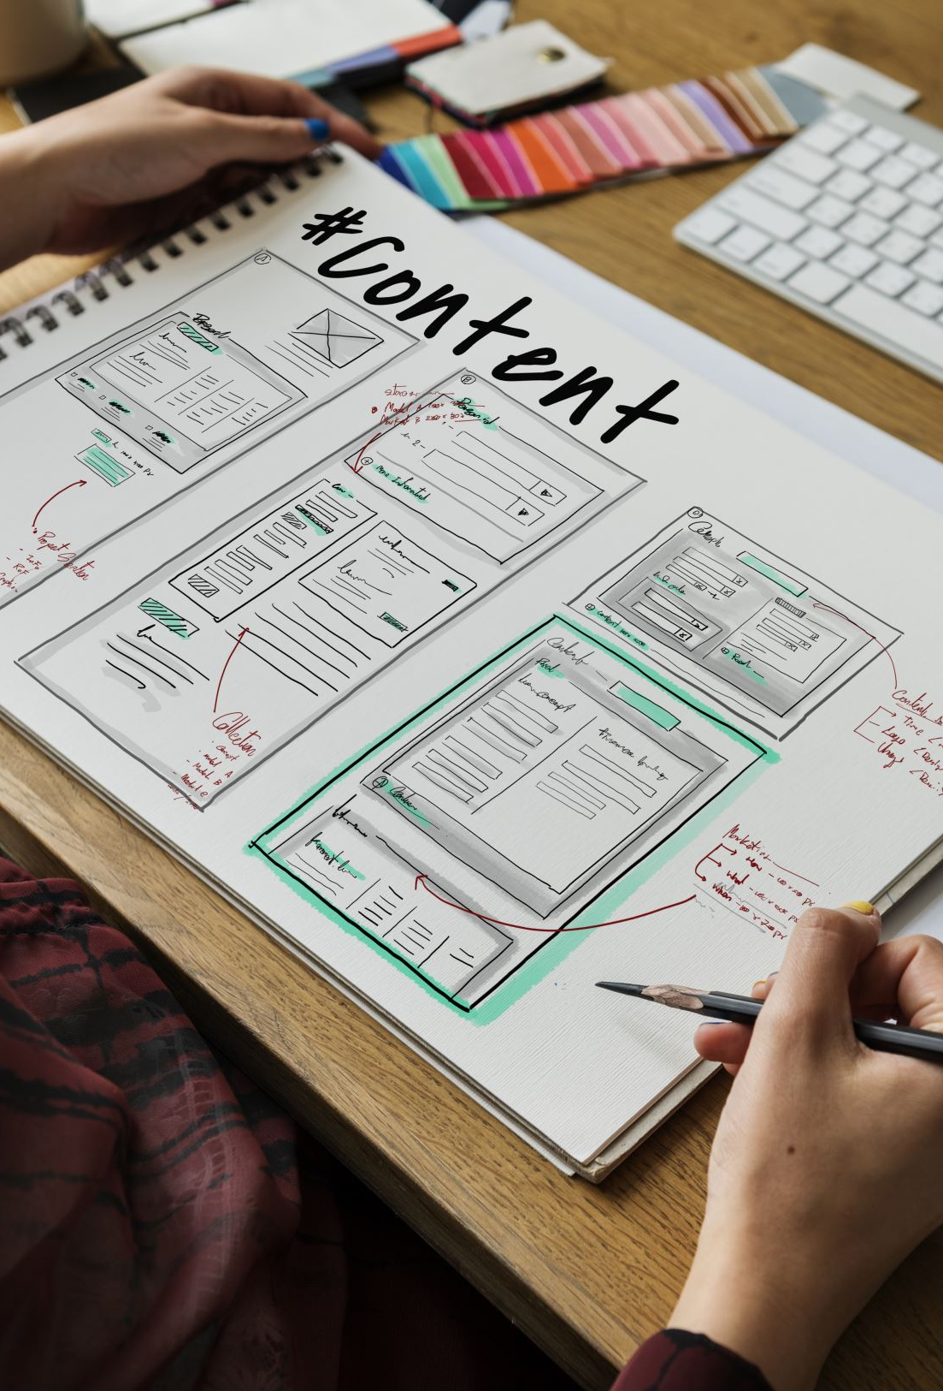
IT Project Management Final Project Presentation
Cheyenne Conner
12-03-2024
Dr. Kendrix
ITI3150-01

Slide 2
Contents
Title: Slide 1
Contents: Slide 2
1. Project Charter Document: Slides 3-4
2. Work Breakdown Structure: Slide 5
3. Project Gant Chart: Slide 6
4. Project Budget Estimate: Slide 7
5. Statement of Work: Slides 8-12
Questions: Slide 13

Slide 3

Project Charter Key Points
Name: Pulse App: Elderly Health
Company: Keenology Tech LLC.
The purpose of the Pulse App is to allow elderly patients to keep track of all appointments and health needs in one place and is easy to access.
This Project will help tackle the problem of elderly declining memories and ensure that they will have a place to store all their important information in a safe place.
The project will include an app guide and a how to use guide.
The objectives of the Pulse App are to help the elderly navigate their declining age with technology that is rapidly growing.
The risk of this app is to create a safe place for the elderly to store information while also making it strong enough where their information cannot be hacked.

Slide 4
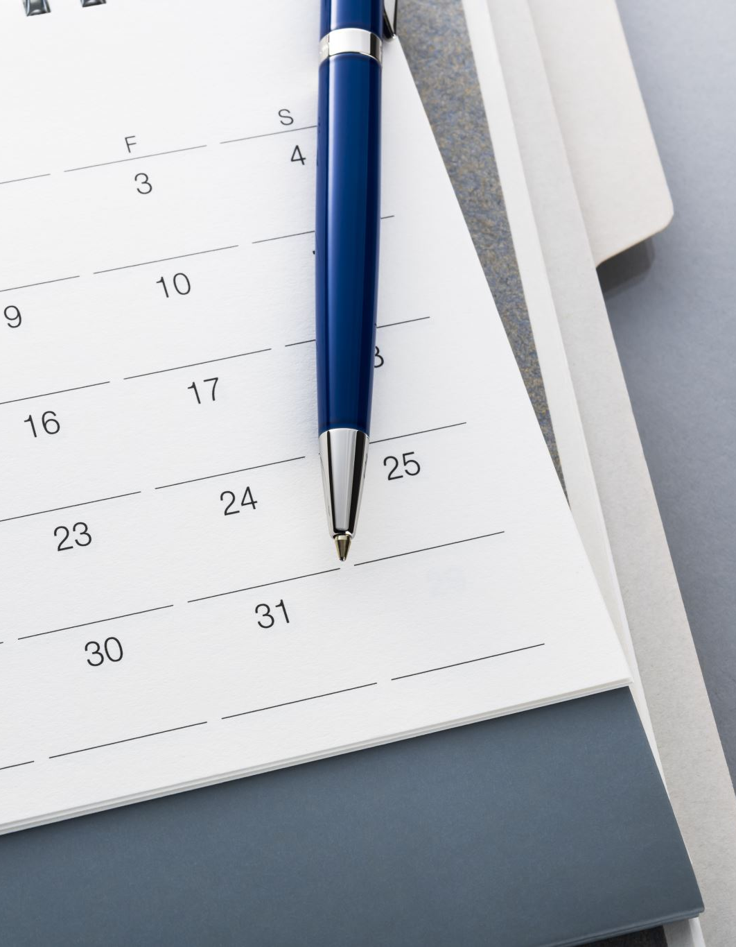
Charter Continued
For this project I put myself as the Project Manager.
Schedule Timeline:
Sep 18, 2024 – Project Plan Complete and Approved
Sep 30, 2024 – Pulse App Design Completed
Oct 31, 2024 – Prototype Completed
Nov 15, 2024 – Testing Completed
Dec 1, 2024 – Rollout Test Completed
Dec 10, 2024 – App is completed and able to be used

Slide 5
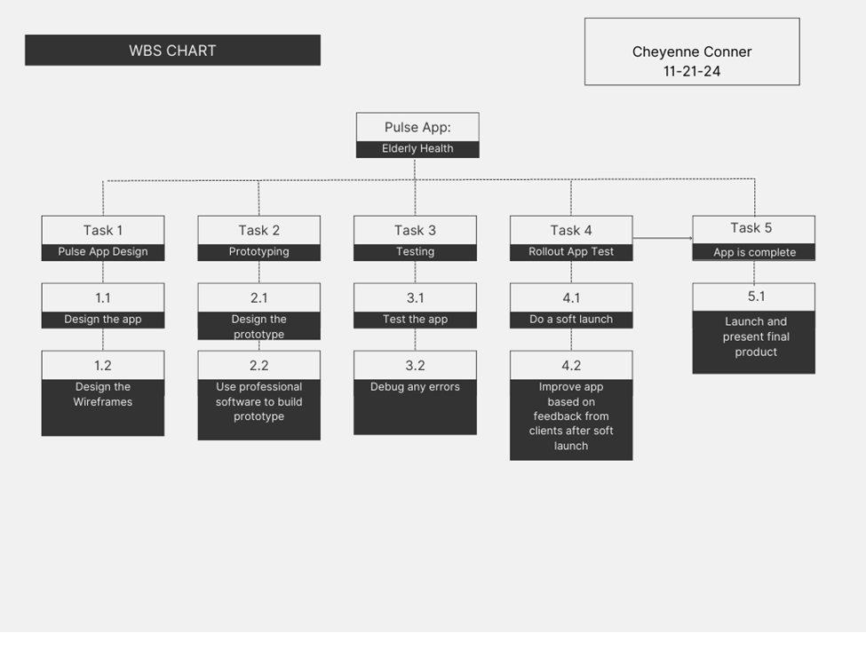
Work Breakdown Structure

Slide 6
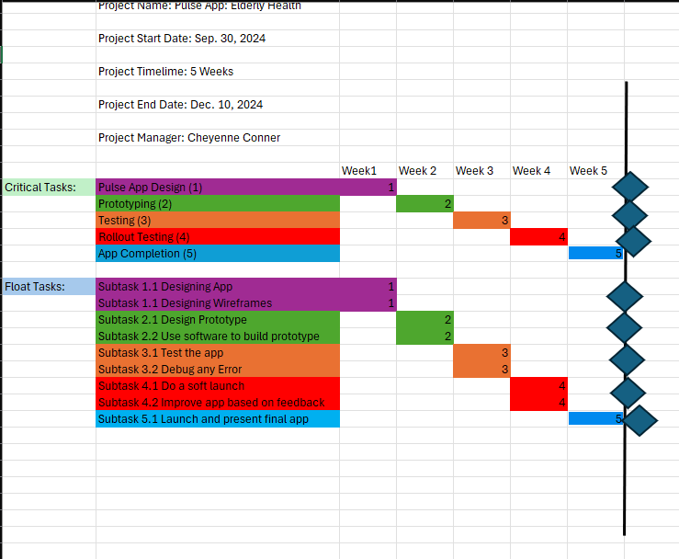
Gant Chart

Slide 7
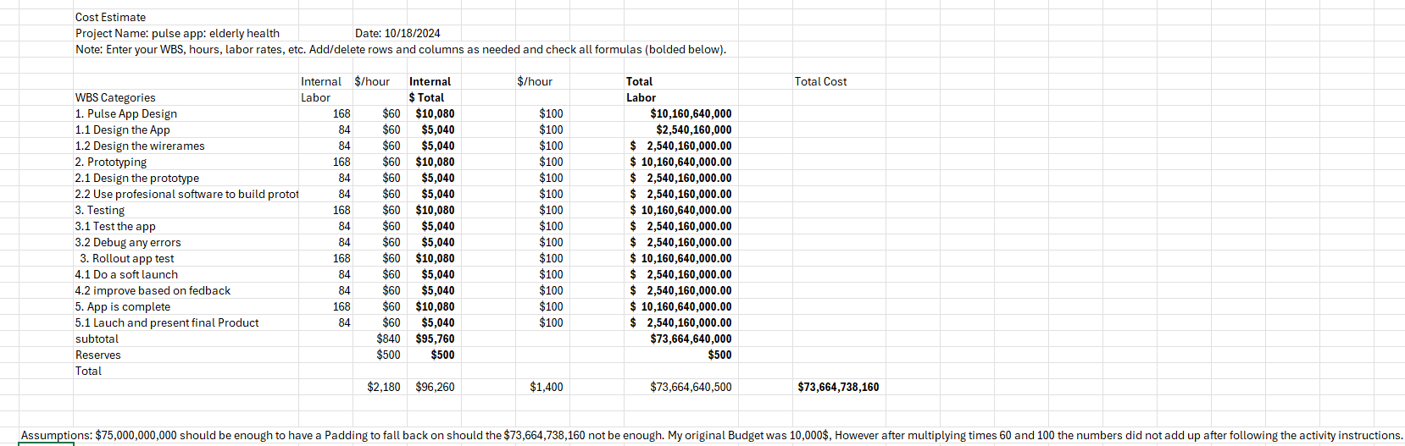
Cost Estimate

Slide 8
Statement of Work
Scope Inclusions:
Design & Development of a mobile app that is easy to navigate for elderly users.
Security Features to ensure that all user data is stored safely and protected from potential hacking.
Testing & Debugging to ensure the app operates smoothly and reliably.
User Guide & Training Materials to help elderly patients understand how to use the app effectively.
Launch & Post-launch Support to ensure smooth rollout and address user feedback.

Slide 9
SOW
Scope Exclusions:
Physical devices (phones/tablets) for users.
Integration with external health systems (e.g., hospital databases).
Ongoing support beyond the initial post-launch period.
The primary objective of the Pulse App project is to create a platform where elderly patients can track all their health-related information (appointments, medications, etc.) in one secure, easy-to-use app. The app will address the issue of declining memory among the elderly by ensuring they have a reliable way to store and retrieve their health information.

Slide 10
SOW
The success of the project will be measured by the following criteria:
The app is functional and free from critical bugs.
Elderly users can easily navigate the app with minimal training.
The app is secure, with no breaches of privacy or data.
Positive feedback from initial user trials and the app’s full implementation.

Slide 11

SOW
Deliverables:
Project Plan: Detailed documentation of the project’s scope, timeline, cost estimate, risk management plan, etc.
App Design: Completed app interface design and user experience mockups.
Prototype: A working prototype of the app for initial testing.
App Testing: Completed functional, user acceptance, and security testing.
Launch Rollout: A successful initial rollout to a limited number of users for live testing.
Final App Version: The fully developed and operational mobile application.
User Guide: A comprehensive guide on how to use the Pulse App.
Post-launch Support: Technical support to handle user feedback and any bugs that may arise after launch.

Slide 12
SOW
The project team consists of the Project Manager, Development Team, Quality Assurance (QA) Team, and Project Sponsor.
The Project Manager, Cheyenne Conner, oversees the project plan, resources, timeline, and communication between stakeholders.
The Development Team is responsible for designing, coding, and testing the Pulse App, ensuring its security and usability, while providing post-launch support.
The QA Team tests the app for functionality, security, and usability, providing feedback to ensure reliability.
The Project Sponsor, Keenology Tech LLC, approves deliverables and ensures the project aligns with organizational goals. Identified risks include security concerns, user adoption challenges, timeline delays, and potential budget overruns, with mitigation strategies in place.
The project will be deemed complete when all deliverables are met, the app is functional, secure, and user-friendly, and positive feedback is received from the target audience.

Slide 13
Any Questions about the Project?
Thank you for Listening!

