Slide 1

ANN-Presentation
A cutting-edge work in stock price prediction
洪梓晋 - 2020101911 - 12/01/2023

Slide 2
CONTENTS
01
02
03
04
01
RNN-based Model
Time-Series Prediction
Vessel Trajectory Prediction
Seq2Seq Structure
RNN-based Model

Slide 3
01
RNN-based Model

Slide 4
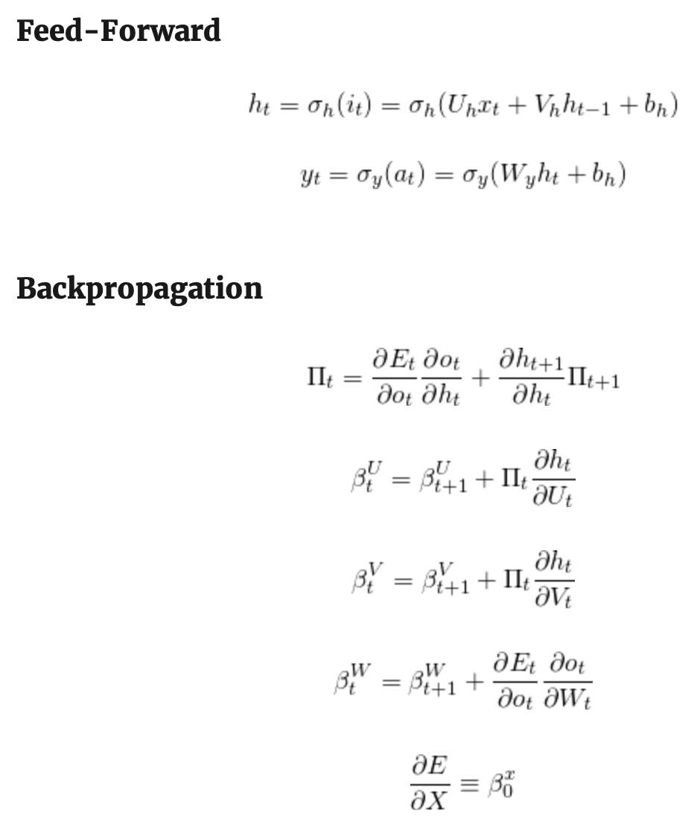
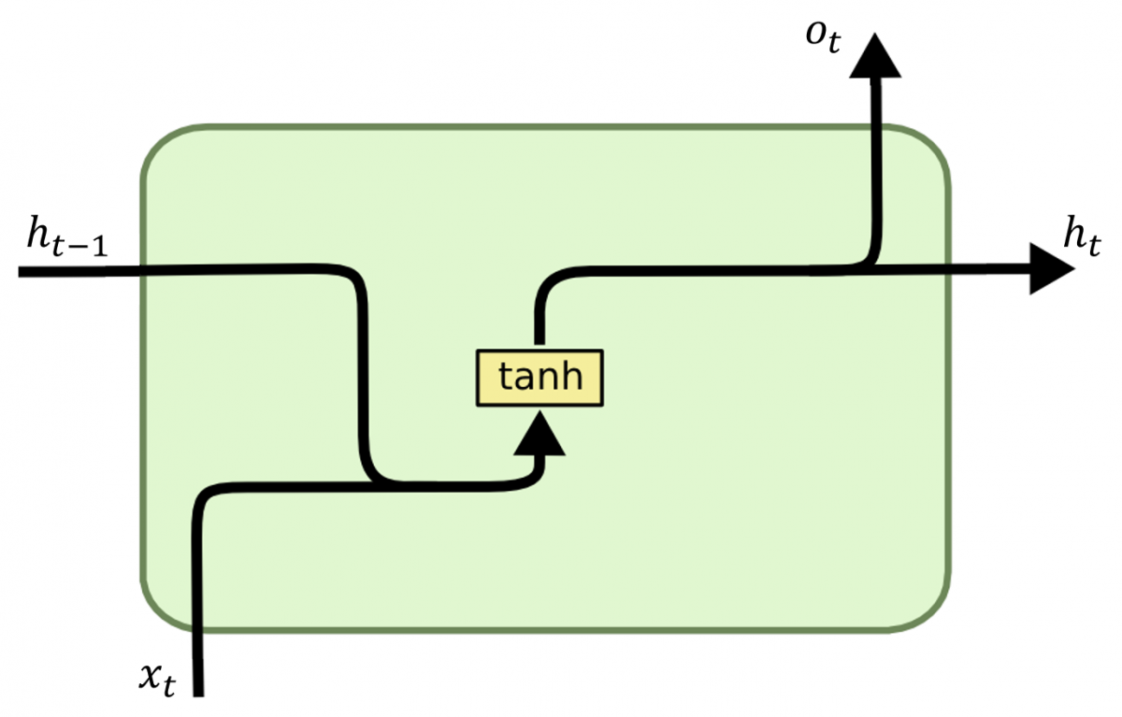

Recurrent Neural Network

Slide 5
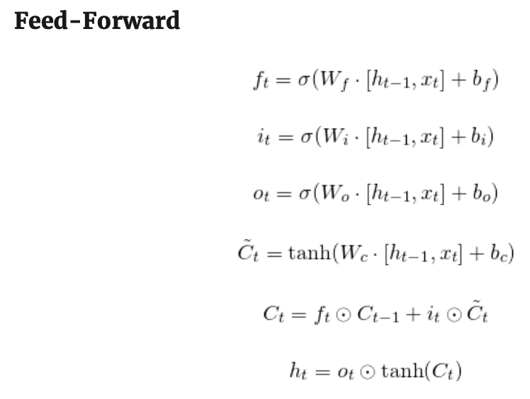
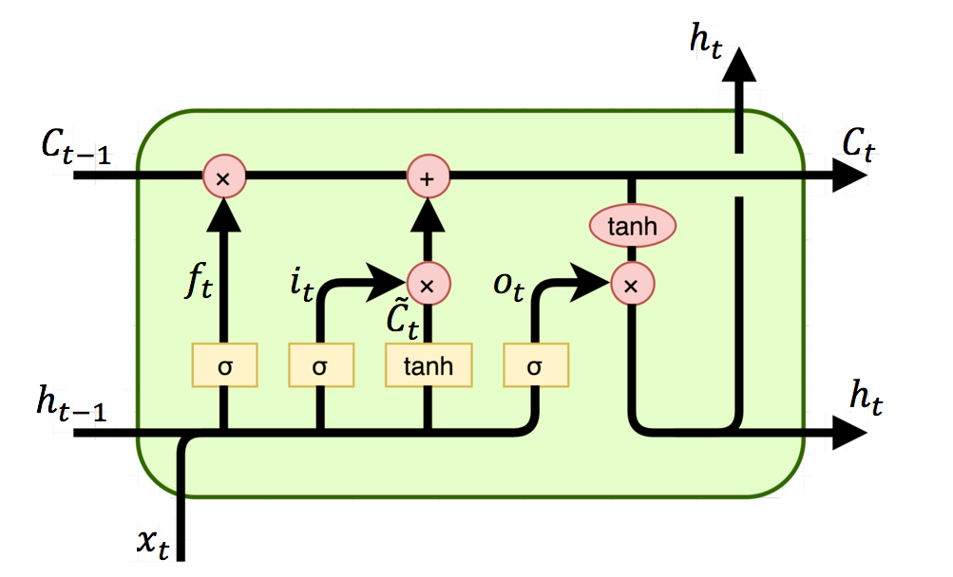
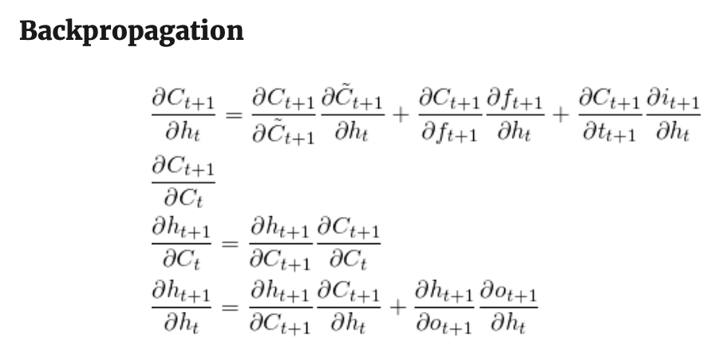
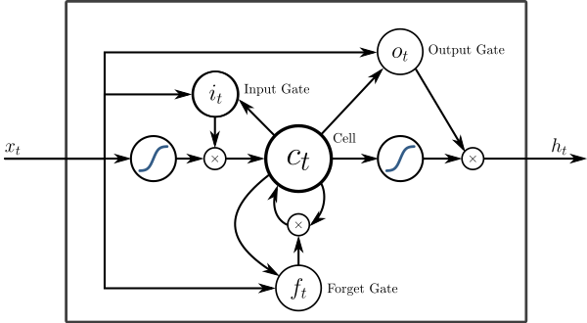

Long-Short Term Memory

Slide 6
02
Seq2Seq Structure

Slide 7
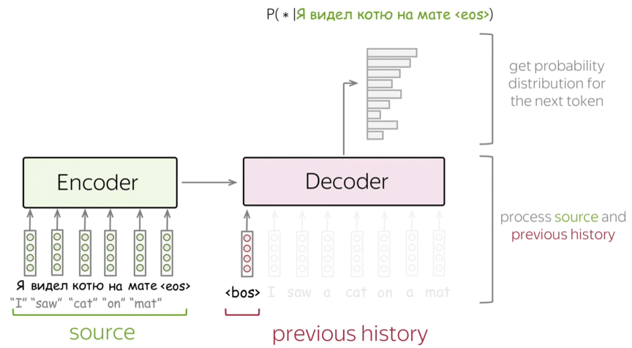
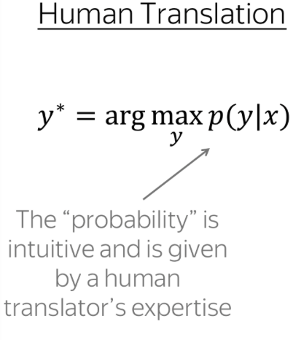
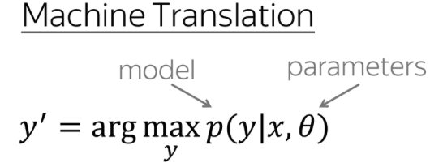


Sequence to Sequence

Slide 8

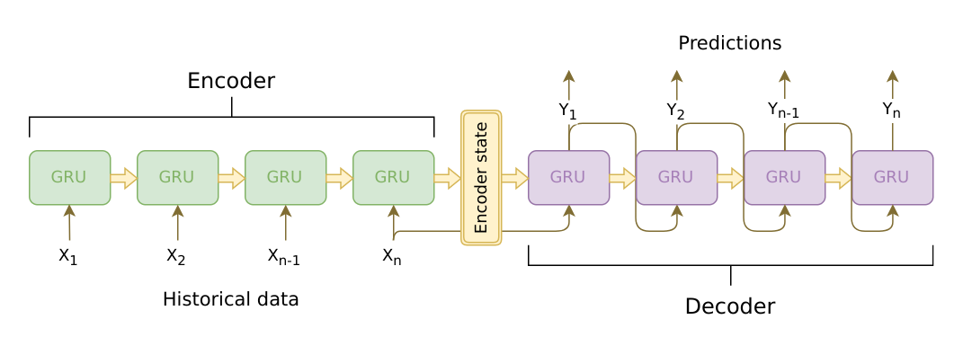
Sequence to Sequence

Slide 9
03
Time Series Prediction

Slide 10
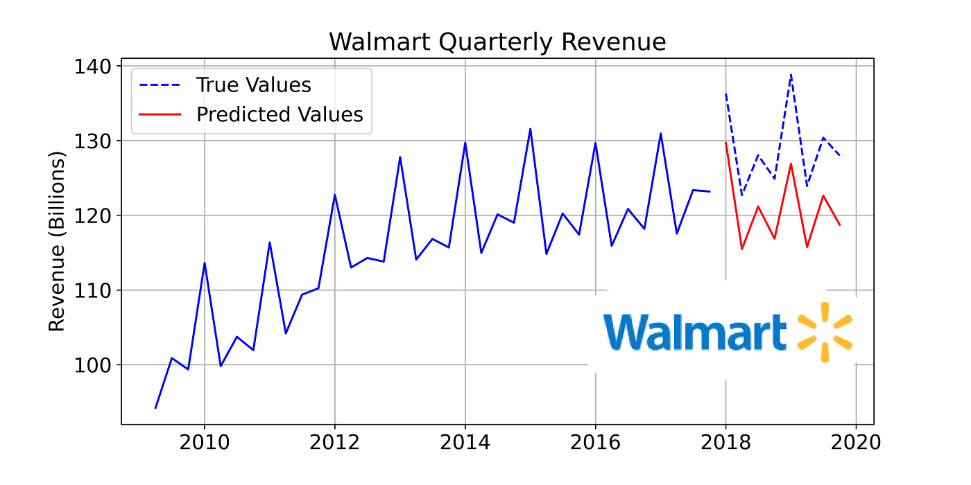
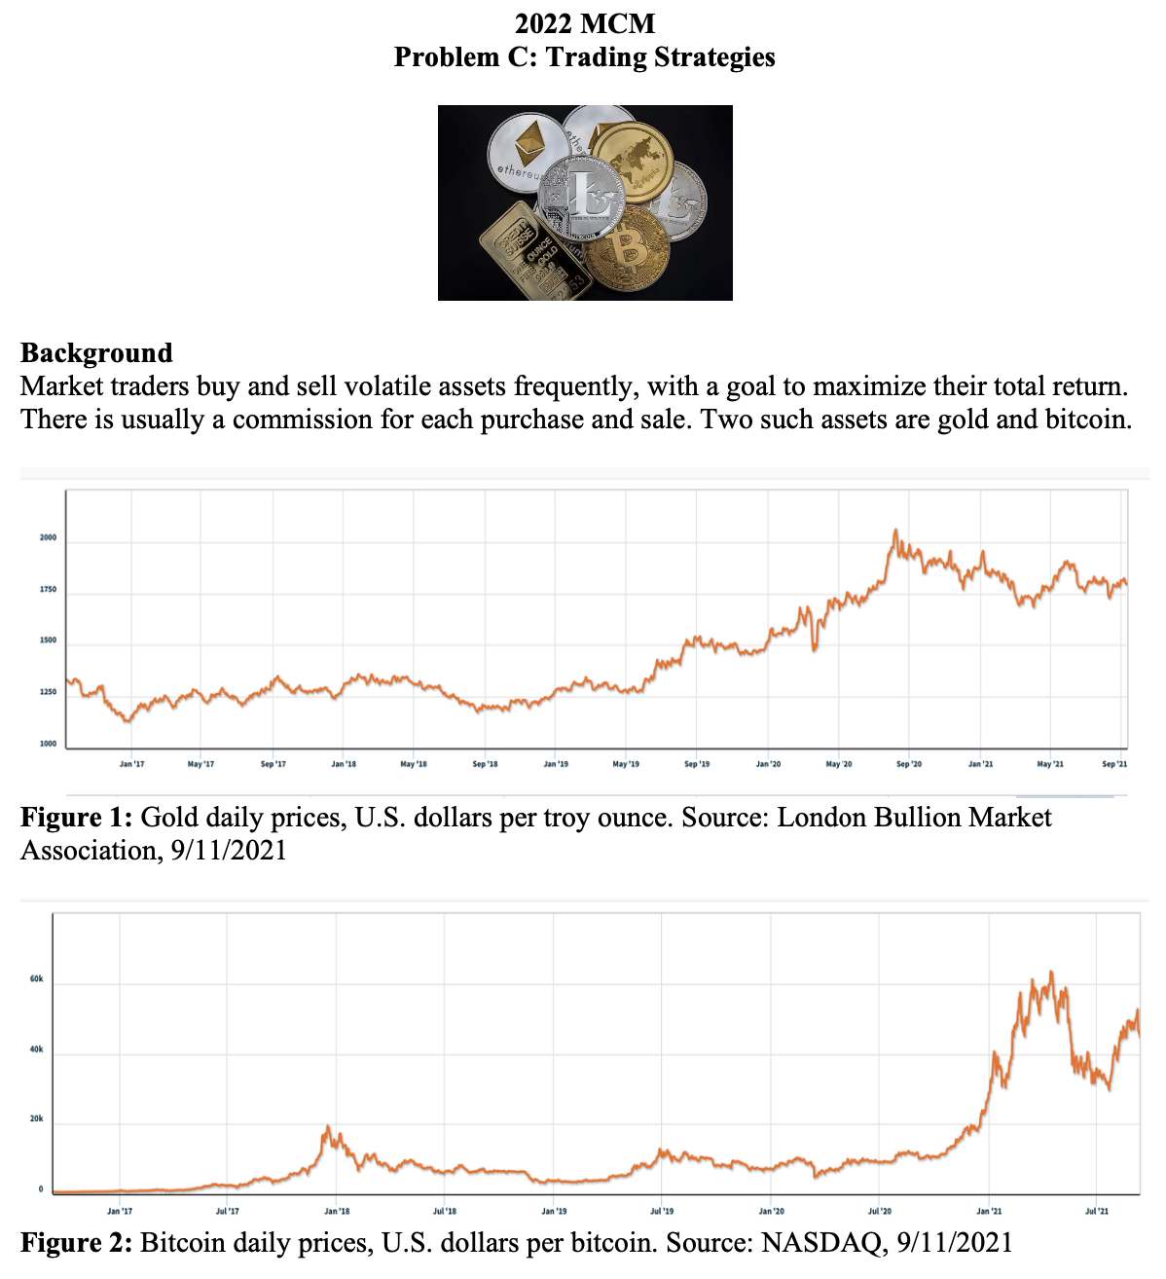
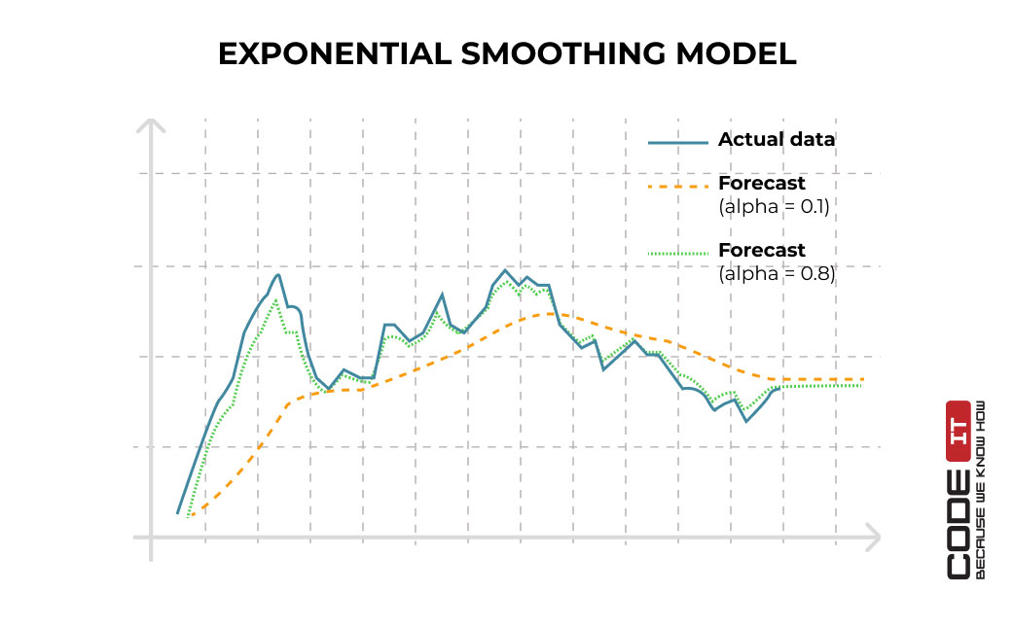
Background

Slide 11
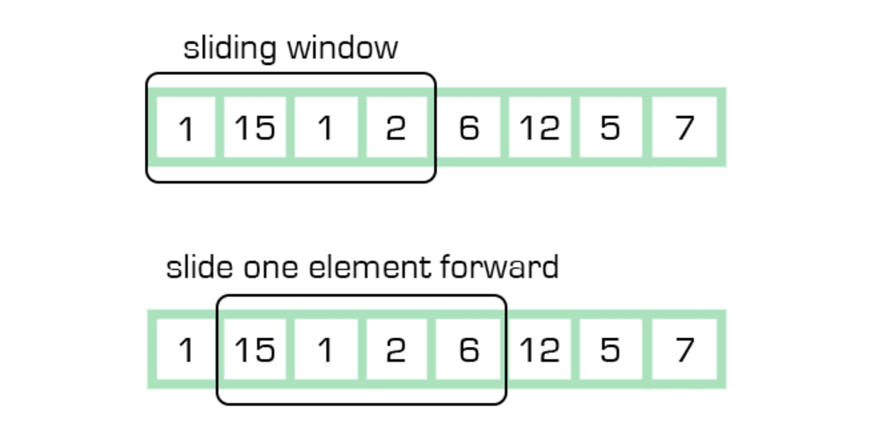


Sequential Data

Slide 12
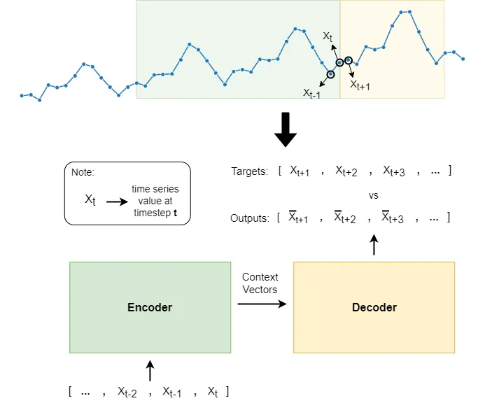

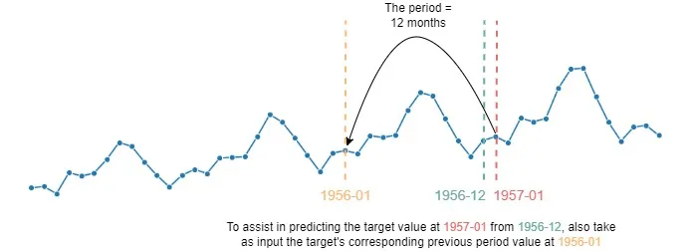
Seq2Seq For TS Prediction

Slide 13
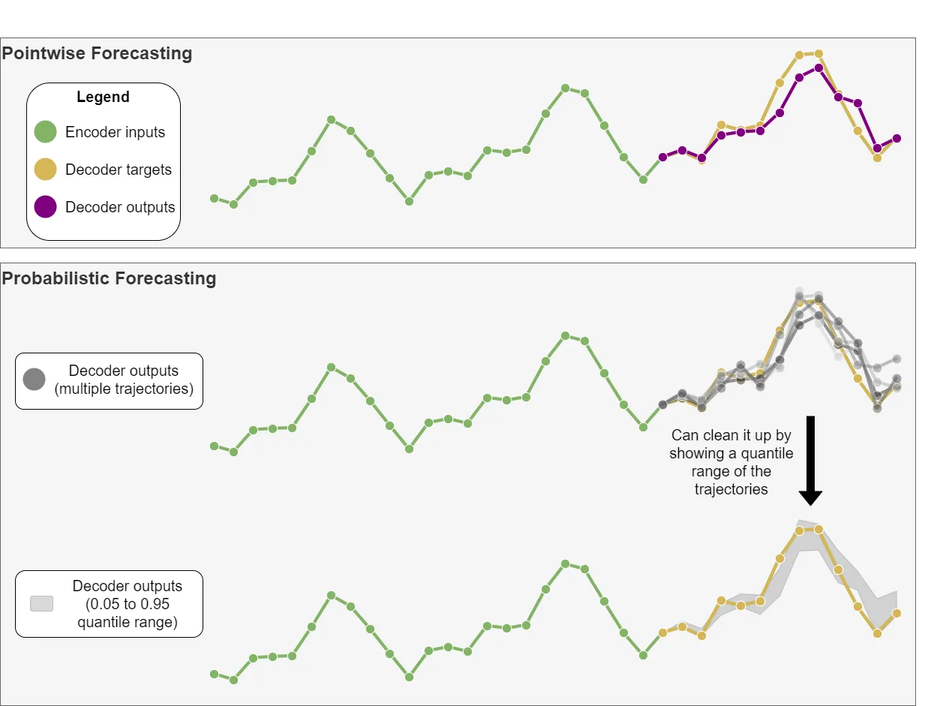
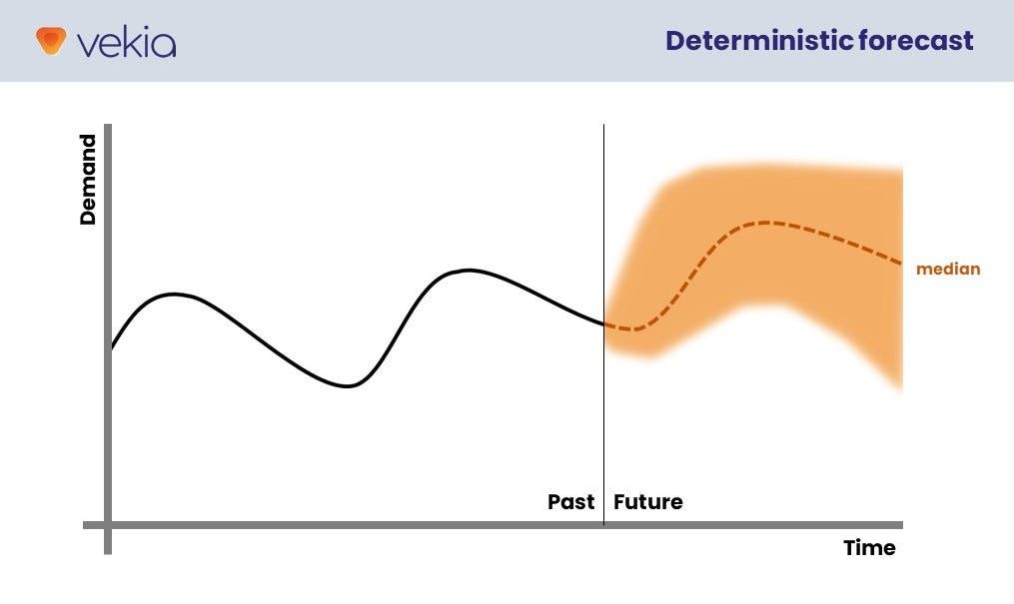
Prediction Details

Slide 14
04
Vessel Trajectory Prediction

Slide 15
Background

Slide 16
Seq2Seq For TS Prediction

Slide 17
Thanks

