Slide 1

ANN-Presentation
A cutting-edge work in stock price prediction
洪梓晋 - 2020101911 - 12/01/2023

Slide 2
CONTENTS
01
02
03
04
01
RNN-based Model
Time-Series Prediction
Vessel Trajectory Prediction
Seq2Seq Structure
RNN-based Model

Slide 3
01
RNN-based Model

Slide 4
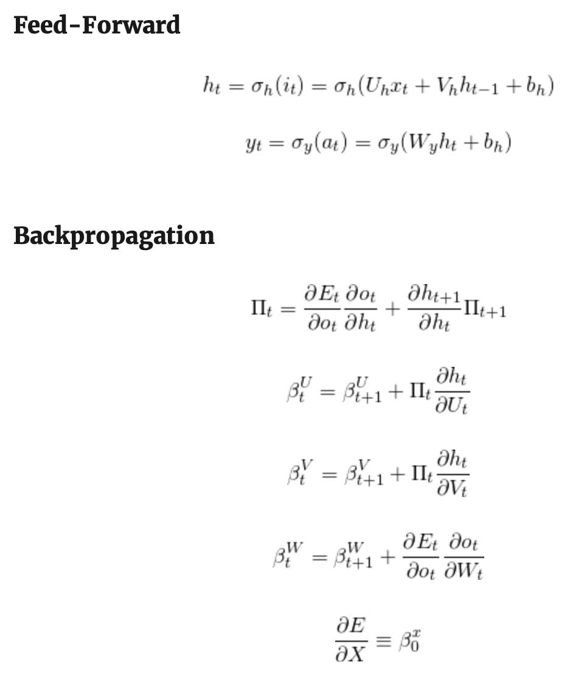
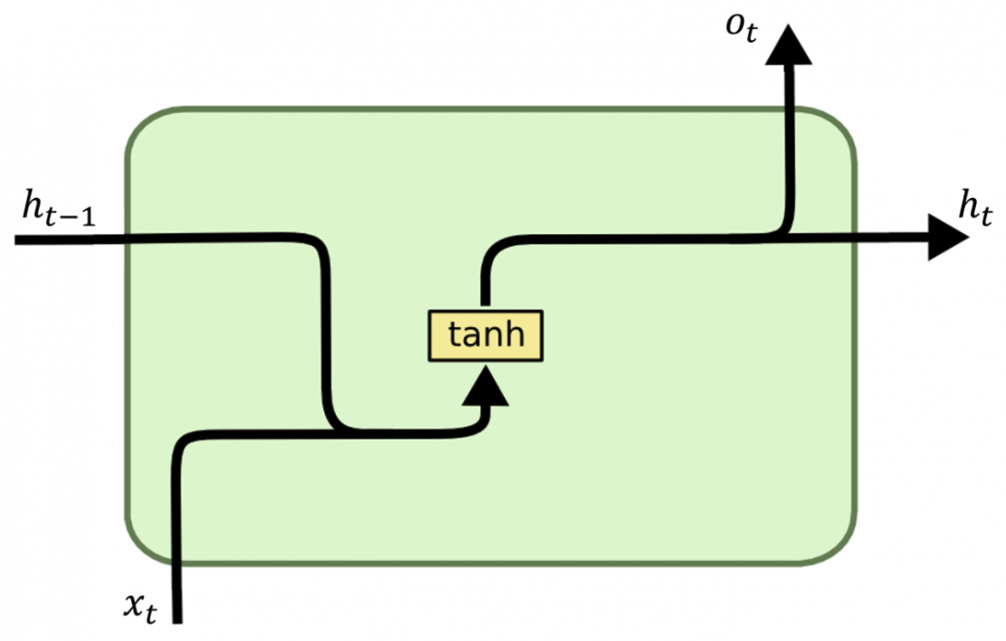
Recurrent Neural Network

Slide 5
Methodology

Slide 6
Methodology

Slide 7
Evaluation

Slide 8
Motivation

Slide 9
Method:IKE

Slide 10
Result

Slide 11
Result

Slide 12
Thanks

