Slide 1



Diversity-guided Multi-objective Differential Evolution for Compact Neural Networks
Multi-objective optimization for modern AI systems
DSAI6707 ADVANCED COMPUTATIONAL INTELLIGENCE
Zijin HONG, 24144677R
November 4, 2026
Notes:
Good morning, everyone. My name is Zijin Hong. Today I will introduce my project, “Diversity-Guided Multi-Objective Differential Evolution for Compact Neural Networks.”
This a small research direction of multi-objective optimization for modern AI systems. Instead of asking only how to make a model more accurate, I also ask how to keep it small.
My project focuses on a simple question: can the diversity of candidate solutions help an evolutionary search find a better balance between accuracy and model size?

Slide 2
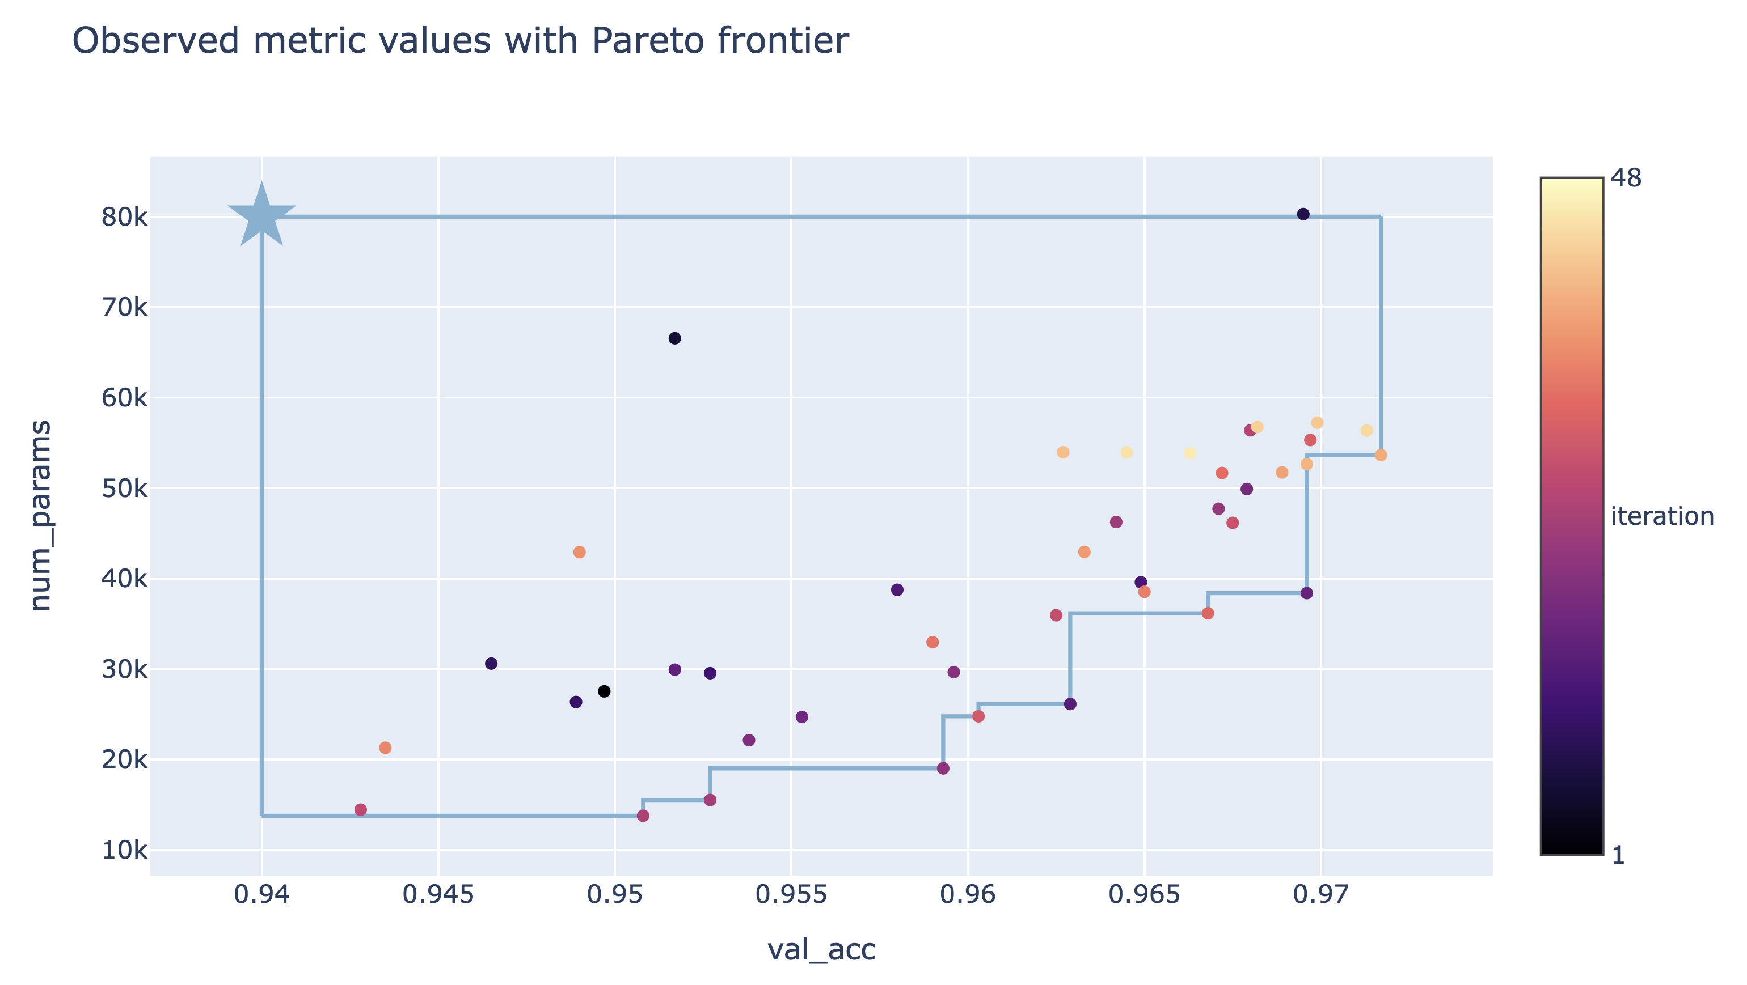
Research Question
Given labelled tabular data, search for an MLP classifier that predicts accurately with fewer trainable parameters.
1. What does the search change?
Hidden-layer depth and width
Regularization and learning rate
Activation function
2. How do we score a candidate?
Maximize validation accuracy
Minimize trainable parameters
Research Question
Each point is a candidate model. The search seeks points toward higher accuracy and fewer parameters.
With equal budgets, does diversity guidance help MODE* find a better accuracy–size trade-off?
Illustration: PyTorch MNIST NAS tutorial.
*Multi-objective Differential Evolution (MODE) is an evolutionary search algorithm. It combines existing candidate settings to propose new MLPs, then balance prediction accuracy and model size.
Notes:
Let me first explain the task. Given labelled tabular data, we want to find an MLP classifier. An MLP is a feed-forward neural network that takes input features and predicts a class.
We want to optimize two objectives at the same time. The first is validation accuracy: we want the model to make correct predictions. The second is the number of trainable parameters: we prefer a smaller model when its accuracy is similar.
Each point in this figure represents one candidate model. The Pareto frontier shows the candidates that offer a good trade-off. A model is on this frontier if there is no other candidate that is both more accurate and smaller.
Our research question is: given the same number of model evaluations, does diversity guidance help MODE find a better accuracy-size trade-off? Our idea is that if the candidate models become too similar, a larger mutation step might help the search explore new solutions. But that is only a hypothesis, so we need to test it.

Slide 3
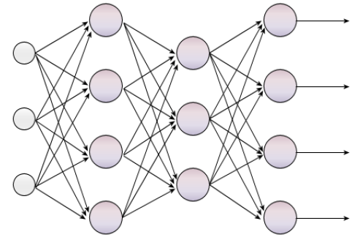
Search Space of MLP
An MLP is a feed-forward network: input features pass through hidden layers to predict a class.
Features
Layer 1
Layer 2
Output
Five MLP search space settings
1. Depth: 1 – 100 hidden layers
2. Width: 16, 32, 64, 128, or 256 neurons per layer
3. L2 strength α: 10⁻⁶ to 10⁻², on a log scale
4. Learning rate: 10⁻⁴ to 10⁻², on a log scale
5. Activation: ReLU or tanh
Example candidate
2 hidden layers; 64 neurons per layer; α = 10⁻⁴; learning rate = 10⁻³; ReLU
Illustrative structure. The search varies the number of hidden layers and neurons.
One five-setting recipe is one candidate. The search algorithm proposes many candidates, then training and validation score each one.
Notes:
What exactly does the search algorithm change? Each candidate model is represented by a recipe with five settings.
The first two settings describe the network structure: the number of hidden layers and the number of neurons in each layer. The next two settings are the L2 regularization strength and the learning rate. The final setting is the activation function, either ReLU or tanh.
For example, one candidate might have two hidden layers, 64 neurons in each layer, an L2 value of ten to the minus four, a learning rate of ten to the minus three, and ReLU activation.
The diagram on the left shows the general structure of an MLP. Input features pass through hidden layers, and the output layer predicts a class. The search algorithm proposes different recipes. We then train and evaluate each candidate using the same process.

Slide 4
Search Algorithms
All baseline algorithms explore the same five MLP settings. They differ in how they propose the next candidate.
Random Search
Draw a fresh recipe at random. Earlier scores do not guide later draws.
NSGA-II
A genetic algorithm: select parents by Pareto rank and crowding distance, then cross and mutate their recipes.
MODE
Differential evolution: use the difference between two recipes to move a third, then cross the trial with its target.
DG-MODE
The project’s MODE variant. It changes the mutation step using population diversity: similar recipes trigger a larger step.
Differential mutation: what each symbol means
MODE · fixed mutation scale
DG-MODE · adapt the mutation scale
v = x₁ + 0.50 (x₂ − x₃)
Fₜ = clip[0.35 + 0.60 (1 − Dₜ), 0.35, 0.95]
x₁: base model configuration
x₂, x₃: two other configurations
v: new mutant, before crossover
Dₜ: current population diversity (generation t)
Fₜ: mutation scale; clip bounds it to [0.35, 0.95]
Lower Dₜ → higher Fₜ → larger mutation step
Each method evaluates 40 candidates per run: 40 independent random draws, or 10 candidates evolved over 3 generations.
Notes:
This slide compares four ways to propose candidate models. All four methods explore the same five settings, but they use different search strategies.
Random Search draws each recipe independently. It does not use the scores of earlier candidates to decide what to try next.
NSGA-II is a genetic algorithm. It selects promising candidates based on Pareto rank and crowding distance. It then combines and mutates candidate recipes to produce new ones.
MODE uses differential evolution. It starts with one candidate and uses the difference between two other candidates to suggest a change. In the equation, each x represents a full five-setting recipe. The vector v is the mutated recipe before it is crossed with the target candidate. MODE keeps the mutation scale F fixed at 0.50.
DG-MODE is the variant used in this project. It changes the mutation scale based on population diversity. D measures how spread out the candidate recipes are. When diversity is low, DG-MODE increases F, creating a larger step in the search space. The clip operation keeps F between 0.35 and 0.95.
So the main difference between MODE and DG-MODE is that MODE uses a fixed mutation scale, while DG-MODE adapts it using diversity. DG-MODE is our project modification of MODE, not a standard baseline algorithm in this experiment.

Slide 5
Experimental Protocol
Four search baseline algorithms use the same data splits and candidate-evaluation budget.
THREE TABULAR DATASETS
Breast Cancer
Wine
Digits
3 seeds per dataset
binary classification
3 classes
10 classes
ONE RUN, FROM DATA TO TEST SCORE
1. Split each dataset
2. Give methods the same budget
3. Select, refit, and test
A
Choose the knee from the validation Pareto front
60%
20%
20%
10 initial + 3 × 10 offspring = 40
A
→
→
Train · Validation · Held-out test
candidate fits per run
B
Refit the selected MLP on train + validation
B
Stratified split; test data stays out of search and model selection.
Population methods evolve 10 candidates across 3 generations.
Random Search draws 40 candidates independently.
C
Evaluate once on the held-out test set
C
SEARCH OBJECTIVES
STUDY SCALE
Validation accuracy ↑ · Trainable parameters ↓
3 datasets × 3 seeds × 4 methods = 36 runs
Held-out metrics: accuracy · balanced accuracy · macro-F1 · model size · inference latency
Notes:
To compare the methods fairly, we use three tabular datasets: Breast Cancer, Wine, and Digits. We run the experiment with three random seeds.
For each dataset and seed, we create a split: 60 percent for training, 20 percent for validation, and 20 percent for testing. Stratified means that each split keeps roughly the same class proportions. All four methods use the same split for a given seed.
The population-based methods start with ten candidates. They then produce ten new candidates in each of three generations. That gives forty candidate fits in total. Random Search also evaluates forty candidates, but draws them independently.
After searching, we use the validation Pareto front to choose a balanced candidate. We refit that model using the training and validation data together, and then evaluate it once on the held-out test data. The test set is kept out of the search and model-selection process.

Slide 6
Experiment Results
Held-out test accuracy, mean ± sample SD over 3 seeds
Method | Breast Cancer | Wine | Digits
Random Search | 0.982 ± 0.015 | 0.963 ± 0.042 | 0.969 ± 0.015
NSGA-II | 0.980 ± 0.005 | 0.972 ± 0.048 | 0.964 ± 0.010
MODE | 0.985 ± 0.005 | 0.972 ± 0.028 | 0.974 ± 0.013
DG-MODE | 0.982 ± 0.009 | 0.907 ± 0.098 | 0.977 ± 0.011
Equal-weight mean across 9 cases: MODE 0.977 | DG-MODE 0.956
Mean parameters (MODE vs DG-MODE): Breast Cancer 2,535 vs 711; Wine 366 vs 366; Digits 3,605 vs 5,397.
Notes:
Now let us look at the held-out test results. The table reports the mean accuracy and sample standard deviation across three seeds. The standard deviation gives us a sense of how much the results vary between runs.
Across all nine dataset-seed cases, MODE has a descriptive mean accuracy of 0.977, while DG-MODE has a mean of 0.956. This overall average is useful as a summary, but it hides differences between datasets.
On Breast Cancer, DG-MODE is close to MODE in accuracy and selects smaller models on average: about 711 parameters compared with 2,535 for MODE.
On Digits, DG-MODE has slightly higher accuracy than MODE, 0.977 compared with 0.974. However, its selected models are larger on average.
Wine shows the clearest difficulty. DG-MODE has lower mean accuracy, 0.907 compared with 0.972 for MODE, and its results vary more across seeds.
So DG-MODE is competitive on some tasks, but it does not consistently improve the accuracy-size trade-off. These results are also based on only three seeds, and the Wine test set is small, so a few classification errors can change the measured accuracy noticeably.

Slide 7
Conclusions
In this test, diversity-guided mutation didn't give a consistent improvements.
PRELIMINARY · COURSE-SCALE STUDY
3 tabular datasets · 3 seeds · compact MLPs · 40 candidate fits per method and run
WHAT WE FOUND
HOW FAR CAN WE GENERALIZE?
WHAT SHOULD COME NEXT?
MODE 0.977
DG-MODE 0.956
This is an initial, low-budget study of small tabular tasks.
Only three datasets and three seeds were tested; results are descriptive, with no statistical-significance claim.
They do not show how the method behaves on larger NAS problems.
Test more datasets and seeds; use repeated cross-validation.
1
Measure diversity between decoded architectures and objective-space solutions.
2
DG-MODE was competitive on Breast Cancer and Digits, but lower and more variable on Wine. The pattern is mixed, not a reliable win.
Then compare again with a larger search budget.
3
TAKEAWAY
A useful first diagnostic—not a broad conclusion about evolutionary NAS.
Notes:
How should we interpret these results? This is an initial, low-budget case study.
The narrow conclusion is that this simple diversity-based adjustment did not give a reliable improvement in our test setup. That is still useful: it shows that changing the mutation step based only on gene-level diversity is not enough to guarantee better results.
A stronger follow-up would test more datasets and seeds, use repeated cross-validation, and measure diversity between the actual decoded architectures or across the objective space. We could then repeat the comparison with a larger search budget.

Slide 8
Thank you for your listening!

