Slide 1



Diversity-guided Multi-objective Differential Evolution for Compact Neural Networks
Multi-objective optimization for modern AI systems
DSAI6707 ADVANCED COMPUTATIONAL INTELLIGENCE
Zijin HONG, 24144677R
November 4, 2026
Notes:
Good morning. I am Zijin Hong. My project is called Diversity-Guided Multi-Objective Differential Evolution for Compact Neural Networks. One of the research direction of multi-objective optimization for modern AI systems. I focus on a small neural architecture search problem: can population diversity help us find an MLP that is both accurate and compact?

Slide 2
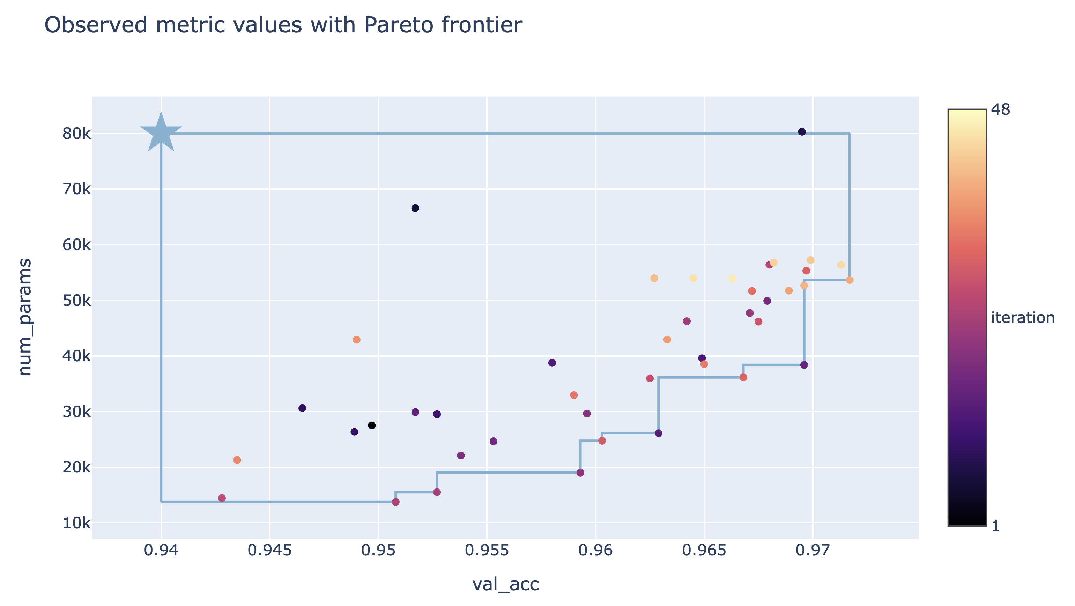
Research Question
Given labelled tabular data, search for an MLP classifier that predicts accurately with fewer trainable parameters.
1. What does the search change?
Hidden-layer depth and width
Regularization and learning rate
Activation function
2. How do we score a candidate?
Maximize validation accuracy
Minimize trainable parameters
Research Question
Each point is a candidate model. The search seeks points toward higher accuracy and fewer parameters.
With equal budgets, does diversity guidance help MODE* find a better accuracy–size trade-off?
Illustration: PyTorch MNIST NAS tutorial.
*Multi-objective Differential Evolution (MODE) is an evolutionary search algorithm. It combines existing candidate settings to propose new MLPs, then balance prediction accuracy and model size.
Notes:
Here is the task. Given labeled tabular data, we search for a multilayer perceptron, or MLP, classifier. We want two things at once: high validation accuracy and fewer trainable parameters. Each dot is a candidate model. The Pareto frontier contains candidates that are not worse on both objectives at the same time. Our question is: with the same evaluation budget, does diversity guidance help MODE find a better accuracy-size trade-off? The intuition is that if candidates become too similar, a larger mutation step may help the search explore improvement.

Slide 3
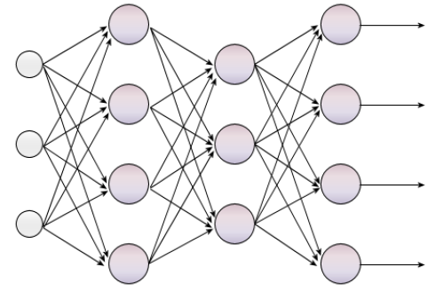
Search Space of MLP
An MLP is a feed-forward network: input features pass through hidden layers to predict a class.
Features
Layer 1
Layer 2
Output
Five MLP search space settings
1. Depth: 1 – 100 hidden layers
2. Width: 16, 32, 64, 128, or 256 neurons per layer
3. L2 strength α: 10⁻⁶ to 10⁻², on a log scale
4. Learning rate: 10⁻⁴ to 10⁻², on a log scale
5. Activation: ReLU or tanh
Example candidate
2 hidden layers; 64 neurons per layer; α = 10⁻⁴; learning rate = 10⁻³; ReLU
Illustrative structure. The search varies the number of hidden layers and neurons.
One five-setting recipe is one candidate. The search algorithm proposes many candidates, then training and validation score each one.
Notes:
To make the search concrete, each candidate is a recipe with five settings: the number of hidden layers, neurons per layer, L2 regularization, learning rate, and activation. For example, one recipe might use two hidden layers with 64 neurons each, an L2 value of ten to the minus four, a learning rate of ten to the minus three, and ReLU. The network diagram is illustrative: input features pass through hidden layers to the class outputs. The search changes the recipe, then we train and score every model in the same way.

Slide 4
Search Algorithms
All baseline algorithms explore the same five MLP settings. They differ in how they propose the next candidate.
Random Search
Draw a fresh recipe at random. Earlier scores do not guide later draws.
NSGA-II
A genetic algorithm: select parents by Pareto rank and crowding distance, then cross and mutate their recipes.
MODE
Differential evolution: use the difference between two recipes to move a third, then cross the trial with its target.
DG-MODE
The project’s MODE variant. It changes the mutation step using population diversity: similar recipes trigger a larger step.
Differential mutation: what each symbol means
MODE · fixed mutation scale
DG-MODE · adapt the mutation scale
v = x₁ + 0.50 (x₂ − x₃)
Fₜ = clip[0.35 + 0.60 (1 − Dₜ), 0.35, 0.95]
x₁: base model configuration
x₂, x₃: two other configurations
v: new mutant, before crossover
Dₜ: current population diversity (generation t)
Fₜ: mutation scale; clip bounds it to [0.35, 0.95]
Lower Dₜ → higher Fₜ → larger mutation step
Each method evaluates 40 candidates per run: 40 independent random draws, or 10 candidates evolved over 3 generations.
Notes:
All four methods explore the same recipe space, but propose candidates differently. Random Search draws recipes independently, so past scores do not guide the next draw. NSGA-II is a genetic algorithm: it selects candidates using Pareto rank and crowding distance, then combines and mutates recipes. MODE uses differential evolution: it takes a base recipe and adds a scaled difference between two other recipes, then crosses the result with the target. In our implementation, the fixed mutation scale F is 0.50. DG-MODE is our project variant: it adjusts F using population diversity. If diversity D is low, F rises and the step gets larger. Each x is a full five-setting recipe, v is the mutant before crossover, and clip keeps F within its allowed range. DG-MODE is a simple project modification of MODE, not a standard baseline in this experiment.

Slide 5
Experimental Protocol
Four search baseline algorithms use the same data splits and candidate-evaluation budget.
THREE TABULAR DATASETS
Breast Cancer
Wine
Digits
3 seeds per dataset
binary classification
3 classes
10 classes
ONE RUN, FROM DATA TO TEST SCORE
1. Split each dataset
2. Give methods the same budget
3. Select, refit, and test
A
Choose the knee from the validation Pareto front
60%
20%
20%
10 initial + 3 × 10 offspring = 40
A
→
→
Train · Validation · Held-out test
candidate fits per run
B
Refit the selected MLP on train + validation
B
Stratified split; test data stays out of search and model selection.
Population methods evolve 10 candidates across 3 generations.
Random Search draws 40 candidates independently.
C
Evaluate once on the held-out test set
C
SEARCH OBJECTIVES
STUDY SCALE
Validation accuracy ↑ · Trainable parameters ↓
3 datasets × 3 seeds × 4 methods = 36 runs
Held-out metrics: accuracy · balanced accuracy · macro-F1 · model size · inference latency
Notes:
To keep the comparison fair, we use three tabular datasets: Breast Cancer, Wine, and Digits. For each of three seeds, the data is stratified into 60 percent training, 20 percent validation, and 20 percent held-out test. All methods use the same split for a given seed. The population methods evaluate ten initial candidates and ten offspring in each of three generations, for forty candidate fits. Random Search also gets forty independent draws. We choose a candidate from the validation Pareto front, refit it on training plus validation, and evaluate it once on the untouched test set.

Slide 6
Experiment Results
Held-out test accuracy, mean ± sample SD over 3 seeds
Method | Breast Cancer | Wine | Digits
Random Search | 0.982 ± 0.015 | 0.963 ± 0.042 | 0.969 ± 0.015
NSGA-II | 0.980 ± 0.005 | 0.972 ± 0.048 | 0.964 ± 0.010
MODE | 0.985 ± 0.005 | 0.972 ± 0.028 | 0.974 ± 0.013
DG-MODE | 0.982 ± 0.009 | 0.907 ± 0.098 | 0.977 ± 0.011
Equal-weight mean across 9 cases: MODE 0.977 | DG-MODE 0.956
Mean parameters (MODE vs DG-MODE): Breast Cancer 2,535 vs 711; Wine 366 vs 366; Digits 3,605 vs 5,397.
Notes:
Now the held-out test results. The table shows mean accuracy and sample standard deviation over three seeds. Averaged descriptively across the nine dataset-seed cases, MODE reaches 0.977 and DG-MODE reaches 0.956. The outcomes vary by dataset. On Breast Cancer, DG-MODE is close in accuracy to MODE and selects smaller models on average. On Digits, DG-MODE is slightly more accurate, but uses larger models. On Wine, its accuracy is lower and much more variable. So this diversity-only rule did not consistently improve the accuracy-size trade-off. We have only three seeds, and the Wine test split is small, so a few classification errors can move the score substantially.

Slide 7
Conclusions
In this test, diversity-guided mutation didn't give a consistent improvements.
PRELIMINARY · COURSE-SCALE STUDY
3 tabular datasets · 3 seeds · compact MLPs · 40 candidate fits per method and run
WHAT WE FOUND
HOW FAR CAN WE GENERALIZE?
WHAT SHOULD COME NEXT?
MODE 0.977
DG-MODE 0.956
This is an initial, low-budget study of small tabular tasks.
Only three datasets and three seeds were tested; results are descriptive, with no statistical-significance claim.
They do not show how the method behaves on larger NAS problems.
Test more datasets and seeds; use repeated cross-validation.
1
Measure diversity between decoded architectures and objective-space solutions.
2
DG-MODE was competitive on Breast Cancer and Digits, but lower and more variable on Wine. The pattern is mixed, not a reliable win.
Then compare again with a larger search budget.
3
TAKEAWAY
A useful first diagnostic—not a broad conclusion about evolutionary NAS.
Notes:
To be clear about scope, this is an initial, low-budget case study. It tests only three tabular datasets, three seeds, compact MLPs. They cannot tell us how this method behaves on large-scale neural architecture search or other model families. A stronger follow-up would use more datasets and seeds, repeated cross-validation, and diversity measures based on decoded architectures or objective-space coverage. Our narrow conclusion is that this simple adaptive mutation rule did not help reliably in this setup.

Slide 8
Thank you for your listening!

