Slide 1
Forecasting NBA Playoff Runs with Advanced Metrics
Stat 418 Final Project
Robert Craig

Slide 2

Overview
How can we look at historical team data to better understand what makes a successful NBA team in the postseason?
Model Specifics: Ordinal Logistic Regression model, 6 buckets (Championship, Finals, Conference Finals, Second Round, First Round, Playoffs Missed)
Metrics Used: Offensive BPI, Defensive BPI, Team, Season

Slide 3
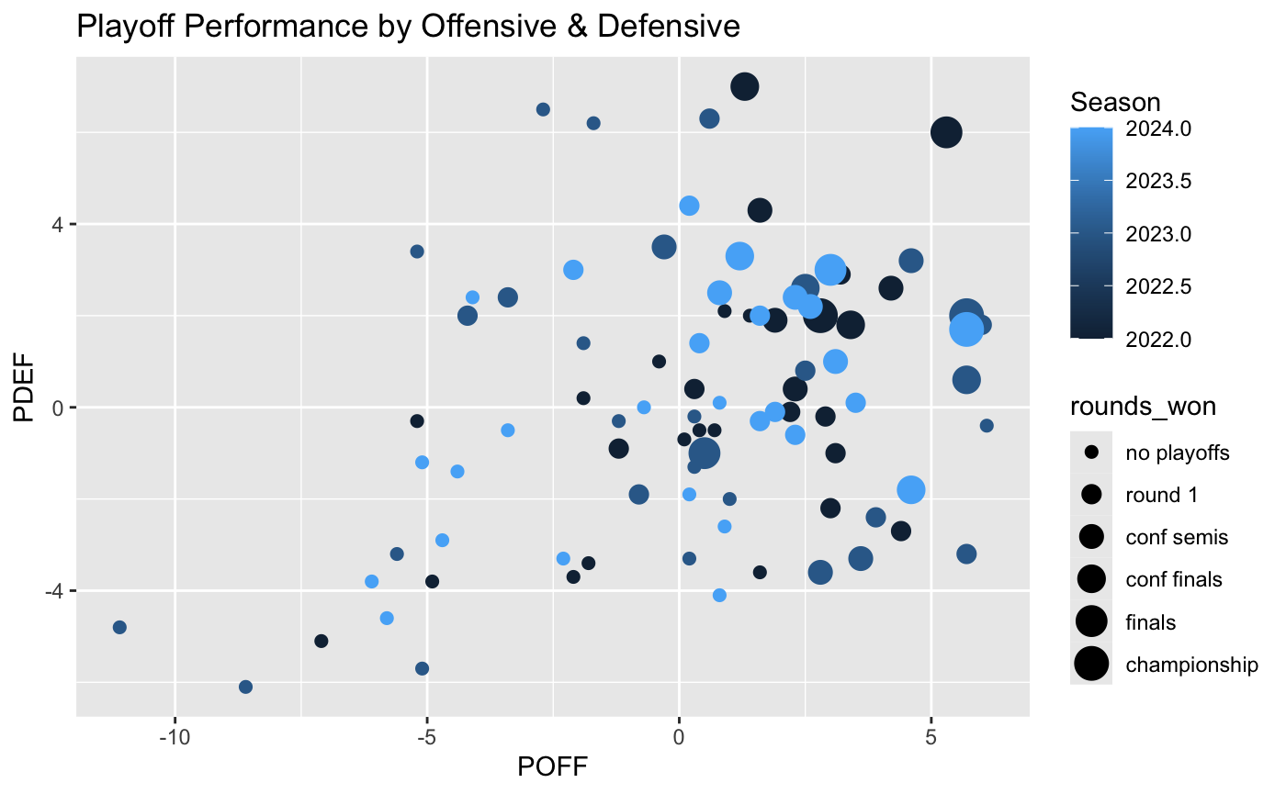
Exploratory Data Analysis

Slide 4
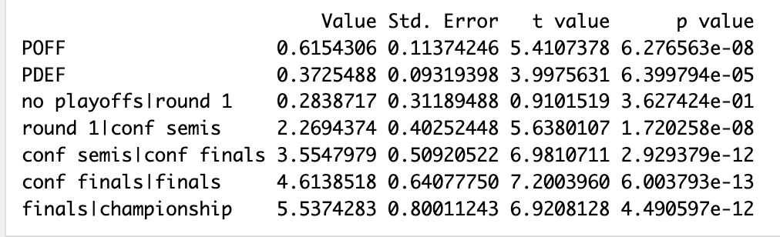
Model building + findings
Two models looked at for consideration: a simplified model that considered only offensive & defensive performance when looking at playoff success, & a full model that also considered team & season as predictive inputs
The decision was made to use the simplified model for the deployed application

Slide 5
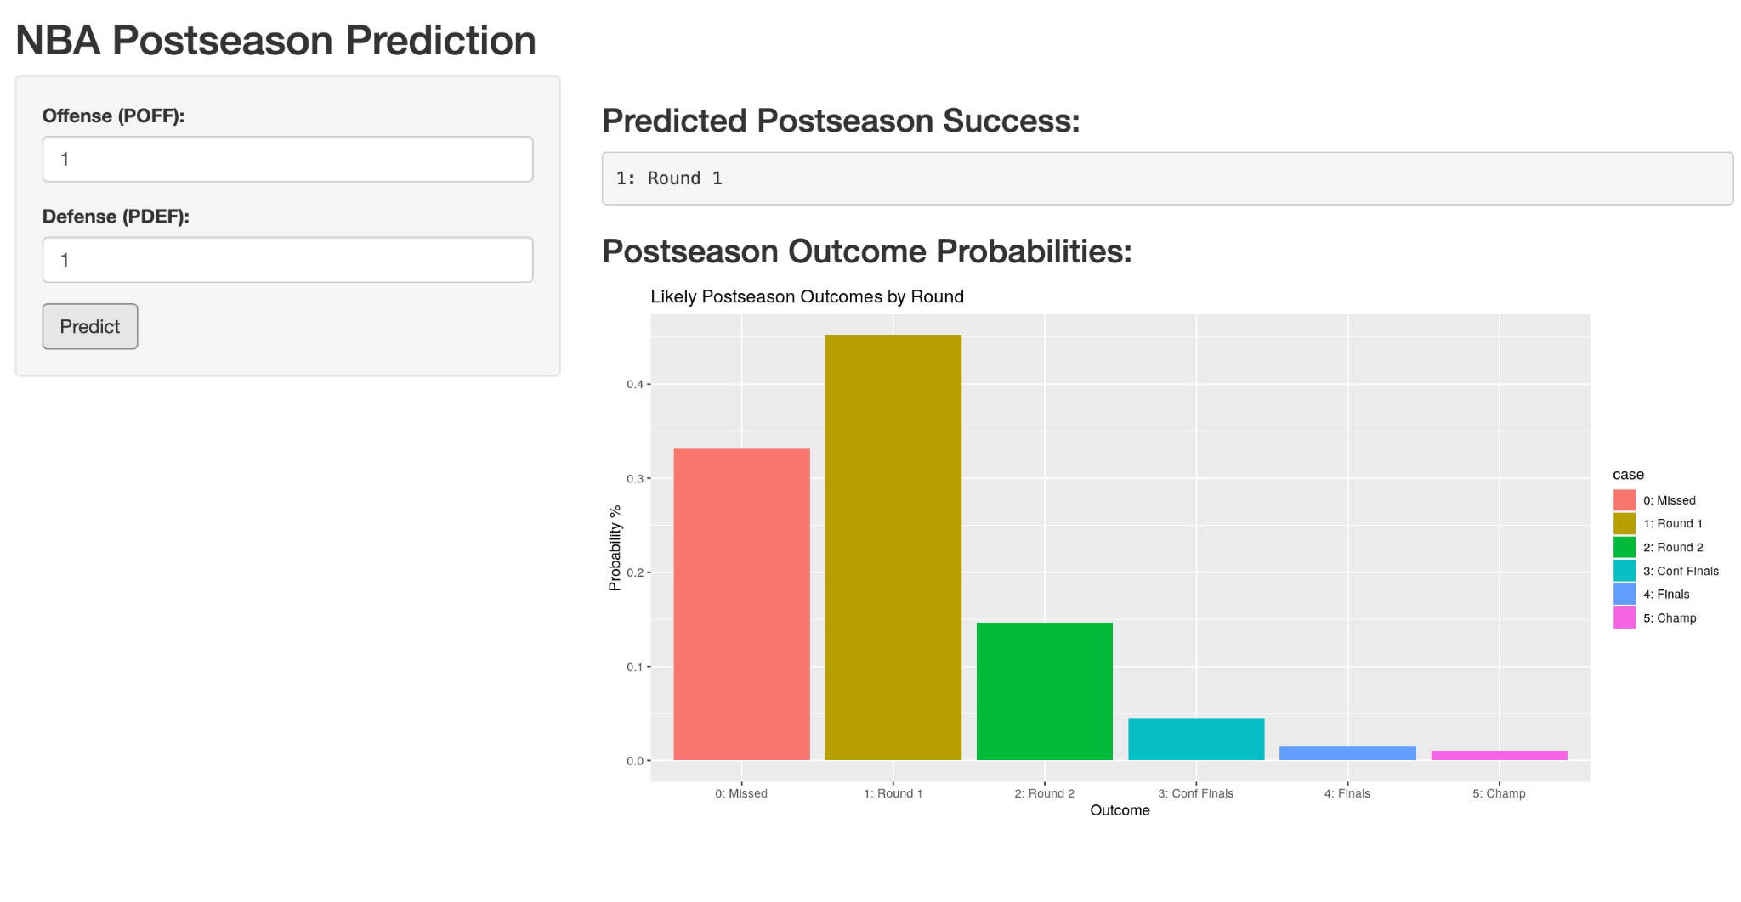
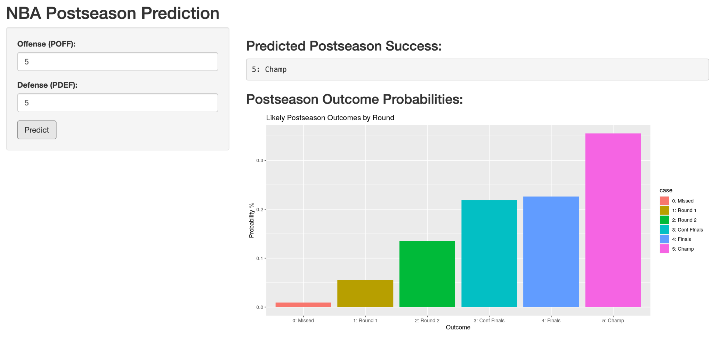
Shiny Application
The final deployed application takes in two inputs, & produces a prediction & a visual depiction the likelihood of each outcome
Currently deployed at https://3r3ehm-robert-craig.shinyapps.io/shiny-app/

