Slide 1


Revealing Political Donors’ Motivations:
The Connection Between Donations and Social Media
Ross Dahlke
@ross_dahlke
github.com/rossdahlke
Stanford University

Slide 2
Roadmap
Political Science Models of Donor Motivations
Political Donor Data
Social Media Data
Granger Causality Model
Donor Size
Donor Polarization

Slide 3
The Folk Theory of Political Donors
Notes:
Understanding political donors reveals the dynamics between influence and participation

Slide 4
Roadmap
Political Science Models of Donor Motivations
Political Donor Data
Social Media Data
Granger Causality Model
Donor Size
Donor Polarization

Slide 5
Political Donor Motivation Models
Access-Oriented
Consumption

Slide 6
More Nuance
PACs versus Individuals
Frequent versus Infrequent Donors
Grouped by other Descriptive

Slide 7
Roadmap
Political Science Models of Donor Motivations
Political Donor Data
Social Media Data
Granger Causality Model
Donor Size
Donor Polarization

Slide 8
Political Donors as Network
Nodes
Donors and Candidates
Edges
Donations between Donors and Candidates

Slide 9
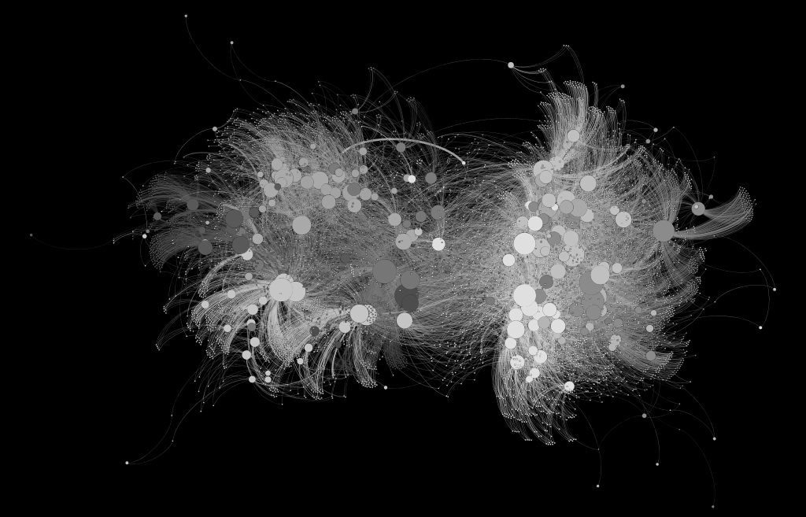
Political Donations as Network
Nodes
Donors and Candidates
Edges
Donations between Donors and Candidates

Slide 10
Political Donations as Network
Nodes
Donors and Candidates
Edges
Donations between Donors and Candidates
Democrats
Republicans

Slide 11
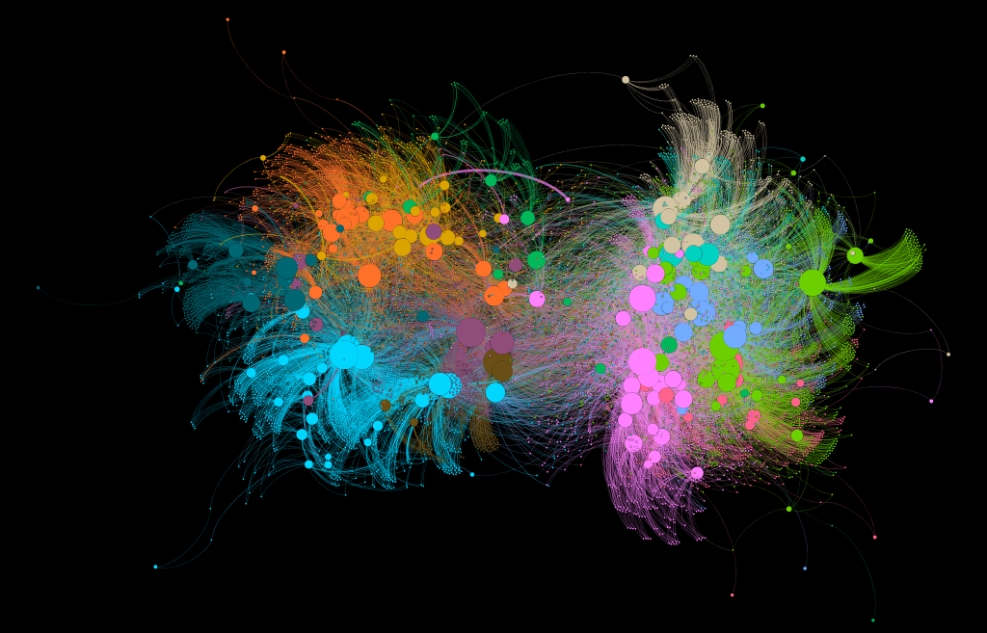
Political Donations as Network
Cluster Donors
Each Color = “Coalition” of Donors
Democrats
Republicans

Slide 12
Roadmap
Political Science Models of Donor Motivations
Political Donor Data
Social Media Data
Granger Causality Model
Donor Size
Donor Polarization

Slide 13
Layer on new dataset: social media

Slide 14
Social Media
Facebook and Twitter posts
Hand-coded subset into 27 topical policy categories
Trained BERT Deep Learning Transfer Model
82.9% classification accuracy

Slide 15
Roadmap
Political Science Models of Donor Motivations
Political Donor Data
Social Media Data
Granger Causality Model
Donor Size
Donor Polarization

Slide 16
Combining Donation Data + Social Media

Slide 17
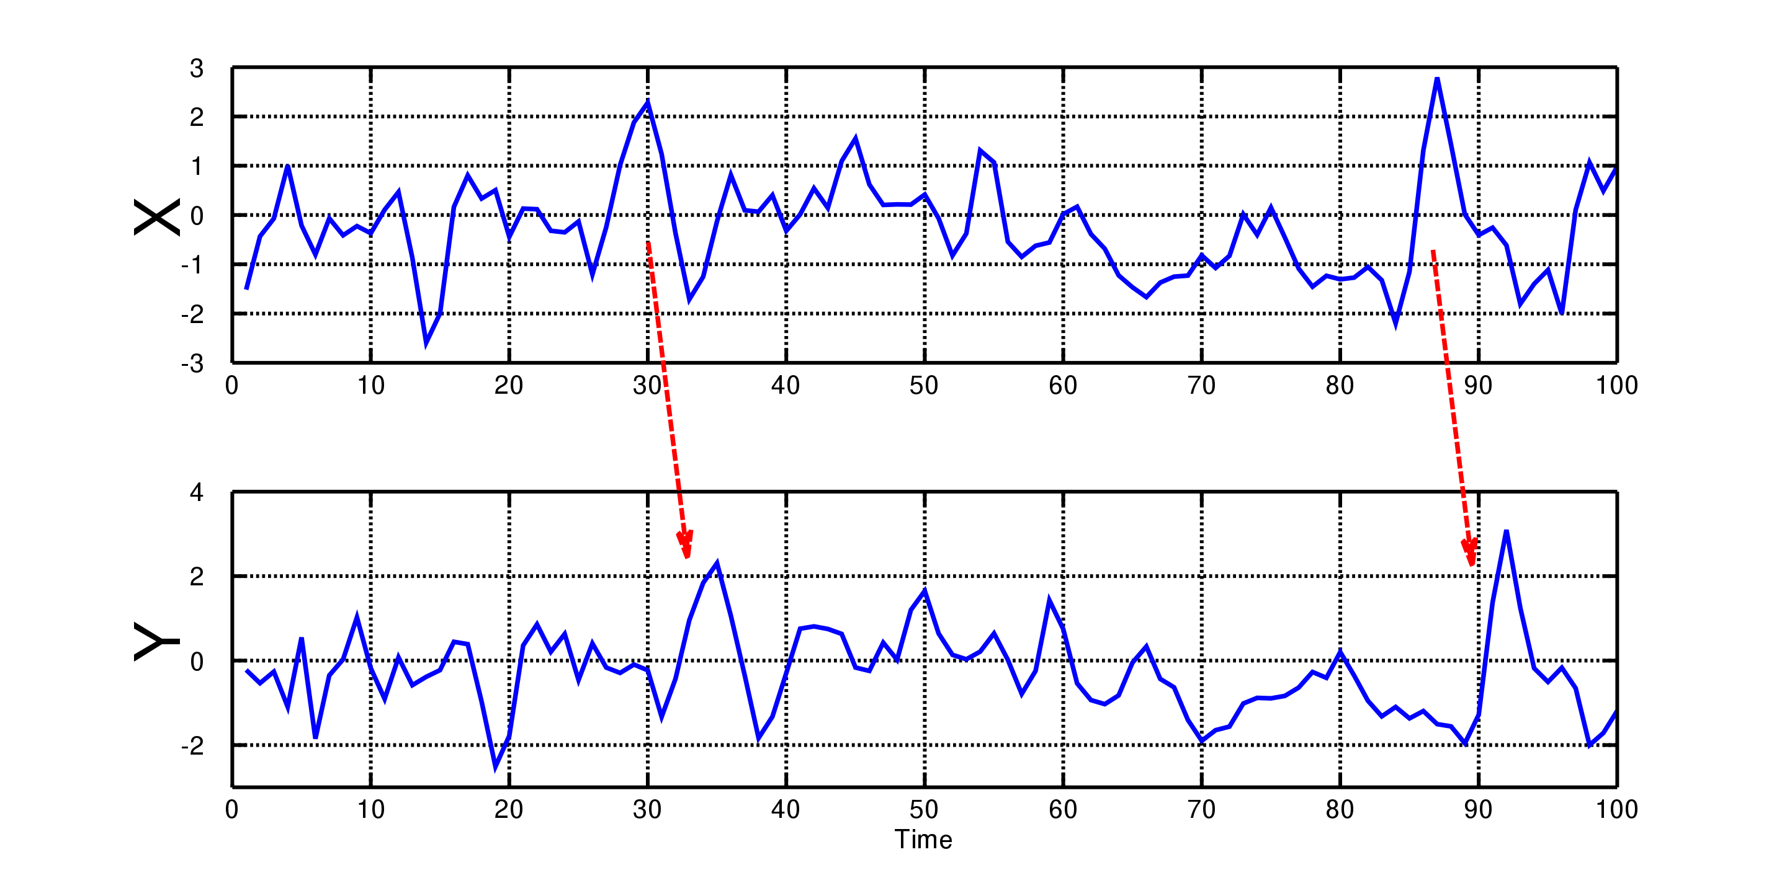
Time-Series Model
Granger Causality
Does one time-series helpfully predict another?
Source: Wikipedia

Slide 18
Application to Donor Models
Access-Oriented
Donations predict support of policy issues
Consumption-Oriented
Support of policy issues predict donations
Ran on every combination of donor coalitions and social media categories

Slide 19
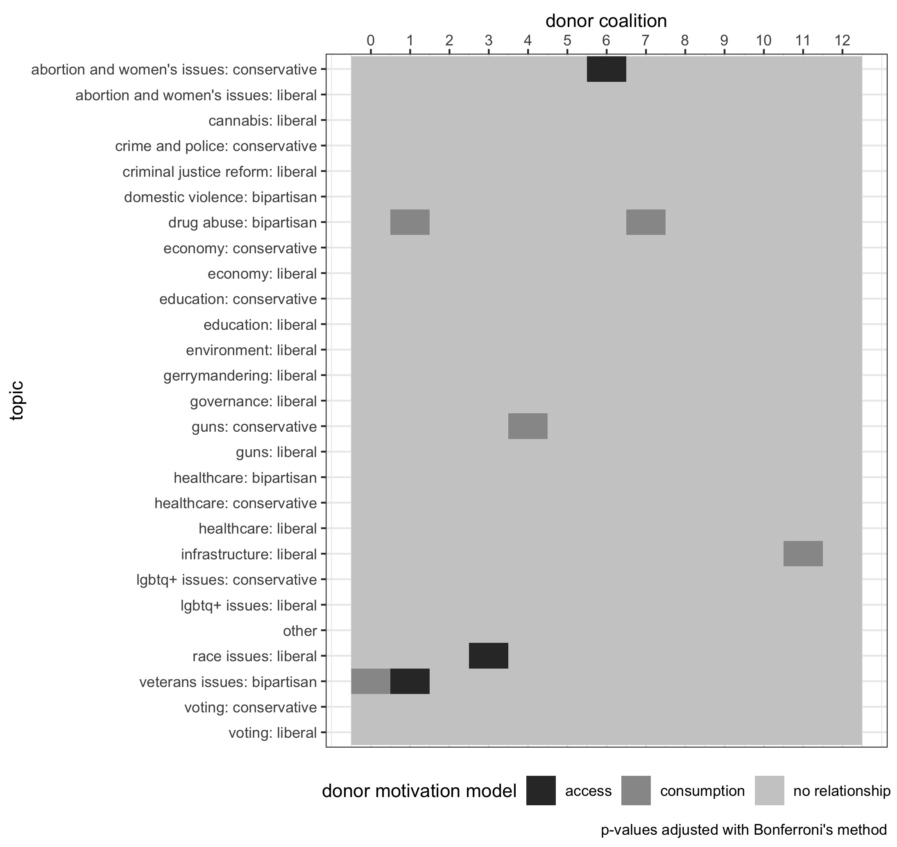
Results
3 coalitions access-oriented
5 coalitions consumption-oriented

Slide 20
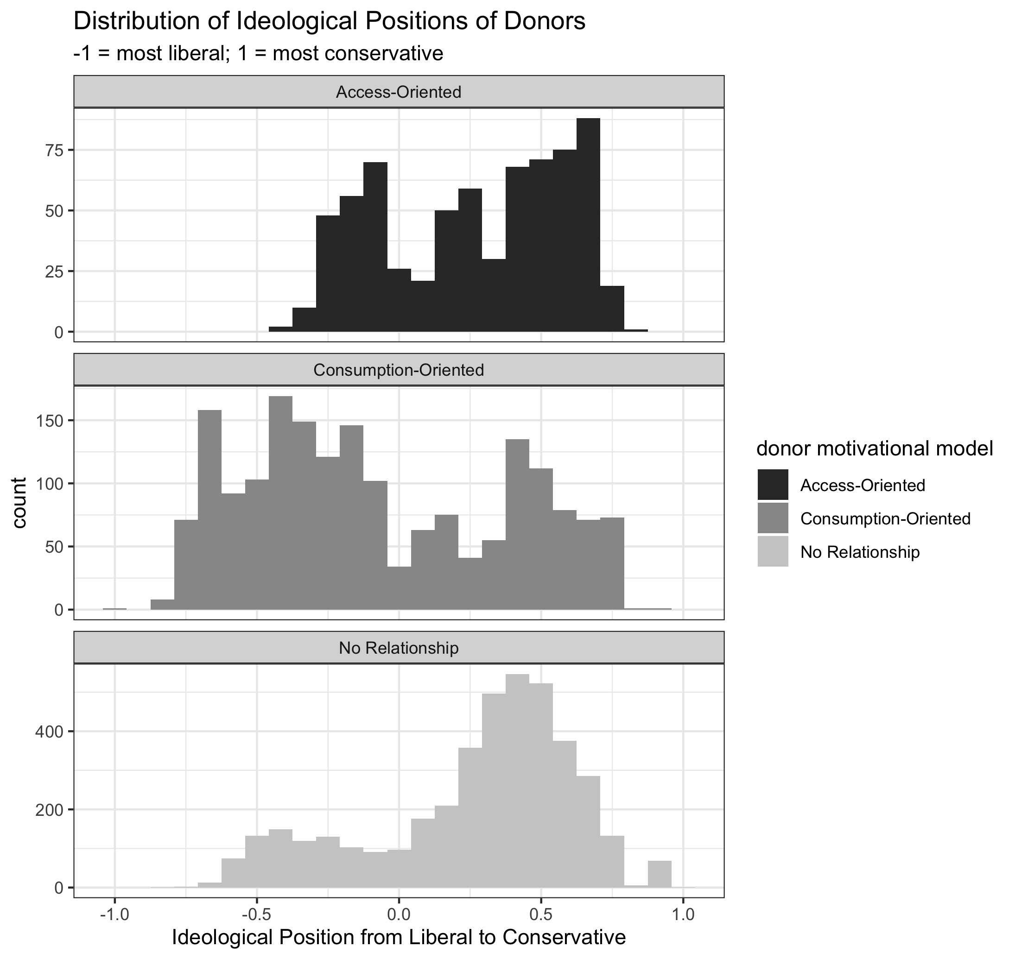
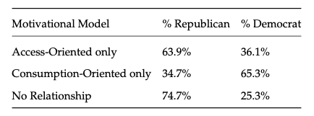
Donor Types

Slide 21
Roadmap
Political Science Models of Donor Motivations
Political Donor Data
Social Media Data
Granger Causality Model
Donor Size
Donor Polarization

Slide 22
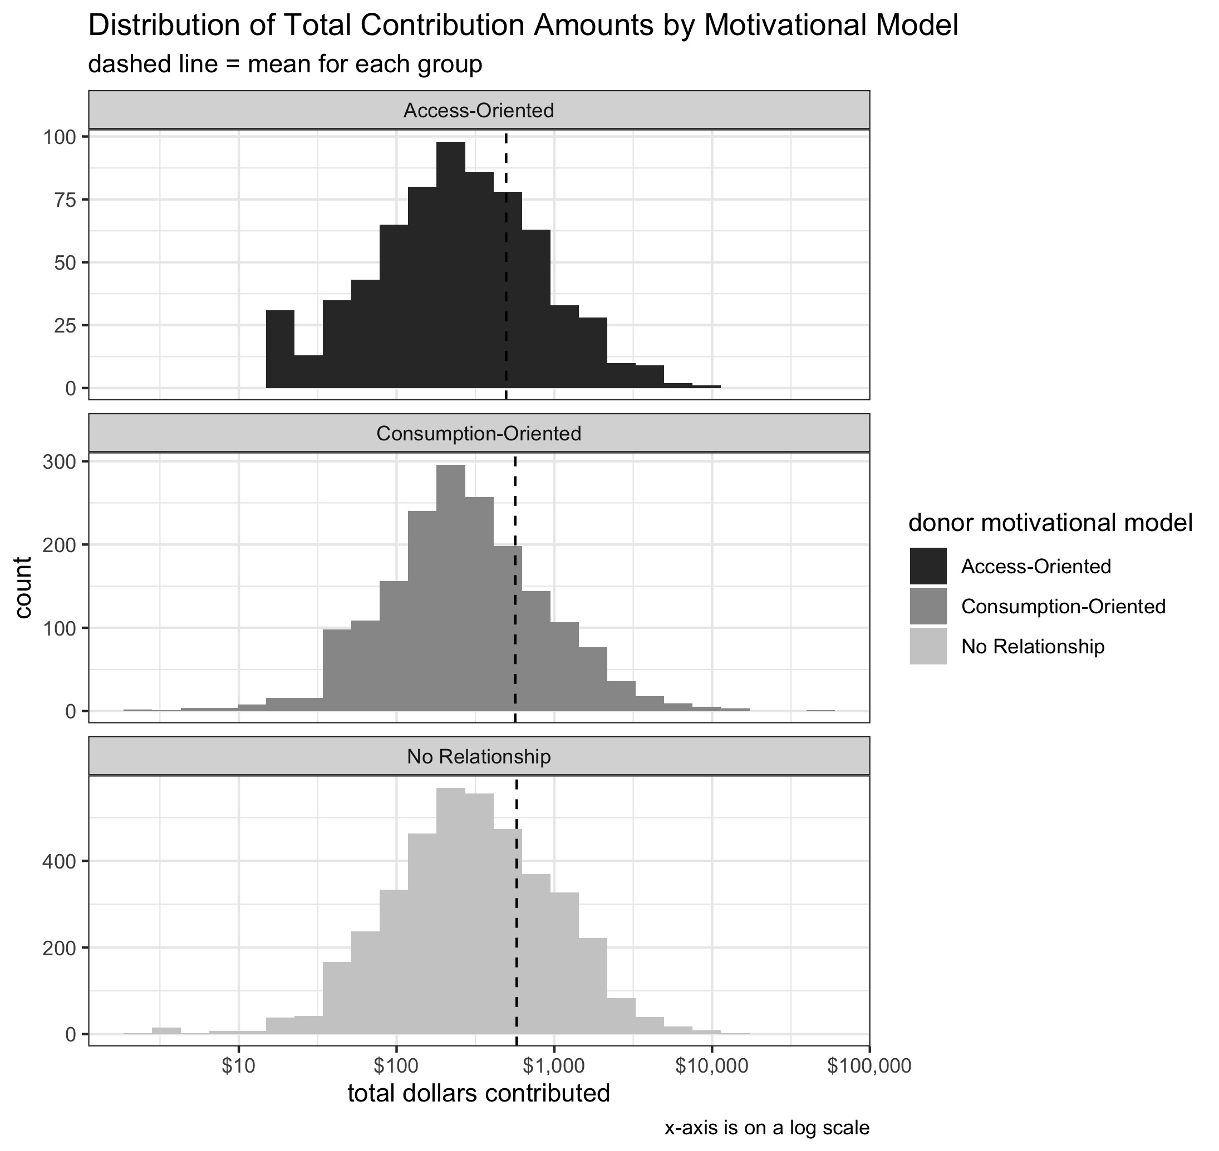
Donor Sizes
Are access-oriented donors bigger?
Are consumption-oriented donors smaller?
No

Slide 23
Roadmap
Political Science Models of Donor Motivations
Political Donor Data
Social Media Data
Granger Causality Model
Donor Size
Donor Polarization

Slide 24
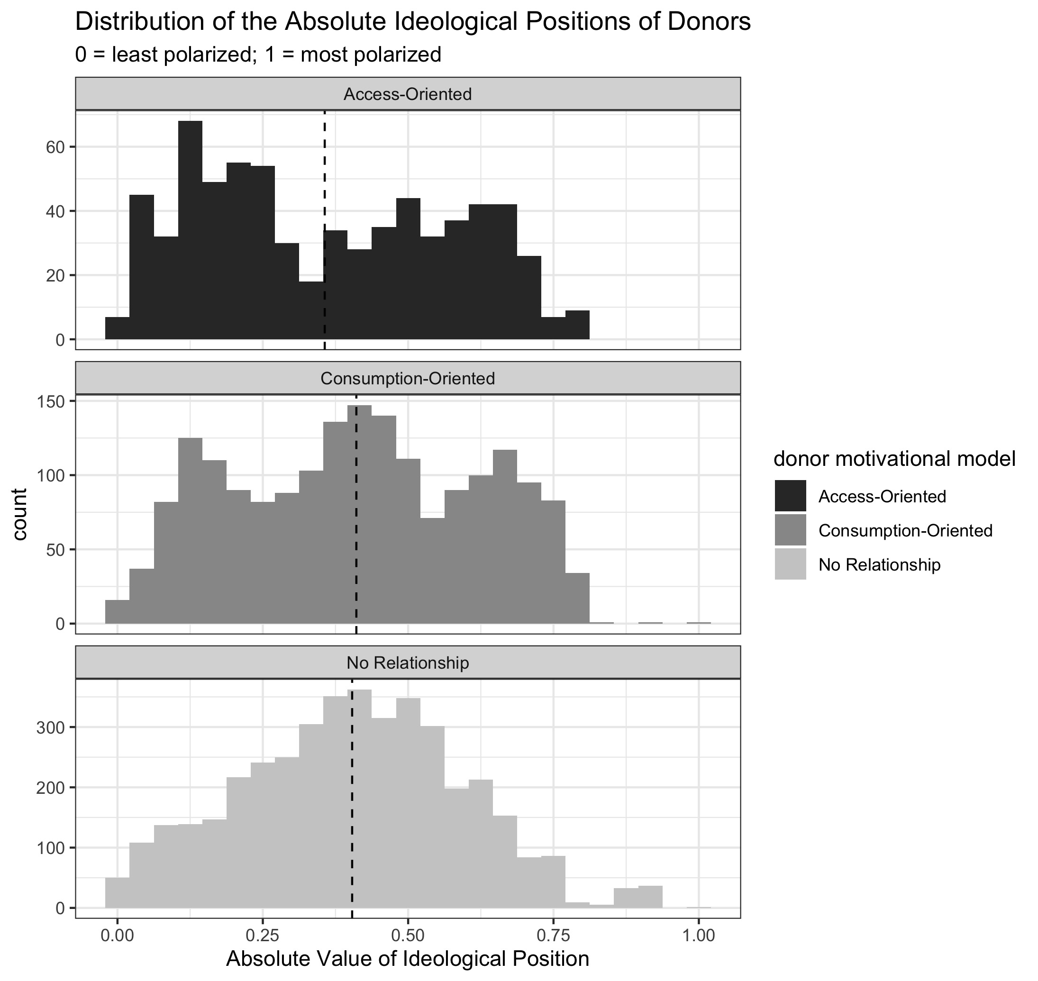
Donor Polarization
Are consumption-oriented donors in more polarized positions?
Are access-oriented donors in more moderate positions?
Yes

Slide 25
Thank you
Democrats
Republicans

Slide 26
If we extrapolate…
2.5M itemized donors in 2020

Slide 27
If we extrapolate…
2.5M itemized donors in 2020
500,000 access-oriented donors
Attempting to gain access to politicians

Slide 28
If we extrapolate…
2.5M itemized donors in 2020
500,000 access-oriented donors
Attempting to gain access to politicians
900,000 consumption-oriented
Potentially polarizing our politics

Slide 29
Which group should we care more about?
Notes:
Understanding political donors reveals the dynamics between influence and participation

