Slide 1
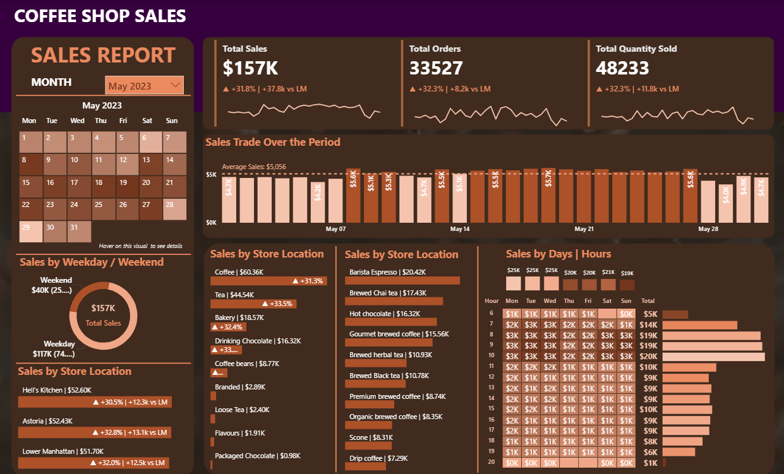


DATA ANALYSIS PROJECT
COFFEE SALES REPORT
POWER BI
My SQL

Slide 2
PROBLEM STATEMENT
KPI'S REQUIREMENTS
1. Total Sales Analysis:
Calculate the total sales for each respective month.
Determine the month-on-month increase or decrease in sales.
Calculate the difference in sales between the selected month and the previous month.
2. Total Orders Analysis:
Calculate the total number of orders for each respective month.
Determine the month-on-month increase or decrease in the number of orders.
Calculate the difference in the number of orders between the selected month and the previous month.
3. Total Quantity Sold Analysis:
Calculate the total quantity sold for each respective month.
Determine the month-on-month increase or decrease in the total quantity sold.
Calculate the difference in the total quantity sold between the selected month and the previous month.

Slide 3
PROBLEM STATEMENT
CHARTS REQUIREMENTS
1. Calendar Heat Map:
Implement a calendar heat map that dynamically adjusts based on the selected month from a slicer.
Each day on the calendar will be color-coded to represent sales volume, with darker shades indicating higher sales.
Implement tooltips to display detailed metrics (Sales, Orders, Quantity) when hovering over a specific day.
2. Sales Analysis by Weekdays and Weekends:
Segment sales data into weekdays and weekends to analyze performance variations.
Provide insights into whether sales patterns differ significantly between weekdays and weekends.
3. Sales Analysis by Store Location:
Visualize sales data by different store locations.
Include month-over-month (MoM) difference metrics based on the selected month in the slicer.
Highlight MoM sales increase or decrease for each store location to identify trends.

Slide 4
PROBLEM STATEMENT
CHARTS REQUIREMENTS
4. Daily Sales Analysis with Average Line:
Display daily sales for the selected month with a line chart.
Incorporate an average line on the chart to represent the average daily sales.
Highlight bars exceeding or falling below the average sales to identify exceptional sales days.
5. Sales Analysis by Product Category:
Analyze sales performance across different product categories.
Provide insights into which product categories contribute the most to overall sales.
6. Top 10 Products by Sales:
Identify and display the top 10 products based on sales volume.
Allow users to quickly visualize the best-performing products in terms of sales.
7. Sales Analysis by Days and Hours:
Utilize a heat map to visualize sales patterns by days and hours.
Implement tooltips to display detailed metrics (Sales, Orders, Quantity) when hovering over a specific day-hour.

Slide 5
USING SQL QUERIES
CONVERT DATE (transaction_date) COLUMN TO PROPER DATE FORMAT
UPDATE coffee_shop_sales
SET transaction_date = STR_TO_DATE(transaction_date, '%d-%m-%Y');
ALTER DATE (transaction_date) COLUMN TO DATE DATA TYPE
ALTER TABLE coffee_shop_sales
MODIFY COLUMN transaction_date DATE;
CONVERT TIME (transaction_time) COLUMN TO PROPER DATE FORMAT
UPDATE coffee_shop_sales
SET transaction_time = STR_TO_DATE(transaction_time, '%H:%i:%s');
ALTER TIME (transaction_time) COLUMN TO DATE DATA TYPE
ALTER TABLE coffee_shop_sales
MODIFY COLUMN transaction_time TIME;

Slide 6
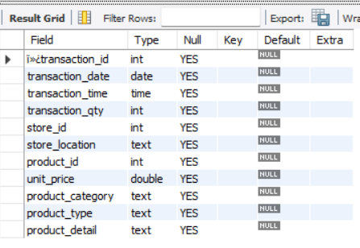
USING SQL QUERIES
DATA TYPES OF DIFFERENT COLUMNS
DESCRIBE coffee_shop_sales;
CHANGE COLUMN NAME `ï»¿transaction_id` to transaction_id
ALTER TABLE coffee_shop_sales
CHANGE COLUMN `ï»¿transaction_id` transaction_id INT;

Slide 7

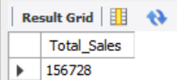
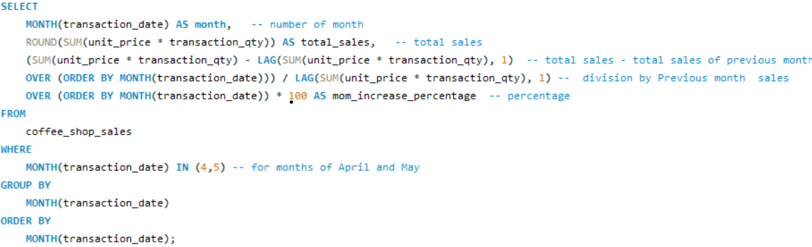
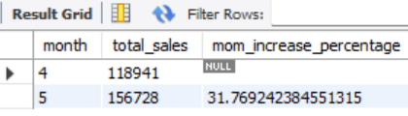
USING SQL QUERIES
TOTAL SALES
DIFFERENCE OF SALES BETWEEN 2 MONTHS

Slide 8

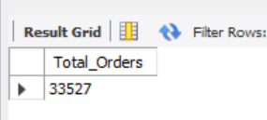
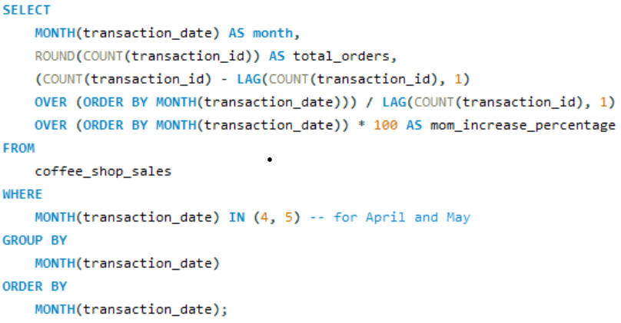
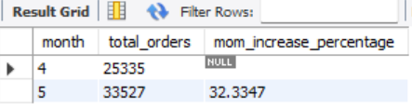
USING SQL QUERIES
TOTAL ORDERS
DIFFERENCE OF ORDERS BETWEEN 2 MONTHS

Slide 9

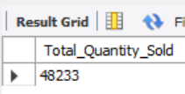
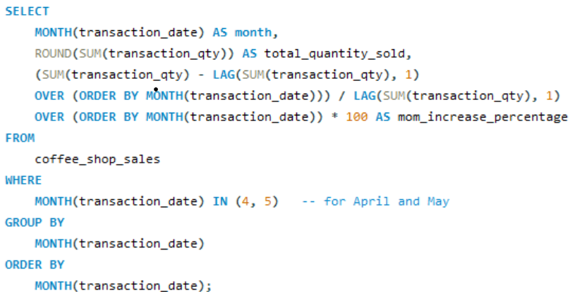
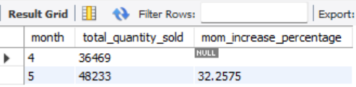
USING SQL QUERIES
TOTAL ORDERS
DIFFERENCE OF ORDERS BETWEEN 2 MONTHS

Slide 10
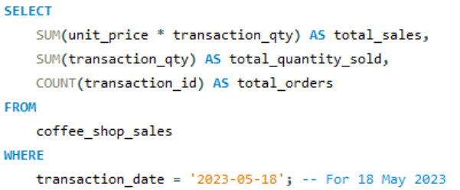

USING SQL QUERIES
DAILY SALES, QUANTITY and TOTAL ORDERS FOR - 18 MAY, 2023

Slide 11
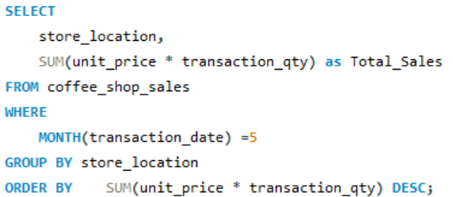
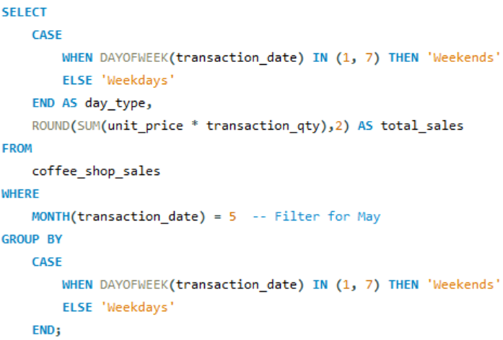
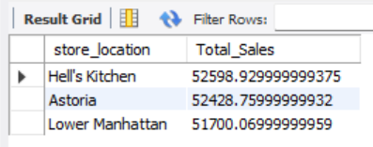
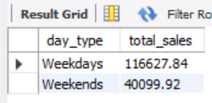
USING SQL QUERIES
SALES ANALYSIS BY WEEKDAYS AND WEEKENDS
SALES ANALYSIS BY STORE LOCATION

Slide 12
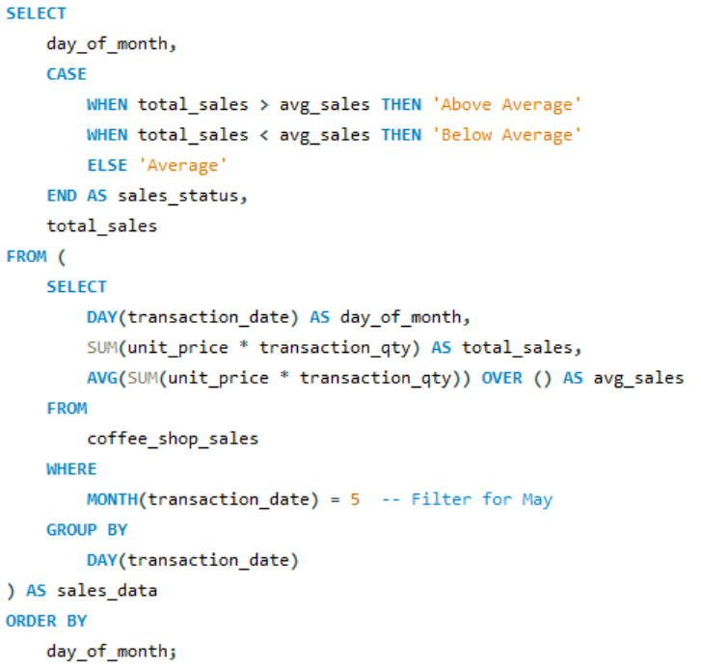
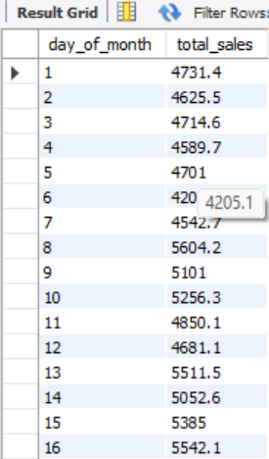
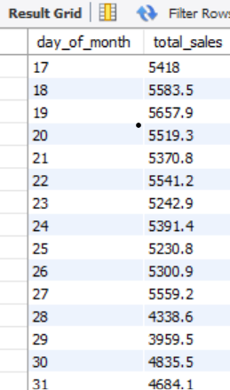
USING SQL QUERIES
DAILY SALES ANALYSIS FOR A MONTH WITH BELOW AND ABOVE AVERAGE SALES

Slide 13
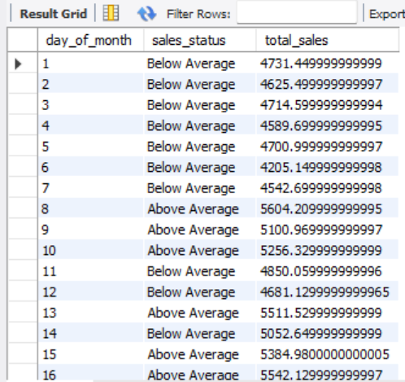
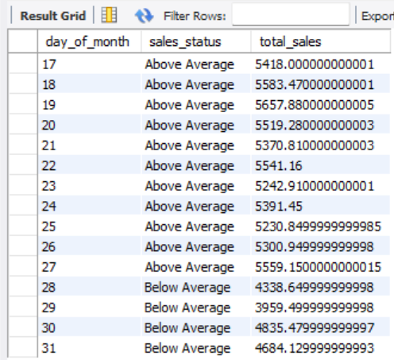
USING SQL QUERIES

Slide 14
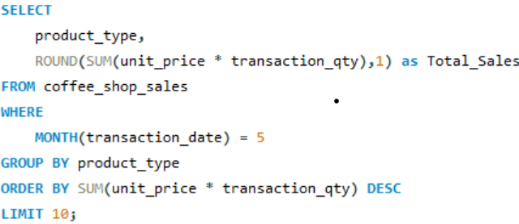
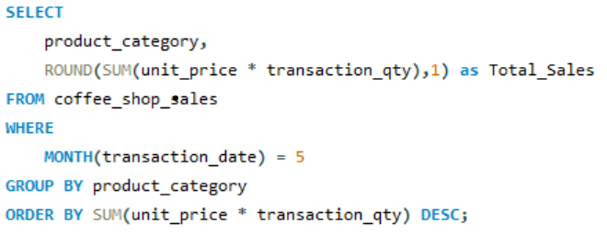
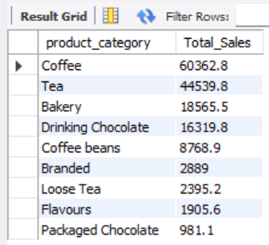
USING SQL QUERIES
SALES ANALYSIS BY PRODUCT CATEGORY
TOP 10 PRODUCTS BY SALES

Slide 15
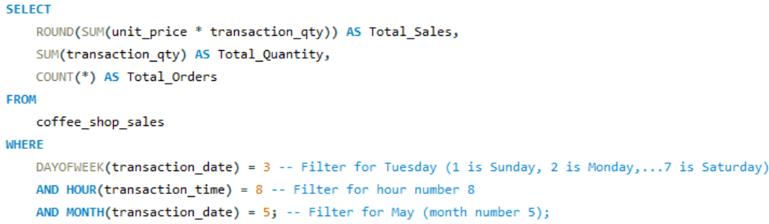

USING SQL QUERIES
SALES BY DAY | HOUR

Slide 16
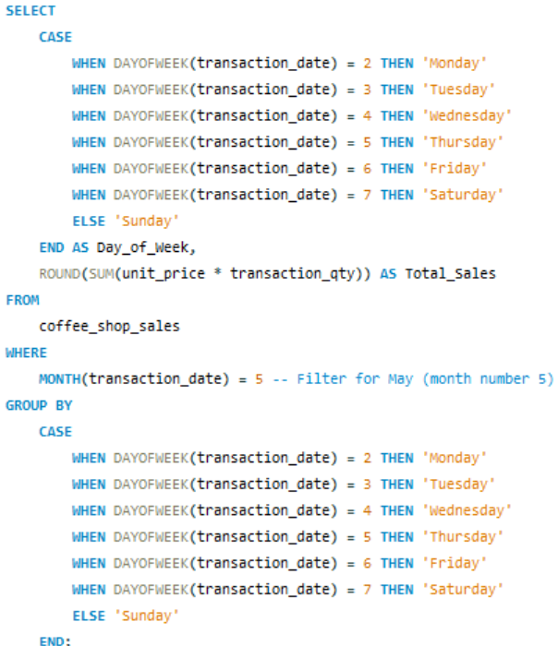
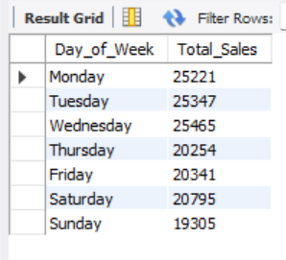
USING SQL QUERIES
SALES FROM MONDAY TO SUNDAY FOR MONTH (MAY)

Slide 17
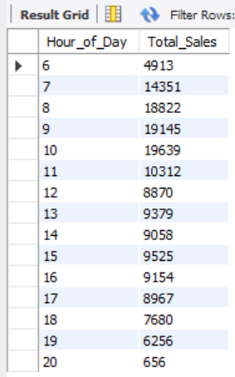
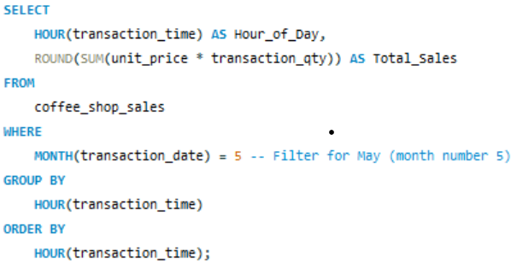
USING SQL QUERIES
SALES FOR ALL HOURS FOR MONTH (MAY)

Slide 18
DASHBOARD IN POEWR BI

