Slide 1
Thumbs up? Sentiment Classification using Machine Learning Techniques
By Ronald de Langen
Research seminar, 2016

Slide 2
Objective of the paper
Sentiment analysis
Is a review negative or positive
Difference between Topic-based categorization and sentiment analysis
Notes:
Exploration of the idea of sentiment analysis, not really done before with machine learning techniques.

Slide 3
Proposal of the paper
Use Naïve Bayes, Maximum Entropy and Support Vector Machine (SVM)
Different features are necessary for Sentiment Analysis compared to Topic Categorization
Notes:
Looking at standard topic classifiers (Bayes and SVM) might be enough for sentiment analysis.
Different features to see which features has influences on what.
New Idea: sentiment analysis using machine learning techniques for topic categorization.
Contribution: discover the difference between topic categorization and sentiment analysis

Slide 4
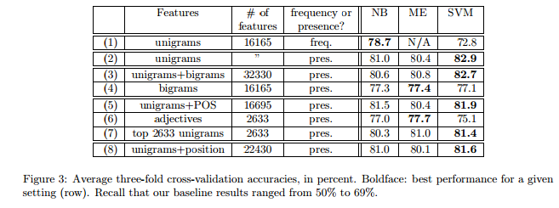
Model
1400 movie reviews with as much positive as negative reviews
NOT_ before words
3-fold cross validation
Notes:
The original 2000 (1300 positive, 750 negative) is turned in 1400 by randomly selecting 700 positive and 700 negative reviews.
They use many different features as can be seen in the table.
Movie reviews are used, because seem the most difficult to classify.
Features are words used at least 4 times.

Slide 5
Evidence
Baseline: 58, 64% humans. 69% from data
Other work: 66%
Notes:
Baseline from Turney (2002) also reason why movie views are used.

Slide 6
Previous work
Based upon the idea of topic classification
Sentence opinion in relation to a linguistic model: Hearst (1992)
Sentiment analysis with a lexicon of two words: Turney (2002)
Notes:
They mention in their method that they want to see if standard topic classification works.
Turney did some research on the average sentiment based upon the (information) difference between words and excellent and poor.

Slide 7
Impact
Started off the field of sentiment analysis using machine learning
5000 times cites total, cited 50 times last 2 weeks
David Zimbra, M. Ghiassi , Sean Lee, “Brand-Related Twitter Sentiment Analysis Using Feature Engineering and the Dynamic Architecture for Artificial Neural Networks”
Notes:
A recent and state of the art example in which this article is cited.

Slide 8
Discussion
Do you think bigrams not being effective for capturing context has to do with the data (eg. only 700 reviews per class) or with the models (eg. independence assumption of Naive Bayes)?
Do you think that choosing from the IMDB review database was a bad choice, as these reviews can sometimes be of poor quality? Do you think it would perhaps have been a better idea to take reviews from newspapers or something more professional?
Have you thought about other features sets that might be useful to increase the score?
Why not cut out the top 10% of words, since words like “The” add very little information.
Has there been any similar sentiment-classification research on data sets where thwarted expectation kind of reviews are less likely (product/restaurant reviews)? If so, what is the performance on these data sets?
Notes:
The bigrams not effectively capturing context has to do with the data, as it shown that a) the ineffectiveness is not model independent and b) the unigrams are also not independent. It has also been shown that naïve Bayes works despite the features being dependent on each other.
I think it was a good choice because of several reasons. One is availability this article was written I 2002, there might not be that many digitized reviews of films out there note that others worked with only 410 reviews in total, for reference google started digitizing libraries in 2004. Besides this it is free and easy gotten from the site. Another reason why this is not necassary bad is that poor quality can be filtered if it is a concern. Thirdly I feel that sentiment analysis is exceptionally useful for thing on the internet and therefore should learn to be useful with data from the internet.
Things that might work are affinity reinforcing words. Things like very. Alternatively something like incorporating but and however as features that turn the review around might be a good idea. However like the author mentions there should be some sort of co-referencing to see which opinion needs to be reversed. Another thing might be throwing away commonly used words like the.
My own question
Senti-lexicon and improved Naïve Bayes algorithms for sentiment analysis of restaurant reviews uses SVM and Naïve Bayes on restaurant reviews this gives better scores, in the range of 90%. However it is not exactly the same method, they also use a lexicon. Another thing is that Turney had higher scores in other domains.

Slide 9
Discussion
I was wondering what the current state of the art in sentiment analysis is and whether the authors did extend their work as indicated at the end of section 7. Were they able to improve their results?
What was the future research (after this paper) on the domain of sentiment analysis of documents and what is the current state of art method?
The authors speculate that the difference in result between feature presence and feature frequency might indicate a difference between sentiment and topic categorization (section 6.2 Feature frequency vs presence). Were you able to find papers that reproduced these results and (if this is the case) did they provide a deeper analysis on why this might be the case?
Notes:
State of the art see the twitter comment. Which is a neural network. Others use regression models. The authors were able to improve on their results. Their next paper on this topic pushed the accuracy to 85-86 percent.
Further research occupied itself with the context of words.
It might be that the thwarted reviews play a role here, since those start with mentioning a lot of good (or bad) things and then go to their conclusion which is shorter than the previous good stuff. Therefore presence might be a better indication than frequency.

