Slide 1
Activity Recognition Using Smartphone Sensors
Ravinder Dhesi

Slide 2
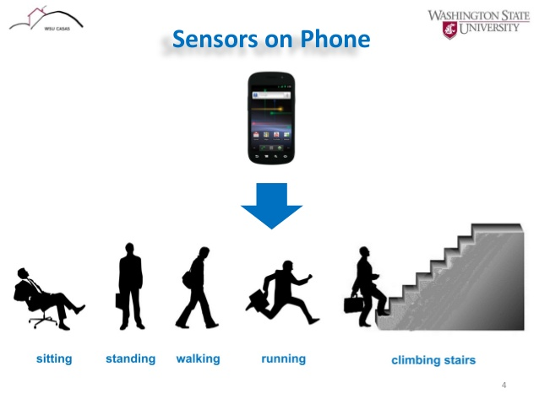
Motivation
Human activity recognition is very useful for things such as elder care and healthcare
Smartphones becoming able to do this would make it both more accessible and enable more freedom

Slide 3
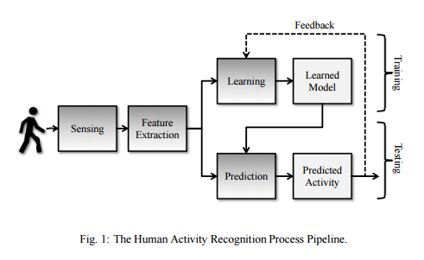
Ways of analyzing the data
Supervised learning
Semi-supervised learning
Incremental learning approaches
Unsupervised
Labels are available but can easily not be used

Slide 4
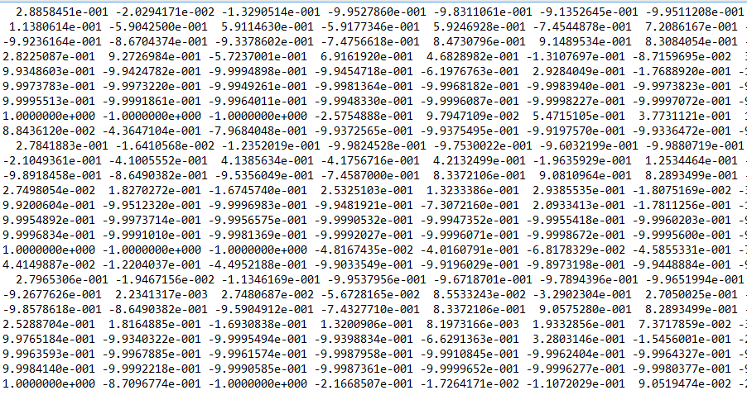
Small section of the data

Slide 5
Data
Inertial sensor data - Raw triaxial signals from the accelerometer and gyroscope of all the trials with with participants. - The labels of all the performed activities.
Records of activity windows. Each one composed of: - A 561-feature vector with time and frequency domain variables. - Its associated activity label (1-6). - An identifier of the subject who carried out the experiment. - 7352 labels for train and 2947 for test

Slide 6
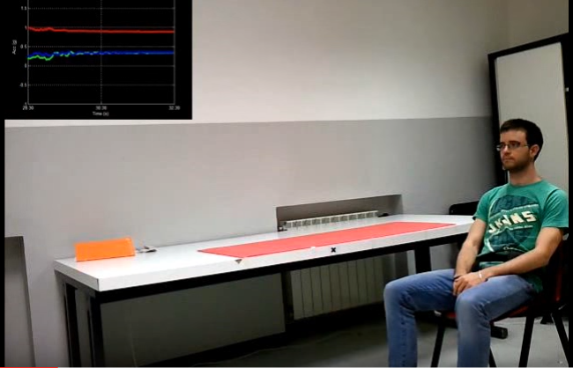
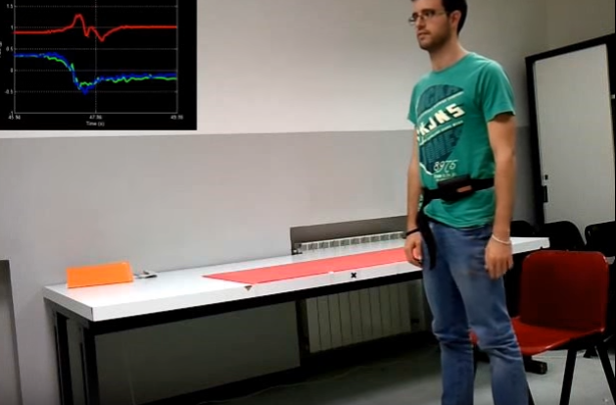
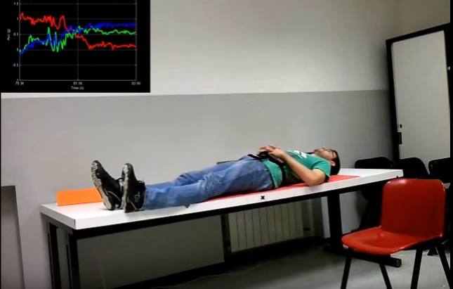
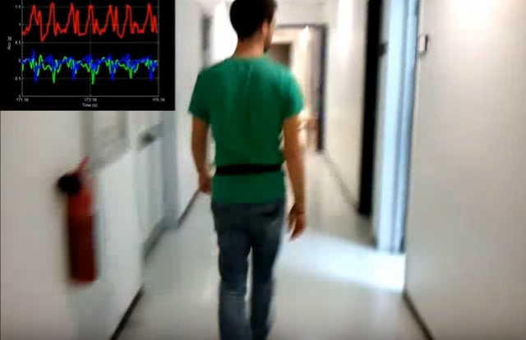
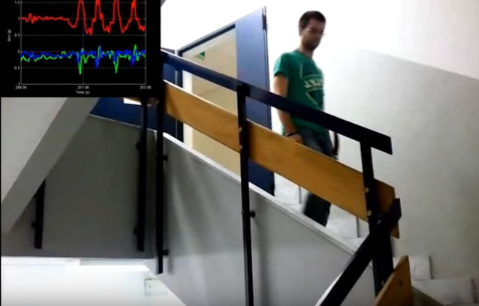
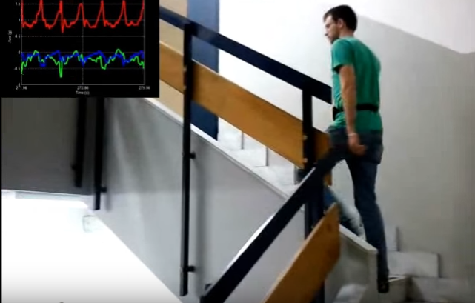
Activity Data Collection
Activities monitored in data set (https://www.youtube.com/watch?v=XOEN9W05_4A)

Slide 7
Methods
PCA
K-means
3D PCA
More methods will probably be applied in the future

Slide 8
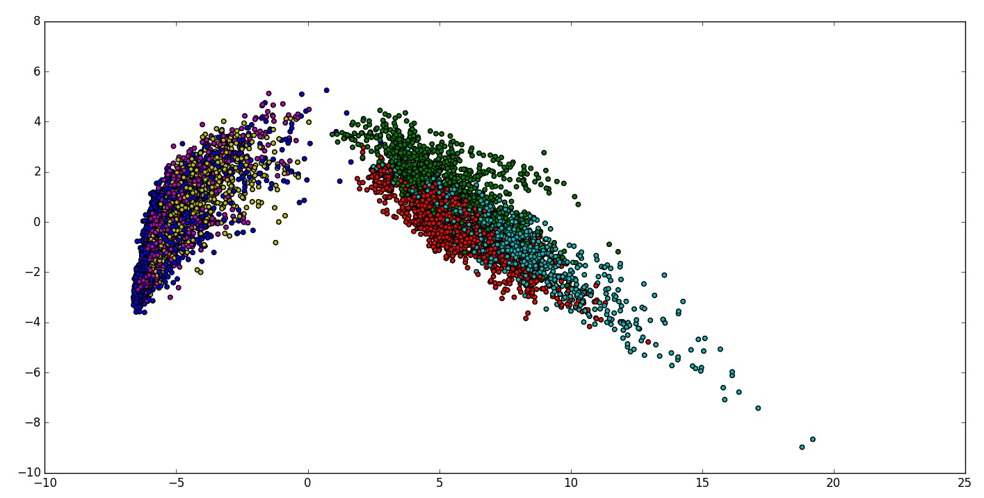
Results
PCA
R Walking
G Walking Upstairs
C Walking Downstairs
M Sitting
Y Standing
B Laying

Slide 9
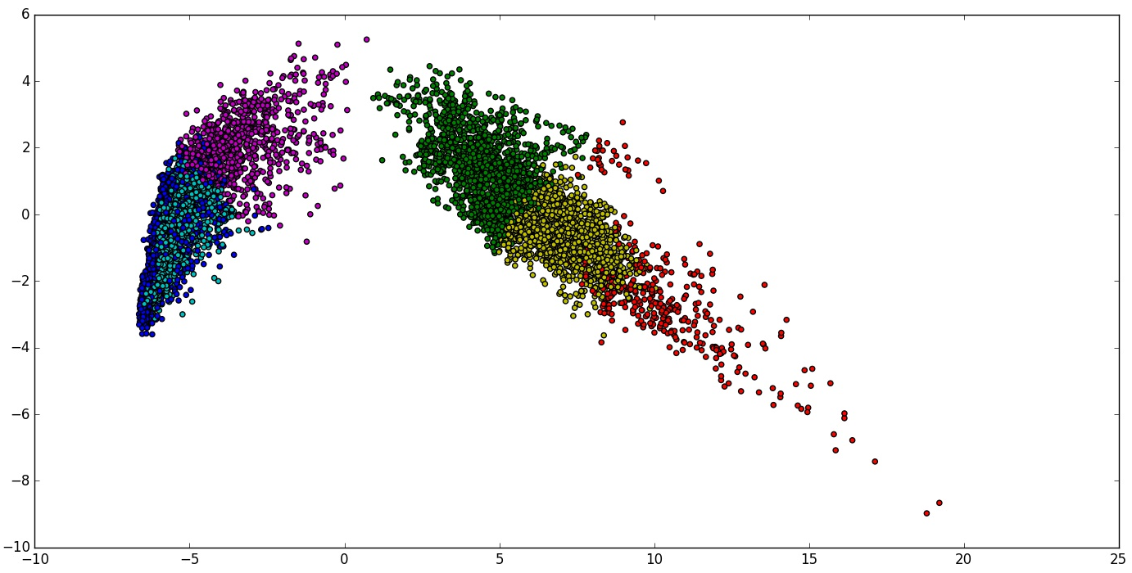
K-Means Attempt

Slide 10
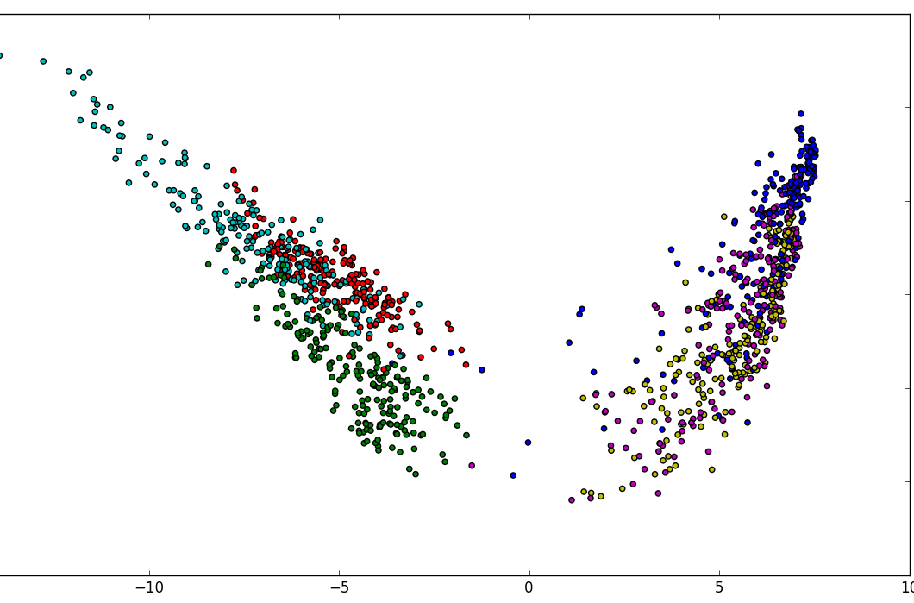
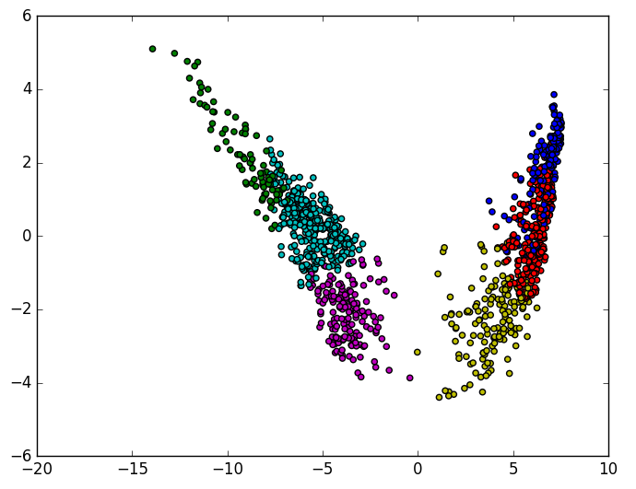
Attempt at reducing data
K-Means
PCA

Slide 11
Current Interpretation and Future Work
Data looks like it is easier for the sensors to discern movement
Data overlaps a lot in PCA but uncertain as to whether or not this is due to 2D
Future Work
Implementing 3D PCA
Obtain a smaller section of the dataset
Find more methods to use and compare

Slide 12
References
- Jorge-Luis Reyes-Ortiz, Luca Oneto, Alessandro Ghio, Albert SamÃ¡, Davide Anguita and Xavier Parra. Human Activity Recognition on Smartphones With Awareness of Basic Activities and Postural Transitions. Artificial Neural Networks and Machine Learning â€“ ICANN 2014. Lecture Notes in Computer Science. Springer. 2014.
- Davide Anguita, Alessandro Ghio, Luca Oneto, Xavier Parra and Jorge L. Reyes-Ortiz. A Public Domain Dataset for Human Activity Recognition Using Smartphones. 21th European Symposium on Artificial Neural Networks, Computational Intelligence and Machine Learning, ESANN 2013. Bruges, Belgium 24-26 April 2013.
- Davide Anguita, Alessandro Ghio, Luca Oneto, Xavier Parra, Jorge L. Reyes-Ortiz. Energy Efficient Smartphone-Based Activity Recognition using Fixed-Point Arithmetic. Journal of Universal Computer Science. Special Issue in Ambient Assisted Living: Home Care. Volume 19, Issue 9. May 2013
- Davide Anguita, Alessandro Ghio, Luca Oneto, Xavier Parra and Jorge L. Reyes-Ortiz. Human Activity Recognition on Smartphones using a Multiclass Hardware-Friendly Support Vector Machine. 4th International Workshop of Ambient Assited Living, IWAAL 2012, Vitoria-Gasteiz, Spain, December 3-5, 2012. Proceedings. Lecture Notes in Computer Science 2012, pp 216-223.
- Jorge Luis Reyes-Ortiz, Alessandro Ghio, Xavier Parra-Llanas, Davide Anguita, Joan Cabestany, Andreu CatalÃ . Human Activity and Motion Disorder Recognition: Towards Smarter Interactive Cognitive Environments. 21th European Symposium on Artificial Neural Networks, Computational Intelligence and Machine Learning, ESANN 2013. Bruges, Belgium 24-26 April 2013.

Slide 13
Questions? Comments?

