Slide 1
Playing Cards Classification
Using Transfer learning in computer vision

Slide 2
Introduction
Transfer learning is the reuse of a pre-trained machine learning model on a new problem. In this project we are using pretrained models on ImageNet data to classify playing cards divided into 53 classes.

Slide 3
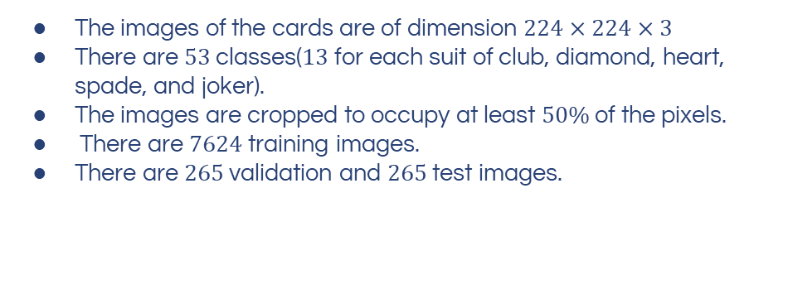
About Dataset
Photos of playing cards
The images of the cards are of dimension $224×224×3$
There are $53$ classes($13$for each suit of club, diamond, heart, spade, and joker).
The images are cropped to occupy at least $50\%$ of the pixels.
There are $7624$ training images.
There are $265$ validation and $265$ test images.
Source

Slide 4
Model Architectures
Resnet-18
Vgg-16
Deep Residual Learning for Image Recognition
Very deep convolutional networks for large-scale image recognition
Efficientnet-B7
Inception-V3
Rethinking Model Scaling for Convolutional Neural Networks
Rethinking the Inception Architecture for Computer Vision

Slide 5
VGG-16
ConvNets
ConvNet automatically learns and extracts features from images. The network consists of multiple layers, including convolutional layers, pooling layers, and fully connected layers, which work together to learn hierarchical representations of the input data.
Transfer
Learning
By reusing the lower layers of the model and training only the top layers on a new dataset, the model can achieve high accuracy with limited training data..

Slide 6
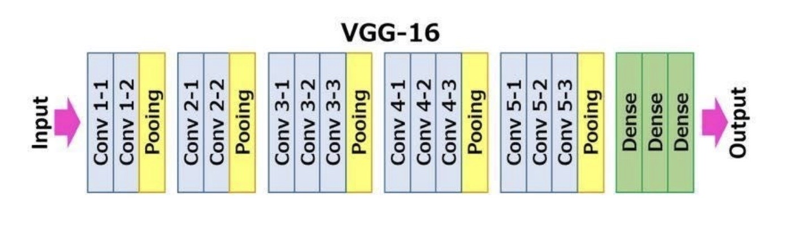
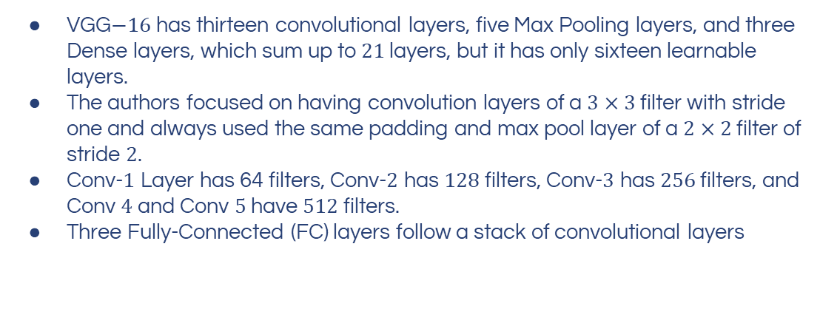
VGG-16
VGG$−16$ has thirteen convolutional layers, five Max Pooling layers, and three Dense layers, which sum up to $21$ layers, but it has only sixteen learnable layers.
The authors focused on having convolution layers of a $3×3$ filter with stride one and always used the same padding and max pool layer of a $2×2$ filter of stride $2$.
Conv-$1$ Layer has 64 filters, Conv-$2$ has $128$ filters, Conv-$3$ has $256$ filters, and Conv $4$ and Conv $5$ have $512$ filters.
Three Fully-Connected (FC) layers follow a stack of convolutional layers

Slide 7
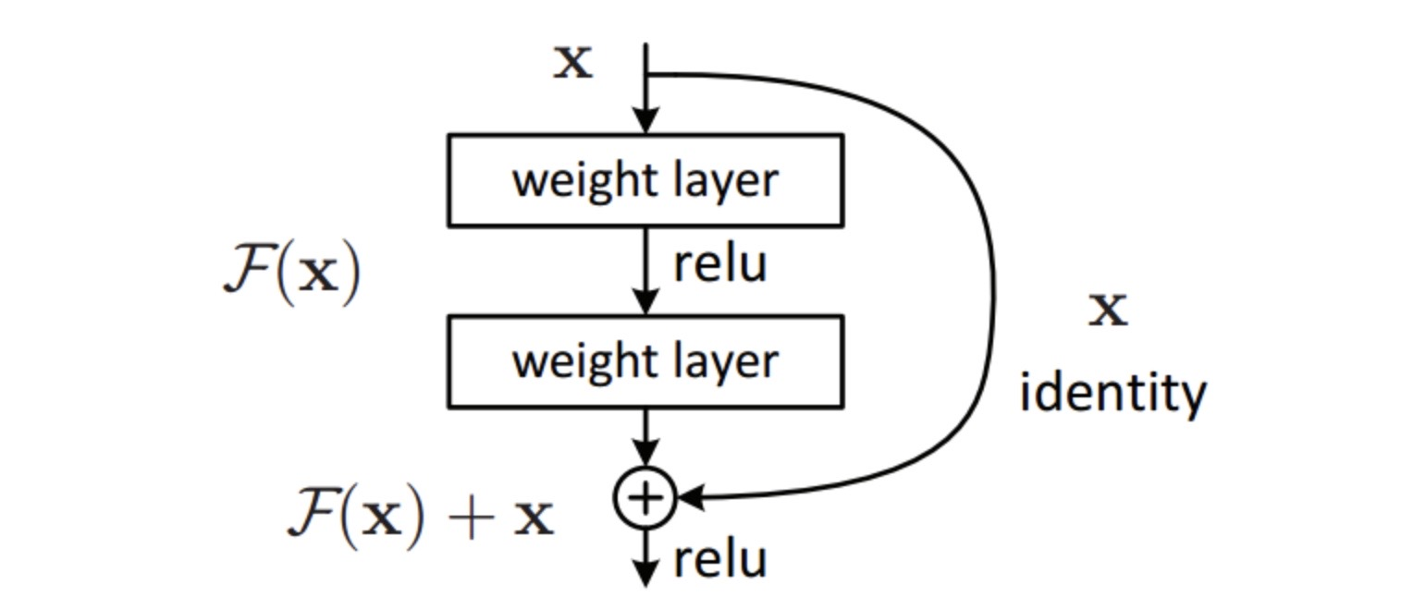
Resnet-18
Residual blocks
The idea is to connect the input of a layer directly to the output of a layer after skipping a few connections.

Slide 8
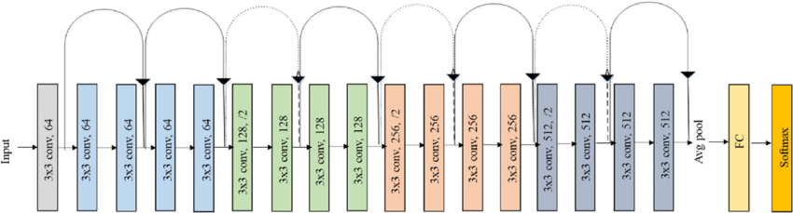
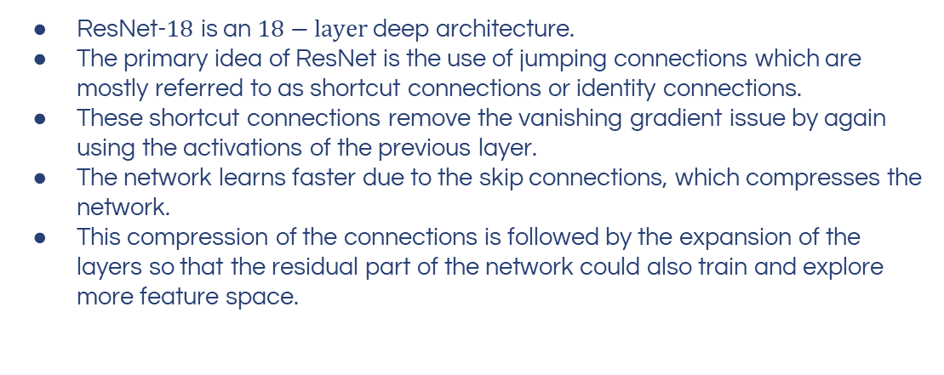
Resnet-18
ResNet-$18$ is an $18−layer$ deep architecture.
The primary idea of ResNet is the use of jumping connections which are mostly referred to as shortcut connections or identity connections.
These shortcut connections remove the vanishing gradient issue by again using the activations of the previous layer.
The network learns faster due to the skip connections, which compresses the network.
This compression of the connections is followed by the expansion of the layers so that the residual part of the network could also train and explore more feature space.

Slide 9
Inception-V3
Inception modules
The basic idea behind Inception modules is to parallelize convolutional operations with different kernel sizes, which allows the network to capture both local and global features of the image.
Factorized convolutions
Factorized convolutions decompose a standard convolution operation into two or simpler operations, which reduces the number of parameters and computations required by the network while maintaining its accuracy.

Slide 10
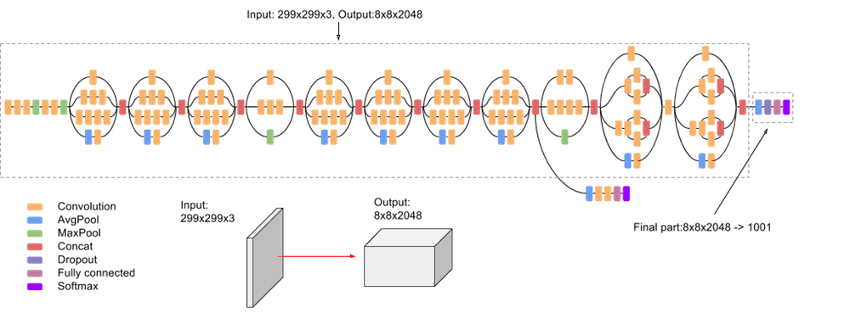
Inception-V3
Inception v3 uses batch normalization, which helps to improve the stability and speed of training by normalizing the activations of the network.
Inception v3 includes "auxiliary classifiers" that are inserted at intermediate layers of the network. These classifiers provide additional supervision during training and improve the stability and convergence of the network.

Slide 11
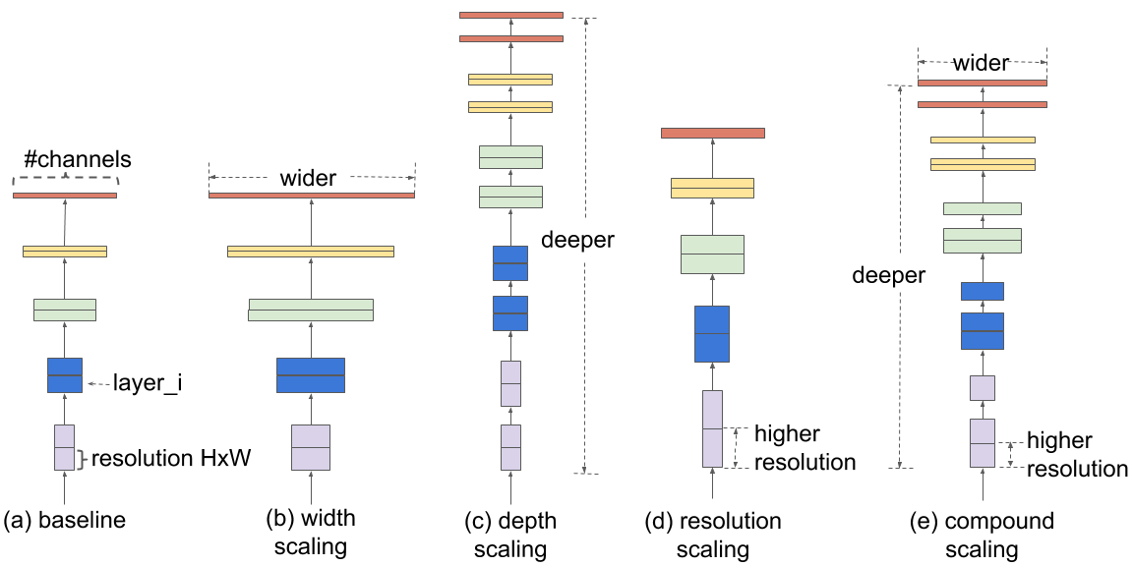
Efficientnet-B7

Slide 12
Efficientnet-B7
The EfficientNet architecture uses a compound scaling method that scales the depth, width, and resolution of the network systematically.
The scaling factors for each dimension are chosen so that the network can achieve the best accuracy with the available computational budget.
EfficientNet uses depthwise separable convolutions to reduce the parameters and computations required during training and inference.
EfficientNet consists of multiple branches that process the input image at different resolutions. This allows the network to capture both local and global features of the image.
EfficientNet uses the Swish activation function, which has been shown to outperform traditional activation functions like ReLU in accuracy.
Swish is a multiplication of a linear and a sigmoid activation.

Slide 13
Learnings Applied
01
04
02
05
03
DATA VERSION CONTROL
MLflow METRICS
TRANSFER LEARNING
FLASK APP
PREDICTION

Slide 14
Model Metrics
Macro-averaging
Cohen-Kappa score
Reduces the multiclass predictions down to multiple sets of binary predictions, calculates the corresponding metric for each of the binary cases, and then averages the results together
Kappa-Score = (ObsAg – ExpAg)/(1-ExpAg)
The kappa score measures the degree of agreement between the two evaluators
The kappa score considers how much better the agreements are over and beyond chance agreements
F1-score
Matthews Correlation coefficient
F1 score = 2*(Prec*Rec)/(Prec+Rec)
F1 score is a measure of a classification model's accuracy, taking into account both precision and recall
It is the harmonic mean of precision and recall
MCC = ((TP*TN)-(FP*FN)) / sqrt[(TP+FP)(TP+FN)(TN+FP)(TN+FN)]
MCC is a measure of the quality of classification models
It is the correlation coefficient between the observed and predicted classifications

Slide 15
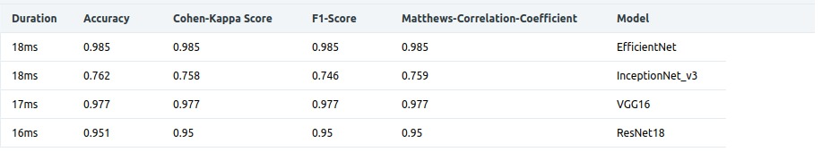
MLFLOW DASHBOARD

Slide 16
Model Metrics Comparison
ResNet
Vgg16
Inception
Net
Efficient
Net
0.950
0.977
0.746
0.985
F1 Score
0.950
0.977
0.758
0.985
Cohen-Kappa Score
0.950
0.977
0.759
0.985
Matthew's Correlation co-eff

Slide 17
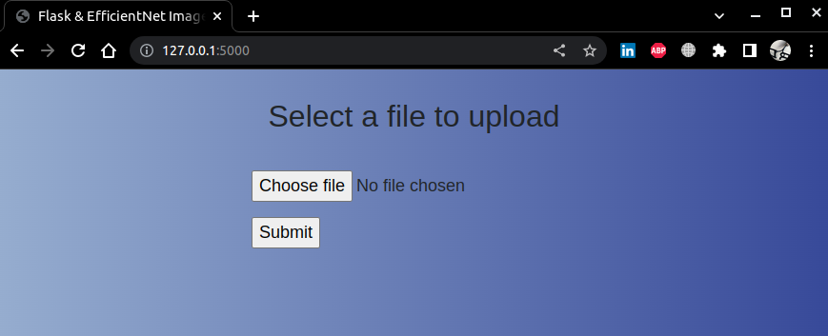
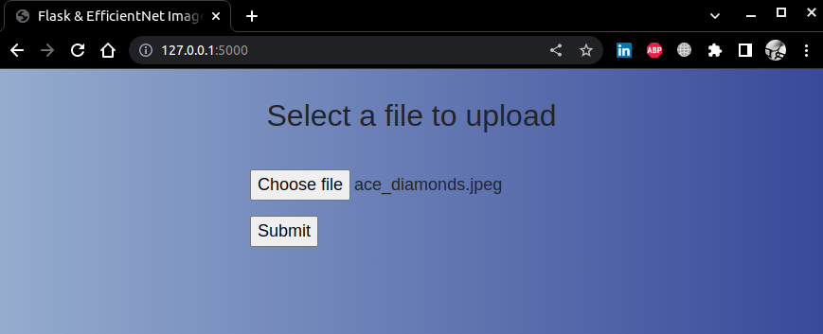
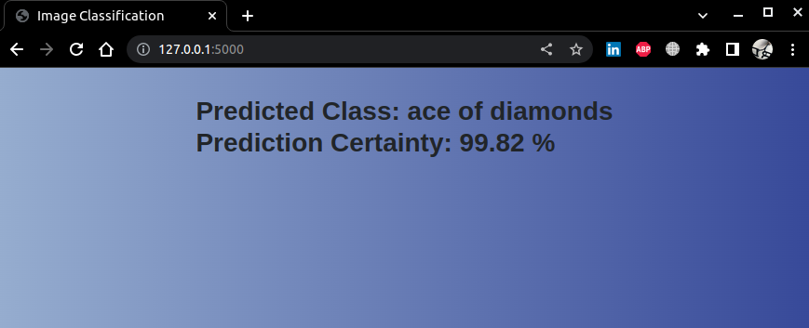
Flask App

Slide 18
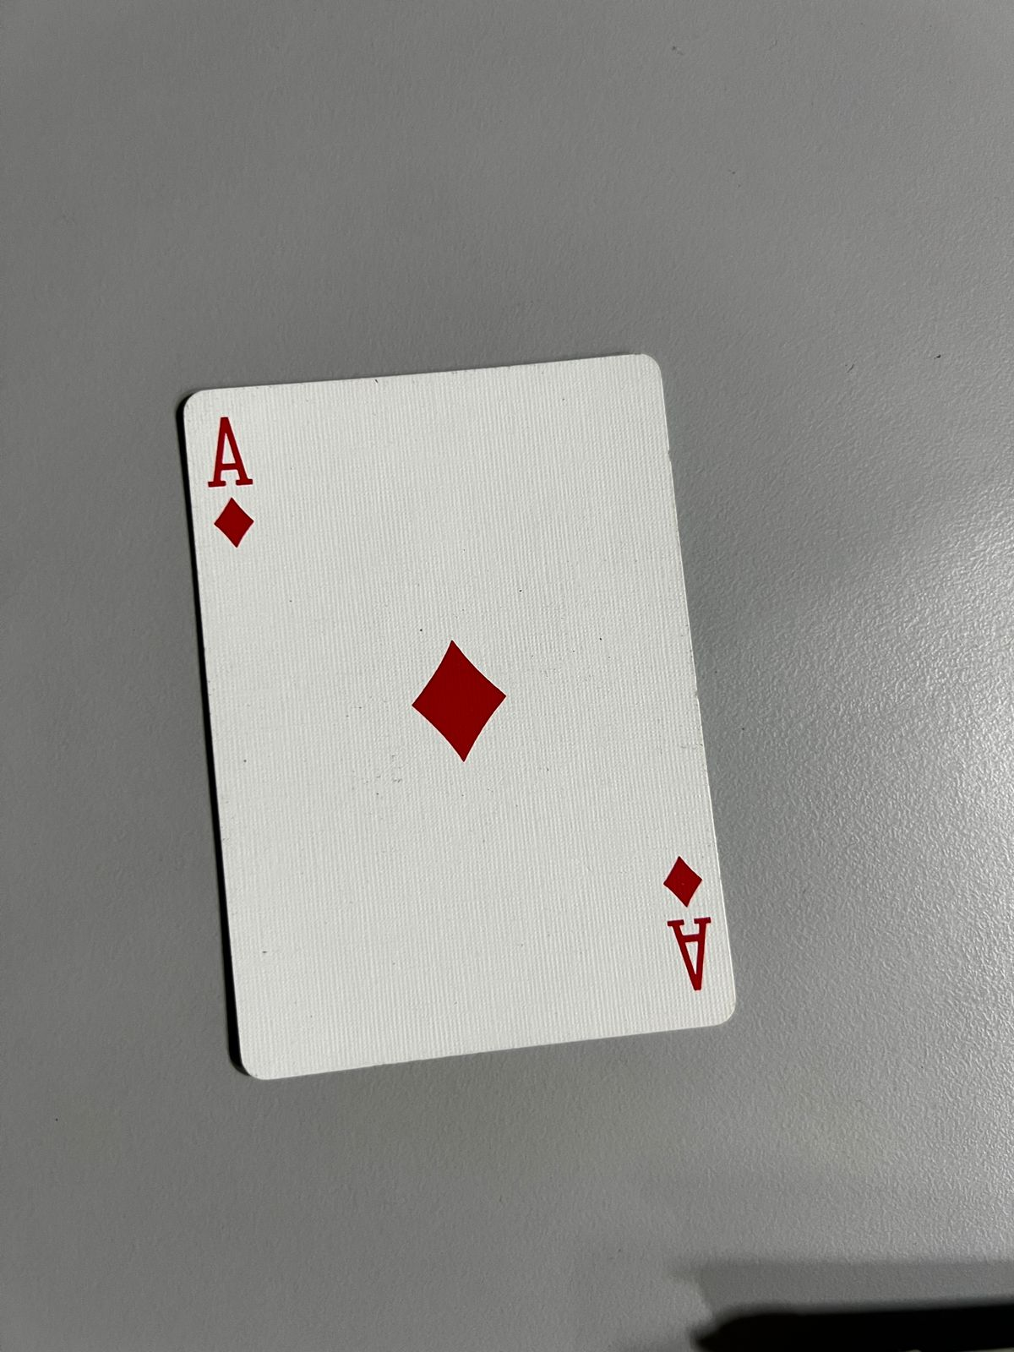
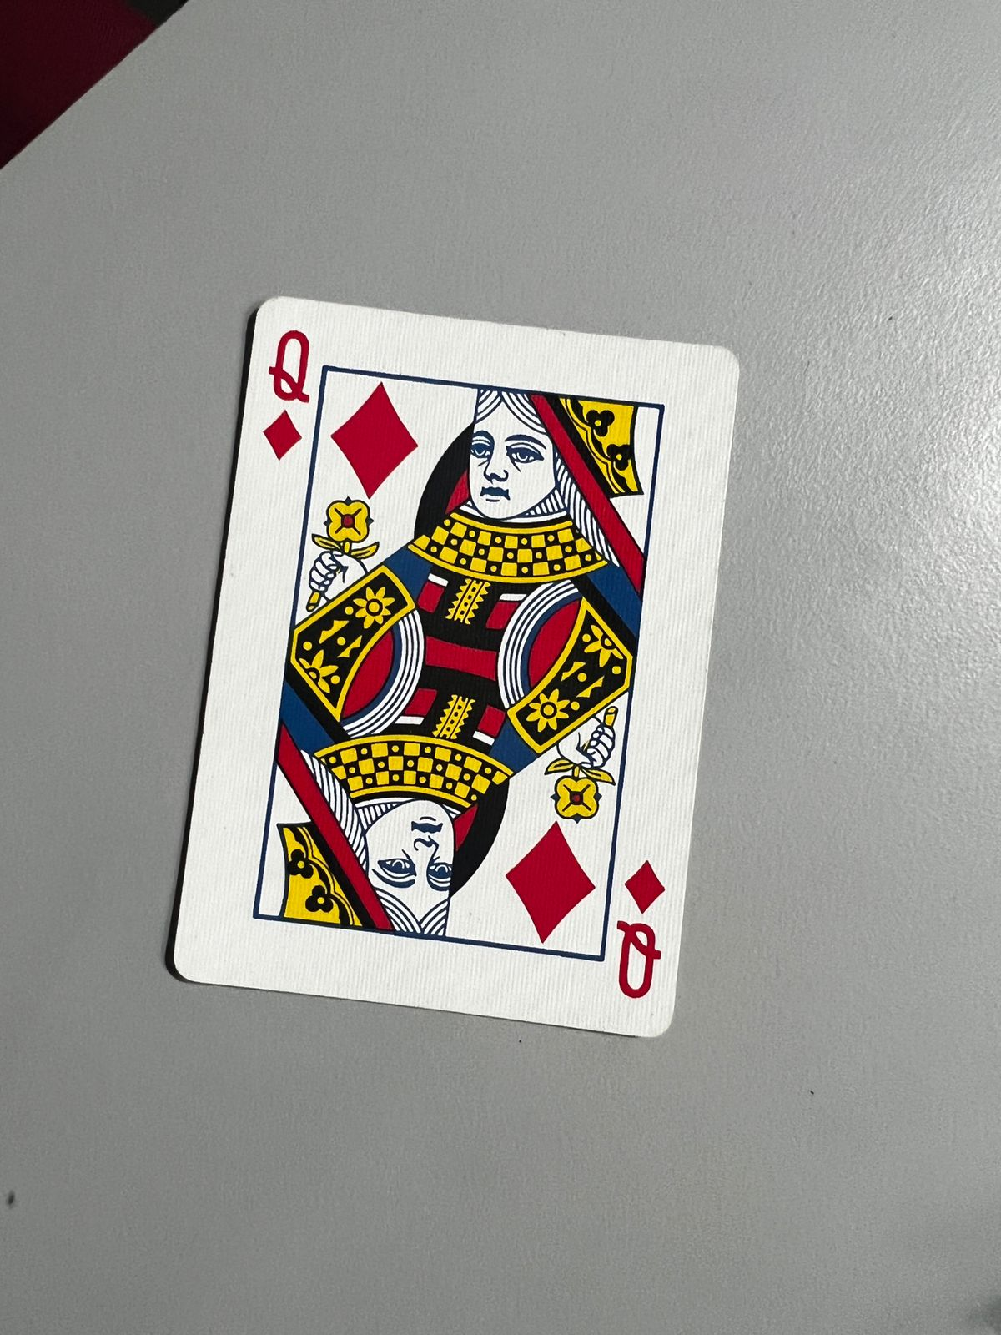
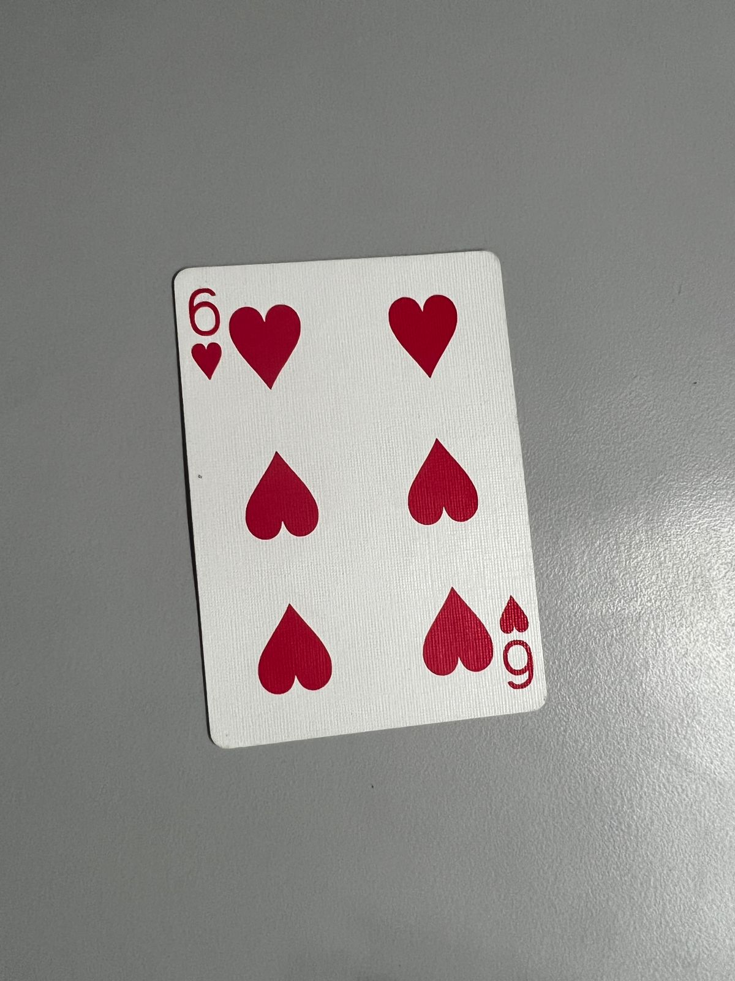
Flask App Predictions
Predicted Class: ace of diamonds Prediction Certainty: 99.82 %
Predicted Class: queen of diamonds Prediction Certainty: 97.643 %
Predicted Class: six of hearts Prediction Certainty: 98.256 %

Slide 19
Member Contributions
Krishna Gupta (MDS202121)
Data Preprocessing, VGG16 model
Rohan Dharmadhikari (MDS202137)
Training code, Flask app,
InceptionNet model
Soham Biswas (MDS202147)
MLflow code, Resnet18 model
Soham Pyne (MDS202148)
Training code, EfficientNet model

Slide 20
THANK YOU

