Slide 1
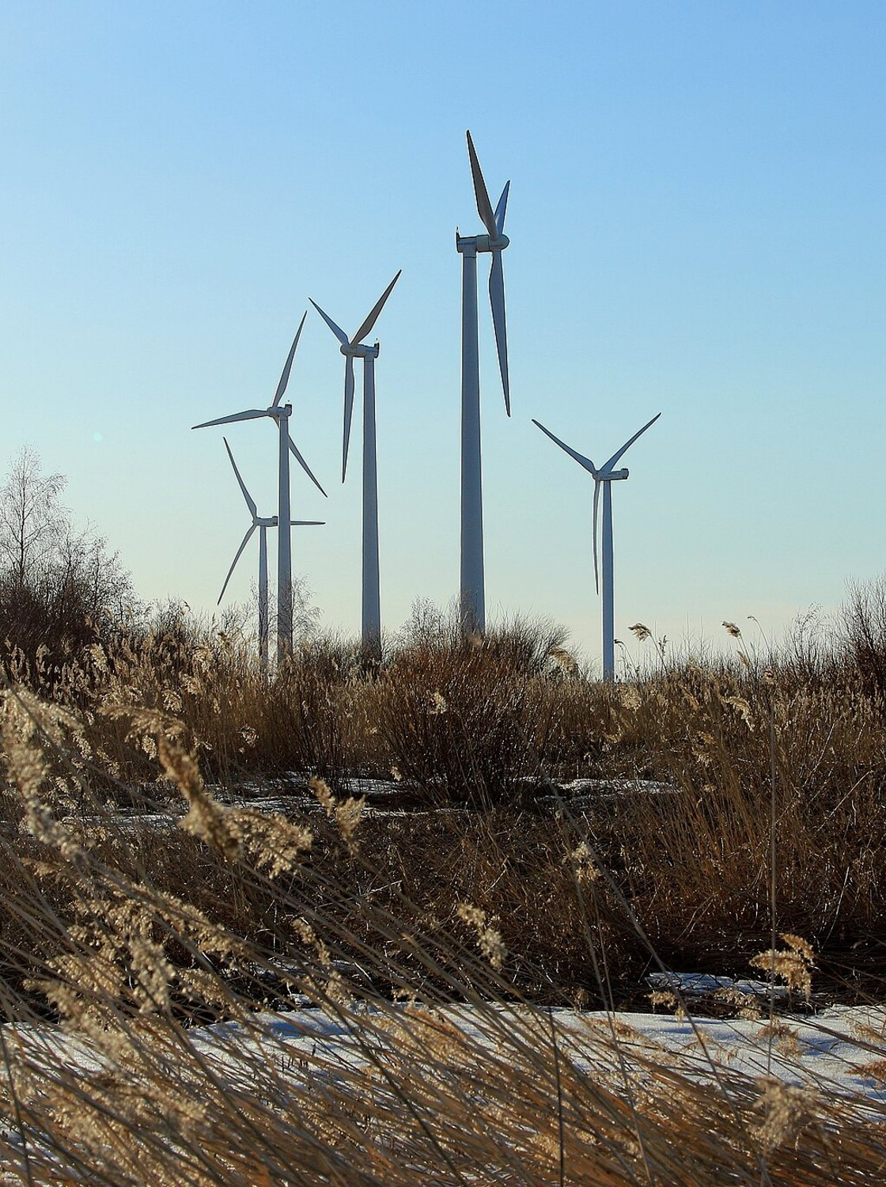

TASEHINTA
Know when the imbalance price will break away from spot, and why, before it happens.
A 10-hour imbalance-price forecast and situational view for Turku Energia, quarter-hour by quarter-hour.
36.7 % better than the baseline
Team EDISS #1 · Since AI 2026 · Turku Energia challenge
Notes:
Tasehinta means 'imbalance price' in Finnish. In one sentence: every hour we forecast the next 10 hours of Finland's imbalance price, quarter by quarter, with its uncertainty, the balancing direction and the spike risk, and we show only what is worth checking. On the organisers' validation month it is 36.7 % better than their baseline.

Slide 2
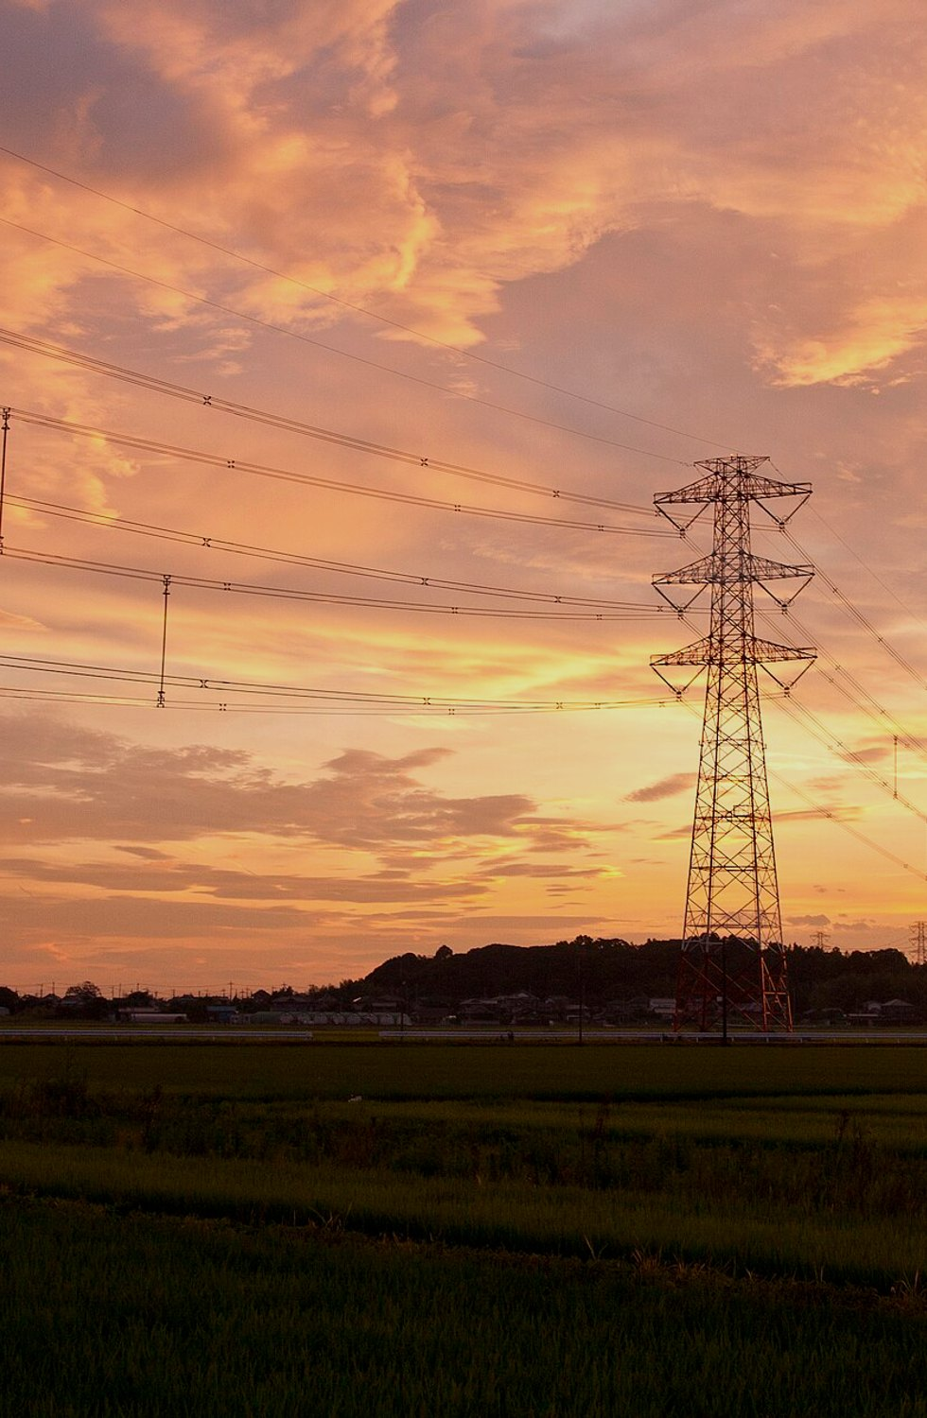
THE PROBLEM
Every missed plan is settled at a price nobody knows yet
Finland's imbalance price is set every 15 minutes. It follows spot until the grid runs short of power or into a surplus, then it can jump far either way.
4,000 €/MWh
the imbalance price on 9 Sep at 20:30, with spot at 200
1 in 4
quarter-hours in September ended more than 50 €/MWh from spot
15 min
settlement period: every quarter-hour is its own price
Source: organisers' validation data, 7 Sep – 4 Oct 2026
Notes:
A trader at Turku Energia plans every quarter-hour; any part of the plan that misses is settled at the imbalance price. With no balancing it equals spot, but when Finland is short of power it jumps above spot, and with a surplus it falls below. In September a quarter of all quarter-hours ended more than 50 euros away from spot, and on 9 September it hit 4,000 euros per MWh against a spot price of 200.

Slide 3





OUR SOLUTION
Every hour, the next 40 quarter-hours, four answers each
What will it cost?
Which way is the grid going?
Will it spike?
Why?
A median imbalance price and an honest 80 % range around it
The probability of up-regulation, down-regulation or none
The chance of a price more than 50 €/MWh above or below spot
The few factors that move the forecast most, strongest first
Then it shows only what deserves attention and says what to check, never what to trade: open data can't see Turku Energia's own position.
TASEHINTA
3
Notes:
For each of the next 40 quarter-hours the model gives four things: the likely price with an 80 % range, the balancing direction, the spike risk in both directions, and the drivers. It runs every full hour. The situational view then surfaces only the situations that need a look, such as spike risk rising, an expected up-regulation, or a forecast that moved, and phrases them as things to check.

Slide 4





HOW IT WORKS
One model, built only from what was known at the time
Published data
Features
One ensemble model
Forecast + dashboard
Only what was out before the hour: market, balancing and grid data, Fingrid real-time, weather runs, 19 months of history
For each of the 40 quarter-hours: recent state, real-time grid, wind-forecast revisions, the shape of the day-ahead price
Two gradient-boosting components, averaged: their errors partly cancel
The submitted CSV and the situational view
Forecast the gap, not the price Spot is known the day before; the unknown is how far the imbalance price lands from it.
Direction first Short of power: above spot. Surplus: below. Price, range, direction and spike risk tell one story.
History made comparable Pre-June prices rebuilt under the June 2026 rule: 99.5 % exact where it can be checked.
Nothing from the future Every input used only from its publication time, enforced by automated leak tests.
TASEHINTA
4
Notes:
Every hour we collect only what had been published by then. Features describe the recent state of the market, the real-time grid in the first two hours, how the weather models have revised the wind since the day-ahead market closed, and the shape of the day-ahead price. One ensemble model, two gradient-boosting components averaged, produces the forecast. Four ideas carry it: forecast the gap to spot, predict the direction first, use 19 months of history rebuilt under the June 2026 price rule, and never use a number before it was published.

Slide 5
RESULTS
More accurate than the baseline on every score
36.7 %
better than the organisers' baseline on their validation month (Sep), weighted by the challenge's points
29.0 %
on August, a second month the model never saw
40.2 vs 66.2 €/MWh median error · better in every September week
Scored with the organisers' own score.py; each month forecast using only data published before it.
TASEHINTA
5
Notes:
On the organisers' validation month our forecast is 36.7 % better than their baseline, weighted by the challenge's own points. Its median error is 40 euros per MWh against 66, and the uncertainty band halves the pinball loss. August, which the model never saw, confirms it at 29 %. Every change we kept had to win both months.

Slide 6
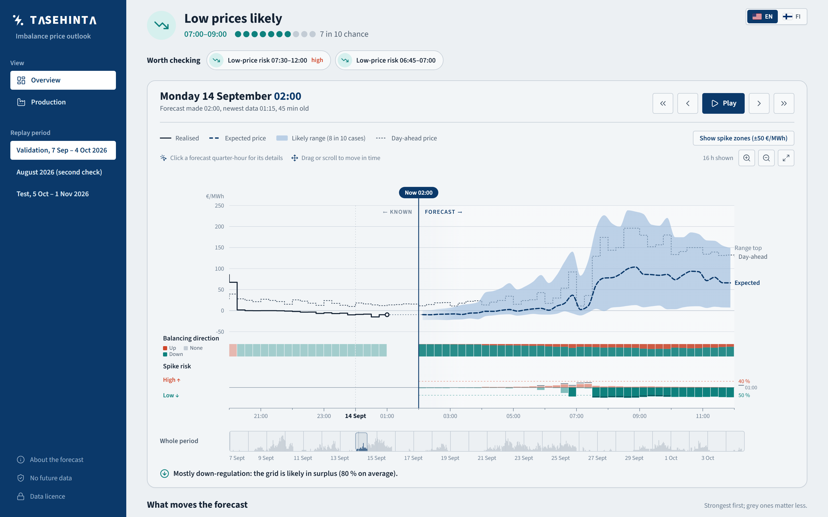



THE SITUATIONAL VIEW
See what's worth checking, and replay any past hour
Only what matters
Spike risk up, regulation expected, forecast moved, an uncertain signal
One time axis
Price and range, direction and spike risk on one 15-minute grid
Move through time
Scroll back in 15-minute steps; nothing published later is shown
Live: tasehinta.lovable.app
TASEHINTA
6
Notes:
The dashboard is built for a trader or a production shift supervisor. At a glance: one sentence for the next 10 hours and the few items worth checking. Below, the price forecast with its range, the balancing direction and the spike risk share one 15-minute time axis. You can scroll back through September, August and the test month, and the page only ever shows what was known at that moment. It is live at tasehinta.lovable.app, in English and Finnish.

Slide 7



WHAT'S NEXT
From “check this” to “offer this”
Turku Energia's own data
Plant capacity, marginal costs and the market position turn a warning into a concrete capacity suggestion
TASEHINTA
Winter weather history
36.7 % better than the baseline. Calibrated uncertainty. Only data that existed at the time.
The history covers winter 2025–26, but weather-forecast runs only from April 2026; adding winter runs is the next model step
tasehinta.lovable.app
Live operation
Run the same pipeline every hour on live Fingrid and weather data, behind an API
Frank Ponce · Abderahim Mojahid · Md Sakibul Alam Patwary · Pavel Samsonov · Pavlo Polish
Photos: Oulunsalo wind farm by Estormiz (CC0); Kashima Power Line 07 by Σ64 (CC BY 4.0); both via Wikimedia Commons.
TASEHINTA
7
Notes:
A model built only on open data can reliably say 'check this situation'. With Turku Energia's own plant capacities, costs and position, the same forecast could suggest how much capacity to offer and where. The next model step is weather-forecast history for winter 2025–26, and after that, running the same pipeline live every hour behind an API. Thank you.

