Slide 1

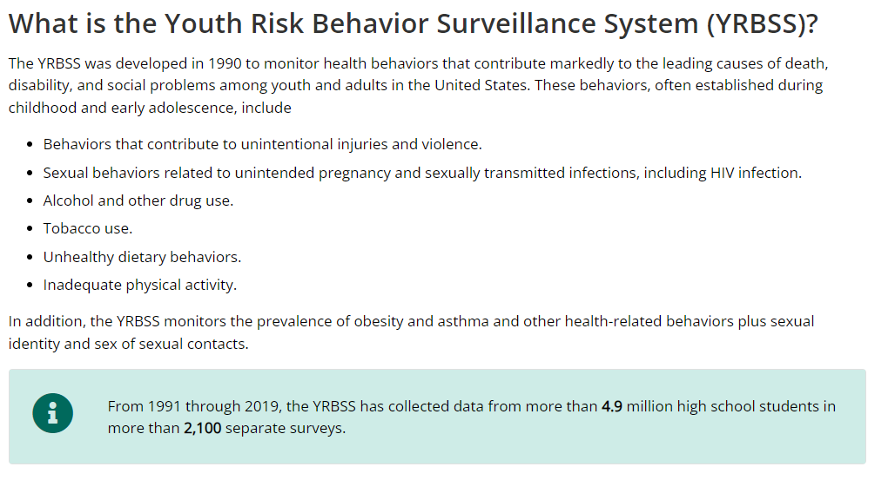
Techs impact on the young
Authors: Matthew Tisdell and Roddey Sims, Mentor: Dr. Erdei
Computer Science Department, University of South Carolina Beaufort, Bluffton, SC 29909
Abstract
Ever since electronics has evolved throughout the years, younger generations have begun to become dependent on them. So dependent that they have changed the younger generation for better or for worse. Knowing this, young people have normalized the lifestyle of kicking back and relaxing at home while they communicate through electronic media, which causes habits as growing to be lazier. Showing the correlation between screen time and a student’s weight will help show the impact screen time has on younger generations. Due to the high screen time a student will receive, it will result in the increase chance of weight gain and less physical interaction younger. YRBS recorded a survey given to high school students in the united states. Contains data regarding how much time a student spends on their electronic devices and how they feel about their wait. This research helps define the correlation towards the amount of time is spent on electronic devices and how a student describes their own weight which will give us a better understanding if electronic devices will cause laziness.
Hypothesis
Alternative: People who describe feeling less close to people at school and having worse grades will spend a different amount of time on devices and have a difference of weight compared to people who describe feeling closer to people at school and having better grades
Null: People who describe feeling less close to people at school and having worse grades will spend a spend generally the same amount of time on devices and generally be of the same weight compared to people who describe feeling closer to people at school and having better grades
About our Dataset Provider
Data Analysis
Currently, We do not have any visual data.
YRBS Research Questions
Q 67. How do you describe your weight?
Q 80. On an average school day, how many hours do you play video or computer games or use a computer for something that is not school work? (Count time spent playing games, watching videos, texting, or using social media on your smartphone, computer, Xbox, PlayStation, iPad, or other tablet.
Demographic Information
Q 102. Do you agree or disagree that you feel close to people at your school?
Q 105. During the past 12 months, how would you describe your grades in school?

