Slide 1




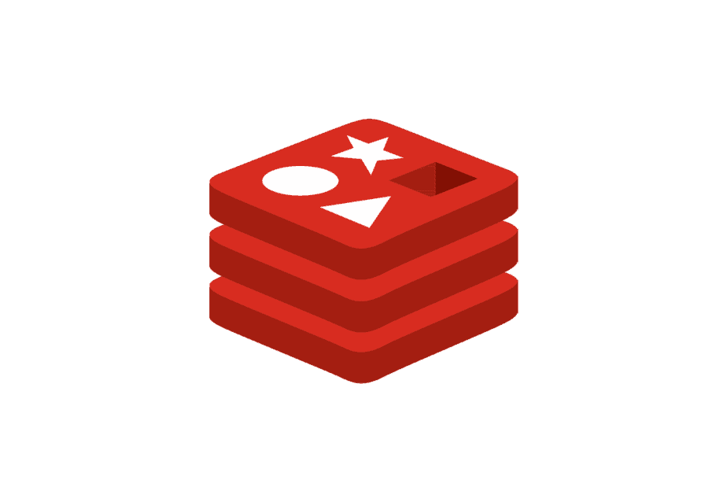





EC2
RDS
Docker Compose
Web
Spring Boot
Redis
PostgreSQL
CI / CD
GitHub
GitHub Actions

