Slide 1
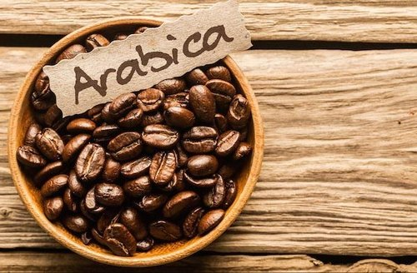
Exploratory Data Analysis (EDA) coffee bean
Name- Rehana Amrin
Data Science & Data Analytics
Batch-Online

Slide 2

INTRODUCTION
Coffee is one of the most widely consumed beverages in the world With 2.25 billion cups sipped daily and around 165 million kilograms produced worldwide each year
The dataset used in this project is based on the Coffee Quality Institute (CQI) Coffee Quality Database and contains 1339 columns of various aspects about the coffee bean.eg. Region, variety, producer, country etc.
The given dataset mainly focuses on the Arabica coffee bean representing about 60% of global production

Slide 3
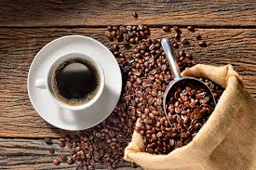
AIM OF THE PROJECT
This project aims at developing an effective, easy-to-interpret predictive model for Coffee quality.
To predict the overall quality score based on intrinsic features of the coffee beans (such as color, variety, Flavor, Aroma), geographical features and information related to the producer, exporter, or grower of the beans.
Identifying the relationship between the given attributes based on different analysis.

Slide 4

PROJECT WORKFLOW
Our analysis plan will be undergoing following steps :
Perform Exploratory Data Analysis to gain insights about the raw data, identify potential data problems, features and target variables, as well as metrics.
Preprocess the data to make it suitable for performing the EDA. This will be done in two steps :
Cleaning the data to remove the duplicates and the ouliers.
Handling the removed values using various statistical methods and visualizing the data through Bar charts, Scatter plots etc for better understanding.

Slide 5
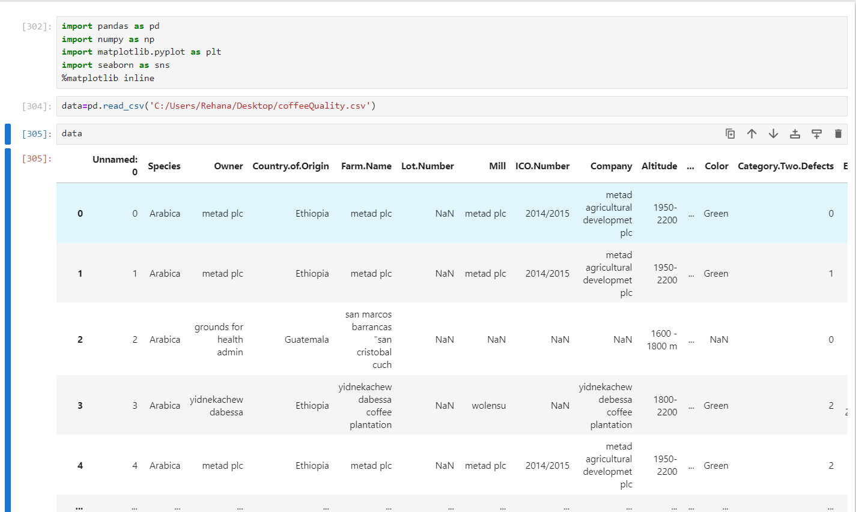
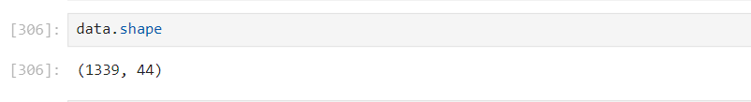
DATA UNDERSTANDING
The given dataset has been read and the data’s has been extracted.
It contains 1339 rows and 44 columns

Slide 6
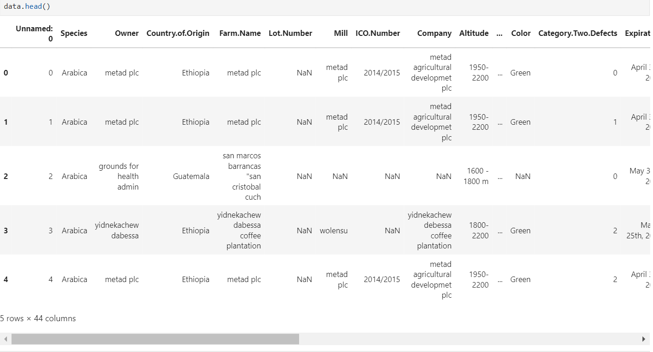
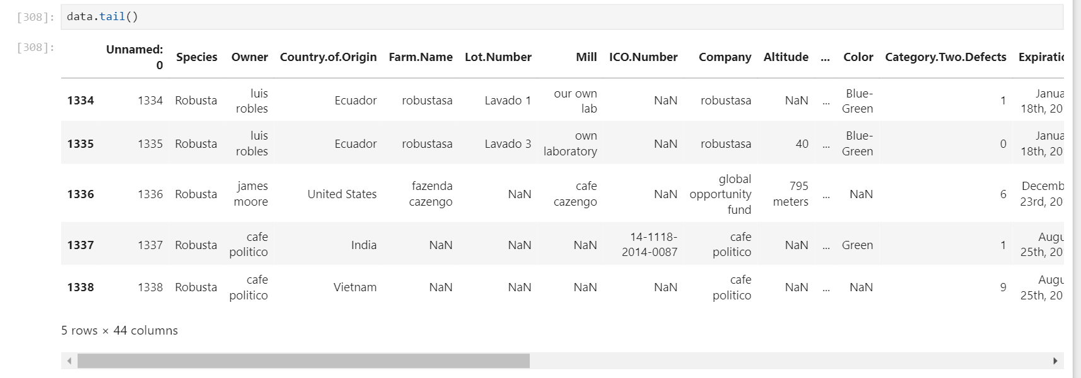
Notes:
The head and tail defines the first and last five columns , rows of the given dataset.

Slide 7
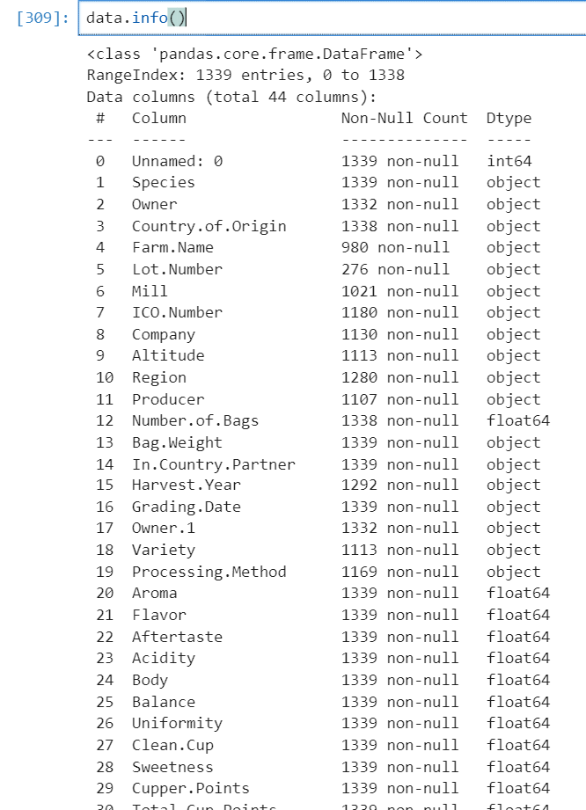
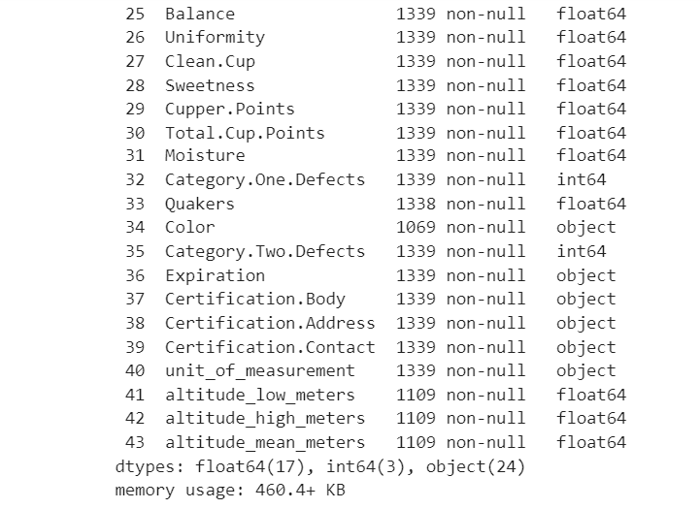
Notes:
Info is used to identify the data type ex- interger, float, object etc

Slide 8
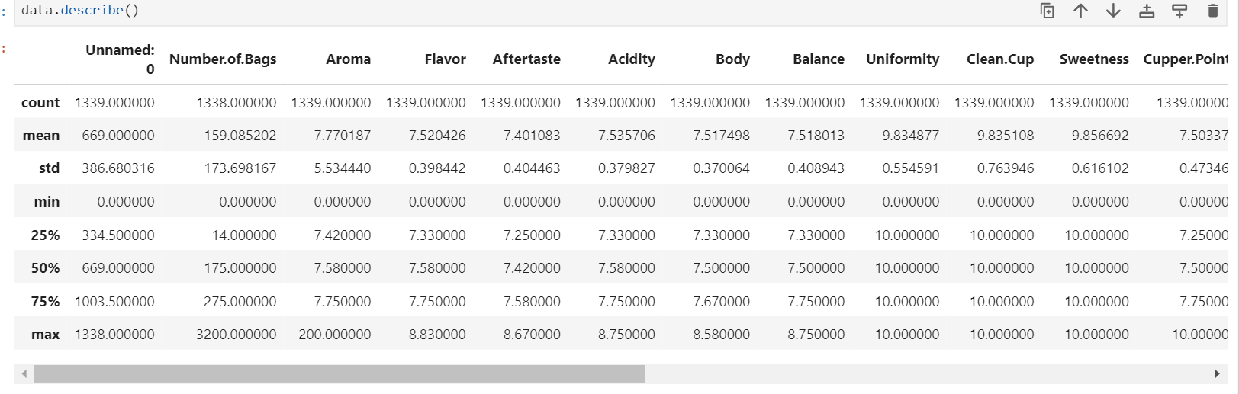
Statistical values derived from the given Dataset

Slide 9
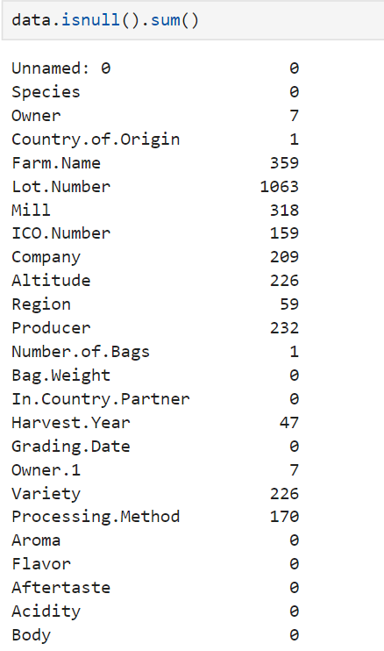
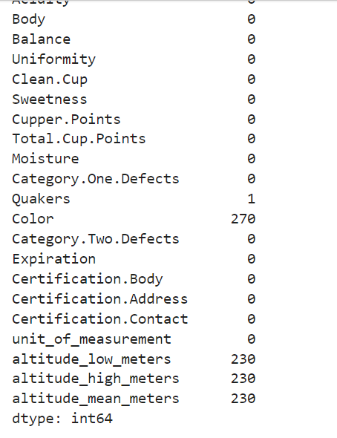
OUTLIERS

Slide 10
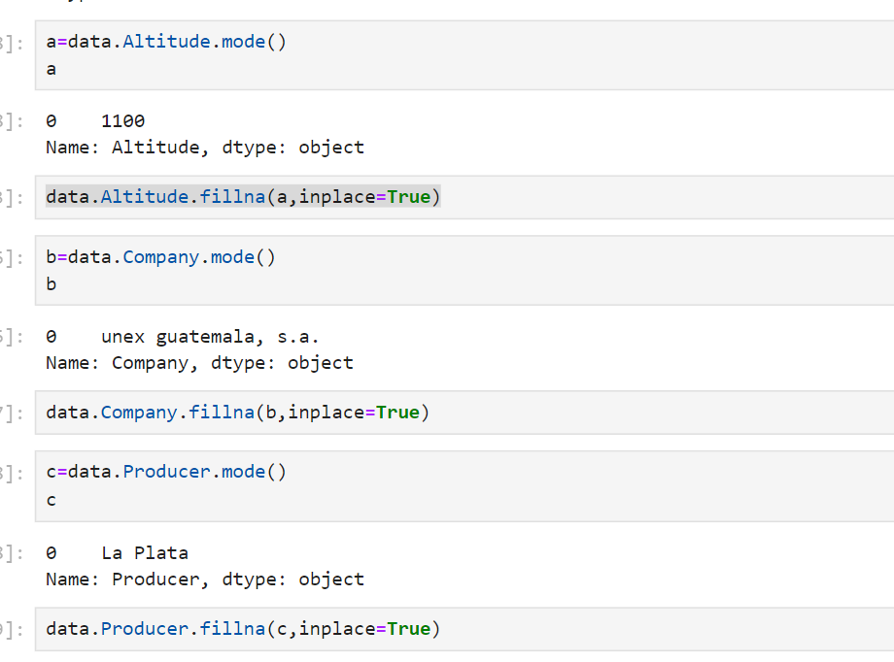
Replacement of Outliers

Slide 11
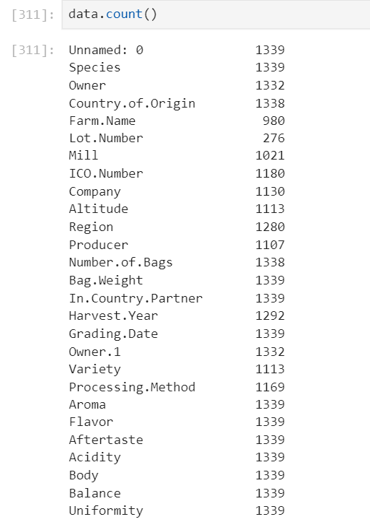
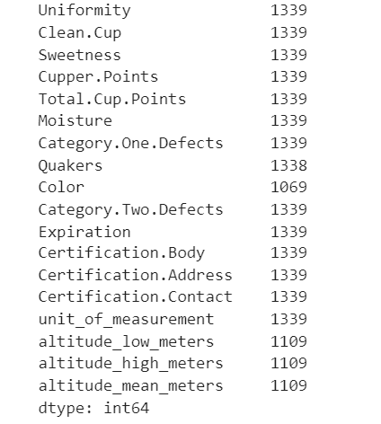
To find the data count

Slide 12
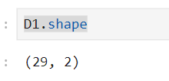
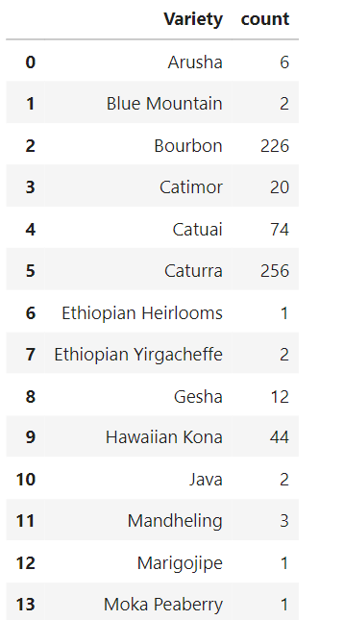
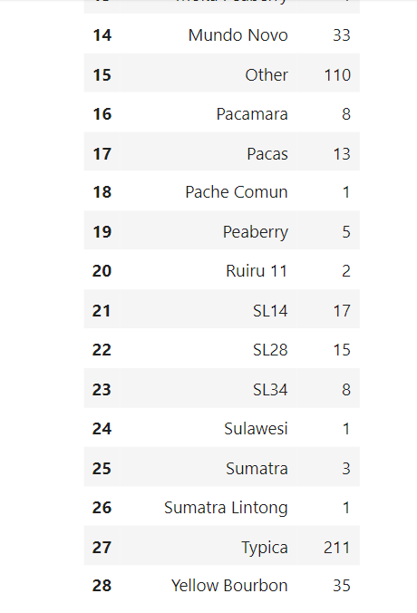
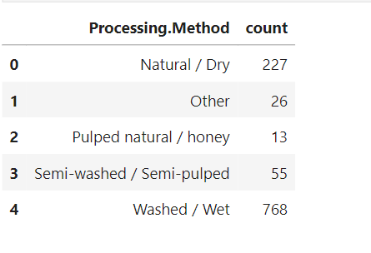
example
Notes:
The groupby is used to group the rows under one column.

Slide 13
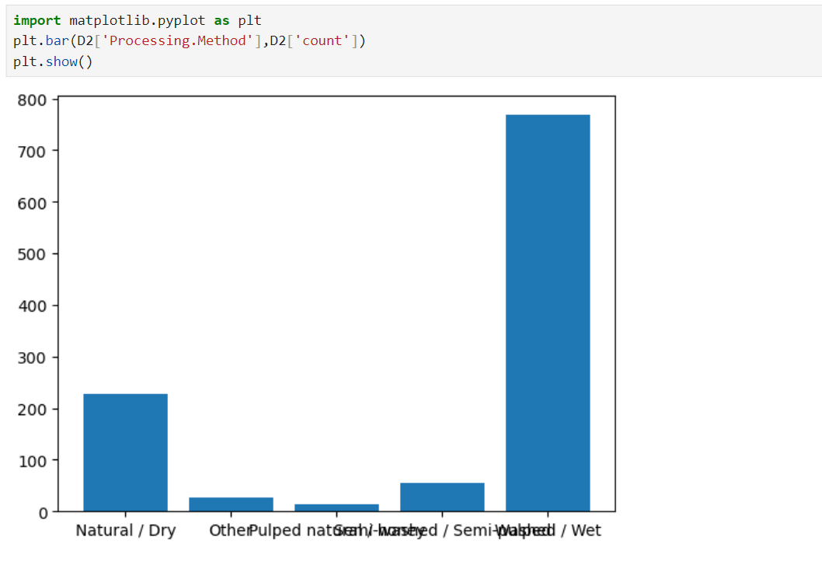
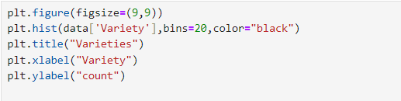
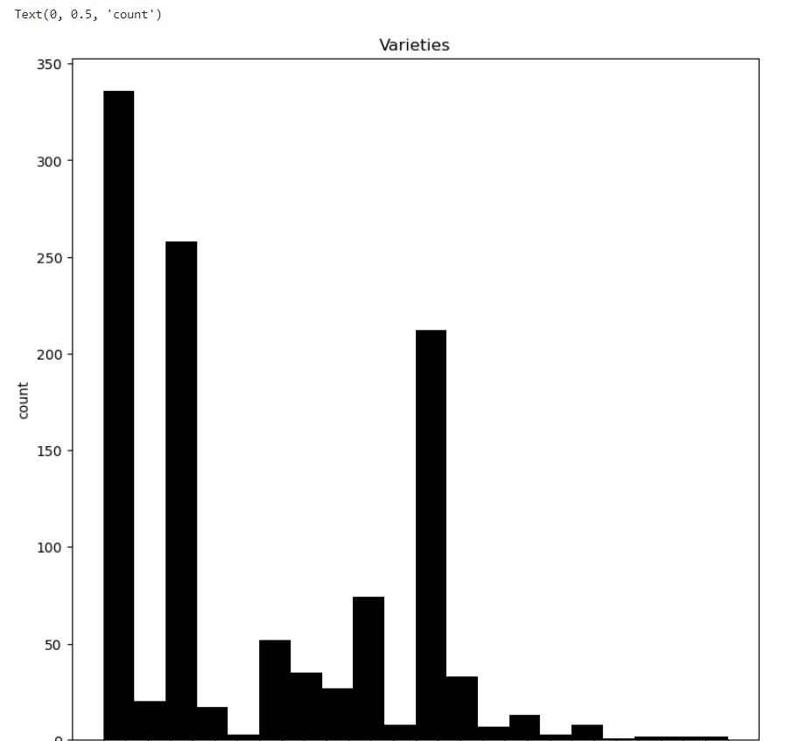
Notes:
The above graph shows the visual representation of the processing method and the varieties in the coffee bean.

Slide 14
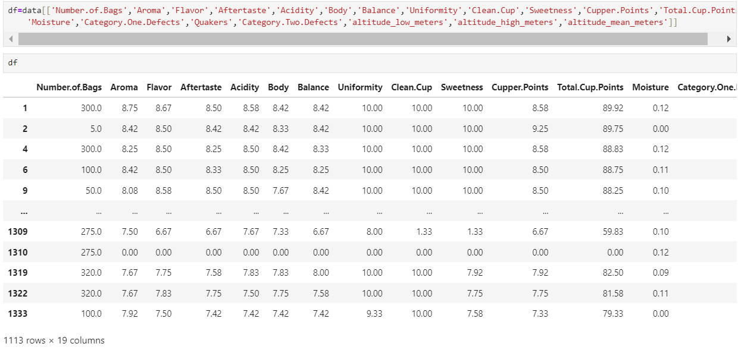
Filtering the numerical columns from the given dataset to perform further Analysis

Slide 15
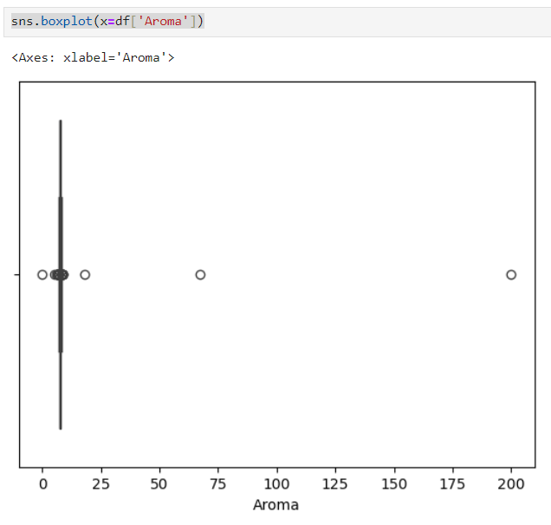
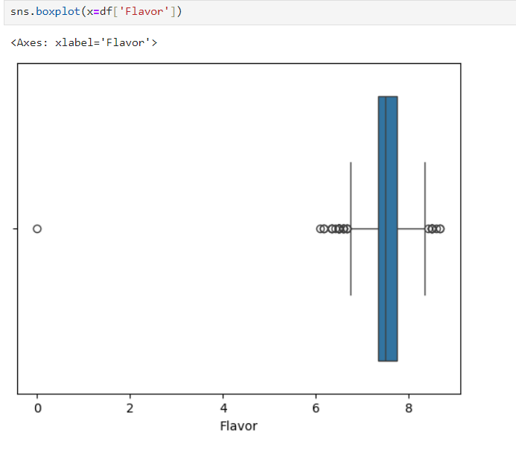

Slide 16
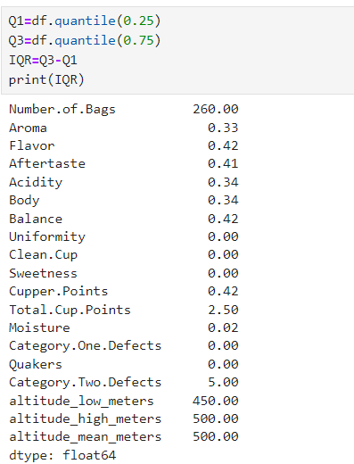
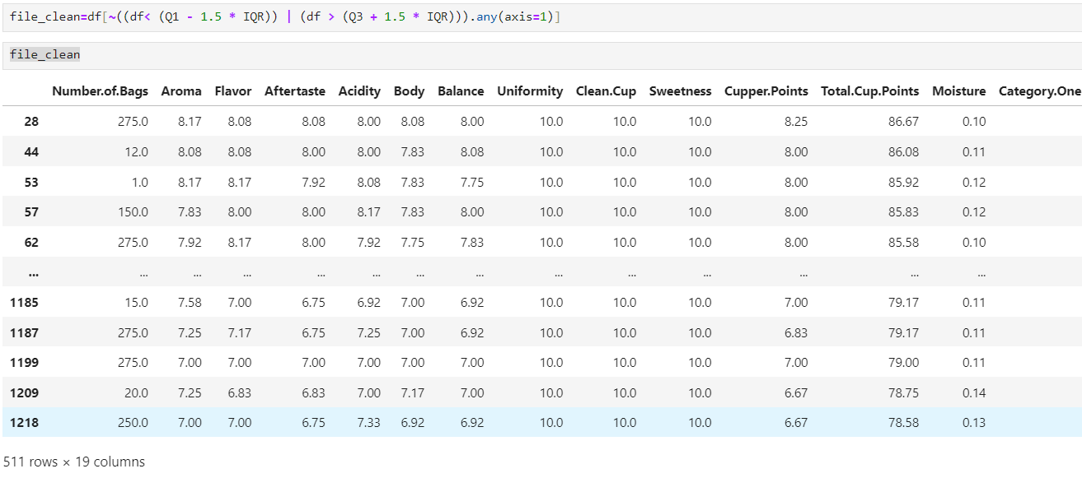
INTER QUANTILE RANGE

Slide 17
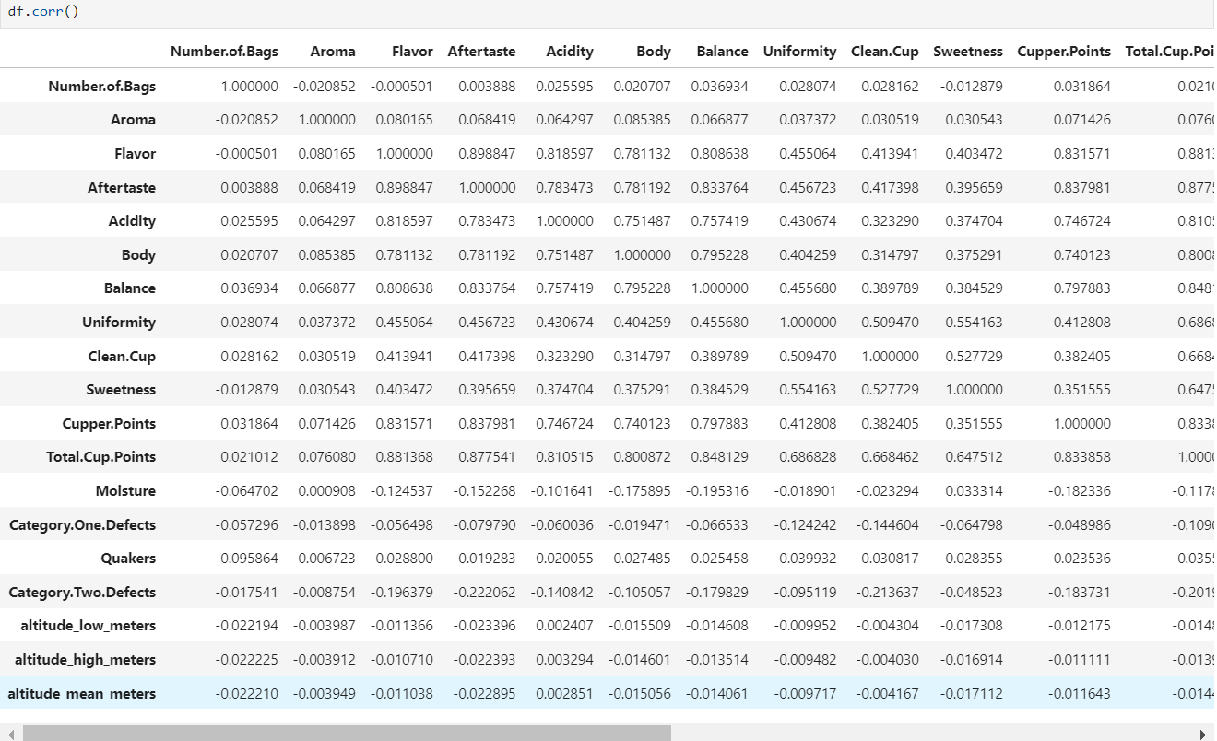
CORRELATION

Slide 18
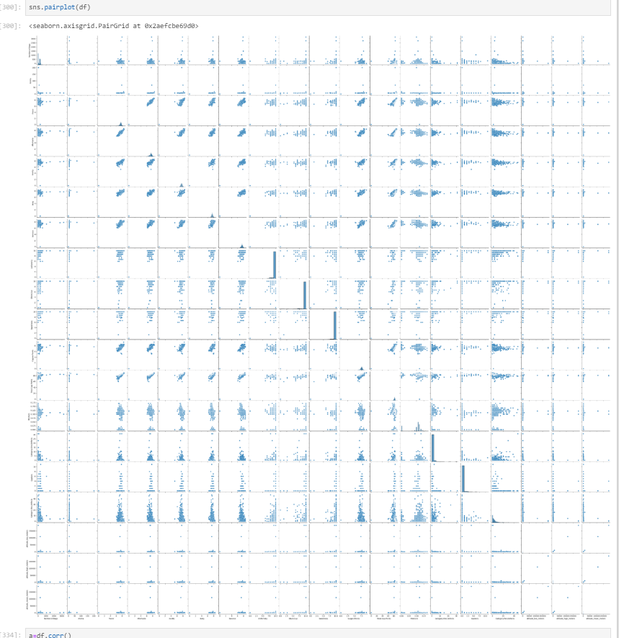

Slide 19
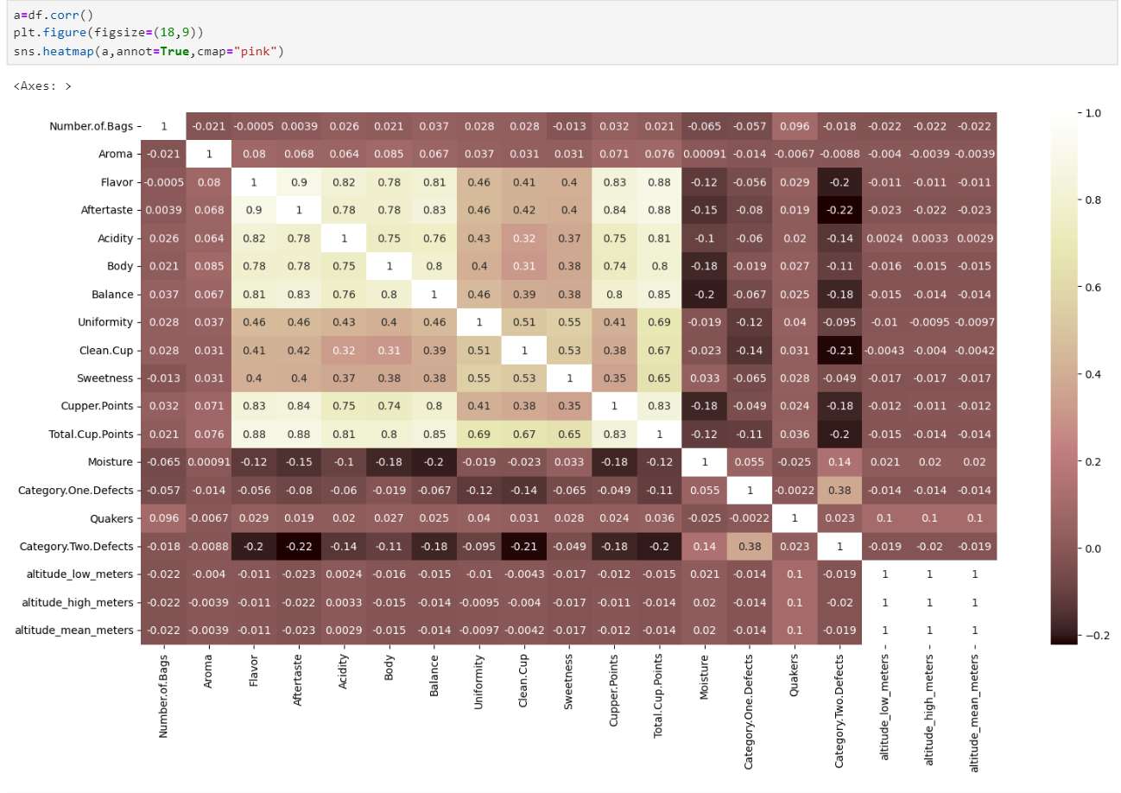

Slide 20
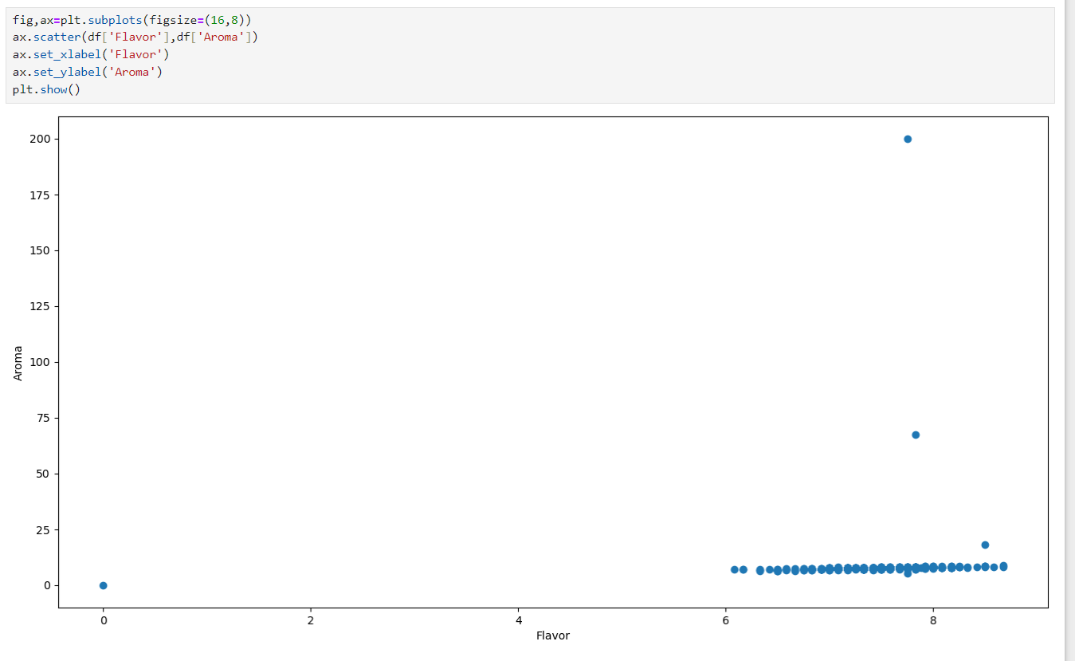
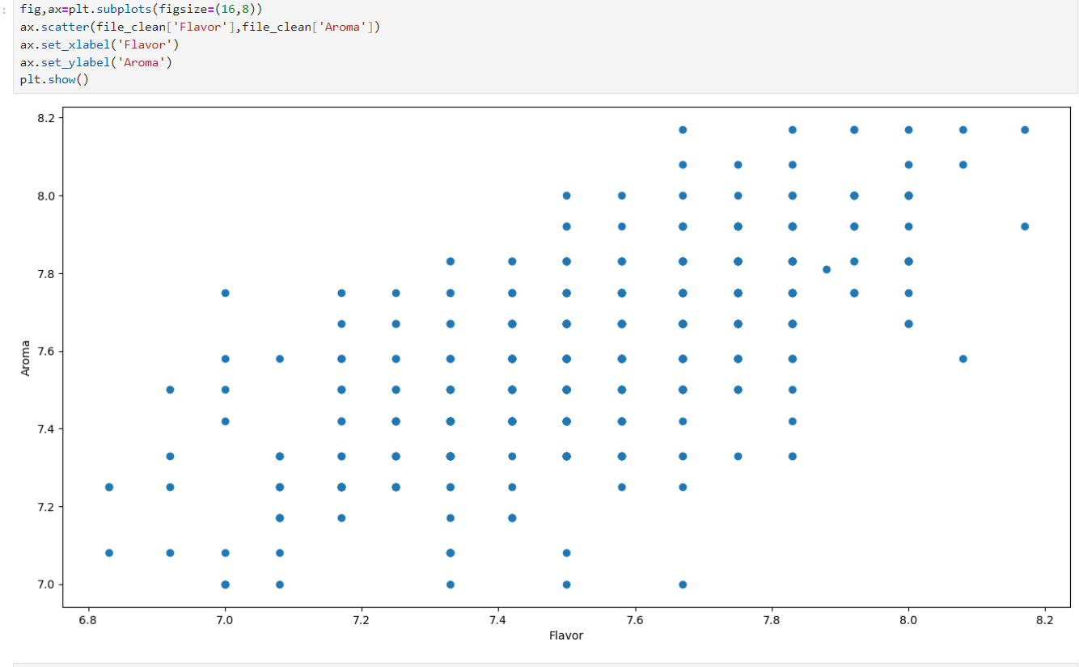

Slide 21
CONCLUSION
From the given dataset the Bourbon and The Cattura are the most produced variety.
Most of the coffee beans are processed using the washed and wet method.
The Aroma and Flavor are the most dependant on various other attributes.
The Flavor and The Aftertaste has high positive Dependancy,.
In Comparision with the Flavor, Moisture has the high negative Dependancy
Further Analysis can be done using the data set to derive various other Results , Comparisons and Dependancy based on our requirements.

Slide 22

an expert in anything was once a beginner!!!

